Slide 1


Welcome to
INTERNSHIP STUDIO
Module 06 | Lesson 03
Bag of Words and TF-IDF
WWW.INTERNSHIPSTUDIO.COM

Slide 2

Word embeddings
Idea: learn an embedding from words into vectors
Need to have a function W(word) that returns a vector encoding that word.
WWW.INTERNSHIPSTUDIO.COM

Slide 3
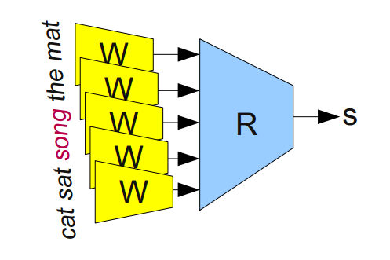
Learning word embeddings
First attempt:
Input data is sets of 5 words from a meaningful sentence. E.g., “one of the best places”. Modify half of them by replacing middle word with a random word. “one of function best places”
W is a map (depending on parameters, Q) from words to 50 dim’l vectors. E.g., a look-up table or an RNN.
Feed 5 embeddings into a module R to determine ‘valid’ or ‘invalid’
Optimize over Q to predict better
WWW.INTERNSHIPSTUDIO.COM

Slide 4
What is a Bag of Words
Bag-of-Words is called (BoW) model as well. Aside from its funny-sounding name, a BoW is a critical part of Natural Language Processing (NLP) and one of the building blocks of performing Machine Learning on text.
A BoW is simply an unordered collection of words and their frequencies (counts). For example, let's look at the following text:
"I sat on a plane and sat on a chair."
and chair on plane sat
1 1 2 1 2
WWW.INTERNSHIPSTUDIO.COM

Slide 5
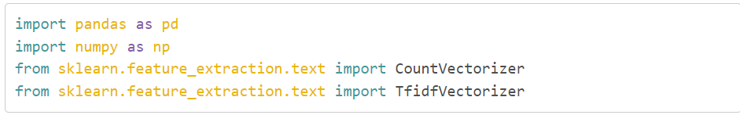
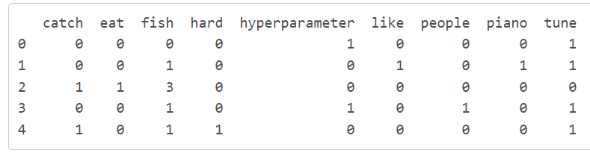
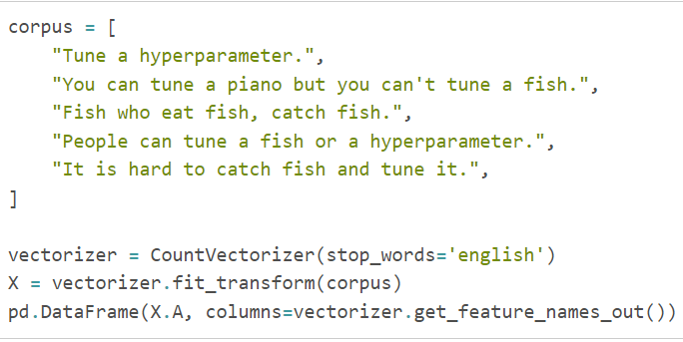
What is a Bag of Words
WWW.INTERNSHIPSTUDIO.COM

Slide 6
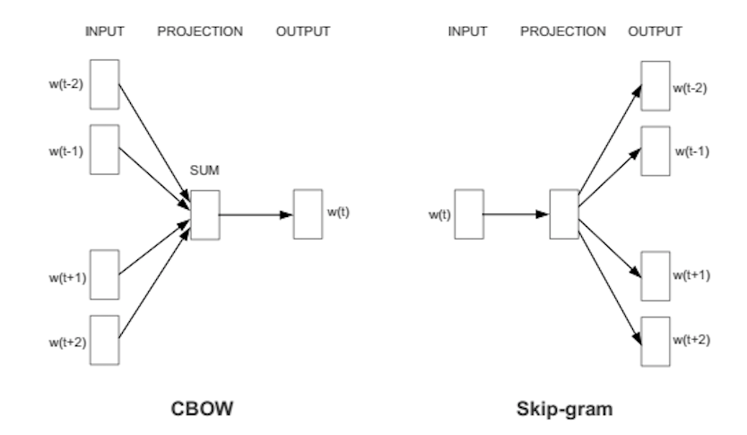
Types of BOW
Predict words using context
Two versions: CBOW (continuous bag of words) and Skip-gram
WWW.INTERNSHIPSTUDIO.COM

Slide 7
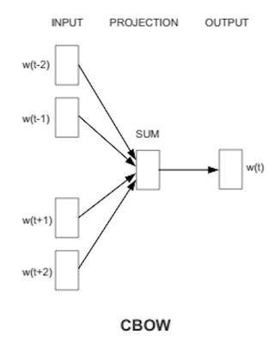
CBOW
Takes vector embeddings of n words before target and n words after and adds them (as vectors).
Also removes word order, but the vector sum is meaningful enough to deduce missing word.
WWW.INTERNSHIPSTUDIO.COM

Slide 8
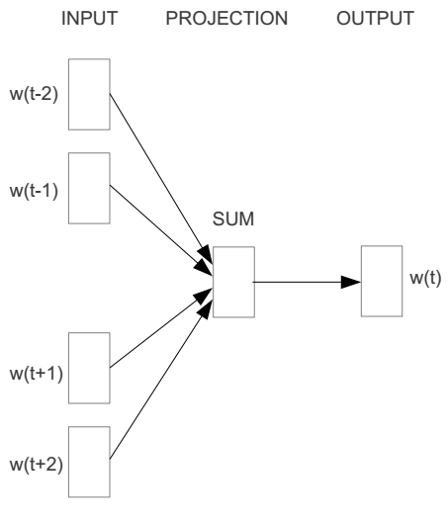
CBOW
E.g. “The cat sat on floor”
Window size = 2
the
cat
sat
on
floor
WWW.INTERNSHIPSTUDIO.COM

Slide 9
CBOW
WWW.INTERNSHIPSTUDIO.COM

Slide 10
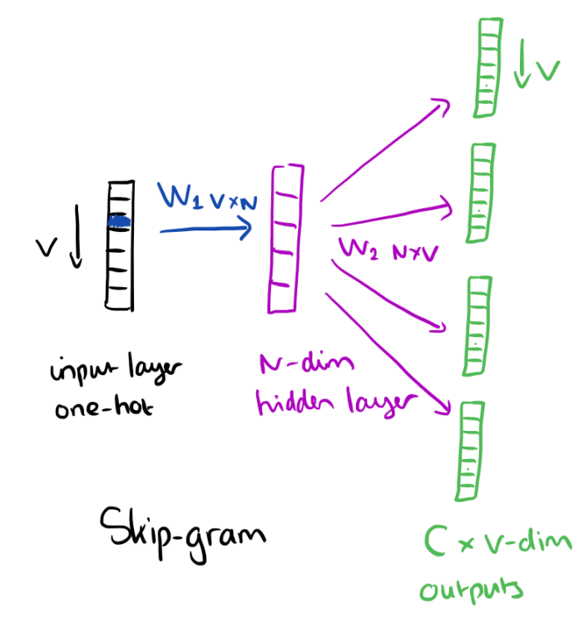
Skip gram
Skip gram – alternative to CBOW
Start with a single word embedding and try to predict the surrounding words.
Much less well-defined problem, but works better in practice (scales better).
In this approach, each word or token is called a “gram”. Creating a vocabulary of two-word pairs is, in turn, called a bigram model. Again, only the bigrams that appear in the corpus are modeled, not all possible bigrams.
WWW.INTERNSHIPSTUDIO.COM

Slide 11
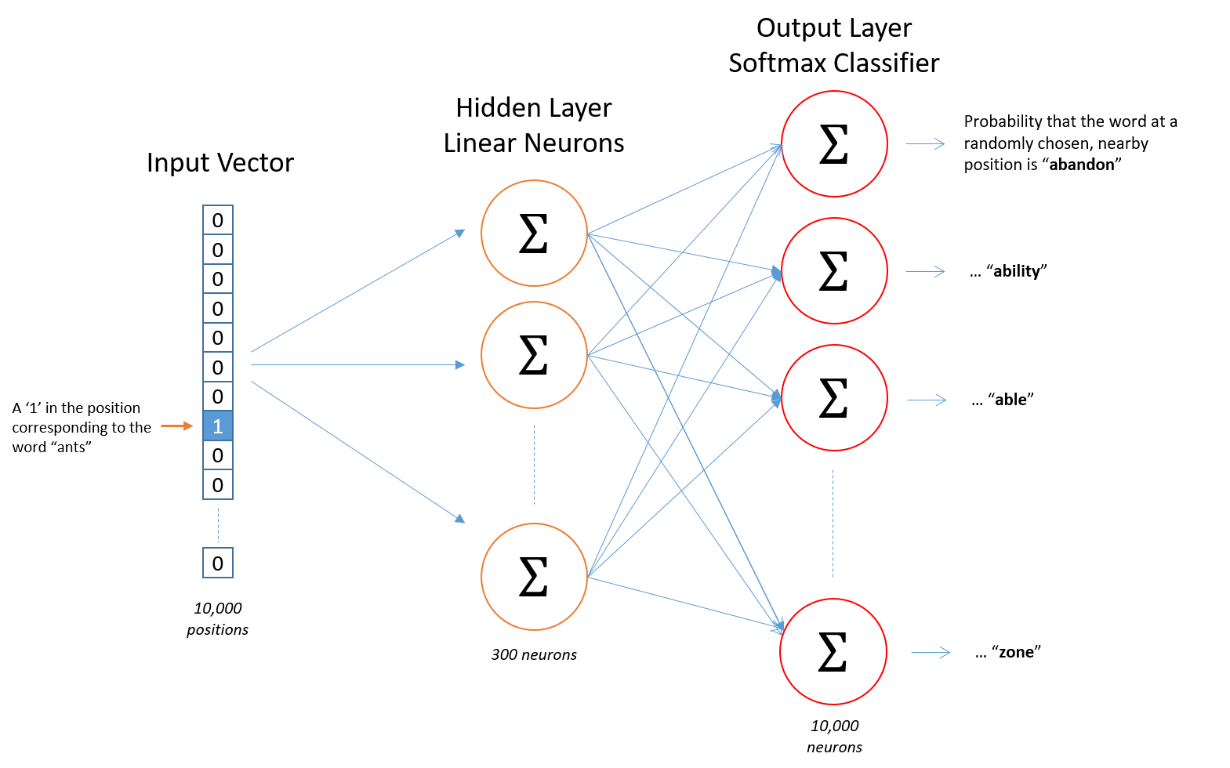
Skip gram
Map from center word to probability on surrounding words. One input/output unit below.
There is no activation function on the hidden layer neurons, but the output neurons use softmax.
WWW.INTERNSHIPSTUDIO.COM

Slide 12
Skip gram/CBOW intuition
Similar “contexts” (that is, what words are likely to appear around them), lead to similar embeddings for two words.
One way for the network to output similar context predictions for these two words is if the word vectors are similar. So, if two words have similar contexts, then the network is motivated to learn similar word vectors for these two words!
WWW.INTERNSHIPSTUDIO.COM

Slide 13
Term Frequency(TF)/Inverse Document Frequency(IDF)
TFIDF, short for term frequency-inverse document frequency, is a numerical statistic that is intended to reflect how important a word is to a document in a collection or corpus.
This concept includes:
· Counts. Count the number of times each word appears in a document.
· Frequencies. Calculate the frequency that each word appears in a document out of all the words in the document.
WWW.INTERNSHIPSTUDIO.COM

Slide 14
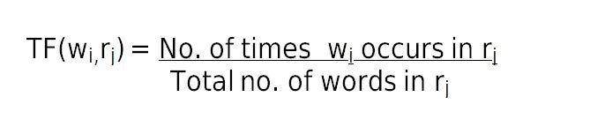
Term Frequency(TF)
Term frequency (TF) is used in connection with information retrieval and shows how frequently an expression (term, word) occurs in a document.
TF can be said as what is the probability of finding a word in a document (review).
WWW.INTERNSHIPSTUDIO.COM

Slide 15
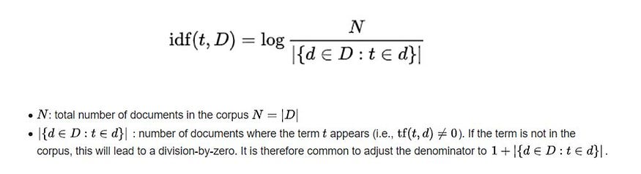
Inverse Document Frequency(IDF)
The inverse document frequency is a measure of how much information the word provides, i.e., if it’s common or rare across all documents.
It is used to calculate the weight of rare words across all documents in the corpus. The words that occur rarely in the corpus have a high IDF score.
WWW.INTERNSHIPSTUDIO.COM

Slide 16

Term frequency–Inverse document frequency:
TF-IDF gives larger values for less frequent words in the document corpus. TF-IDF value is high when both IDF and TF values are high i.e the word is rare in the whole document but frequent in a document.
WWW.INTERNSHIPSTUDIO.COM

Slide 17
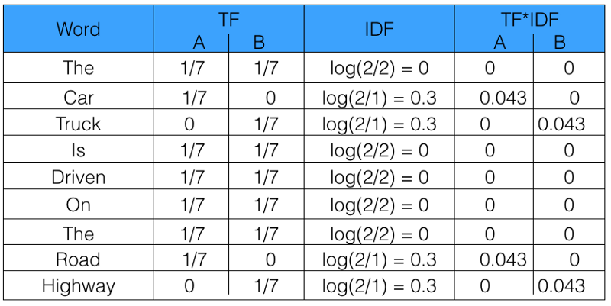
Term frequency–Inverse document frequency:
TF-IDF gives larger values for less frequent words in the document corpus. TF-IDF value is high when both IDF and TF values are high i.e the word is rare in the whole document but frequent in a document.
Sentence 1: The car is driven on the road.
Sentence 2: The truck is driven on the highway.
WWW.INTERNSHIPSTUDIO.COM

