Slide 1


Welcome to
INTERNSHIP STUDIO
Module 06 | Lesson 05
Introduction to transformer-based models
WWW.INTERNSHIPSTUDIO.COM
Notes:
https://huggingface.co/learn/nlp-course/chapter1/4, https://towardsdatascience.com/transformers-89034557de14

Slide 2

Background
The RNN and LSTM neural models were designed to process language and perform tasks like classification, summarization, translation, and sentiment detection
RNN: Recurrent Neural Network
LSTM: Long Short Term Memory
In both models, layers get the next input word and have access to some previous words, allowing it to use the word’s left context.
They used word embeddings where each word was encoded as a vector of 100-300 real numbers representing its meaning
WWW.INTERNSHIPSTUDIO.COM
Notes:
https://www.analyticsvidhya.com/blog/2019/06/understanding-transformers-nlp-state-of-the-art-models/

Slide 3
Background
Transformers extend this to allow the network to process a word input knowing the words in both its left and right context
This provides a more powerful context model
Transformers add additional features, like attention, which identifies the important words in this context
And break the problem into two parts:
An encoder (e.g., Bert)
A decoder (e.g., GPT)
WWW.INTERNSHIPSTUDIO.COM
Notes:
http://hal.cse.msu.edu/teaching/2020-fall-deep-learning/14-nlp-and-transformers/#/

Slide 4
Attention
While processing a word, Attention enables the model to focus on other words in the input that are closely related to that word.
eg. ‘Ball’ is closely related to ‘blue’ and ‘holding’. On the other hand, ‘blue’ is not related to ‘boy’.
WWW.INTERNSHIPSTUDIO.COM
Notes:
http://hal.cse.msu.edu/teaching/2020-fall-deep-learning/14-nlp-and-transformers/#/

Slide 5
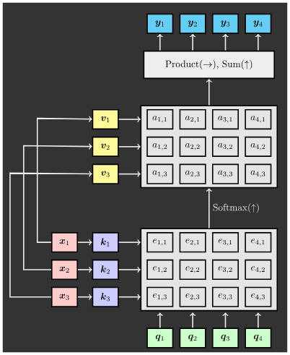
ATTENTION LAYER
Inputs:
Query Vector: q∈Rd
Input Vector: X∈Rn×d
Similarity Function: fatt(⋅)
Computation:
Keys: K=WkX
Similarities: E=fatt(K,Q), e∈Rn×n
Attention Weights: A=softmax(E), A∈Rn×n
Values: V=WvX
Output Vector: yj=∑ni=1Aijvi, y∈ Rd
WWW.INTERNSHIPSTUDIO.COM
Notes:
https://www.analyticsvidhya.com/blog/2019/06/understanding-transformers-nlp-state-of-the-art-models/

Slide 6
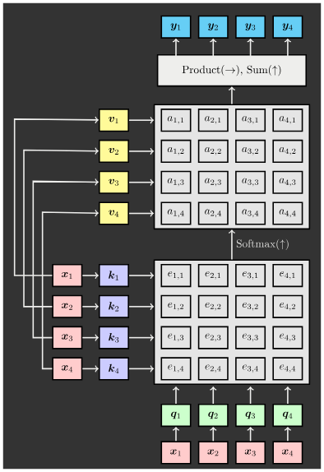
SELF-ATTENTION LAYER
Inputs:
Query Vector: X∈Rn×d
Input Vector: X∈Rn×d
Parameters: Wk∈Rd×d′, Wq∈Rd×d′, Wv∈Rd×d′
Similarity Function: fatt(q,xi)=qTxi/underroot(d)
Computation:
Keys and Queries: K=WkX, Q=WqX
Similarities: E=fatt(K,Q), E∈Rn×n
Attention Weights: A=softmax(E), A∈Rn×n
Values: V=WvX
Output Vector: yj=∑ni=1Aijvi, y∈Rd
WWW.INTERNSHIPSTUDIO.COM
Notes:
https://www.analyticsvidhya.com/blog/2019/06/understanding-transformers-nlp-state-of-the-art-models/

Slide 7
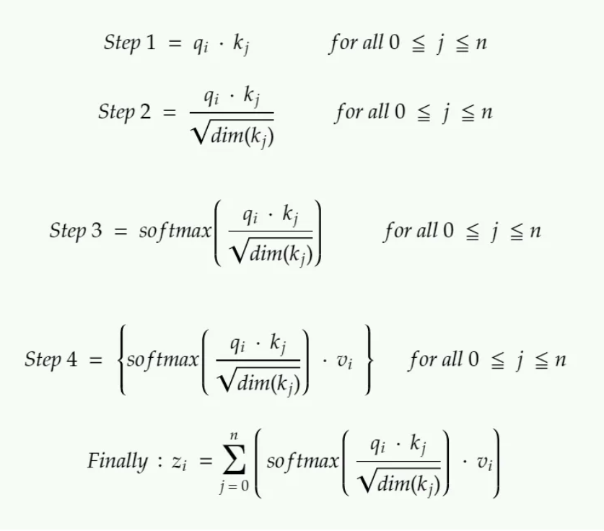
SELF-ATTENTION LAYER
Inputs:
Query Vector: X∈Rn×d
Input Vector: X∈Rn×d
Parameters: Wk∈Rd×d′, Wq∈Rd×d′, Wv∈Rd×d′
Similarity Function: fatt(q,xi)=qTxi/underroot(d)
Computation:
Keys and Queries: K=WkX, Q=WqX
Similarities: E=fatt(K,Q), E∈Rn×n
Attention Weights: A=softmax(E), A∈Rn×n
Values: V=WvX
Output Vector: yj=∑ni=1Aijvi, y∈Rd
WWW.INTERNSHIPSTUDIO.COM
Notes:
https://www.analyticsvidhya.com/blog/2019/06/understanding-transformers-nlp-state-of-the-art-models/

Slide 8
ADVANTAGES OF ATTENTION
Significantly improves Neural Machine Translation performance.
Allows decoder to focus on certain parts of the source.
Solves the bottleneck problem.
Allows decoder to look directly at source; bypass bottleneck
Helps with vanishing gradients problem
provides shortcut between faraway states
Provides some intepretability
By inspecting attention distribution, we can see what the decoder was focusing on.
WWW.INTERNSHIPSTUDIO.COM
Notes:
https://www.analyticsvidhya.com/blog/2019/06/understanding-transformers-nlp-state-of-the-art-models/

Slide 9
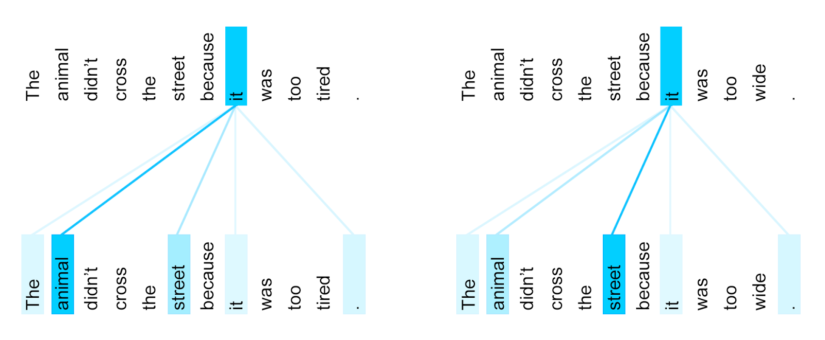
VISUALIZING ATTENTION
WWW.INTERNSHIPSTUDIO.COM
Notes:
https://www.analyticsvidhya.com/blog/2019/06/understanding-transformers-nlp-state-of-the-art-models/

Slide 10
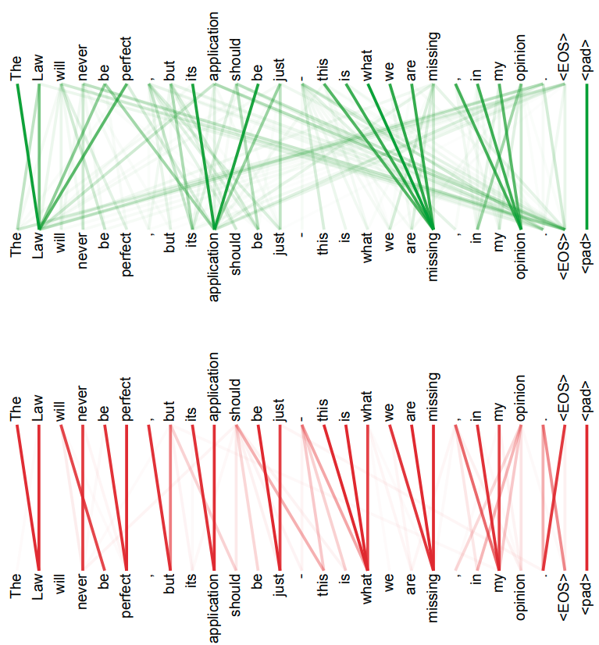
VISUALIZING MULTI-HEAD ATTENTION
WWW.INTERNSHIPSTUDIO.COM
Notes:
https://www.analyticsvidhya.com/blog/2019/06/understanding-transformers-nlp-state-of-the-art-models/

Slide 11
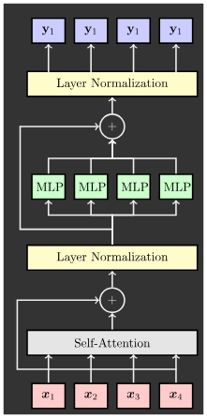
Why Transformers
We want parallelization but RNNs are inherently sequential.
Despite LSTMs, RNNs generally need attention mechanism to deal with long range dependencies.
path length between states grows with distance otherwise
But if attention gives us access to any state… maybe we can just use attention and don't need the RNN?
WWW.INTERNSHIPSTUDIO.COM
Notes:
https://www.analyticsvidhya.com/blog/2019/06/understanding-transformers-nlp-state-of-the-art-models/

Slide 12
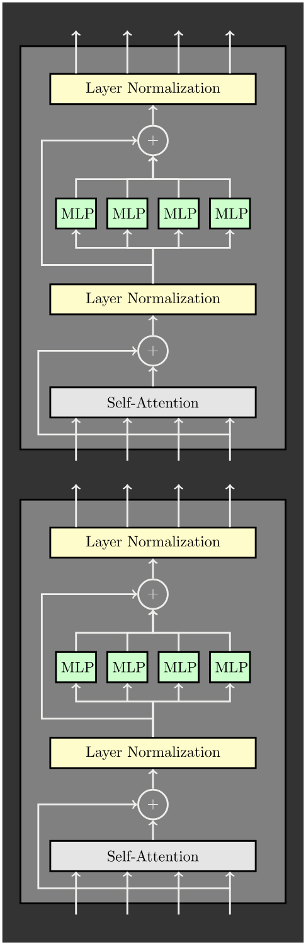
Why Transformers
All vectors interact with each other
Residual Connection
Choice of normalization: Layer normalization
MLP independently on each vector
Residual connection
Output
Transformer Block:
Input: set of vectors x
Output: set of vectors y
Self-attention is the only interaction between vectors
Layer Norm and MLP work independently per vector
Highly scalable, highly parallelizable
A Transformer is a sequence of transformer blocks.
Vasawani et al: 12 blocks, d=512, 6 heads
WWW.INTERNSHIPSTUDIO.COM
Notes:
https://www.analyticsvidhya.com/blog/2019/06/understanding-transformers-nlp-state-of-the-art-models/

Slide 13
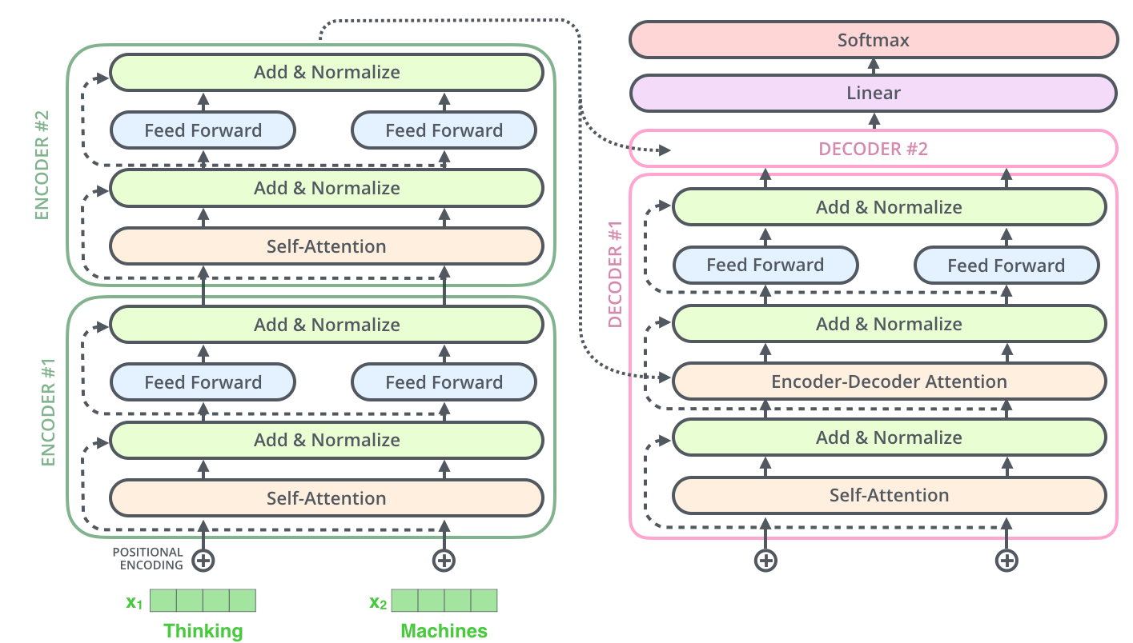
Transformers
Encoder (e.g., BERT)
Decoder (e.g., GPT)
WWW.INTERNSHIPSTUDIO.COM
Notes:
https://www.analyticsvidhya.com/blog/2019/06/understanding-transformers-nlp-state-of-the-art-models/

Slide 14
TRANSFORMER VARIANTS
GPT
Contextualize words by just using left-to-right language model
Pre-train network to predict the next word
ELMo
Pretrains two language models: left-to-right and right-to-left
Concatenate final layer output
Only 'shallow' combination of leftward and rightward context
BERT
Mask 15% of tokens, and predict blanks
All words condition on all other words
RoBERTa
Simplify BERT’s pre-training objective
Scale up batch sizes, train on 1000 GPUs
XLNet: Predict masked tokens auto-regressively in random order
SpanBERT: Mask spans instead of tokens
ELECTRA: Substitute tokens with similar ones, and predict which changed
ALBERT: Tie weights across layers
XLM: Run BERT on lots of languages
WWW.INTERNSHIPSTUDIO.COM
Notes:
https://www.analyticsvidhya.com/blog/2019/06/understanding-transformers-nlp-state-of-the-art-models/

Slide 15
THE TRANSFORMER: TRANSFER LEARNING
"ImageNet Moment for Natural Language Processing"
Pre-Training:
Download a lot of text from the internet
Train a giant Transformer model for language modeling
Lot of objectives work well!
Crucial to model deep, bidirectional interactions between words
Large gains from scaling up pre-training, with no clear limits yet
Finetuning:
Fine-tune the Transformer on your own NLP task
WWW.INTERNSHIPSTUDIO.COM
Notes:
https://www.analyticsvidhya.com/blog/2019/06/understanding-transformers-nlp-state-of-the-art-models/

Slide 16
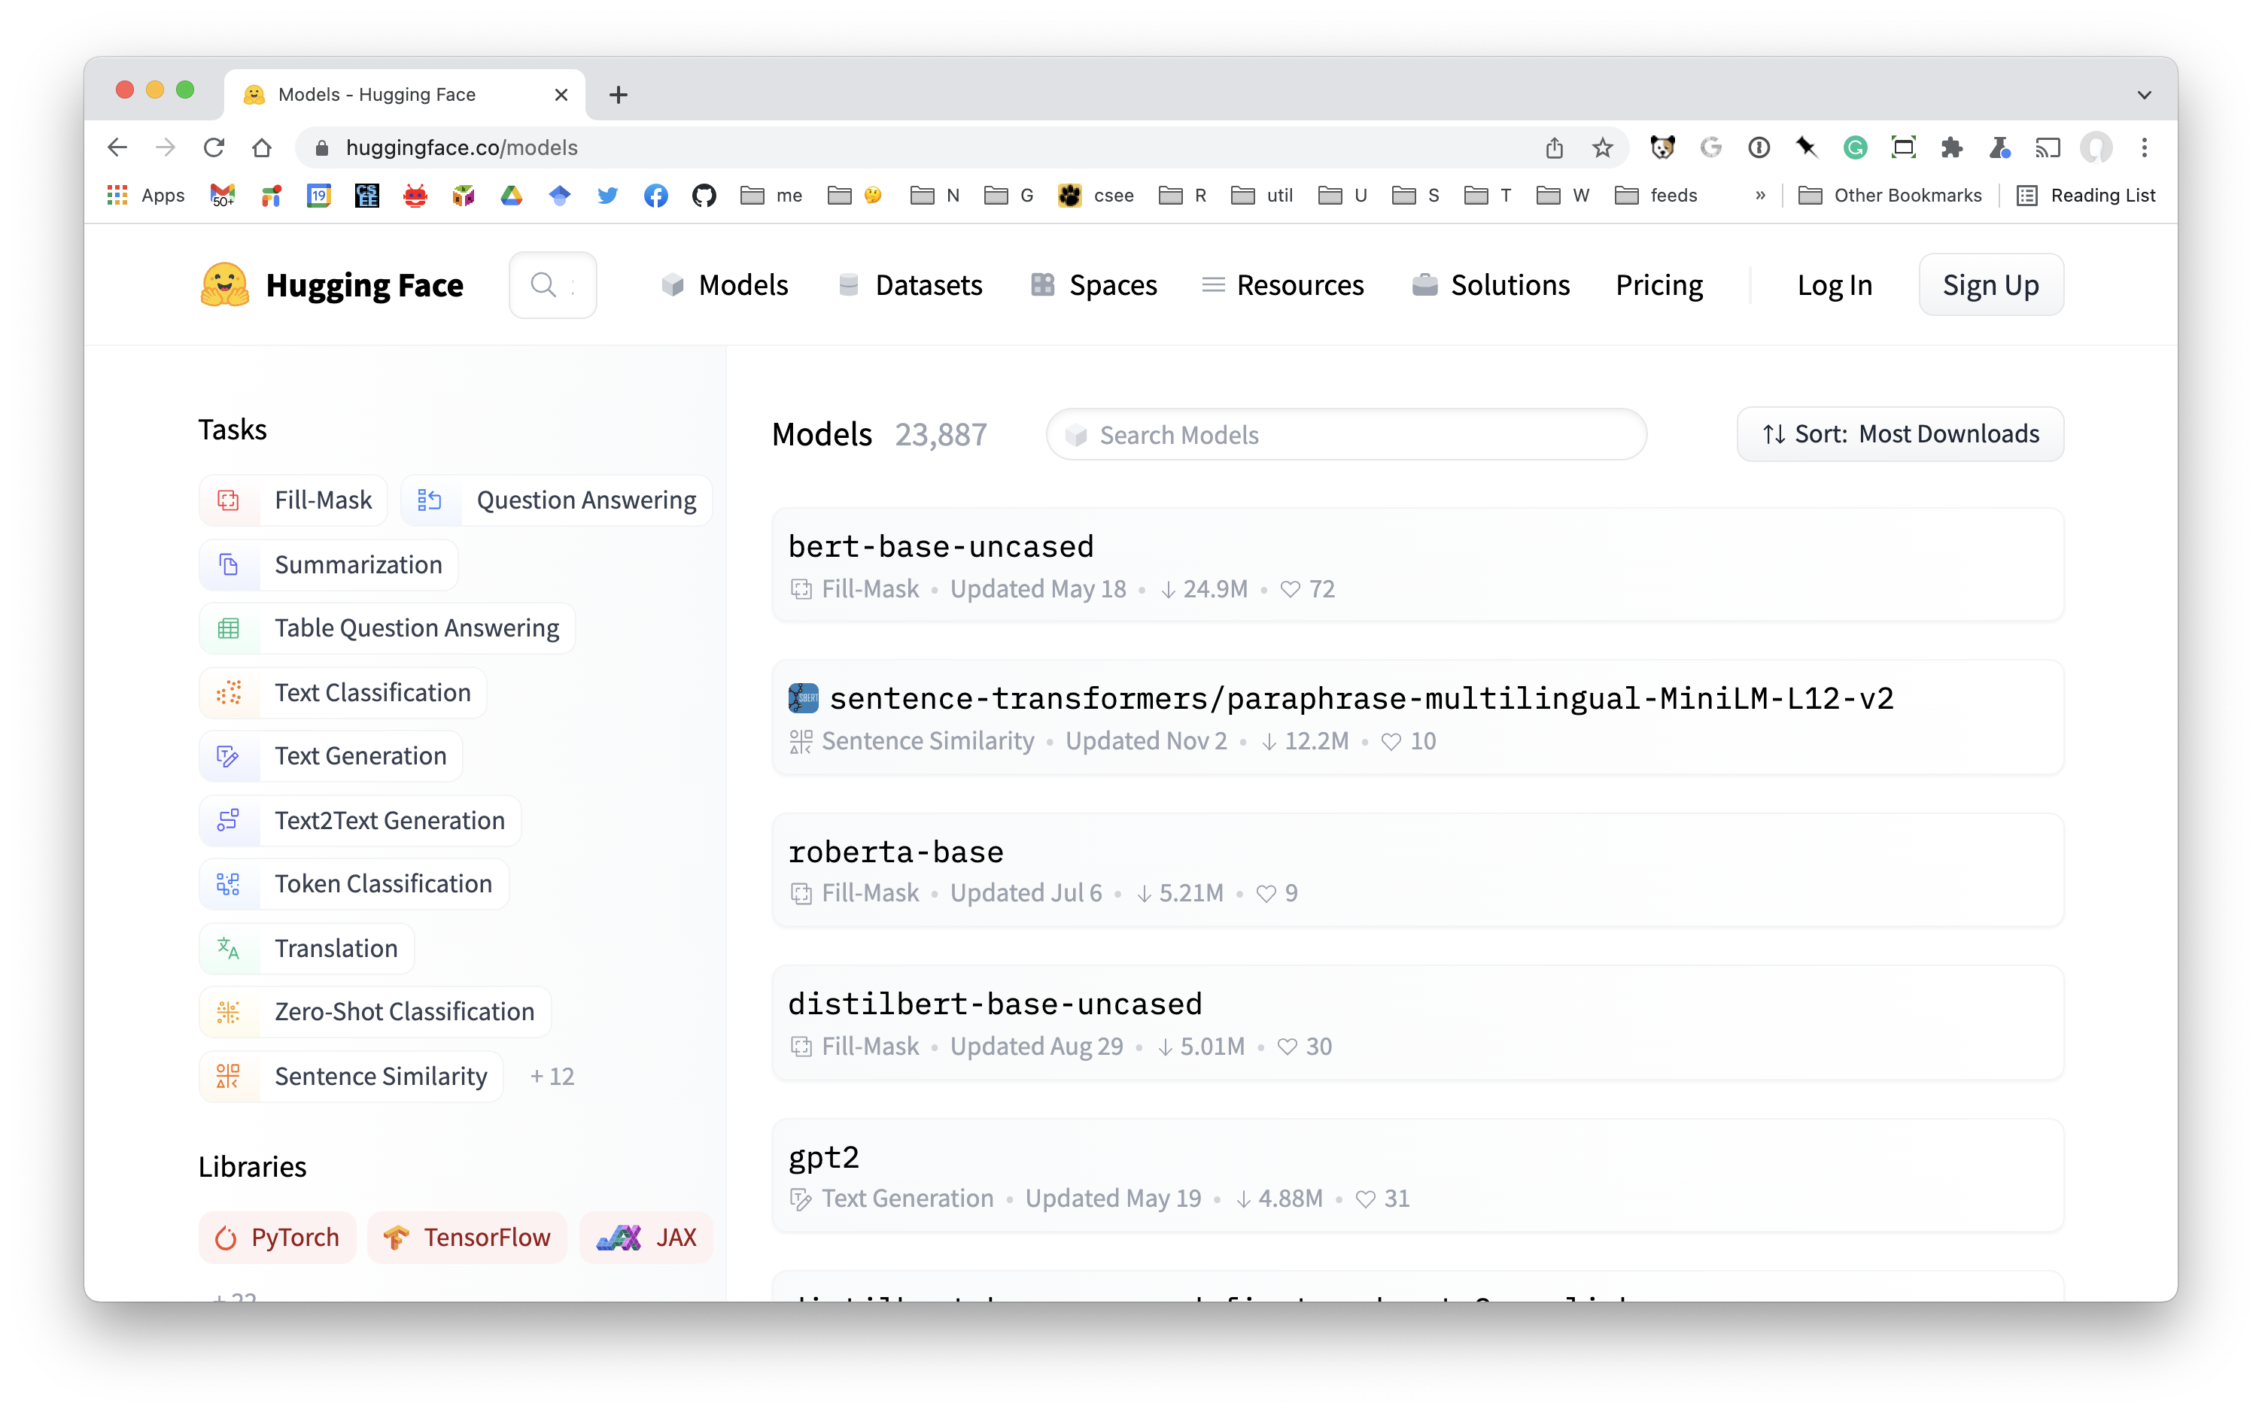
Hugging face models
WWW.INTERNSHIPSTUDIO.COM
Notes:
https://www.analyticsvidhya.com/blog/2019/06/understanding-transformers-nlp-state-of-the-art-models/

Slide 17

Open AI Applications
WWW.INTERNSHIPSTUDIO.COM
Notes:
https://www.analyticsvidhya.com/blog/2019/06/understanding-transformers-nlp-state-of-the-art-models/

Slide 18
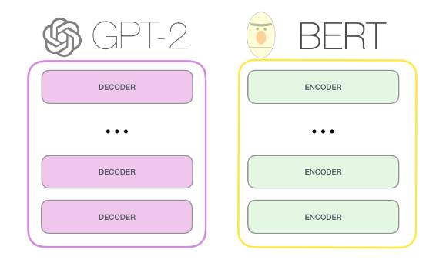
GPT-2 vs BERT
WWW.INTERNSHIPSTUDIO.COM
Notes:
https://www.analyticsvidhya.com/blog/2019/06/understanding-transformers-nlp-state-of-the-art-models/

Slide 19
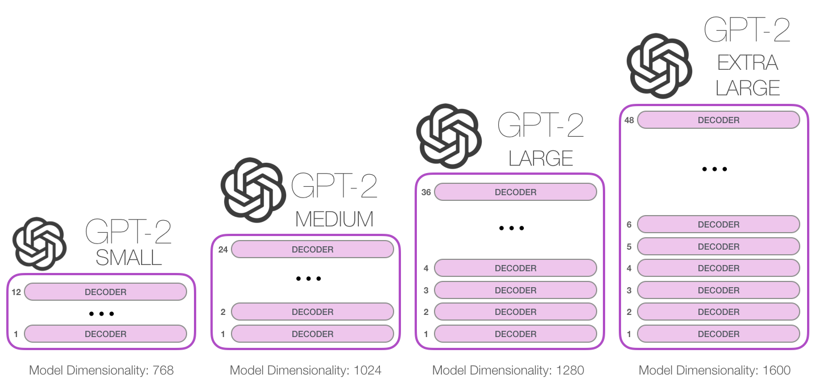
Trend of GPT
GPT released June 2018
GPT-2 released Nov. 2019 with 1.5B parameters
GPT-3 released in 2020 with 175B parameters
117M parameters
345M
762M
1542M
WWW.INTERNSHIPSTUDIO.COM
Notes:
https://www.analyticsvidhya.com/blog/2019/06/understanding-transformers-nlp-state-of-the-art-models/

Slide 20
SCALING UP TRANSFORMER
Model | Layers | Width | Heads | Params | Data | Training
Transformer-Base | 12 | 512 | 8 | 65M |  | 8x P100 (12 hrs)
Transformer-Large | 12 | 1024 | 16 | 213M |  | 8x P100 (3.5 days)
BERT-Base | 12 | 768 | 12 | 110M | 13GB
BERT-Large | 24 | 1024 | 16 | 340M | 13GB
XLNet-Large | 24 | 1024 | 16 | 340M | 126GB | 512x TPU-v3 (2.5 days)
RoBERTa | 24 | 1024 | 16 | 355M | 160GB | 1024x V100 (1 day)
GPT-2 | 48 | 1600 | ? | 1.5B | 40GB
Megatron-LM | 72 | 3072 | 32 | 8.3B | 174GB | 512x V100 (9 days)
Turing-NLG | 78 | 4256 | 28 | 17B | ? | 256x V100
GPT-3 | 96 | 12288 | 96 | 175B | 694GB | ?
WWW.INTERNSHIPSTUDIO.COM
Notes:
https://www.analyticsvidhya.com/blog/2019/06/understanding-transformers-nlp-state-of-the-art-models/

Slide 21
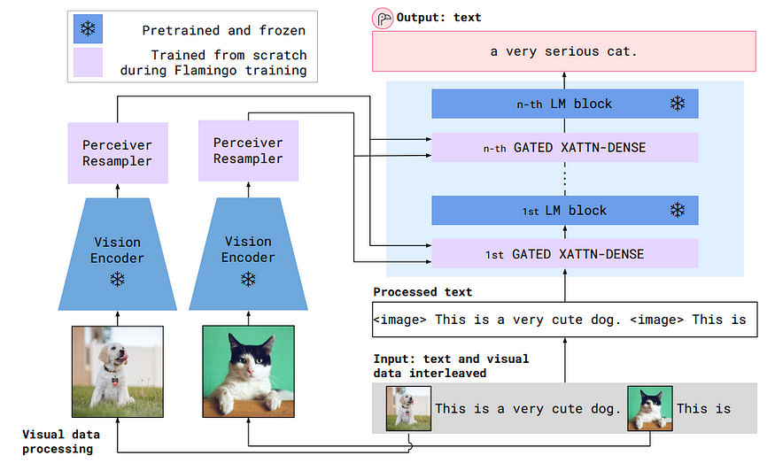
GPT-4
It is large multimodal that can accept image and text inputs and emit outputs.
It exhibits human-level performance on various professional and academic benchmarks.
WWW.INTERNSHIPSTUDIO.COM
Notes:
https://www.analyticsvidhya.com/blog/2019/06/understanding-transformers-nlp-state-of-the-art-models/

Slide 22
SUMMARY
You got this
Next session
1 Transformers are a new neural network model that only uses attention.
2 If you can afford large data and large compute, transformers are the go to architecture, instead of CNNs, RNNs, etc.
1 Project on face recognition
WWW.INTERNSHIPSTUDIO.COM

