Slide 1


Welcome to
INTERNSHIP STUDIO
Module 03 | Lesson 01
Introduction to NumPy
WWW.INTERNSHIPSTUDIO.COM

Slide 2

Introduction to NumPy
NumPy is an open-source library for working efficiently with arrays.
Developed in 2005 by Travis Oliphant.
The name stands for Numerical Python. It is a library consisting of multidimensional array objects and a collection of routines for processing of array.
WWW.INTERNSHIPSTUDIO.COM

Slide 3
Why is NumPy so popular?
NumPy is extremely popular because it dramatically improves the ease and performance of working with multidimensional arrays.
Some of NumPy's advantages are:
Mathematical operations on NumPy’s with ndarray objects are up to 50x faster than iterating over native Python lists using loops. The efficiency gains are primarily due to NumPy storing array elements in an ordered single location within memory, eliminating redundancies by having all elements be the same type and making full use of modern CPUs. The efficiency advantages become particularly apparent when operating on arrays with thousands or millions of elements, which are pretty standard within data science.
It offers an Indexing syntax for easily accessing portions of data within an array.
It contains built-in functions that improve quality of life when working with arrays and math, such as functions for linear algebra, array transformations, and matrix math.
It requires fewer lines of code for most mathematical operations than native Python lists.
WWW.INTERNSHIPSTUDIO.COM

Slide 4
Features of Numpy
NumPy contains many features, some of which are listed below :
NumPy is a combination of Python and the C language as it is partially written in Python and most of its parts are written in C or C++.
The object-oriented approach is also fully supported by Numpy.
NumPy functions can be used to work with code that is written in other programming languages and provides tools for integrating with languages such as C, Fortran, etc.
NumPy is an open-source core Python package for scientific computing.
NumPy uses less space and stores data in contiguous memory.
It offers a multidimensional array object with excellent performance as well as methods for working with these arrays.
Arrays can be reshaped into different dimensions using the reshape function provided by NumPy.
We can work with different data types using NumPy and can determine the type of data using the dtype function.
NumPy comes with a plethora of built-in functions such as sum, sort, max, and so on, allowing users to write fewer lines of code while improving the quality of their work.
NumPy provides a broadcasting technique by which we can perform arithmetic operations on arrays of different shapes.
NumPy with SciPy is also used as an alternative to MATLAB.
WWW.INTERNSHIPSTUDIO.COM

Slide 5
NumPy documentation
Official documentation
http://docs.scipy.org/doc/
The NumPy book
http://www.tramy.us/numpybook.pdf
Example list
http://www.scipy.org/Numpy_Example_List_With_Doc
WWW.INTERNSHIPSTUDIO.COM

Slide 6
NumPy Installation
To check if you already have NumPy installed in your Python installation (it most likely is), run the following command:
import numpy as np (NumPy is usually imported under the np alias.)
If no error message is returned, that's a good sign NumPy is already available. If you get an error message like
ModuleNotFoundError: No module named 'numpy’ this means it’s not installed, then install using following command
pip install numpy
WWW.INTERNSHIPSTUDIO.COM

Slide 7
A Simple NumPy Example
Checking NumPy Version
The version string is stored under __version__ attribute.
import numpy as np print(np.__version__)
Numpy 1-d array :
import numpy as np
li = [1, 2, 3, 4]
numpyArr = np.array(li)
print(numpyArr)
Output: [1 2 3 4]
Numpy 2-D array :
import numpy as np
arr=np.array([[1,2,3],[3,2,1]])
print(arr)
Output: [[1 2 3]
[3 2 1]]
WWW.INTERNSHIPSTUDIO.COM

Slide 8
A Simple NumPy Example
NumPy is used to work with arrays. The array object in NumPy is called ndarray.
We can create a NumPy ndarray object by using the array() function.
import numpy as np arr = np.array([1, 2, 3, 4, 5]) print(arr) print(type(arr))
Output: [1 2 3 4 5]
<class 'numpy.ndarray’>
To create an ndarray, we can pass a list, tuple or any array-like object into the array() method, and it will be converted into an ndarray.
WWW.INTERNSHIPSTUDIO.COM

Slide 9
Operations Using Numpy
Indexing : Indexing is used for accessing elements from an array. It starts from 0. Below is a code example where the element of the index (0,2) are accessed, where 0 stands for the 1st row and 1 for the 3rd column from the 2-D array.
Ex:
import numpy as np
arr=np.array([[1,2,3],[3,2,1]])
index=arr[0,2]
print("The element at index(0,2) is:", index)
Output: The element at index(0,2) is:3
Slicing : Slicing is the method for getting substrings from the original arrays by mentioning the start and end inside the slice operator []. Let's see the below example where the substring from the 2nd element to the 5th element is sliced.
Ex:
import numpy as np
arr=np.array([3,6,4,1,8,9,7])
sliced=arr[1:5]
print(sliced)
Output: [6 4 1 8]
WWW.INTERNSHIPSTUDIO.COM

Slide 10
Operations Using Numpy
3. array.ndim : array.ndim is used to find the number of dimensions of the array. Let us look into the code example below :
import numpy as np
arr=np.array([[1,2,3],[3,2,1]])
print("dimensions of array:",arr.ndim)
Output: dimensions of the array: 2
4. array.itemsize : array.itemsize is used to find the size of each element of the Numpy array in bytes. Below is an array consisting of integers and the size of an integer is 8 bytes that's why the itemsize is 8.
import numpy as np
arr=np.array([[1,2,3],[3,2,1]])
print("itemsize of array:",arr.itemsize)
Output: itemsize of the array: 8
5. array.size : array.size is used to find the size of the array by counting the number of elements from the given array.
import numpy as np
arr=np.array([[1,2,3],[3,2,1]])
print("size of array:",arr.size)
Output: 6
WWW.INTERNSHIPSTUDIO.COM

Slide 11
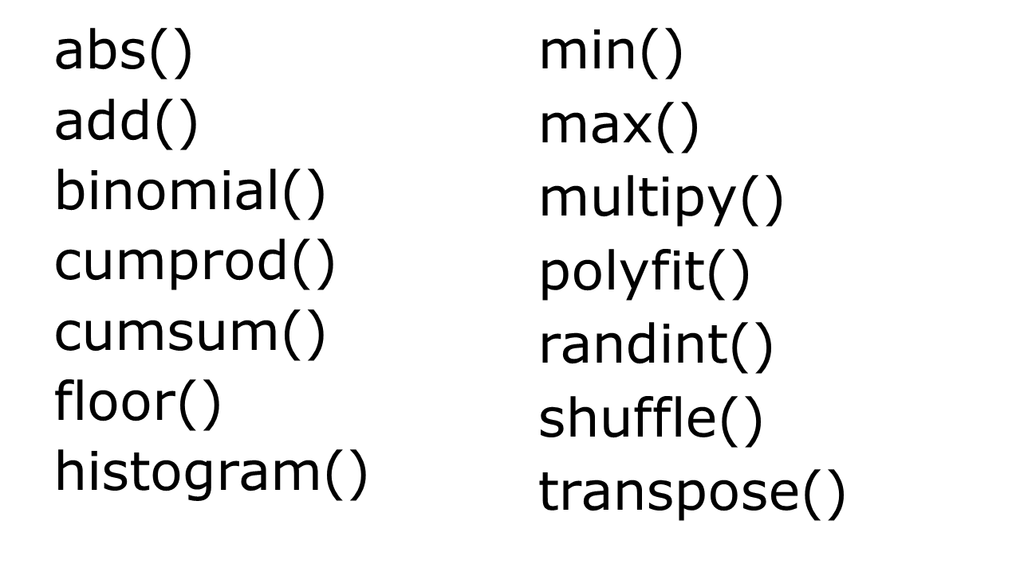
Functions of NumPy
WWW.INTERNSHIPSTUDIO.COM

Slide 12
The Relationship between NumPy, SciPy, Scikit-learn, and Pandas
Scipy is the Scientific library that has a slower computation speed. Scipy builds on Numpy and consists of all functionalities of Numpy. Both can use for faster mathematical and scientific calculations.
Pandas is a Numpy tutorial extension that adds functions for exploratory data analysis, statistics, and data visualization to Numpy. It's like Python's version of Microsoft Excel spreadsheets for manipulating and examining tabular data.
Scikit-learn is also built on Numpy and Scipy. It is an extension of advanced machine learning algorithms Numpy and Scipy.
WWW.INTERNSHIPSTUDIO.COM

