Slide 1


Welcome to
INTERNSHIP STUDIO
Module 03 | Lesson 02
Introduction to Pandas
WWW.INTERNSHIPSTUDIO.COM

Slide 2

Introduction to Pandas
Pandas is an open-source library that is made mainly for working with relational or labeled data both easily and intuitively.
It provides various data structures and operations for manipulating numerical data and time series.
This library is built on the top of the NumPy library.
Pandas is fast and it has high-performance & productivity for users.
WWW.INTERNSHIPSTUDIO.COM

Slide 3
Why we use Pandas?
Pandas will extract the data from that CSV into a DataFrame — a table, basically — then let you do things like:
Calculate statistics and answer questions about the data, like
What’s the average, median, max, or min of each column?
Does column A correlate with column B?
What does the distribution of data in column C look like?
Clean the data by doing things like removing missing values and filtering rows or columns by some criteria
Visualize the data with help from Matplotlib. Plot bars, lines, histograms, bubbles, and more.
Store the cleaned, transformed data back into a CSV, other file or database
WWW.INTERNSHIPSTUDIO.COM

Slide 4
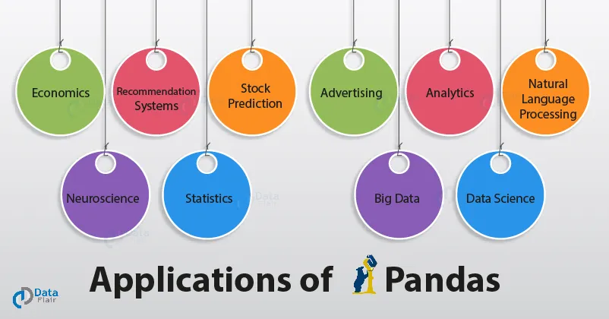
Applications of Pandas
WWW.INTERNSHIPSTUDIO.COM

Slide 5
Pandas First Steps: install and import
Pandas is an easy package to install. Open up your terminal program (shell or cmd) and install it using either of the following commands:
For jupyter notebook users, you can run this cell:
The ! at the beginning runs cells as if they were in a terminal.
To import pandas we usually import it with a shorter name since it's used so much:
$ conda install pandas
OR
$ pip install pandas
!pip install pandas
import pandas as pd
Installation: https://pandas.pydata.org/pandas-docs/stable/getting_started/install.html
WWW.INTERNSHIPSTUDIO.COM

Slide 6
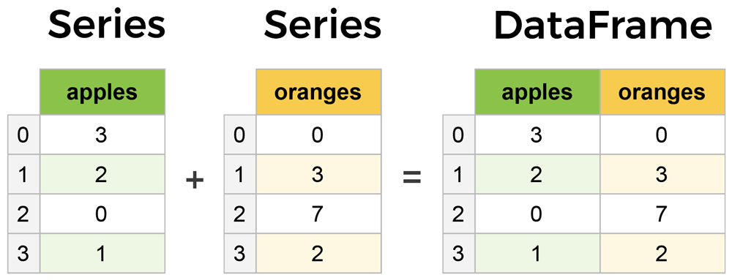
Core components of pandas: Series and DataFrames
A Series is essentially a column, and a DataFrame is a multi-dimensional table made up of a collection of Series.
WWW.INTERNSHIPSTUDIO.COM

Slide 7
pandas.DataFrame
pandas.DataFrame(data, index , columns , dtype , copy )
data: data takes various forms like ndarray, series, map, lists, dict, constants and also another DataFrame.
index: For the row labels, that are to be used for the resulting frame, Optional, Default is np.arrange(n)if no index is passed.
columns: For column labels, the optional default syntax is - np.arrange(n). This is only true if no index is passed.
dtype: Data type of each column.
copy: This command (or whatever it is) is used for copying of data, if the default is False.
Create DataFrame
A pandas DataFrame can be created using various inputs like −
Lists
dict
Series
Numpy ndarrays
Another DataFrame
WWW.INTERNSHIPSTUDIO.COM

Slide 8
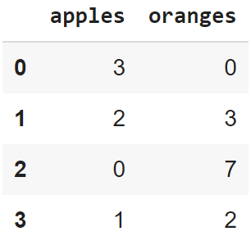
Creating a DataFrame from scratch
There are many ways to create a DataFrame from scratch, but a great option is to just use a simple dict. But first you must import pandas.
Let's say we have a fruit stand that sells apples and oranges. We want to have a column for each fruit and a row for each customer purchase. To organize this as a dictionary for pandas we could do something like:
And then pass it to the pandas DataFrame constructor:
import pandas as pd
data = { 'apples':[3, 2, 0, 1] , 'oranges':[0, 3, 7, 2] }
df = pd.DataFrame(data)
WWW.INTERNSHIPSTUDIO.COM

Slide 9
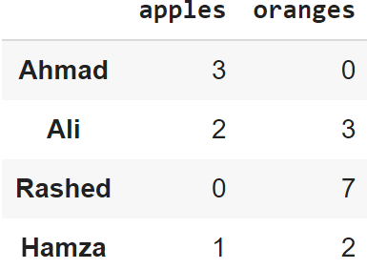
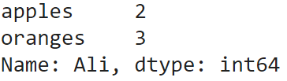
How did that work?
Each (key, value) item in data corresponds to a column in the resulting DataFrame.
The Index of this DataFrame was given to us on creation as the numbers 0-3, but we could also create our own when we initialize the DataFrame.
E.g. if you want to have customer names as the index:
df = pd.DataFrame(data, index=['Ahmad', 'Ali', 'Rashed', 'Hamza'])
So now we could locate a customer's order by using their names:
df.loc['Ali']
WWW.INTERNSHIPSTUDIO.COM

Slide 10
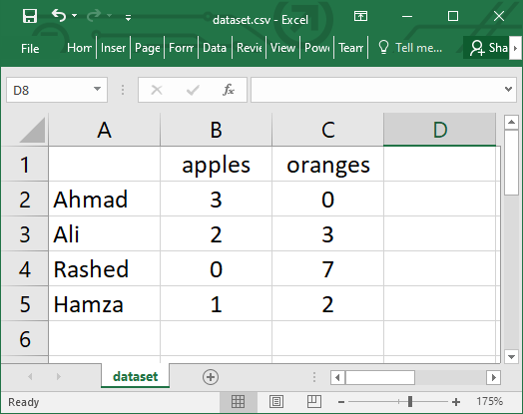
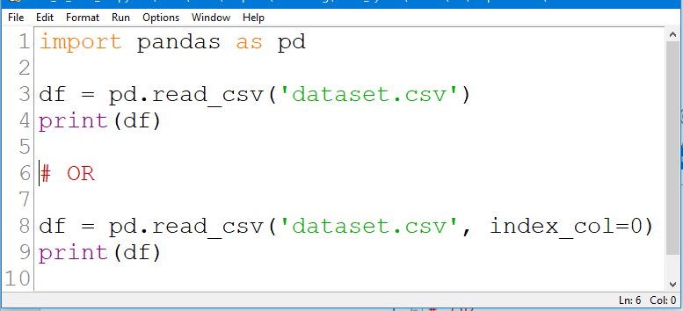
Reading data from a CSV file
WWW.INTERNSHIPSTUDIO.COM

Slide 11
Most important DataFrame operations
DataFrames possess hundreds of methods and other operations that are crucial to any analysis.
As a beginner, you should know the operations that:
that perform simple transformations of your data and those
that provide fundamental statistical analysis on your data.
WWW.INTERNSHIPSTUDIO.COM

Slide 12
Loading dataset
We're loading this dataset from a CSV and designating the movie titles to be our index.
movies_df = pd.read_csv("movies.csv", index_col="title")
https://grouplens.org/datasets/movielens/
WWW.INTERNSHIPSTUDIO.COM

Slide 13
Viewing your data
The first thing to do when opening a new dataset is print out a few rows to keep as a visual reference. We accomplish this with .head():
.head() outputs the first five rows of your DataFrame by default, but we could also pass a number as well: movies_df.head(10) would output the top ten rows, for example.
To see the last five rows use .tail() that also accepts a number, and in this case we printing the bottom two rows.:
movies_df.head()
movies_df.tail(2)
WWW.INTERNSHIPSTUDIO.COM

Slide 14
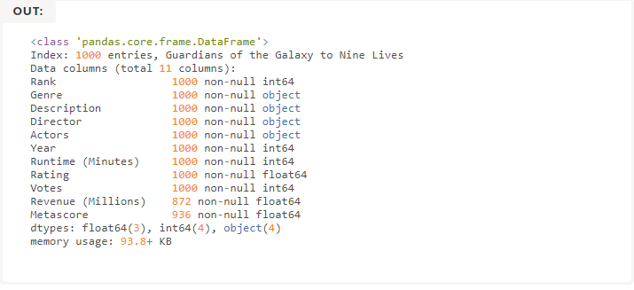

Getting info about your data
.info() should be one of the very first commands you run after loading your data
.info() provides the essential details about your dataset, such as the number of rows and columns, the number of non-null values, what type of data is in each column, and how much memory your DataFrame is using.
movies_df.info()
movies_df.shape
WWW.INTERNSHIPSTUDIO.COM

Slide 15


Handling duplicates
This dataset does not have duplicate rows, but it is always important to verify you aren't aggregating duplicate rows.
To demonstrate, let's simply just double up our movies DataFrame by appending it to itself:
Using append() will return a copy without affecting the original DataFrame. We are capturing this copy in temp so we aren't working with the real data.
Notice call .shape quickly proves our DataFrame rows have doubled.
temp_df = movies_df.append(movies_df)
temp_df.shape
Now we can try dropping duplicates:
temp_df = temp_df.drop_duplicates()
temp_df.shape
WWW.INTERNSHIPSTUDIO.COM

Slide 16
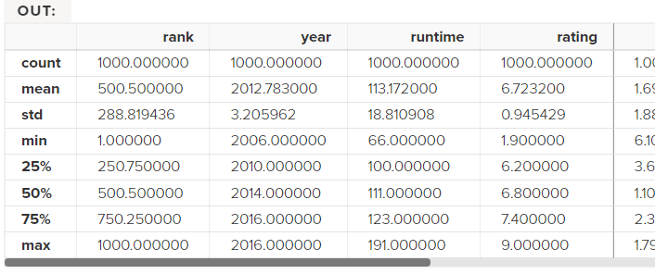
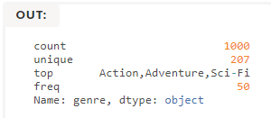
Understanding your variables
Using .describe() on an entire DataFrame we can get a summary of the distribution of continuous variables:
.describe() can also be used on a categorical variable to get the count of rows, unique count of categories, top category, and freq of top category:
This tells us that the genre column has 207 unique values, the top value is Action/Adventure/Sci-Fi, which shows up 50 times (freq).
movies_df.describe()
movies_df['genre'].describe()
WWW.INTERNSHIPSTUDIO.COM

Slide 17
References
pandas documentation
https://pandas.pydata.org/pandas-docs/stable/index.html
pandas: Input/output
https://pandas.pydata.org/pandas-docs/stable/reference/io.html
pandas: DataFrame
https://pandas.pydata.org/pandas-docs/stable/reference/frame.html
pandas: Series
https://pandas.pydata.org/pandas-docs/stable/reference/series.html
pandas: Plotting
https://pandas.pydata.org/pandas-docs/stable/reference/plotting.html
WWW.INTERNSHIPSTUDIO.COM

