Slide 1


Welcome to
INTERNSHIP STUDIO
Module 03 | Lesson 03
Data visualization with Matplotlib
WWW.INTERNSHIPSTUDIO.COM

Slide 2

Data Visualization
Data visualization is an important aspect of all AI and machine learning applications. You can gain key insights into your data through different graphical representations.
Why Data Visualization is important?
Visualizations are the easiest way to analyze and absorb information.
Visuals help to easily understand the complex problem. They help in identifying patterns, relationships, and outliers in data.
It helps in understanding problems better and quickly.
Insights gathered from the visuals help in building strategies.
It is also a precursor to many high-level data analysis for Exploratory Data Analysis(EDA) and Machine Learning(ML).
WWW.INTERNSHIPSTUDIO.COM

Slide 3
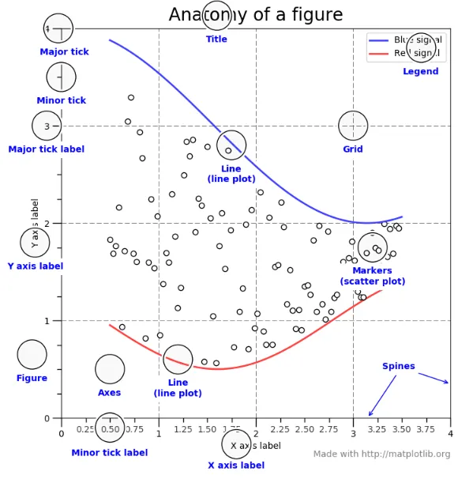
Matplotlib
Matplotlib is a 2-D plotting library that helps in visualizing figures. Matplotlib emulates Matlab like graphs and visualizations. Matlab is not free, is difficult to scale and as a programming language is tedious. So, matplotlib in Python is used as it is a robust, free and easy library for data visualization.
WWW.INTERNSHIPSTUDIO.COM

Slide 4
Installing Matplotlib
Jupyter Notebook
!pip install matplotlib
conda install -c conda-forge matplotlib
Importing matplotlib
import matplotlib.pyplot as plt
WWW.INTERNSHIPSTUDIO.COM

Slide 5
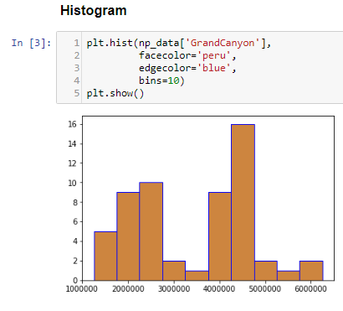
Histogram
A histogram takes in a series of data and divides the data into a number of bins. It then plots the frequency data points in each bin (i.e. the interval of points). It is useful in understanding the count of data ranges.
When to use: We should use histogram when we need the count of the variable in a plot.
eg: Number of particular games sold in a store.
Implementation: Histogram
WWW.INTERNSHIPSTUDIO.COM

Slide 6
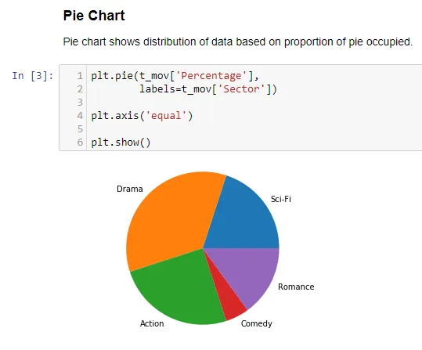
Pie Chart
It is a circular plot which is divided into slices to illustrate numerical proportion. The slice of a pie chart is to show the proportion of parts out of a whole.
When to use: Pie chart should be used seldom used as It is difficult to compare sections of the chart. Bar plot is used instead as comparing sections is easy.
Implementation: Pie Chart
WWW.INTERNSHIPSTUDIO.COM

Slide 7
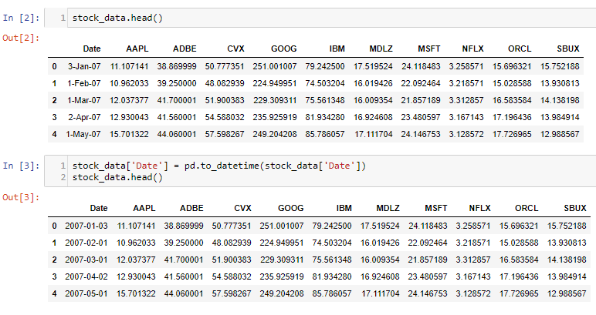
Time Series by line plot
Time series is a line plot and it is basically connecting data points with a straight line. It is useful in understanding the trend over time.
When to use: Time Series should be used when single or multiple variables are to be plotted over time.
eg: Stock Market Analysis of Companies, Weather Forecasting.
WWW.INTERNSHIPSTUDIO.COM

Slide 8
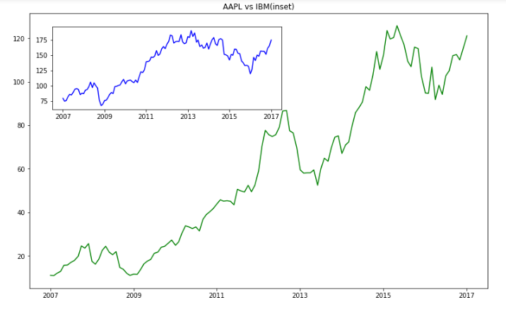
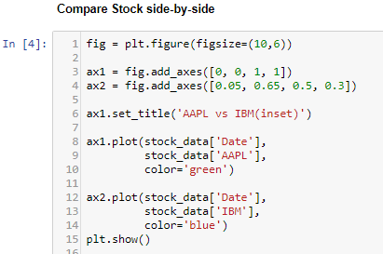
Time Series by line plot
First, Convert Date to pandas DateTime for easier plotting of data.
Implementation: Time Series
WWW.INTERNSHIPSTUDIO.COM

Slide 9
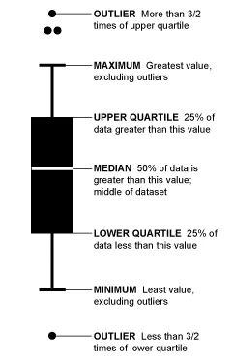
Boxplot and Violinplot
Boxplot gives a nice summary of the data. It helps in understanding our distribution better.
When to use: It should be used when we require to use the overall statistical information on the distribution of the data. It can be used to detect outliers in the data.
eg: Credit Score of Customer. We can get the max, min and much more
information about the mark.
WWW.INTERNSHIPSTUDIO.COM

Slide 10
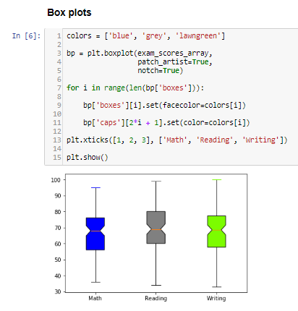
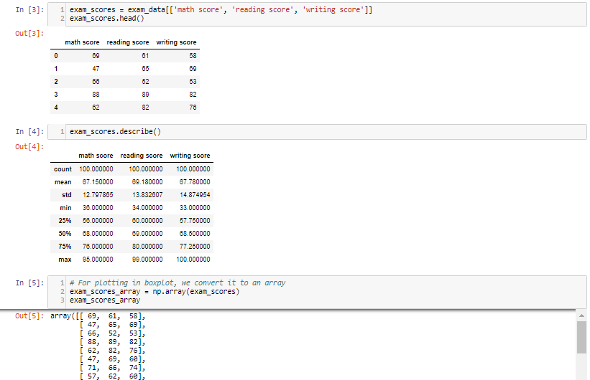
Boxplot and Violinplot
Implementation: Boxplot & Violinplot
WWW.INTERNSHIPSTUDIO.COM

Slide 11
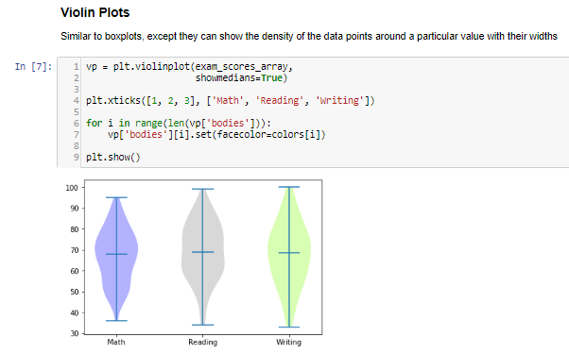
Boxplot and Violinplot
WWW.INTERNSHIPSTUDIO.COM

Slide 12
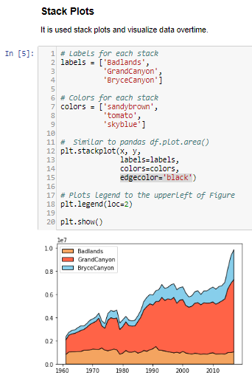
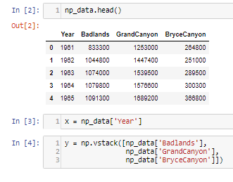
Stack Plot
Stack plot visualizes data in stacks and shows the distribution of data over time.
When to use: It is used for checking multiple variable area plots in a single plot.
Eg: It is useful in understanding the change of distribution in multiple variables over an interval.
As stack plot requires stacking,
it is done in using np.vstack()
WWW.INTERNSHIPSTUDIO.COM

Slide 13
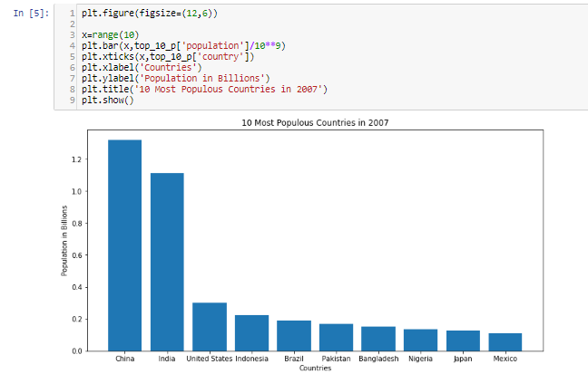
Bar Plot
Bar Plot shows the distribution of data over several groups. It is commonly confused with a histogram which only takes numerical data for plotting. It helps in comparing multiple numeric values.
When to use: It is used when to compare between
several groups.
Eg: Student marks in an exam.
Implementation: Bar Plot
WWW.INTERNSHIPSTUDIO.COM

Slide 14
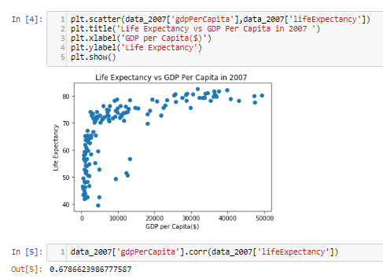
Scatter Plot
Scatter plot helps in visualizing 2 numeric variables. It helps in identifying the relationship of the data with each variable i.e correlation or trend patterns. It also helps in detecting outliers in the plot.
When to use: It is used in Machine learning concepts like regression, where x and y are continuous variables. It is also used in clustering scatters or outlier detection.
Implementation: Scatter Plot
WWW.INTERNSHIPSTUDIO.COM

