Slide 1

Academix
Choudhry Kamran & Maxime Mir-Orefice

Slide 2
Introduction
“Academix” is a calendar/agenda application tailor made for students.
Users can login, register and forget password.
Users can view, add, edit and delete tasks in a calendar.
Tasks are color coded by task type.
We will be using Firestorm as our database for user account info and tasks info.
Github: https://github.com/ItsMax123/Academixdemix

Slide 3
Division of labour
UI/UX Kamran: Account pages, Home page, List page and Profile pages Max: Calendar page and Task pages
Backend Kamran: Forget password, Weekly tasks, Edit profile and notifications Max: Database setup, Login, Register, Calendar, Tasks and API

Slide 4


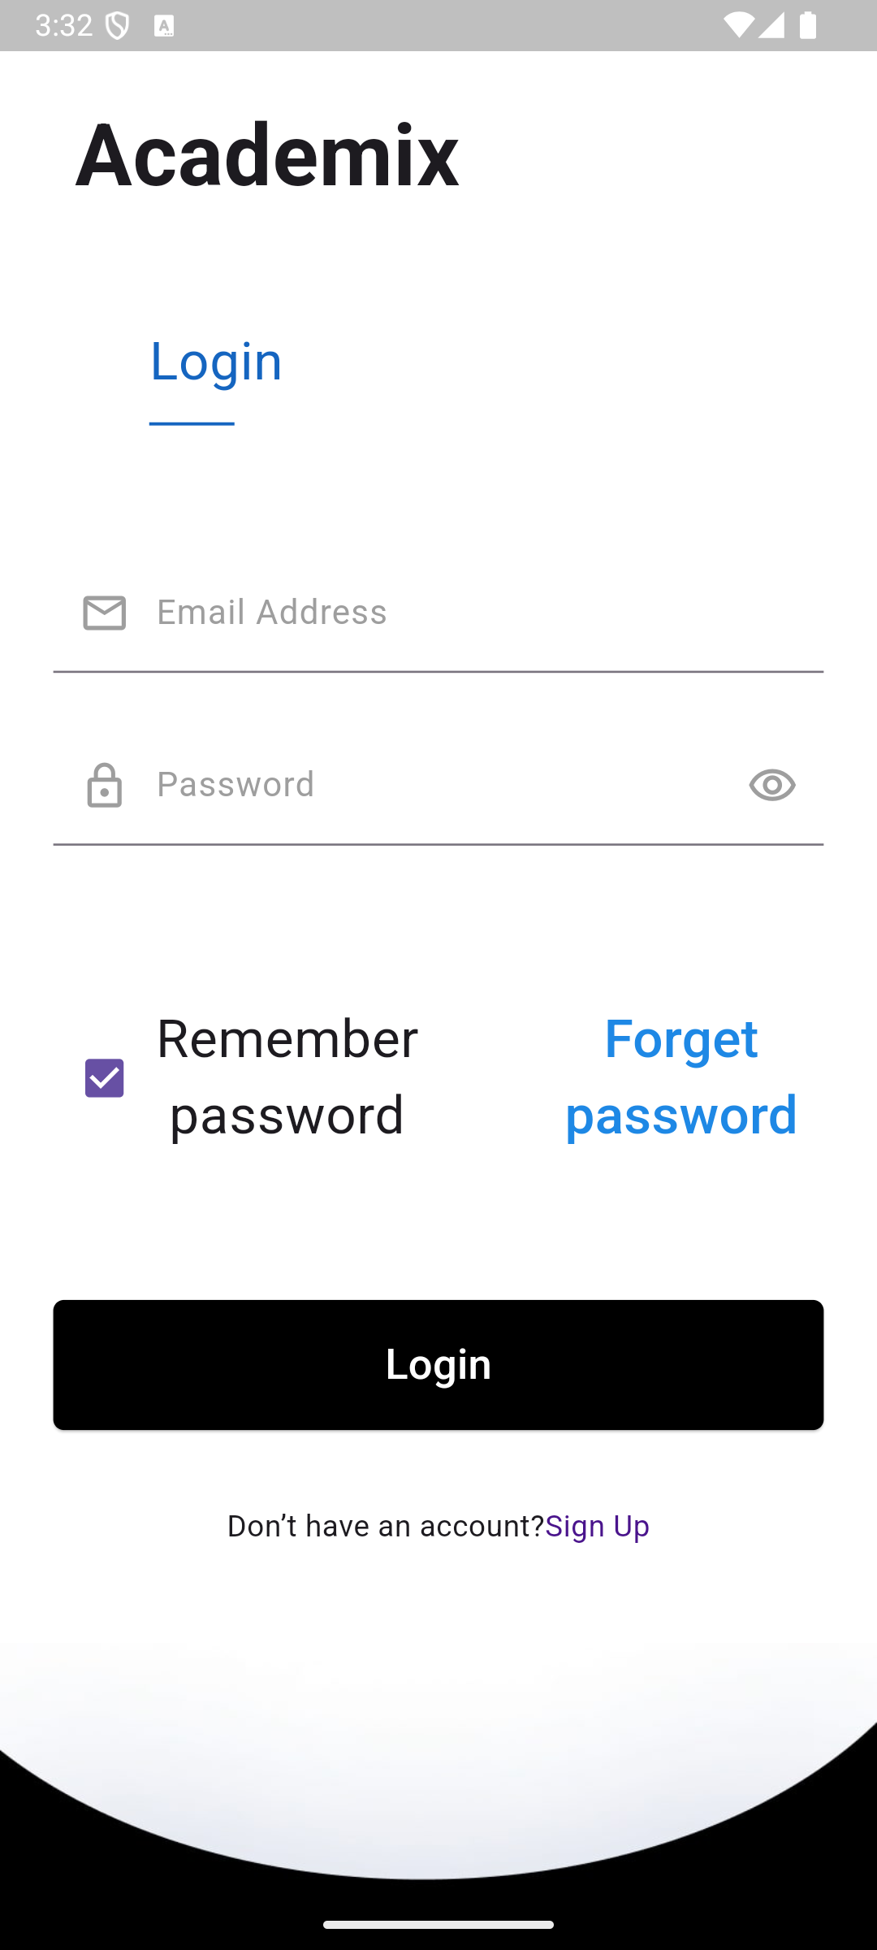
Log in
Let’s the user log into their account using their email and password.
Let’s user stay logged in.

Slide 5
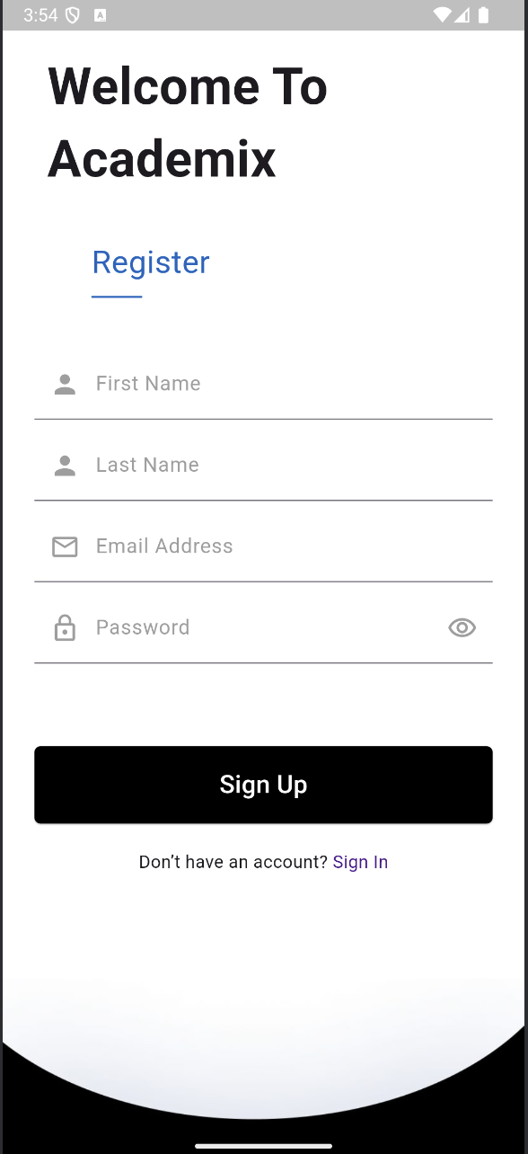
Register
Let’s the user create a new account using their first name, last name, email and password.

Slide 6
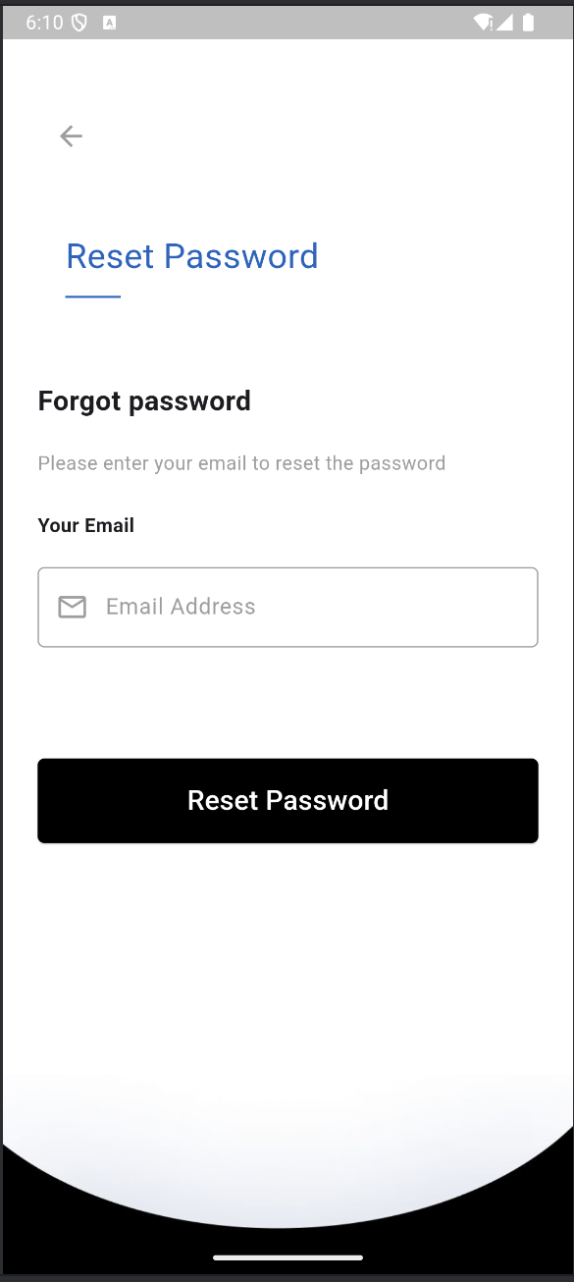
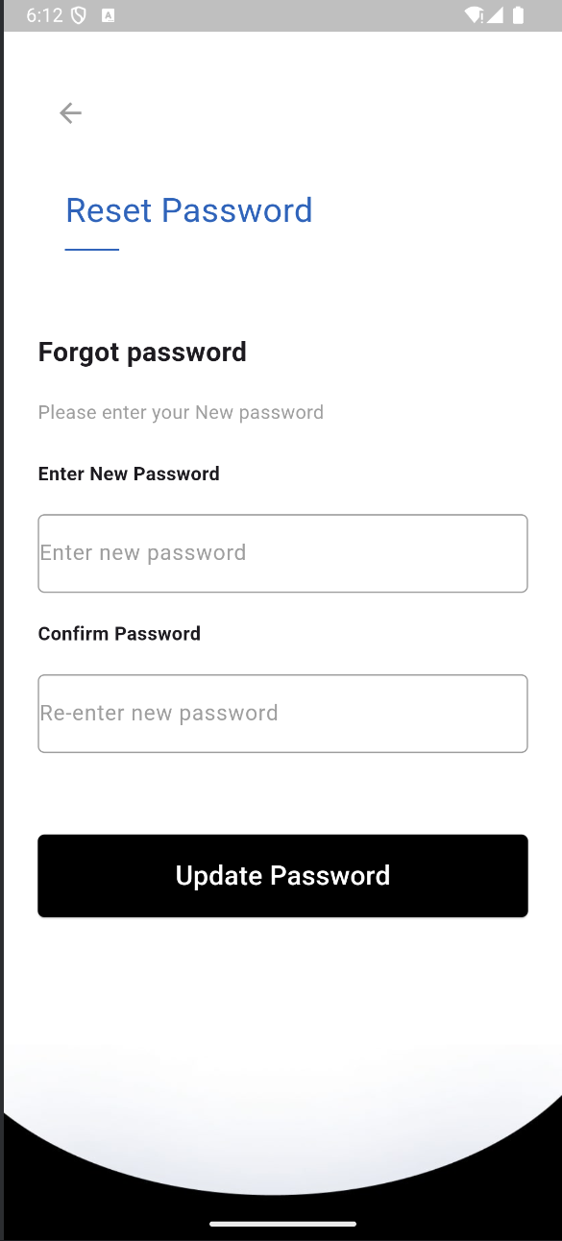
Forgot Password
Let’s the user reset their password through email if they forgot it.

Slide 7
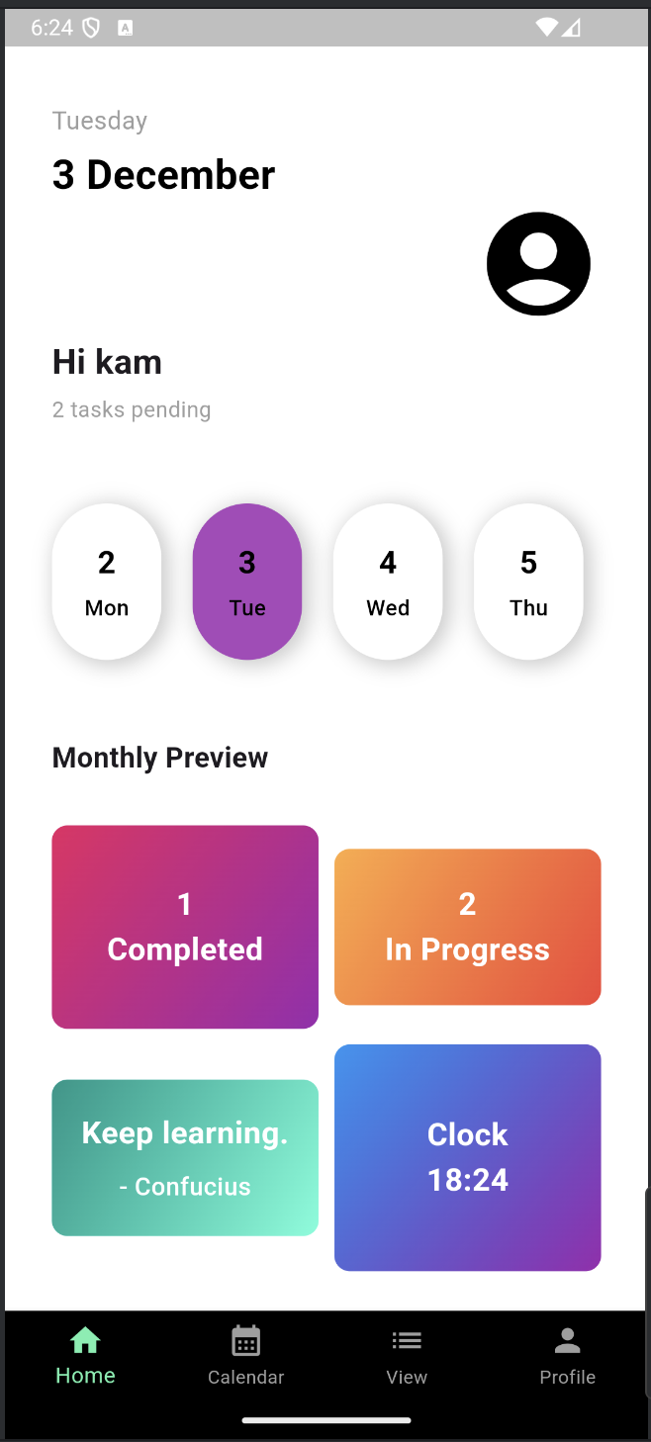
Home page
Shows general information about the user and the app.

Slide 8
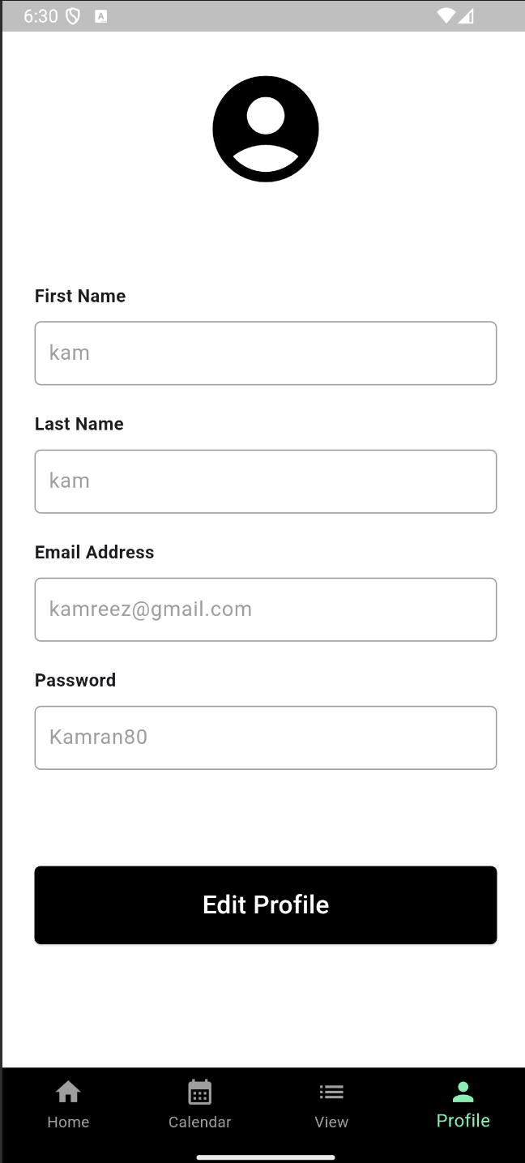
Profile
Shows the users first name, last name, email and password.

Slide 9
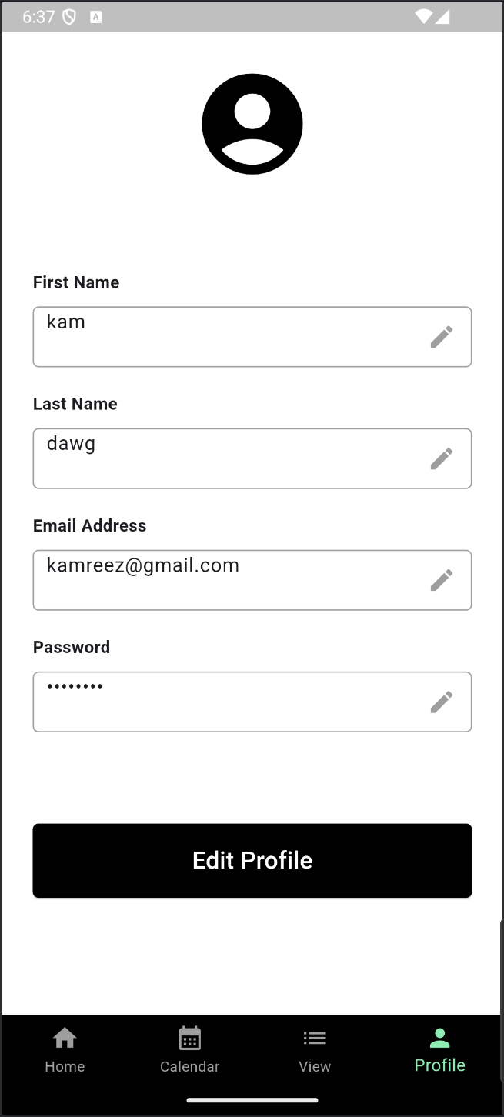
Edit Profile
Let’s user edit their info.

Slide 10
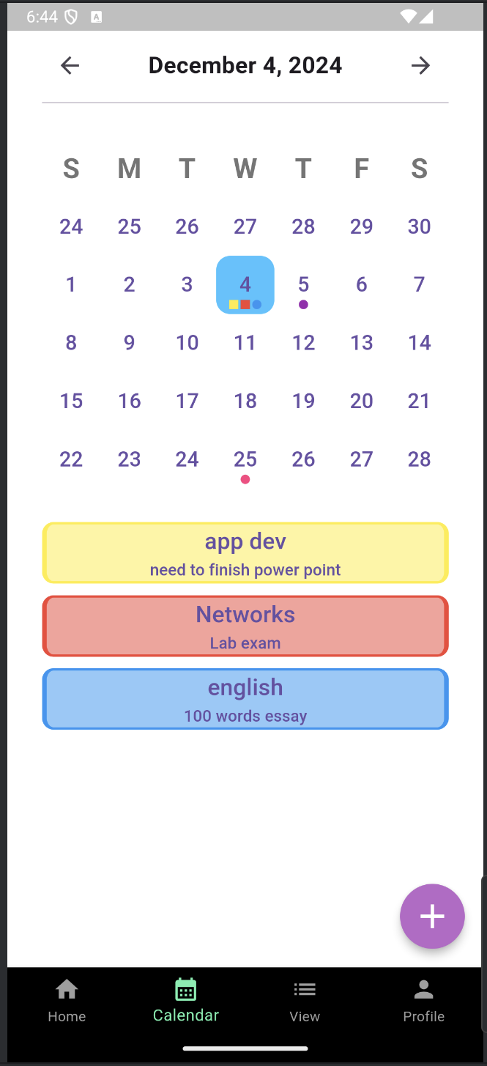
Calendar Page
Shows all tasks from the previous week until three weeks into the future.
The user can click a day to select it. The selected day will be displayed in grey, the full date will be on top of the screen and that day’s tasks will appear bellow the calendar.
At the bottom right, there is also the Add Task button.

Slide 11
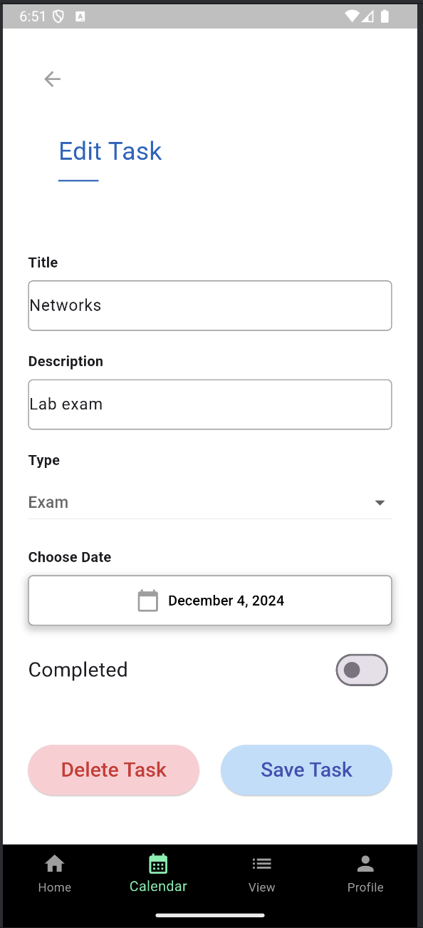
Task Page
This page lets users edit, delete or mark a task as complete.
A completed task will still be appearing the day’s list of tasks but the icon will not appear on the calendar.

Slide 12
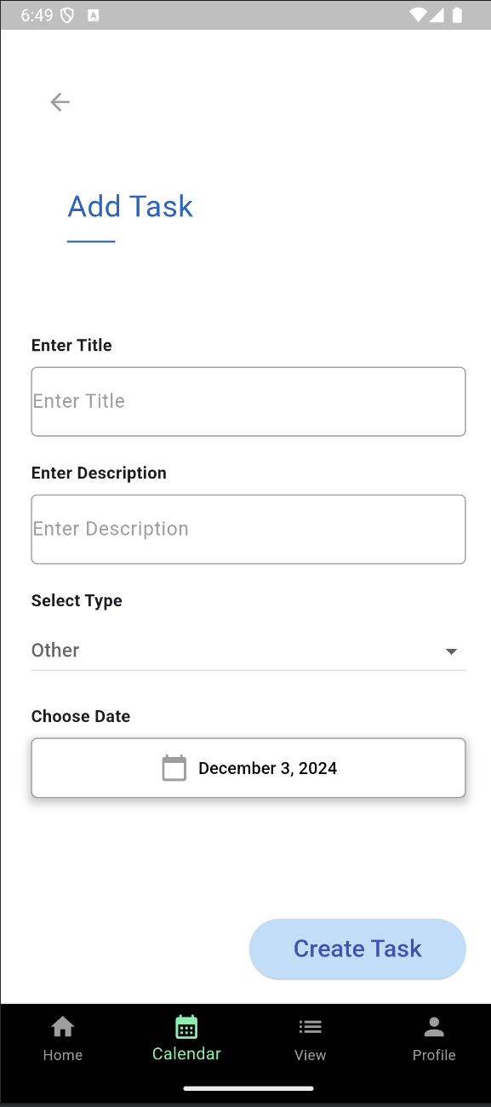
Add Task
The user can fill in the fields to add a task to the calendar.
The date will be pre-filled with the day the user was on when pressing the add task button.
There is also a Back button and a Save button.

Slide 13
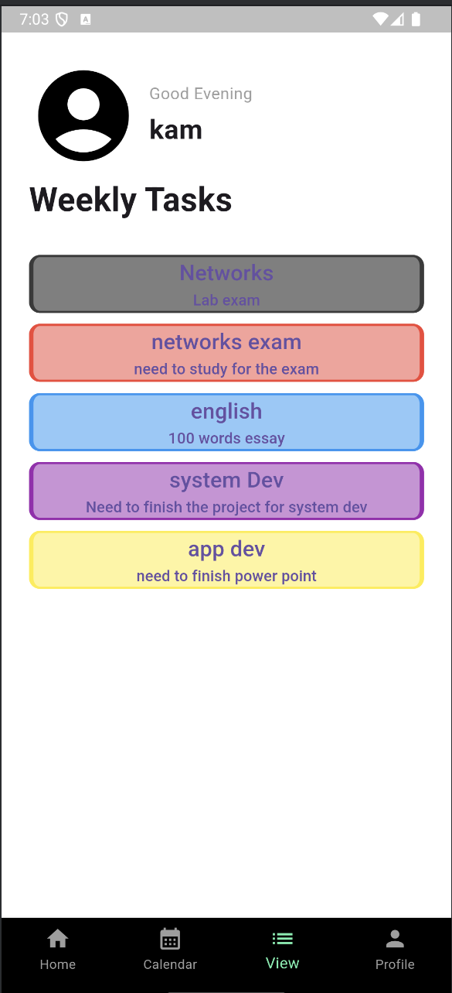
Upcoming Week
This page shows all upcoming tasks this week.

Slide 14
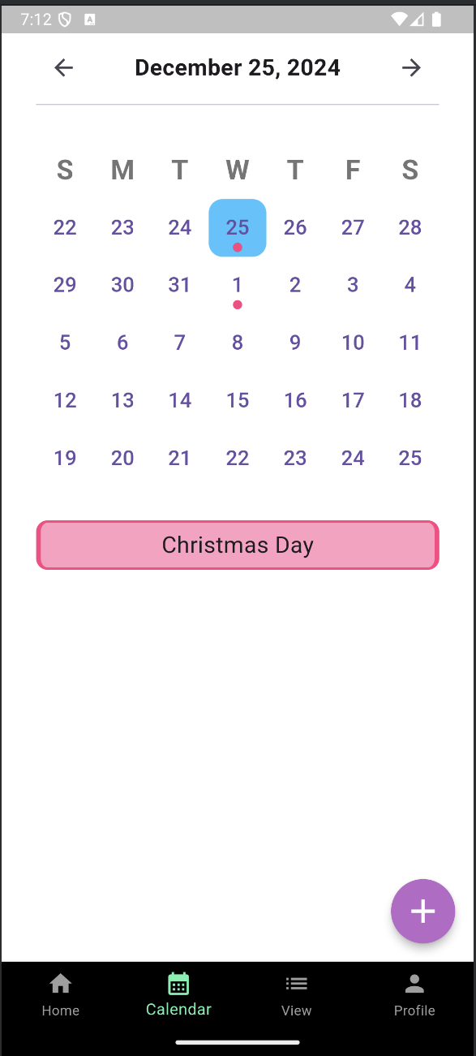
API
Used API to display important days or holidays

Slide 15
Determine which features to include and which to exclude from your project?
We chose to include only important and relevant features to keep our application simple.
We decided to leave out features that didn’t directly improve the user experience or add meaningful value to the app. Our goal was to keep things simple and focus on what truly matters to our users.

Slide 16
Future improvements
Notify 24h (customizable) before a task to remind to finish and submit
2FA
More profile customisation

Slide 17

Thank you!

