Slide 1
Academix
By Kamran Choudhry & Maxime Mir-Orefice

Slide 2
Introduction
“Academix” is a calendar/agenda application tailor made for students.

Slide 3
Database
We will be using SQLflite as our database for its simplicity.

Slide 4
Github
https://github.com/ItsMax123/Academixdemix

Slide 5
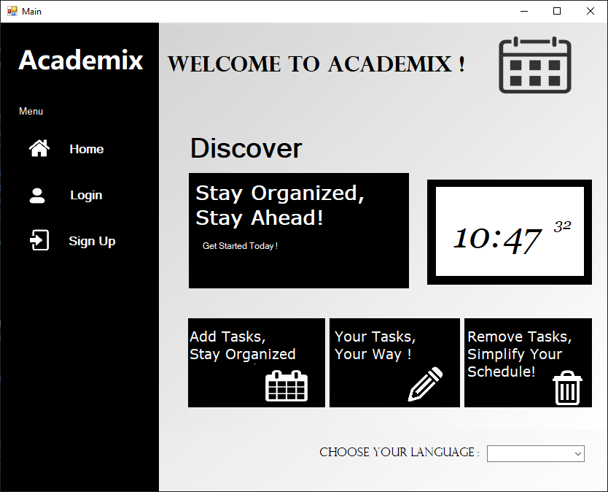
Home page
Shows general information about the application.
Allows users to log in or register.

Slide 6
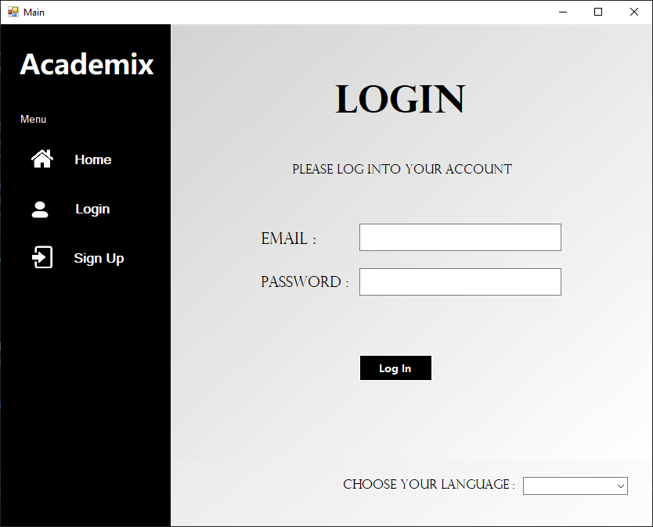
Log in
Let’s the user log into their account using their email and password.

Slide 7
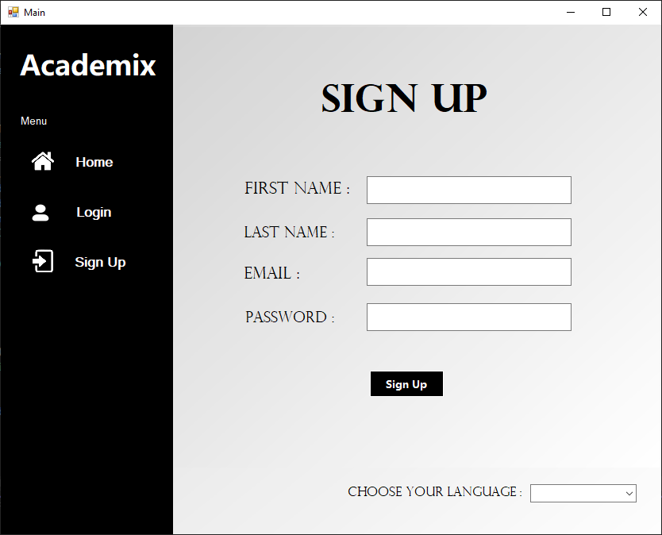
Register
Let’s the user create a new account using their first name, last name, email and password.

Slide 8
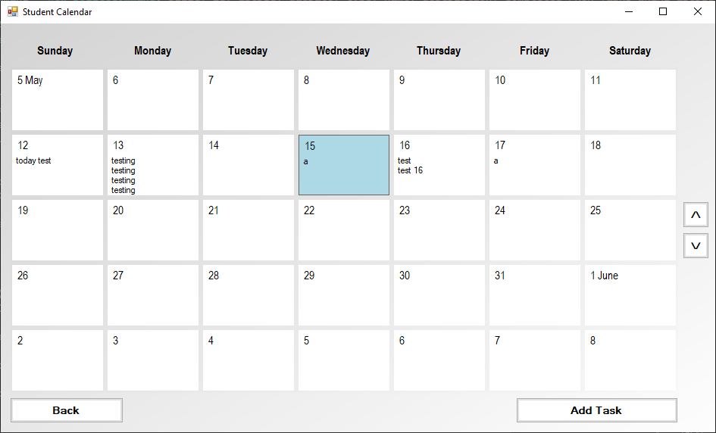
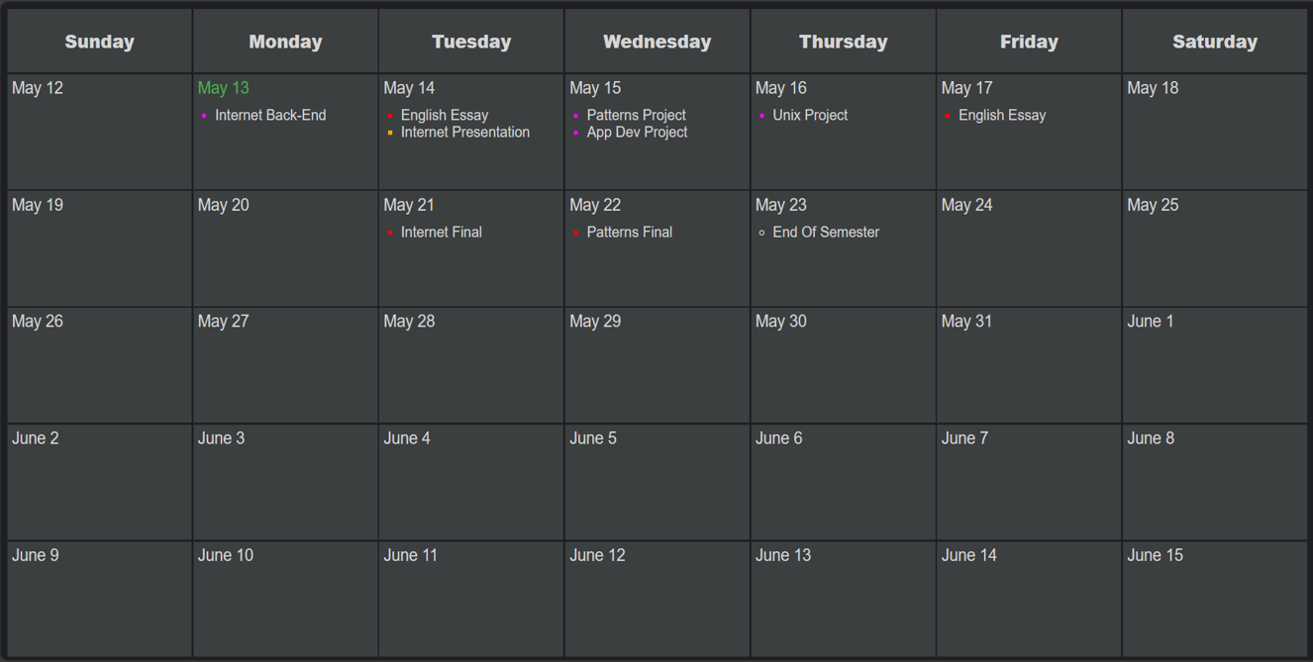
Calendar Page
Shows all tasks from the previous week to 3 weeks into the future.
The user can click a grid panel to go to that day’s page or add task page if there are no current tasks that day.
At the bottom, there is also the Add Task button and the Log Out button.
The current day is displayed in blue.

Slide 9
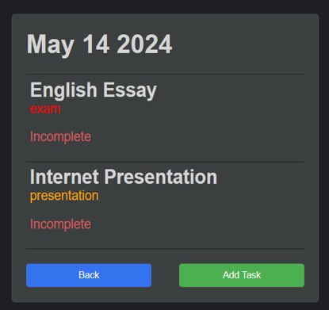
Day Page
This page contains all tasks with their information.
When clicking a task, the user goes to the Edit Task page for that task.
The user can scroll to see more tasks.
At the top, there is a Back button and a Add Task button.

Slide 10
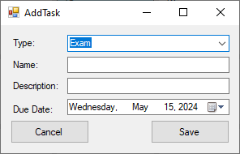
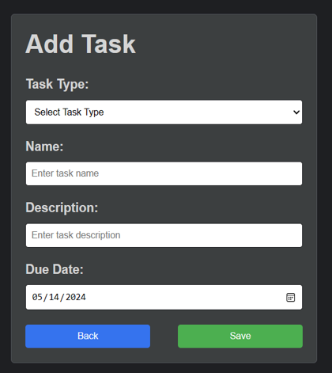
Add Task
The user can fill in the fields to add a task to the calendar.
There is also a Back button and a Save button.

Slide 11
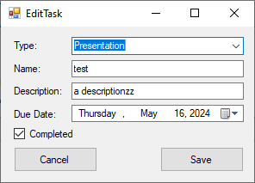
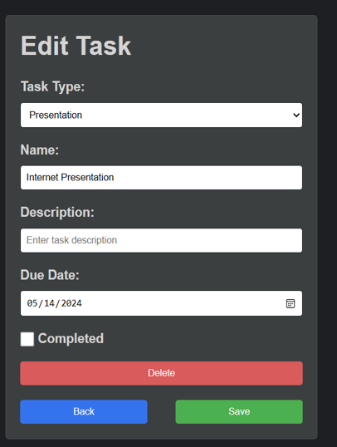
Edit Task Page
This page is like the Add task page, but the current task information is already filled in.
There is also a Mark As Completed checkbox, a Delete button, a Back button and a Save button.
The user can change the information and click the save button or cancel.

