Slide 1
Wander-Must
The must-have packing app

Slide 2
Traveling is already hard – make Packing easy
There are packing apps, and there are travel apps, but no one is giving you a social network to really know what to pack! Wander-Must is the app for both.
First – start a suitcase
Choose your destination
Choose your dates (weather api will let you know the weather)
Set your type of ravel: Luxury, Business, Vacation, Adventure
Next see a list of users suitcases for the same areas.
Shop their packing lists to add to you own.
Don’t see an item on their list? You can add one!
Note helpful remarks on their suitcases to help you pack
ex – Thailand women shouldn’t forget to bring a head scarf and something to cover their legs and shoulders for all the temples.
Update your suitcase by deleting things you don’t need, or didn’t use on your trip. Even add things you want to remember next time!

Slide 3
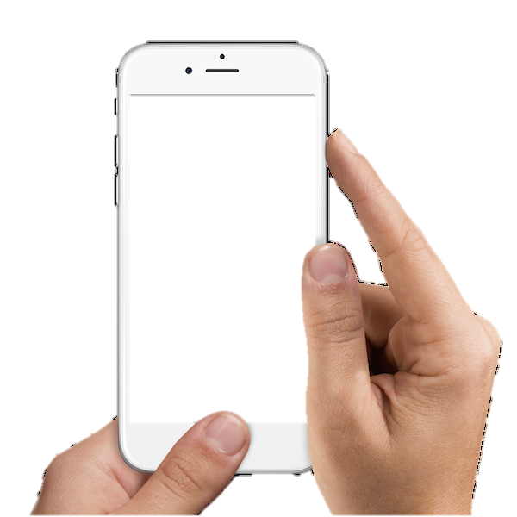



Set up Suitcase
Destination – Pull from Google maps!
Dates – Pull weather from almanac api
Travel Type – find users with your travel type.
Destination
Dates
Travel Type

Slide 4
Scroll others suitcases
14 Wanders have gone to:
BANGKOK
7 days - Luxury
14 days - Adventure
12 days - Business
7 days - Vacation
10 days - Adventure
21 days - Adventure

Slide 5
Scroll others suitcases
7 days - Luxury
Clothes: QTY
Shorts 3
Summer Dress 2
Pants 2
Tank Top 4
Blouse 2
Sweater 2
Underware 5
Bra 3
Shoes: QTY
Tennis shoes 1
Heels 1
Sandals 1
Add Selected

Slide 6
Requirements
Node & Express Web-Server
MYSQL Database with a Sequelize ORM
GET & POST Routes
Basic Testing Framework
Deployed using Heroku (with data)
1+ new library, package or technolog
Polished front /UI
MVC Paradigm Folder structure
Quality coding standards
Bonus!
Utilize Handlebars for server-side templating
Incorporate authentication
Use an existing public dataset to power the database
Create a migration strategy for sharing data among the team

Slide 7
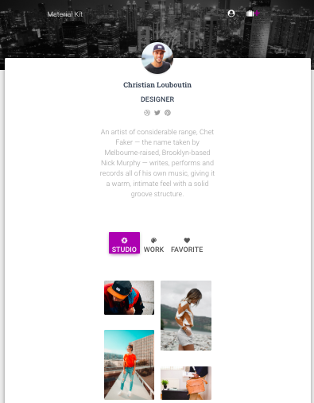
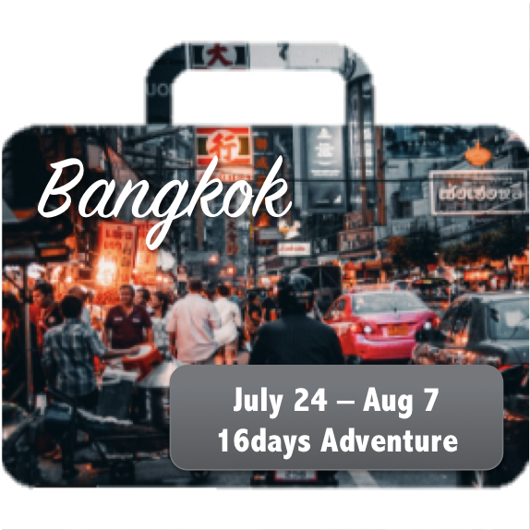
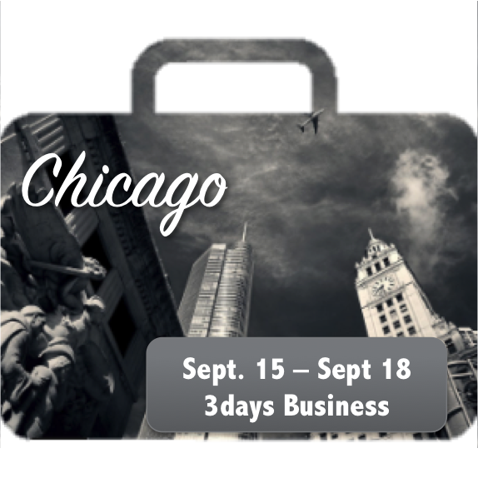

Slide 8



My Trips
Bangkok
Chicago
July 24 – Aug 7
16days Adventure
Sept. 15 – Sept 18
3days Business

Slide 10
SignUp/Login
Wayne w/ Passport
Persistent search bar

Slide 11





We can’t wait to see what you pack!

Slide 12
Upgrade
React – sql retrieval – Xander & B
Axios???? & Mern
Cloudinary – Sam
Travel Deals - Evan
Passport – using react state - Wayne
Finishing CRUD operations - Molly
Persistent Search
Mongoose for social components/chats
Social Wall

