Slide 1
Wander-Must
The Must Have Packing App

Slide 2

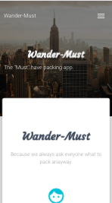
Because you were going to ask what to pack anyway…

Slide 3
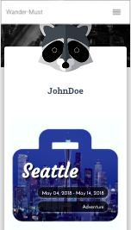
Get a profile and share your packing list…
Easy right?!?!
Sure! For the user…

Slide 4
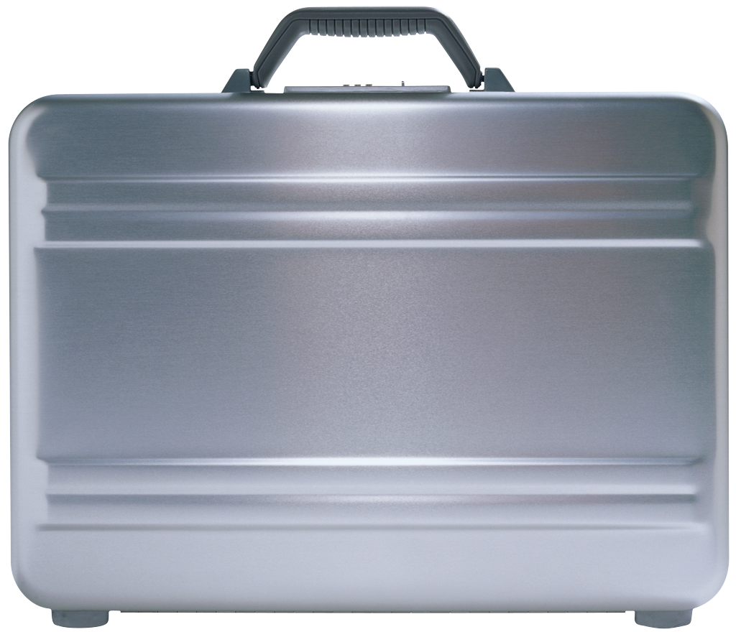
How to Develop a database for everything
Users
Items
Suitcases
Cities
Packing
That’s a lot of info

Slide 5
Users
Associate
Has many!
(Suitcases)
Can be created, destroyed and altered.
ID
Username
Email
Spirit Animal (image)
Password
Gender
Routes

Slide 6
Cities
Associate
Has many!
(Suitcases)
Can be created.
Routes
ID
City
State/Providence
Country

Slide 7
Items
Associate
Item Belongs to many!
(Suitcase Items)
And can be created… less often destroyed.
Routes
ID
Item name
Item Category

Slide 8
suitcases
Associate
Belongs to & Belongs to many!
(User, City, Suitcase Items)
And can be created, destroyed and altered.
ID
Start Date
End Date
Travel Category
Notes
City ID
User ID
Routes

Slide 9
Packing
Associate
I only exist because everything else exists.
I get deleted with the Suitcase.
I get created with the suitcase. I’m very co-dependent.
Routes
Item ID
Suitcase ID

Slide 10

Packing

Slide 11
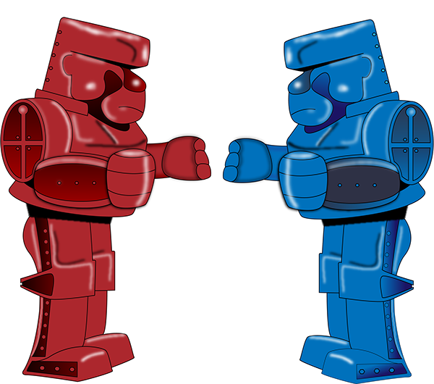
HTML vs. API
Routes
DATABASE CALLS AF

Slide 12

We Can Almost Build a Suitcase
Where do you want to go?

Slide 13
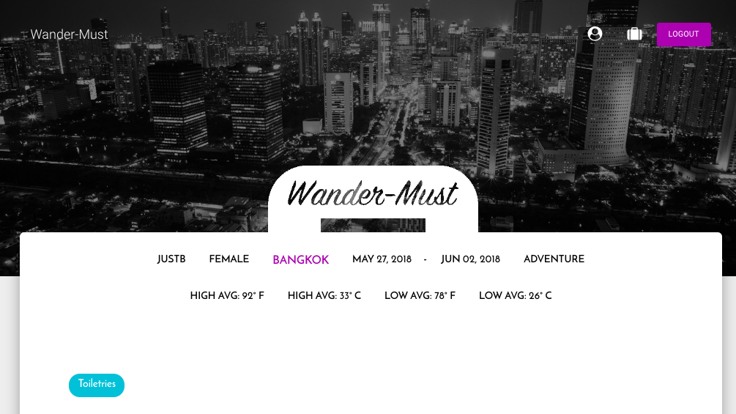
API’s for user experience
Weather Underground
Give them the high and low temperatures!

Slide 14
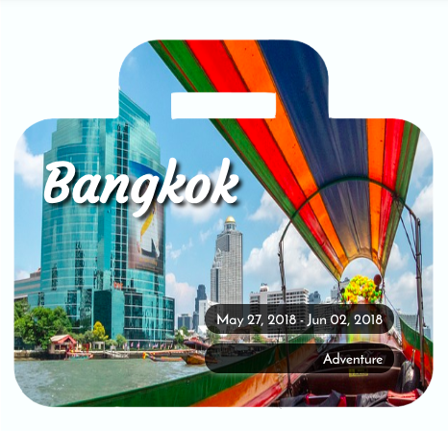
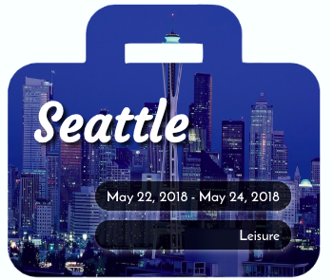

API’s for user experience
Pixabay
So pretttttttyyyyyy….

Slide 15


Passport – Not the travel Kind
Node JS Passport

Slide 16
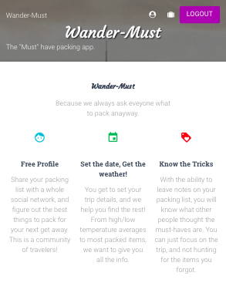
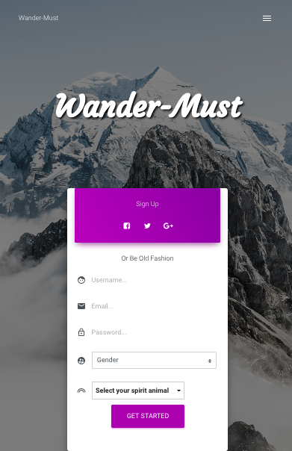
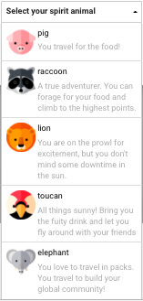
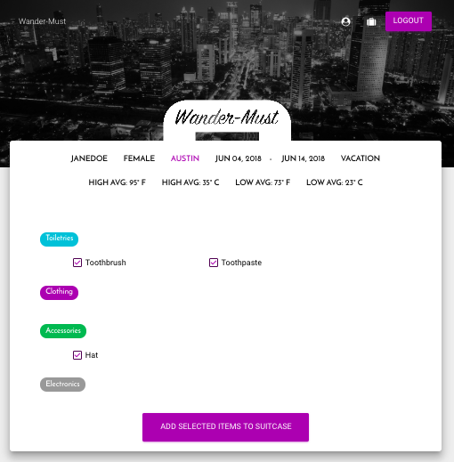
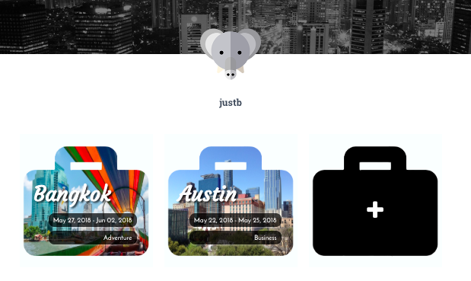
Clean, Fun,
A little Feminine.

Slide 17
The Future of
Wander-Must
Host photos on your profile
Have multiple cities for one trip
Add qty of items to your packing list
Let brands host branded packing items
Offer as a plugin to travel sites
See the world through a Wander-Luster .

Slide 18





We can’t wait to see what you pack!
Wander-Must

