Slide 1
Wander-Must
The must-have packing app

Slide 2





Traveling is already hard – make Packing easy
There are packing apps, and there are travel apps, but no one is giving you a social net work to really know what to pack! Wander-Must is the app for both. – Well, it’s about to be!
Coder(s): Xander & B
Convert to React to increase app efficiency and eliminate jQuery
Coder: Molly
Convert to GraphQL for better control over the data
CRUD completion (add items)
Coder: Wayne
Increase ease of login with Passport
Coder: Evan
Add API for local traveling made more fun
Auto-complete to add items
Coder: Sam
Increase customization with photos set for the suitcase
Extra
Increase social interaction with notes and post wall.
Allow users to change cover photo
Persistent search
We can’t wait to see what you pack!

Slide 3
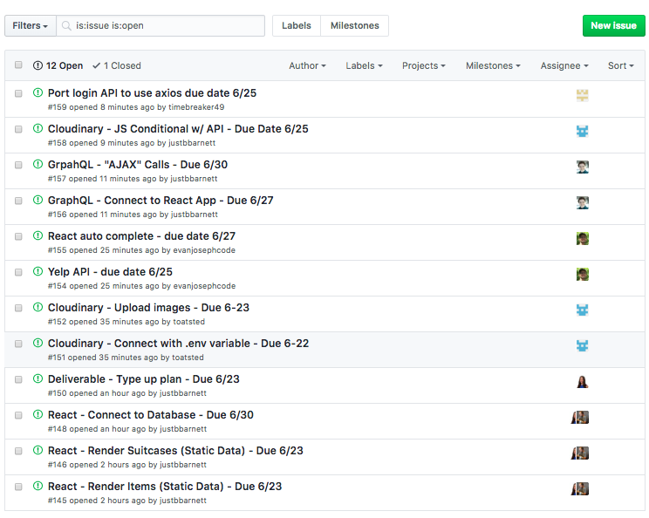

Staying on track!– GH Pages w/ Issues

Slide 4
Schedule!– outline of deadlines
Monday | Tuesday | Wednesday | Thursday | Friday | Saturday | Sunday
Week 1
11 | 12 | 13 | 14 Xander & B – Pages in recat MEET-UP 5:30p – 9:30p Assign tasks and prepare plan | 15 | 16 B – typed Plan | 17 MEET-UP 2:30p – 3:30p
Week 2
18 | 19 | 20 Xander – Render Items B – render suitcases | 21 MEET-UP 5:30p – 9:30p Set up GH and assign issues | 22 Sam – Cloud code with .env | 23 Sam – Cloud code to upload images | 24 MEET-UP 2:30p – 3:30p
Week 3
25 Wayne – Passport Axios Sam – Cloud JS Cond Evan – Yelp API | 26 Wayne – Routes Auth | 27 Molly – Connect GraphQL to React App | 28 MEET-UP 5:30p – 9:30p Evan – React Auto-Complete | 29 Xander & B – Connect React to Database Sam – Connect to Database Wayne – Social login | 30 Molly – GraphQL Calls | 1 MEET-UP 2:30p – 3:30p
Week 4
2 MEET-UP After Class | 3 B - work on any CSS issues Wayne – handeling isLoggedIn | 4 | 5 MEET-UP 5:30p – 9:30p Test functionality and work on bugs | 6 | 7 Group – Bug fixes loaded to GH Wayne – Passing error messages | 8 MEET-UP 2:30p – 3:30p
Week 5
9 B – Power Point | 10 | 11 | 12 MEET-UP 5:30p – 9:30p Work on bugs Begin Presentation practice | 13 MEET-UP 5:30p – 9:30p Work on Presentation | 14 PRESENTATIONS

Slide 5
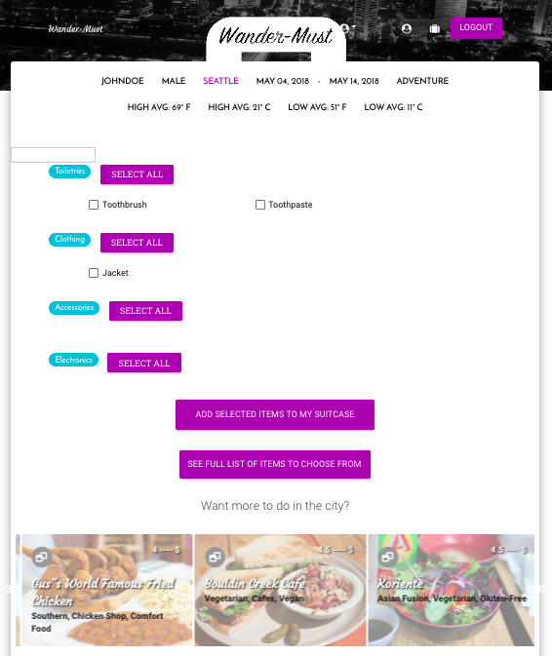
Title: My Days in Seattle
Notes:

