Slide 1
Wander-Must
The Must Have Packing App

Slide 2

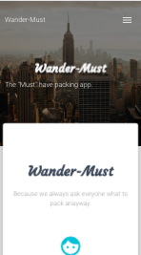
Because you were going to ask what to pack anyway…

Slide 3
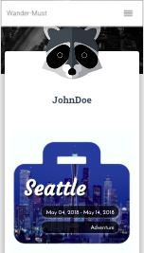
Get a profile and share your packing list…
Easy right?!?!
Sure! For the user…

Slide 4
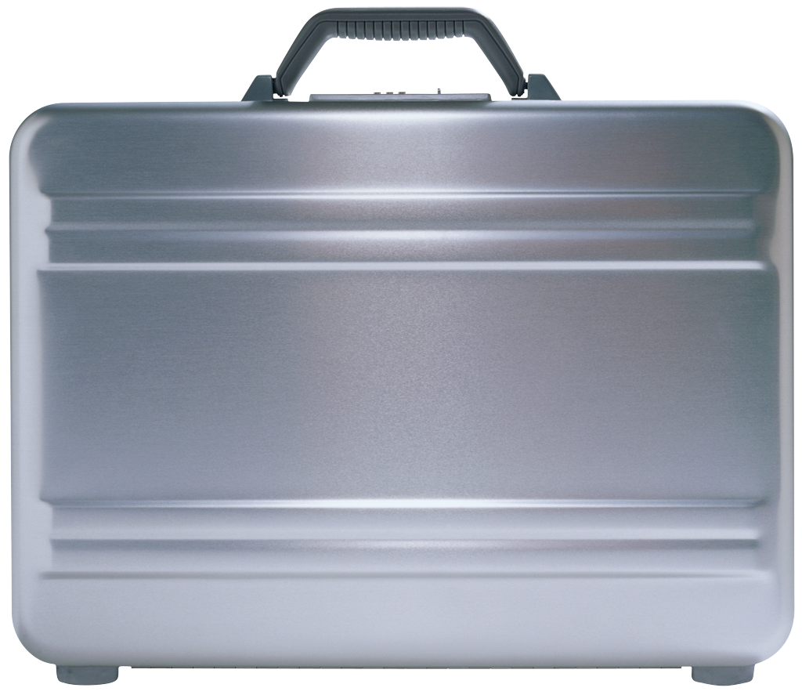
How to Develop a database for everything
Users
Items
Suitcases
Cities
Packing
That’s a lot of info

Slide 5
Users
Associate
ID
Username
Email
Spirit Animal (image)
Password
Gender
Has many!
(Suitcases)
Can be created, destroyed and altered.

Slide 6
Cities
Associate
Has many!
(Suitcases)
Can be created.
ID
City
State/Providence
Country

Slide 7
Items
Associate
Item Belongs to many!
(Suitcase Items)
And can be created… less often destroyed.
ID
Item name
Item Category

Slide 8
suitcases
Associate
ID
Start Date
End Date
Travel Category
Notes
City ID
User ID
Belongs to & Belongs to many!
(User, City, Suitcase Items)
And can be created, destroyed and altered.

Slide 9

Packing
Associate
I only exist because everything else exists.)
I get deleted with the Suitcase.
I get created with the suitcase. I’m very co-dependent.
Item ID
Suitcase ID

Slide 10

We Can Almost Build a Suitcase
Where do you want to go?

Slide 11
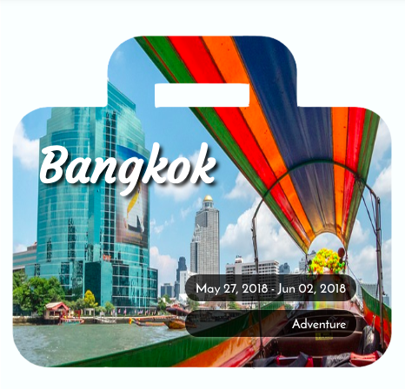
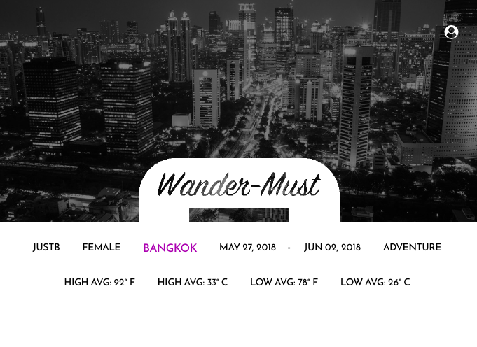
API’s for user experience
Pixabay
Weather Underground

Slide 12

Passport – Not the travel Kind
Node JS Passport

Slide 13
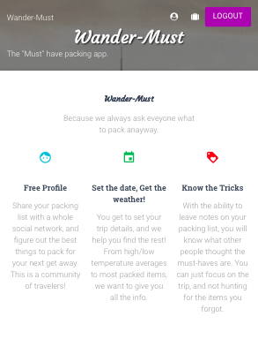
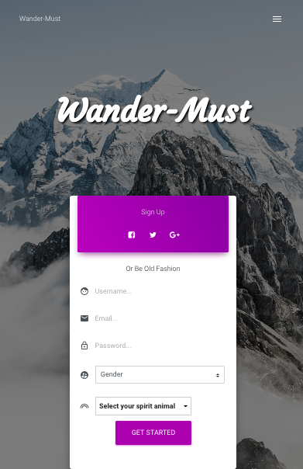
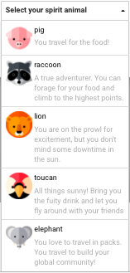
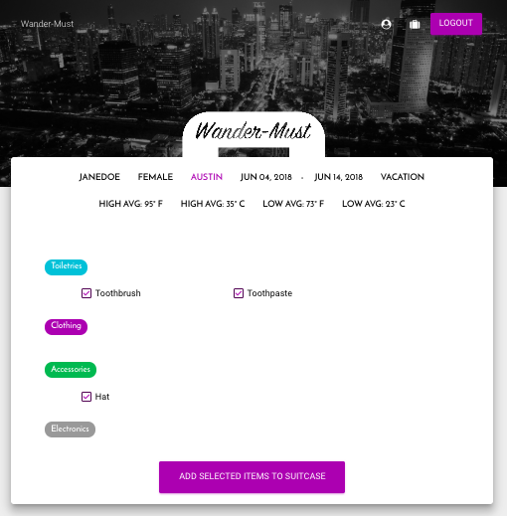
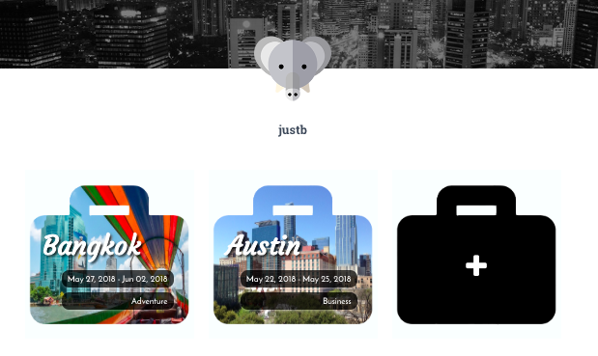
Clean, Fun,
A little Feminine.

