Slide 1
Secure Data Hiding In Images Using Steganography
CAPSTONE PROJECT
Presented By: Muhammad Aftab
Student Name : Muhammad Aftab
College Name & Department : Institute of Aeronautical Engineering / IT

Slide 2
OUTLINE
Problem Statement
Technology used
Wow factor
End users
Result
Conclusion
Git-hub Link
Future scope

Slide 3
Problem Statement
In the modern digital landscape, safeguarding data security and privacy is more critical than ever. Conventional encryption techniques, while effective, can often attract unwanted attention and be susceptible to interception. Our project addresses this issue by leveraging steganography—a technique that embeds secret messages within images. This approach provides a discreet and secure means of communication, ensuring sensitive information remains hidden in plain sight. By concealing data within visual media, our method enhances confidentiality while minimizing the risk of detection, making it an ideal solution for secure information exchange.

Slide 4
Technology used
Programming Language: Python
Libraries:
OpenCV for image processing
Tkinter (with ttk) for the GUI
NumPy for efficient array manipulation
Platform: Cross-platform (Windows/Linux)
Tools: Visual Studio Code

Slide 5
Wow factors
Utilizes a robust LSB steganography approach to securely embed both the passcode and message length within the image header.
Employs a lossless PNG format to ensure the integrity of hidden data is maintained. Incorporates a sleek, user-friendly GUI for seamless encryption and decryption.
Merges advanced image processing techniques with secure data transmission to enhance confidentiality and reliability.
Features a modern, user-friendly GUI for both encryption and decryption processes.
Combines advanced image processing techniques with secure data transmissio

Slide 6
End users
Ideal for security professionals and cybersecurity enthusiasts seeking advanced data protection.
Beneficial for journalists, activists, and government agencies requiring covert communication methods.
Valuable for students and researchers exploring data privacy and steganography techniques. Suitable for general users looking to enhance their digital security and confidentiality.
Security professionals and cybersecurity enthusiasts.Journalists, activists, and government agencies needing secure communication channels.
Students and researchers interested in data privacy and steganography.
General users looking for enhanced digital security.

Slide 7
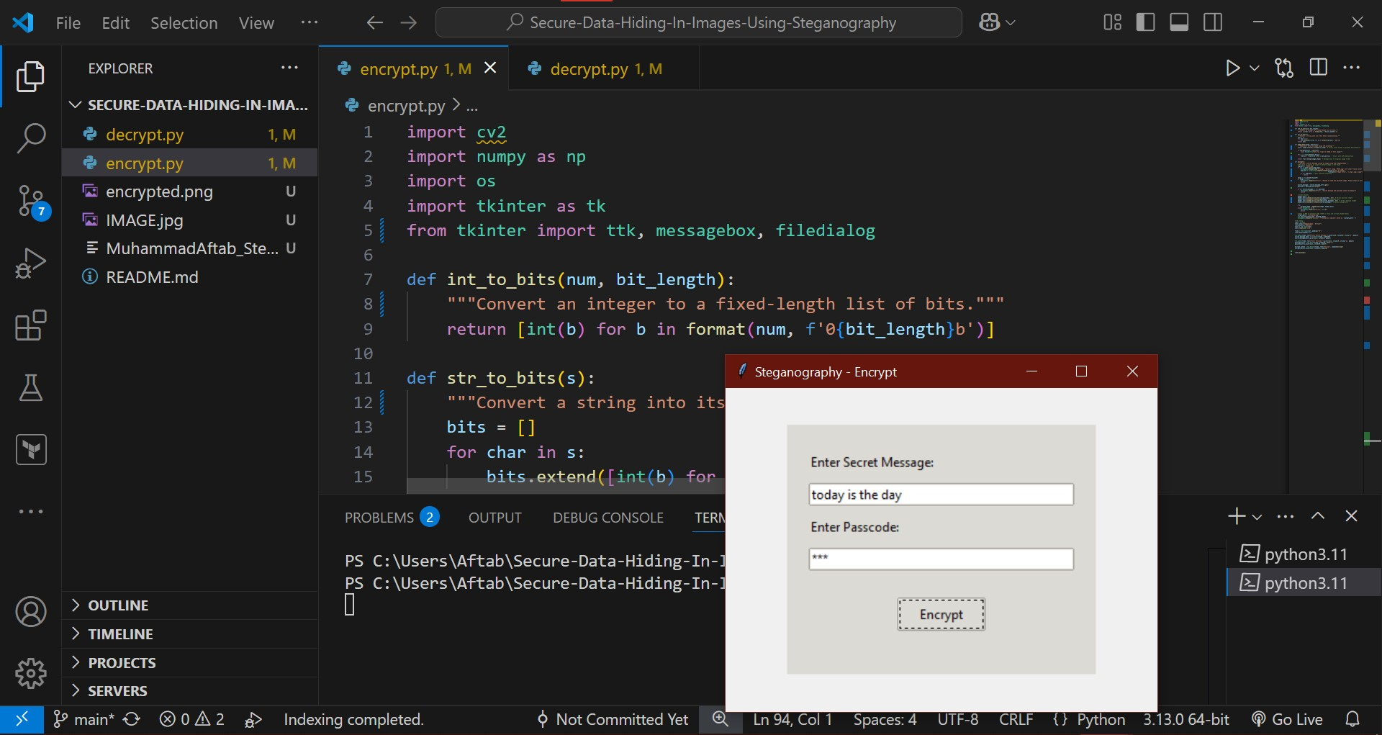
Results

Slide 8
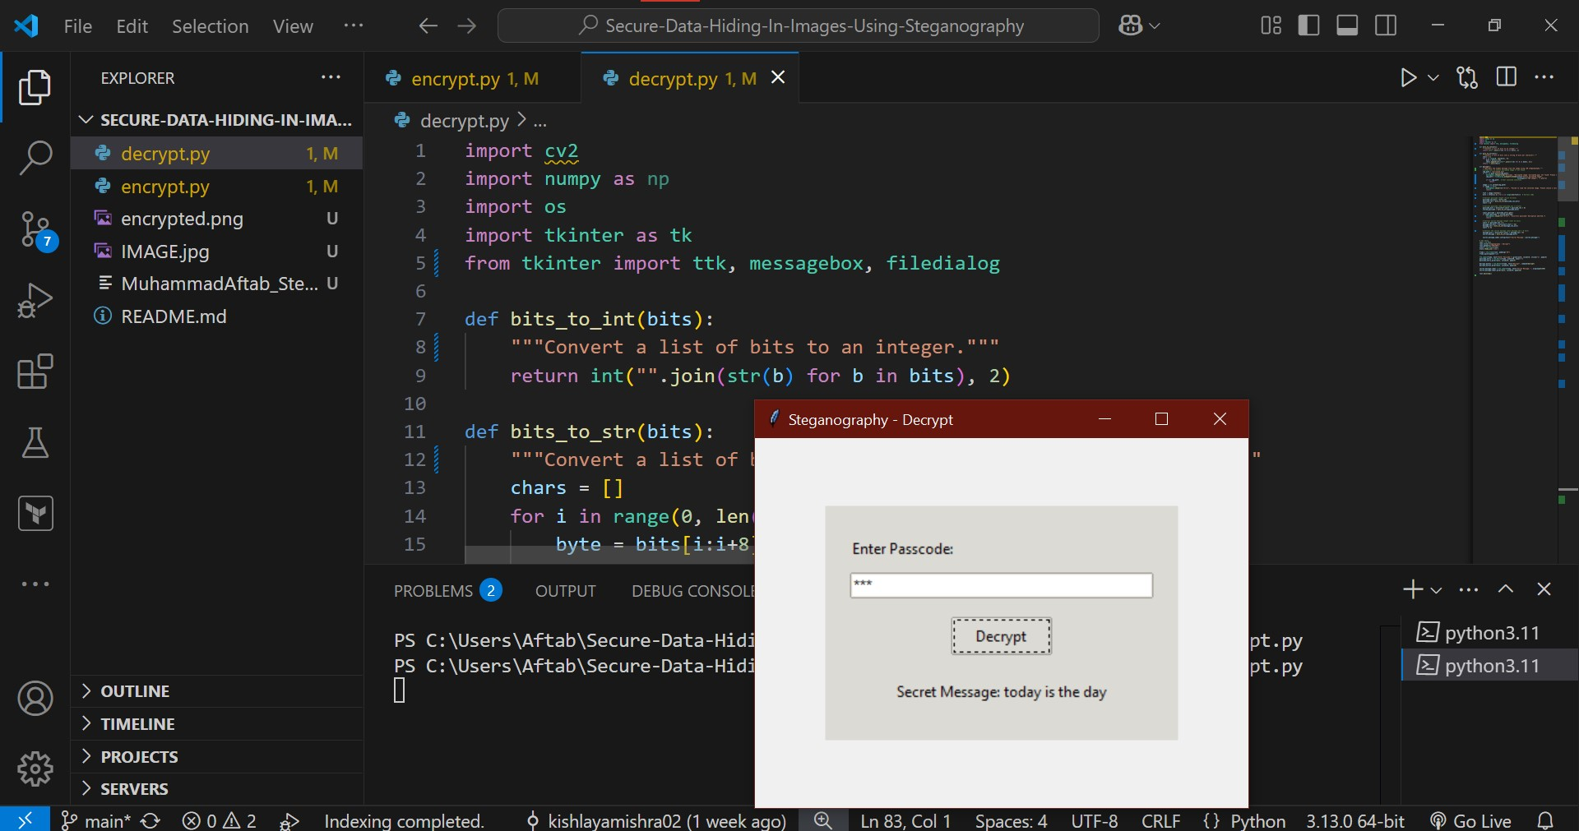
Result

Slide 9
Conclusion
Our project effectively showcases an innovative approach to data security by embedding information within images using LSB steganography.
This method ensures both security and stealth by incorporating critical header details such as passcode and message length.
The intuitive, user-friendly GUI enhances usability, making secure communication more accessible. By integrating advanced steganographic techniques, this project contributes to the growing field of digital privacy and secure data transmission..

Slide 10
GitHub Link
https://github.com/ItsMdAftab/-Secure-Data-Hiding-In-Images-Using-Steganography.git

Slide 11
Future scope(optional)
Enhance compatibility by supporting multiple image formats and higher-resolution images.
Expand the technique to video steganography, enabling dynamic and secure data hiding.
Integrate advanced encryption algorithms to further strengthen message security.
Develop a web-based or mobile application to improve accessibility and usability.
Investigate automated detection and extraction tools for analyzing steganographic content.

Slide 12
THANK YOU

