Slide 1
Online CarRental System
Presented By:
Arbin Maharjan
Praful Shrestha

Slide 2
Introduction
Online Car Rental System is a web-based application to enhance the growth of booking car onlines and making it easier for car renters to book the car of their choice.
This system aims to modernize and streamline essential processes, from booking and inventory management to customer interactiona and business analytics.
This process is a response to the need for a centralized, automated platform that enhances the effectiveness of car rental businesses.
Traditional car rental operations often graple with challenges such as manual booking processes, inventory management complexities and a lack of centralized systems to monitor vehicle status and customer interactions.

Slide 3
Objectives
To enhance business processes.
Online vehicle reservation.
Customer’s registration.
Group Bookings

Slide 4
Limitatations
Unavailability of mobile application.
Requires a moderate internet speed.

Slide 5
Problem Statement
Lack of computerized database management system.
Vulernable to system crash or data loss.
Service may slow down due to the increase in number of users.
Car Renter must contact the car rental company for booking their cars.

Slide 6
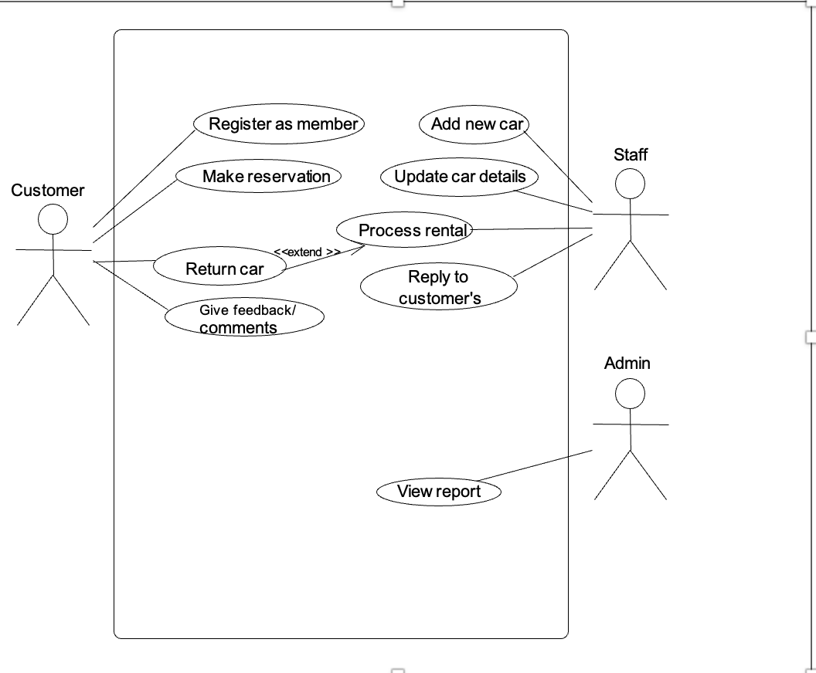
Use Case Diagram

Slide 7
Future Recommendations
Limitations of geographical location can be eliminated.
Offer contactless rental experiences.
Implement blockchain technology.

Slide 8
Conclusion
This project will be really helpful for solving the issues of car rental system.
The integration of cutting-edge technologies like AI-driven platforms, IoT for vehicle mangement will redefine the rental process.
People can rely on this system to rent a car.

