Slide 1
Image Segmentation
By: Jimmie Cox and Vichaka Houi

Slide 2
Topic Introduction (Image Segmentation)
What is Image Segmentation?: Image Segmentation (Similar to Image Classification) is the process in which an image’s individual pixels are segmented into different classes. Essentially each pixel gets associated to some class rather than the entire image getting associated with a class which is Image Classification.
Problem: Taking a terrain and height (grayscale) image and trying to classify each pixel to either the water, grassland, forest, hills, desert, mountain, or tundra class. We then compare this to our ground truth segmentation image provided by the dataset.
Motivation: Can be used for identifying environment changes over time
Solution: Tried 3 different models: Support Vector Machine, Random Forest, and KNN.

Slide 3
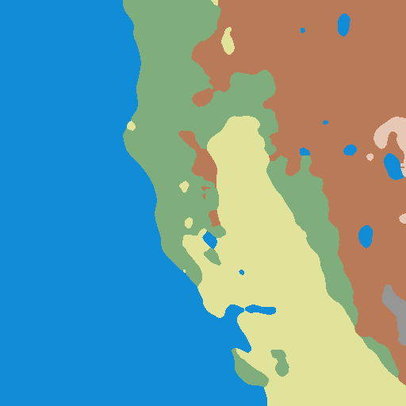
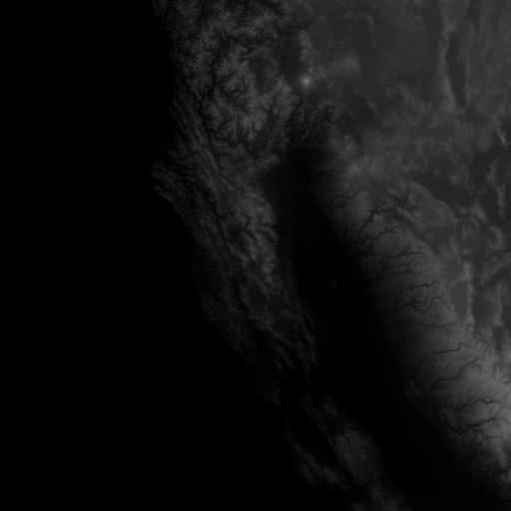
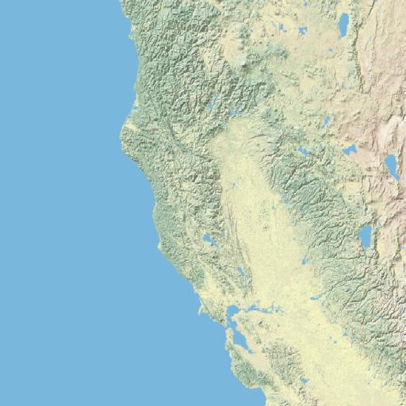
Dataset
Where: “Earth Terrain, Height, and Segmentation Map Images” by Thomas Pappas on Kaggle
Size: 15k Images (3k used); 1k groups
Explanation: This dataset holds terrain, height, and segmentation images.
Ground Truth: The segmentation images given

Slide 4
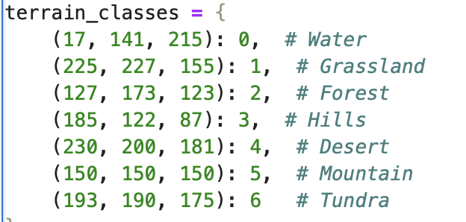
Preprocessing Dataset
Loading in Data: We loaded the images from the dataset and separated the images into groups. The groups are as follow: ####_h for height, ####_i2 for segmentation and ####_t for terrain images.
Terrain and Segmentation images were loaded in color and the height images were loaded in grayscale.
Resizing Images: For all models we used 64x64 pixels value.
Extracting Features: From the height and terrain image, we were able to extract the rgb values from the terrain images (3 channels; rgb) and the height (1 value between 0 and 255).

Slide 5
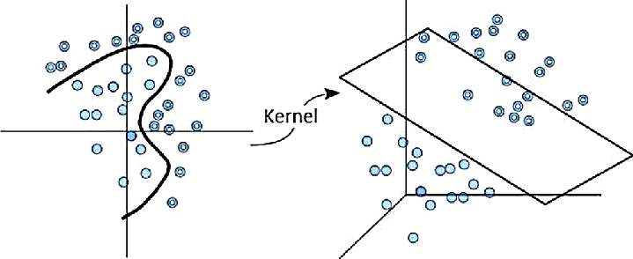
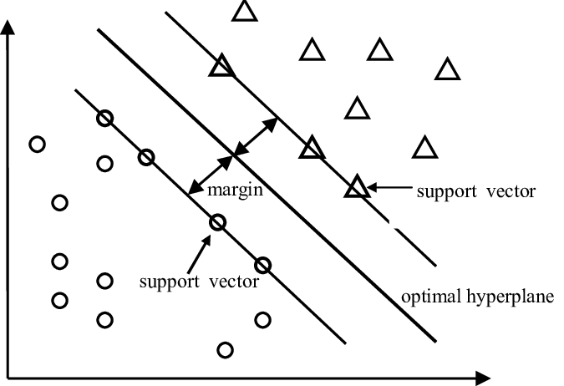
Model 1 Support Vector Machine (SVM)
What is it?: A machine learning algorithm that focuses on finding a hyperplane between the different classes to classify datapoints on either side of this hyperplane. And we want to maximize the margin between the closest datapoint on each side.
In our case though, since we are working with both rgb values and height (4 features), we are working with non-linear relationships.
How does it work?: The most important part of the SVM in our case is the kernel. We chose the RBF (Radial Basis Function (Gaussian Kernel) because of its fast convergence rate and its ability to work on non-linear relationships.
Specifically from what I’ve read online, the RBF allows the data to be mapped into a higher-dimensional space rather than a 2D one that is easier to visualize.
Ex: Like maybe the water and grassland have a similar color(they don’t but if they did), we can differentiate them by also looking at height which would cause us to be in a higher dimensional plane.
Why use Support Vector Machines?: The main reason we chose to use the SVM is because SVM is great for smaller datasets and is computationally faster than other methods. That is the primary reason.
Parameters: Kernel (RBF), C (Tradeoff in Generalization), and Max Iterations (1000)

Slide 6
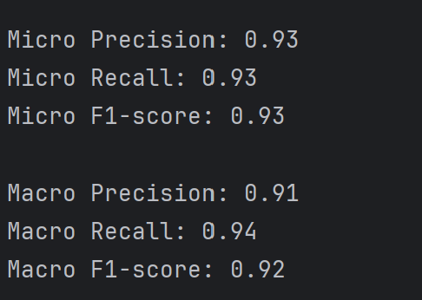
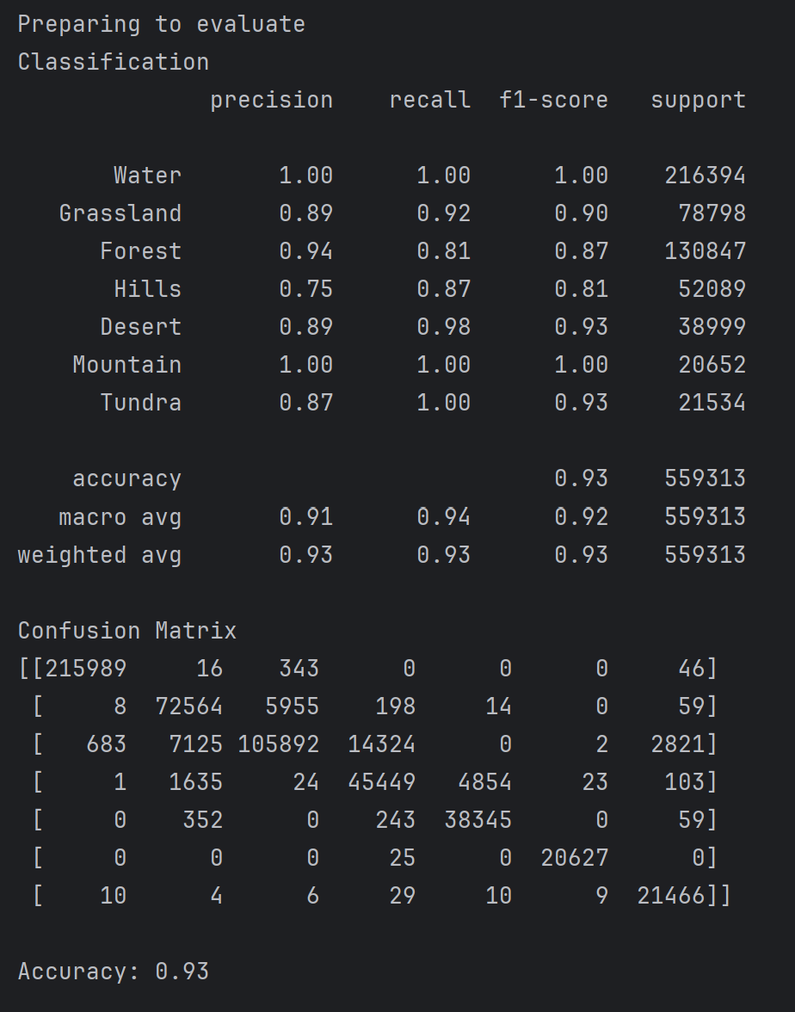
Results and Evaluation
Results: Transformed Images to 64 x 64
Overall Accuracy: 0.93 or 93%
Best Classes for Precision and Recall: Water and Mountain
Important to Consider: After a lot of evaluating and consideration, I did realize there is a large imbalance in support between classes.
Support meaning the number of training pixels labeled as that specific class.
Water: 216,394 and Mountain: 20,652
This could potentially lead to a skewed accuracy from my understanding because water will contribute more to the overall accuracy.

Slide 7
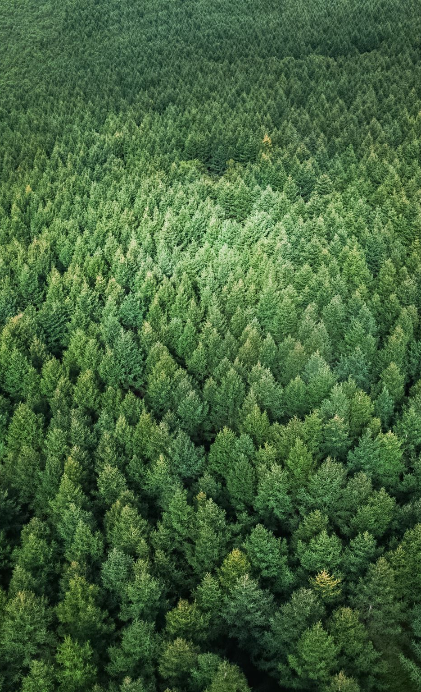
Model 2 Random Forest
What is it? A type of ensemble learning that builds multiple decision tree during training and merges their outputs by majority voting for classification.
How does it work? Random forest takes multiple subsets of training data that gets randomly sampled to make each decision tree train on different subsets of data.
Why use random forest? Random forest is capable of handling high dimensional data effectively. And the randomness in it helps present overfitting.

Slide 8
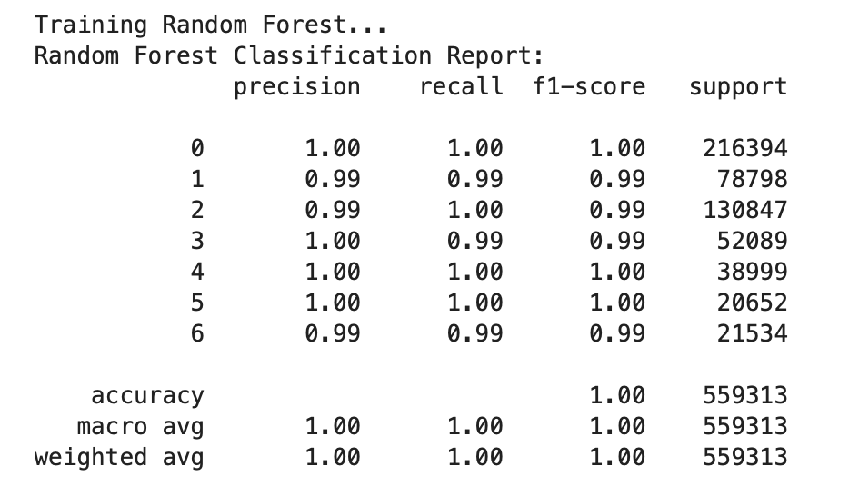
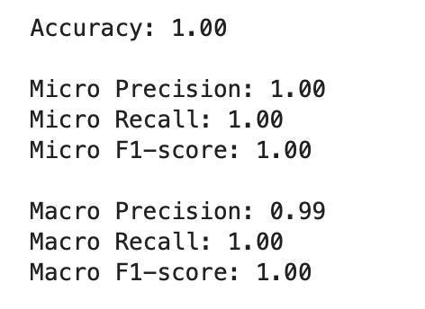
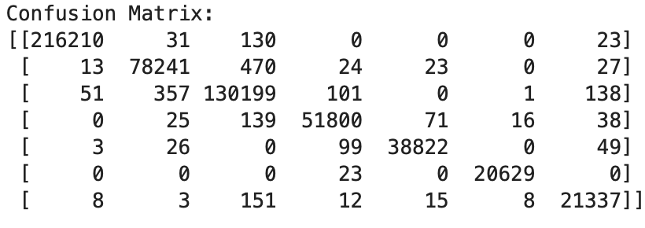
Results and Evaluation

Slide 9
Model 3 KNN
What is it? A classification model that makes predictions by finding the “k” nearest data points to a specific point and making decisions based on the majority class.
How does it work? We extract features such as the RGB values from the terrain, and height from height images. We use the mask image to create class identification. We use RGB values to help identify a unique area of terrain and height adds more details to finding that terrain.
Why use KNN? KNN appeared to be valid option if we chose to work with a somewhat small dataset. We also believed that it was straightforward to implement and understand.

Slide 10
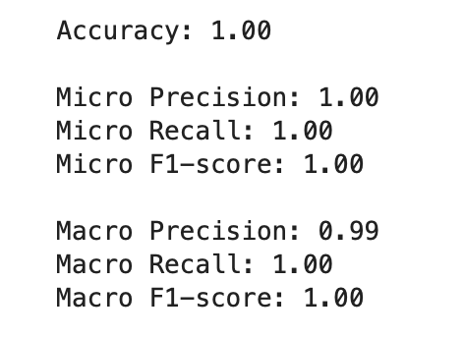
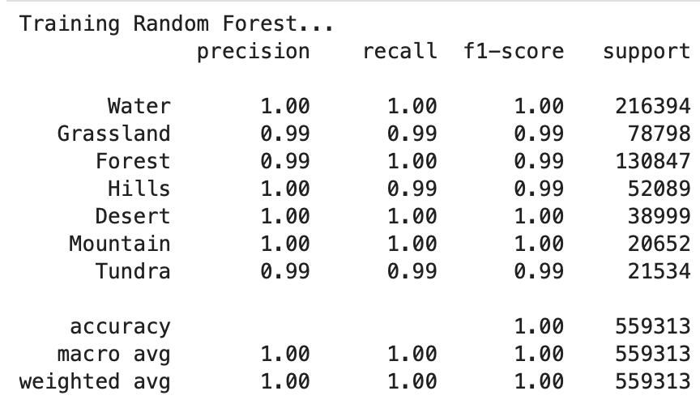
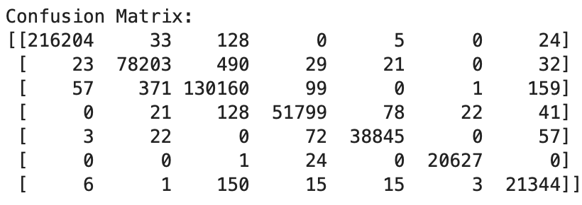
Results and Evaluation

Slide 11
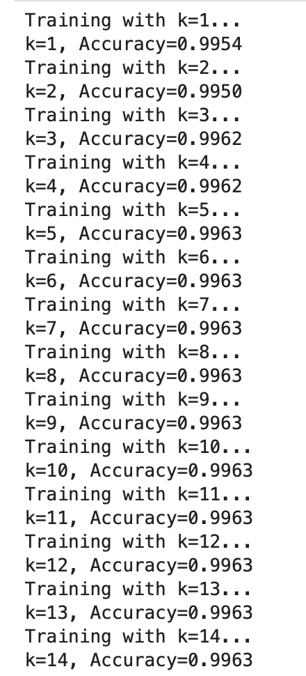
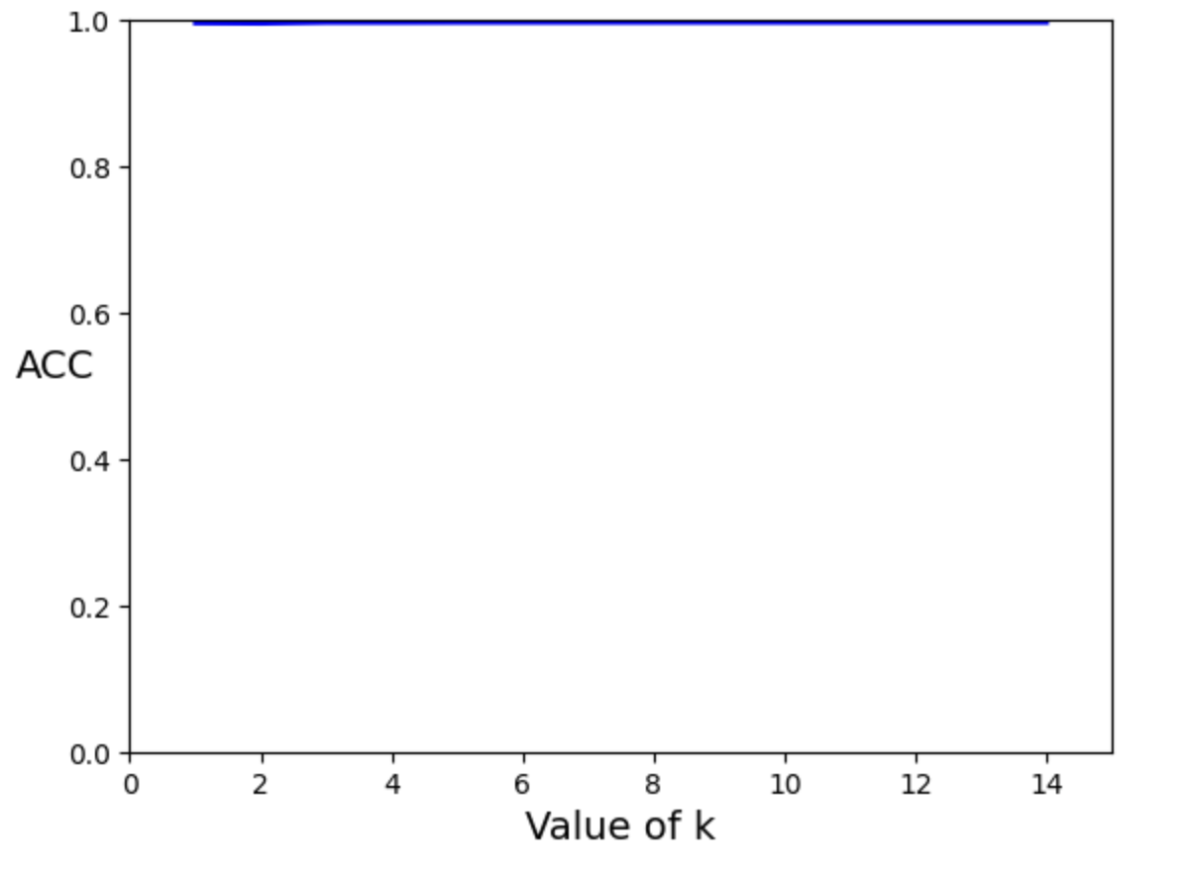
Results continued

Slide 12
Comparison
Support Vector Machine (SVM)
Accuracy: 93%
F1-Score Macro: 92%
F1-Score Micro: 93%
Random Forest
Accuracy: 99.63%
F1-Score Macro: 100%
F1-score Micro: 100%
KNN
Accuracy: 99.63% (with k=5)
F1-Score Macro: 100%
F1-score Micro: 100%

