Slide 1

WeBWorK In Introductory Statistics Course (STAB22)
Sohee Kang
University of Toronto Scarborough
soheekang@utsc.utoronto.ca

Slide 2
Outline
Key features and demonstration of WeBWorK
Case study with STAB22H3
Gamification Attempt in WebWork and result
Future development plan – Project Idea
Q & A

Slide 3
Course Structure
STAB22 (Statistics I) : First year course for general disciplines
Term | Enrollment
2015 Fall | 871
2016 Winter | 917
2016 Fall | 654
2017 Winter | 631

Slide 4
Homework “reinforces class work, fosters student initiative, independence, and responsibility, and increases the engagement”
(Cooper, 2008), (Bonham, Deardorff &
Beichner, 2003)
Effective way for students to practice problem solving skill.
Traditional paper based homework will not work for large classes: takes too much time to grade and students receive the feedback.

Slide 5
WeBWorK Key Features
Making homework more effective and efficient.
It is effective by:
Providing students with immediate feedbacks.
Providing students with individualized versions of problems.
It is efficient by:
Providing automatic grading of assignments
Providing performance information of students and course

Slide 6
WeBWorK Key Features
WeBWorK's National Problem Library contains more than 23,000 questions covering trigonometry, college algebra, pre-calculus through calculus, linear algebra, differential equations, vector calculus, complex variables, probability, statistics, and other subjects.

Slide 7
WeBWorK Problem Set Demo
Trying out the site
http://math.utsc.utoronto.ca/webwork2/
Students can download a hardcopy of problem sets.
Students can submit their answers to receive the immediate feedback and make infinite trials until the homework due date.

Slide 8
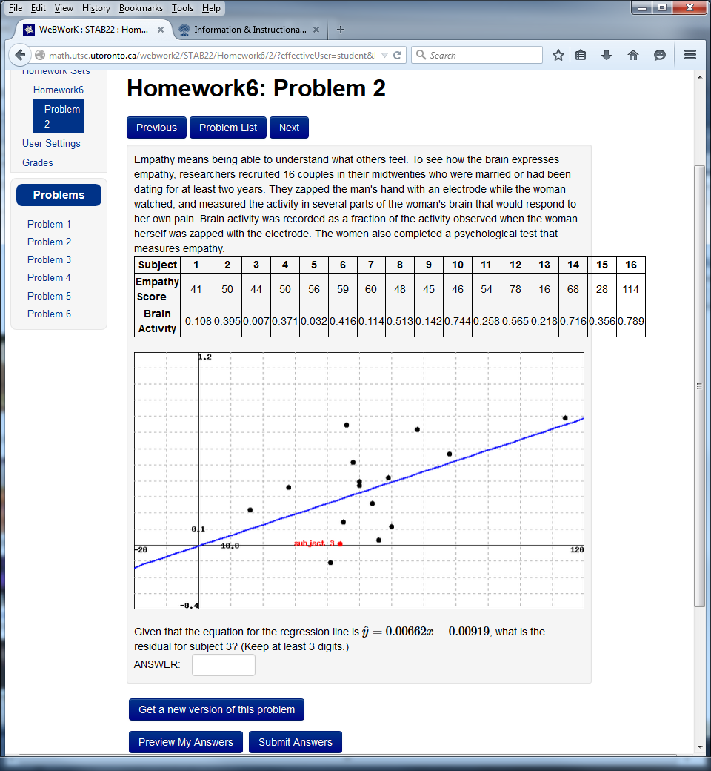
WeBWorK Problem Set Demo

Slide 9
Typical tasks for a WeBWorK professor:
Creating the problem sets
Editing the problem sets
Make it visible to students
Set-up due date
Viewing student progress
Scoring sets
Adding students

Slide 10
General tips for creating problem sets
Starts with National Problem Library and modify questions.
WeBWork wiki site: http://webwork.maa.org/wiki
The sites that you can play around – login as “GUEST” account
https://hosted2.webwork.rochester.edu/webwork2/UR101/
https://hosted2.webwork.rochester.edu/webwork2/HKUST101/

Slide 11
Case Study
2014 Fall STAB22:
WeBWork Homework Grading Scheme:
Give 2 bonus points in the final grade
If students get more than 60% of total homework

Slide 12
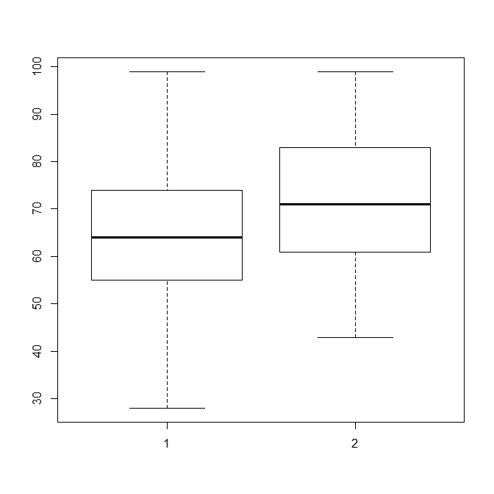
Participated Students: 216/686=32%
Final Grade Comparison
Group | Mean | SD | n
No-Webwork | 65.26 | 16.11 | 470
Yes-Webwork | 72.32 | 13.34 | 216
Two sample t-test
t = -6.7224, df = 684, p-value ≈ 0
95% confidence interval:
(-9.13, -5.00)
No Webwork
Yes Webwork

Slide 13
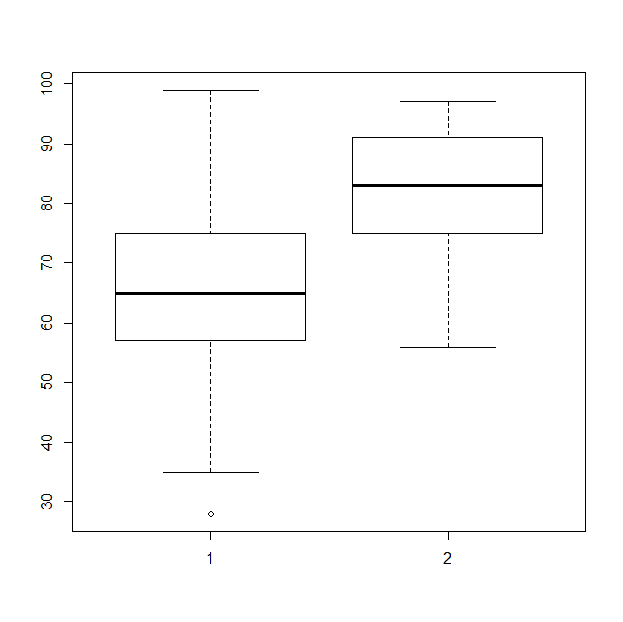
Students who received the bonus marks: 57/686= 8%
Final Grade Comparison
Group | Mean | SD | n
No Bonus | 66.22 | 12.60 | 629
Bonus | 81.33 | 11.60 | 57
Two sample t-test
t = -8.7238, df = 684, p-value ≈ 0
95% confidence interval:
(-18.51, -11.71)
No Bonus Group
Bonus Group

Slide 14
WeBWorK Current Grading Scheme
20% Quiz or
15% Quiz + 5% WeBWorK
Still Optional!
Natural Question
How to increase students’ engagement in WeBWorK?
How to build a good homework habit?
Notes:
Introducing projects into the curriculum is not a new or revolutionary idea in education. During the past decade, however, the practice has evolved in
to a more formally defined teaching strategy. Project-based learning has gained a greater foothold in the classroom
as researchers have documented what teachers have long understood: Students become more engaged in learning
when they have a chance to dig into complex, challenging, and sometimes even messy problems
that closely resemble real life.

Slide 15
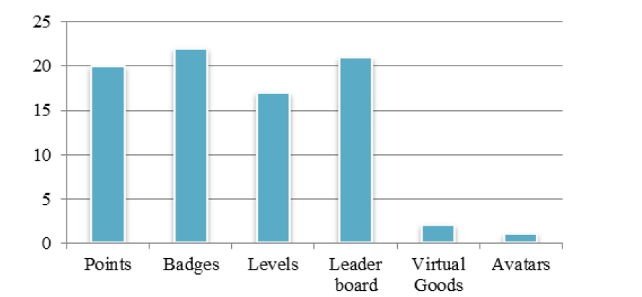
Gamification In Education
Game mechanics:
Dicheva, D., Dichev C., Agre G., & Angelova G. (2015). Gamification in Education: A Systematic Mapping Study. Educational Technology & Society, 18 (3), 75–88.

Slide 16
Achievements
Thanks to Kyung Hun (Ryan) Lee – undergraduate CS specialist for making this project possible.
Develop of mechanisms from game design to foster feelings of accomplishment and progress.
Leveling
Level 1 – level 5
Badges
Playful badges
Encouraging good homework habits

Slide 17
Leveling
Level 1: Novice
Level 2: Data Interpreter
Level 3: Data Apprentice
Level 4: Data Craftsman
Level 5: Junior Statistician

Slide 18
Badges
Playful and Encouraging Good Homework Habits
Badge | Image
Night owl (submit the answer after midnight)
Early bird (Complete the homework sets before one week of deadline, there are two deadlines)
Persistence (keep up!) (10 tries and correct)

Slide 19
Badges
Playful and Encouraging Good Homework Habits
Badge | Image
One-click is all I need (Get the correct answer after one attempt )
You’re on fire (Ten questions in a row correct)
Go speed Stat-er (Takes 15 minutes or less to complete homework set)

Slide 20
Challengers
Set Five Challenging Questions and students will collect these badges after they submit the correct answer.

Slide 21
We can activate “Achievement” from WeBWorK
At the MAIN MENU (left panel)
Course Configuration
What | Default | Current
… | … | …
Enable Course Achievements | False | True
Achievement Points per problem | 5 | 3

Slide 22
WeBworK Achievement
“Achievement Editor” and “Achievement” folders will be created.
You could use default achievements, however, they are mainly for Math, and images are very dull (black and white).

Slide 23
So..what is the result then?
Participation Rate 1: At least one questions
Participation Rate 2: Completed more than 60%
Academic Term | Rate 1 | Rate 2
2014 Fall | 32% | 8%
2015 Fall | 60% | 34%
2016 Winter | 54% | 30%
2016 Fall | 53% | 17%
2017 Winter | 47% | 14%
Two Bonus Marks
Optionally 5% of Grade
Optionally 5% of Grade + Achievement

Slide 24
Future Plan (Project for CSCC01) - Can I beat that? (better name? Catch-Up)
Let’s change the WeBWorK Assignment Paradigm.
Instead of allowing unlimited attempts for each question, students are permitted to retake an entire assignment.
Each assignment is completely new randomized assignment.
Each assignment will consist of a large pool of templates, with each instance of an assignment being a random subset of templates being populated with random parameters.

Slide 25
References
From WebWorK main site:
http://webwork.maa.org/wiki/Achievements#.WTqwXmcRrYI
Geoff Goehle (2013) Gamification and Web-based Homework, PRIMUS, 23:3, 234-246
Cater, B., Kang, S., and Pollanen (2015), M., An Efficient Gamified Model for Online Homework in the Mathematical Sciences, Proceedings of the 2015 International Symposium on Teaching, Education, and Learning – Summer Session, 14-27.

Slide 26
Any Questions?
I will set my office hours for this project to Wednesday 1-2pm at IC 483

