Slide 1

Master Of Science in Computer Engineering
Electronics and Communications Systems
MATRIX MULTIPLIER
VHDL IMPLEMENTATION
Megan Maremmani
Eleni Zewdu Belayhun

Slide 2
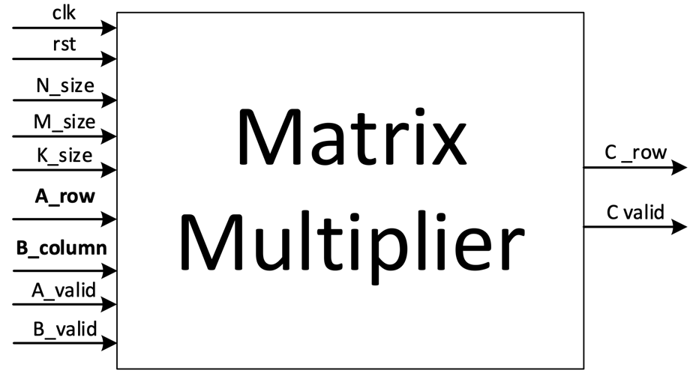

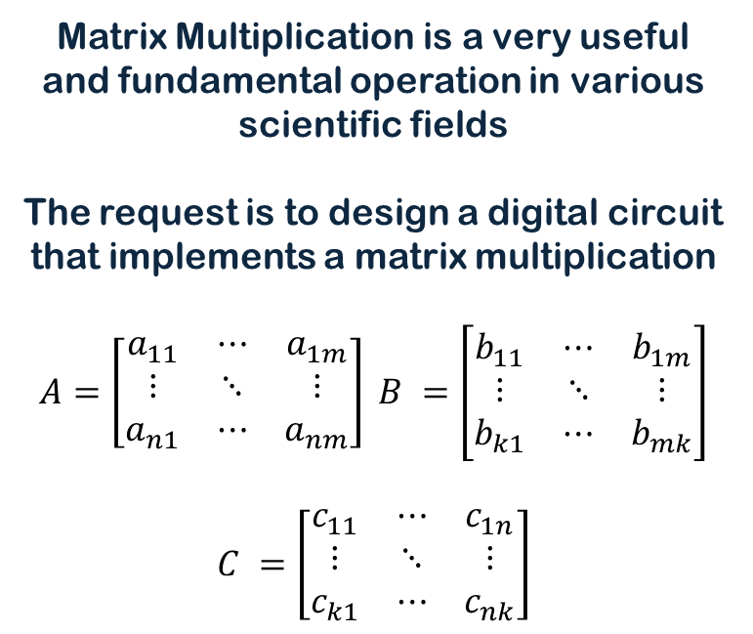
PROBLEM DESCRIPTION
THE DESIGN:
Matrix Multiplication is a very useful and fundamental operation in various scientific fields
The request is to design a digital circuit that implements a matrix multiplication
$$A=\left[\begin{matrix}a_{11} & ⋯ & a_{1m} \\ ⋮ & ⋱ & ⋮ \\ a_{n1} & ⋯ & a_{nm}\end{matrix}\right] B =\left[\begin{matrix}b_{11} & ⋯ & b_{1m} \\ ⋮ & ⋱ & ⋮ \\ b_{k1} & ⋯ & b_{mk}\end{matrix}\right]$$
$$C =\left[\begin{matrix}c_{11} & ⋯ & c_{1n} \\ ⋮ & ⋱ & ⋮ \\ c_{k1} & ⋯ & c_{nk}\end{matrix}\right]$$

Slide 3


PORTS DESCRIPTION
INPUTS:
OUTPUTS:
clk : Clock signal
rst : Reset signal (active high)
N_size : Rows for A and C
M_size : Columns for A and rows for B
K_size : Columns for Matrices B and C
A_row : In A stored row-wise
B_column : In B stored column-wise
A_valid : Valid signal for A
B_valid : Valid signal for B
C_row : Output matrix C stored row-wise
C_valid : Output valid signal for C
To improve code readability and modularity, a dedicated signals package is included to reference the system’s inputs and outputs in a clean and structured manner

Slide 4
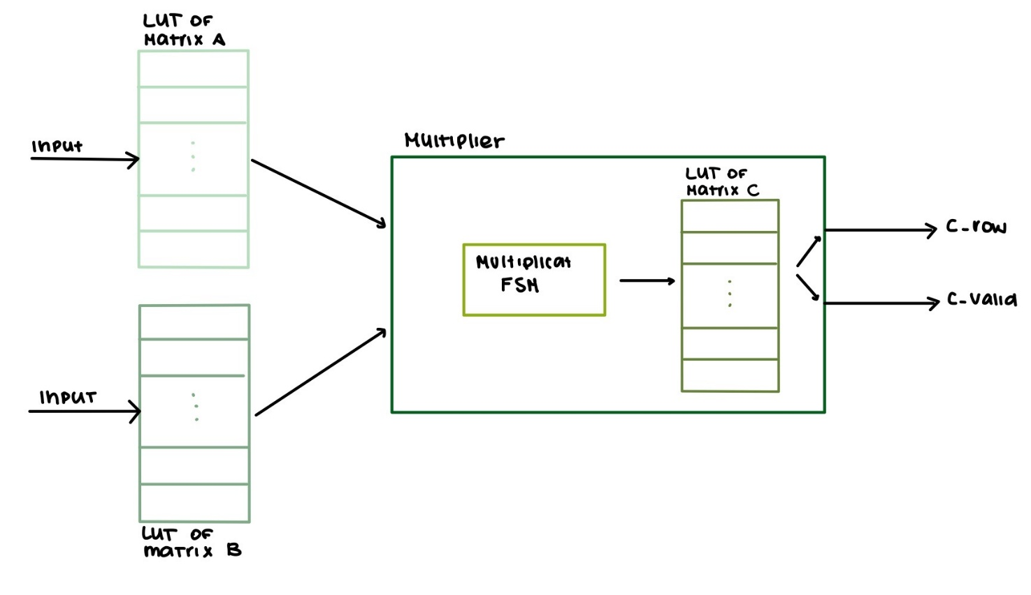
BLOCK DIAGRAM
Circuit’s block diagram

Slide 5

LOOK UP TABLES (LUT)
An implementation of LUTs has been made:
Matrix_LUT_A:
Matrix_LUT_B:
Stores input data for Matrix A in a row-wise format.
Data is loaded sequentially and fully before computation begins to ensure synchronization with the system and the second LUT.
Stores input data for Matrix B in a column-wise format.
Data is loaded sequentially and fully before computation begins to ensure synchronization with the system and the second LUT.

Slide 6
MULTIPLIER AND LUT_C
MatrixMultiplier
Matrix_LUT_C: Stores results of the multiplication in row-wise format.
Each element is written to its corresponding address and mapped to C_row, with C_valid indicating result validity.
Implemented using a Finite State Machine (FSM)
Processes:
state_reg: synchronous state transitions and counter updates based on clock/reset.
FSM: Defines next states and control signals.
MUL: Performs dot product operations during multiplication phase.
RESULT_OUT: Assembles and outputs Matrix C row by row, signaling readiness via C_valid.

Slide 7

MULTIPLIER 2/2
MatrixMultiplier
IDLE: Initial state; system is ready and initialized.
LOAD_MAT: Loads data into LUTs and synchronizes inputs.
CHECK: Ensures all preconditions for multiplication are met.
MULTIPLY: Performs matrix multiplication.
MAT_C: Stores multiplication results into output
LUT_RESULT: Prepares final matrix C for output, row by row.
END_MUL: Indicates completion of the multiplication process
STATES DEFINITION

Slide 8
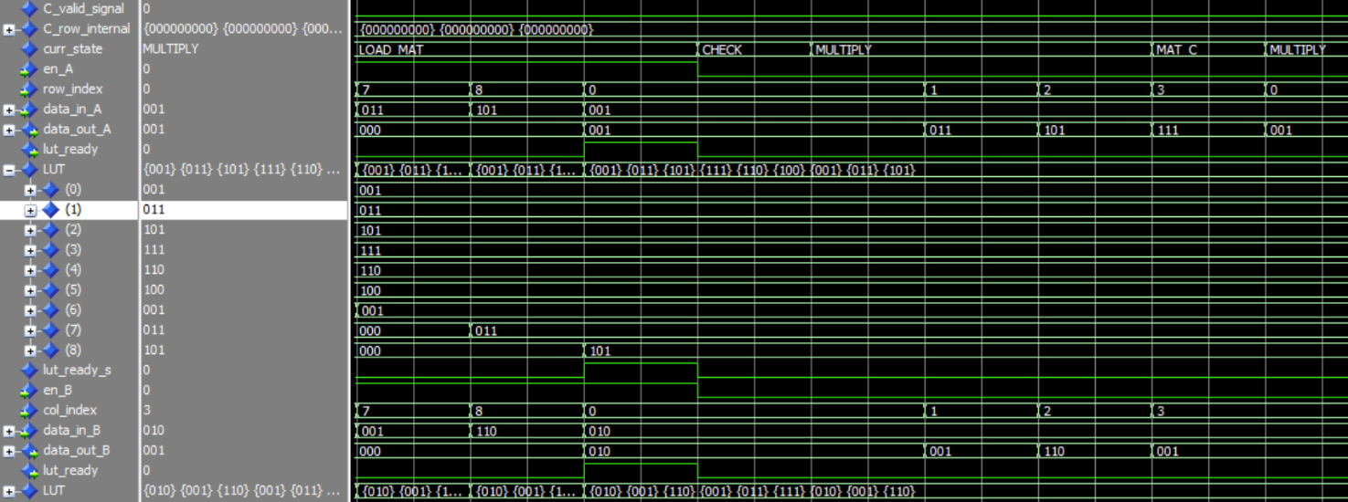

TEST BENCH – TEST PLAN
The matrix multiplication was verified using a VHDL testbench in ModelSim-Intel FPGA Standard Edition.
A 3×3 matrix configuration was chosen to balance simplicity and thoroughness.
Testbench validates functional correctness based on input dimensions.
Simulation progress and key events are tracked through reports.
Loading of one LUT with values

Slide 9
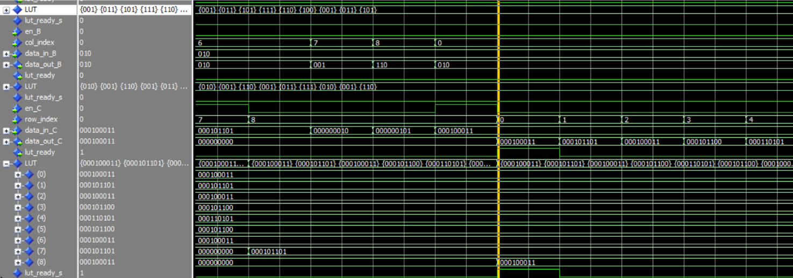
SOME HIGHLIGHTS
LUT C result storage

Slide 10
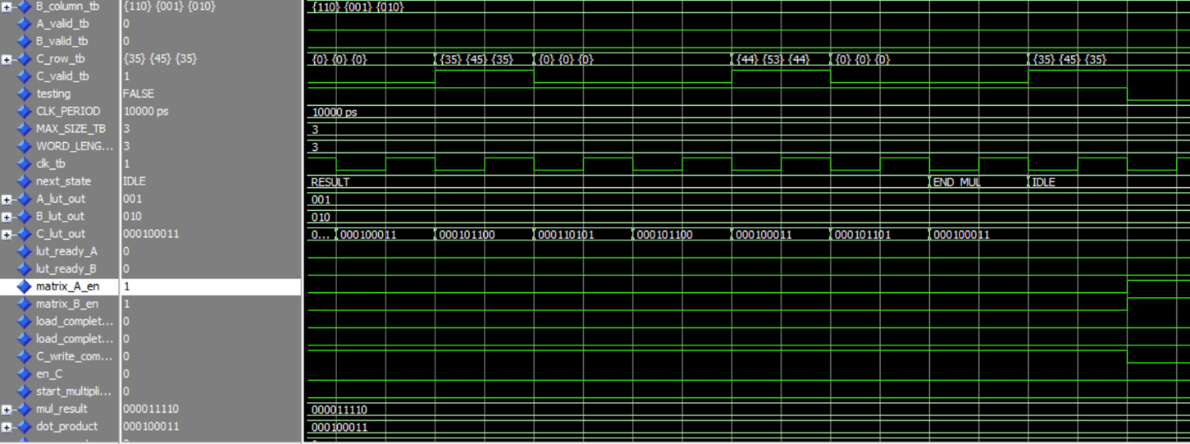
SOME HIGHLIGHTS
output of the results

Slide 11
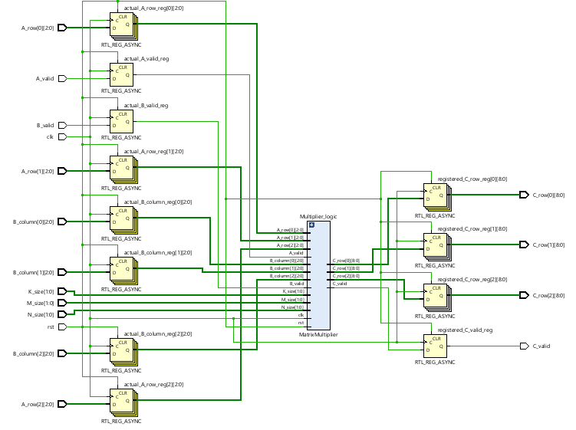
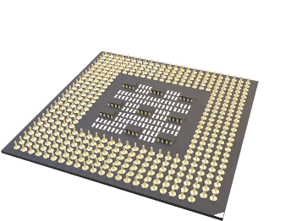
SYNTHESIS
The synthesis was done without mapping the actual physical I/O ports of the FPGA pins, using the -mode out_of_context option.
A warning came up during simulation:
because we used the out of context mode, so the accuracy of the timing is affected, however this does not impact the validity of the current results

Slide 12
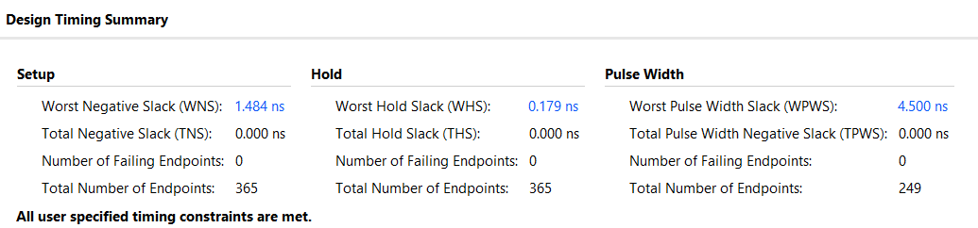

TIMING REPORT
The design timing summary confirms that all user-specified timing constraints for the matrix multiplier implementation have been successfully met

Slide 13
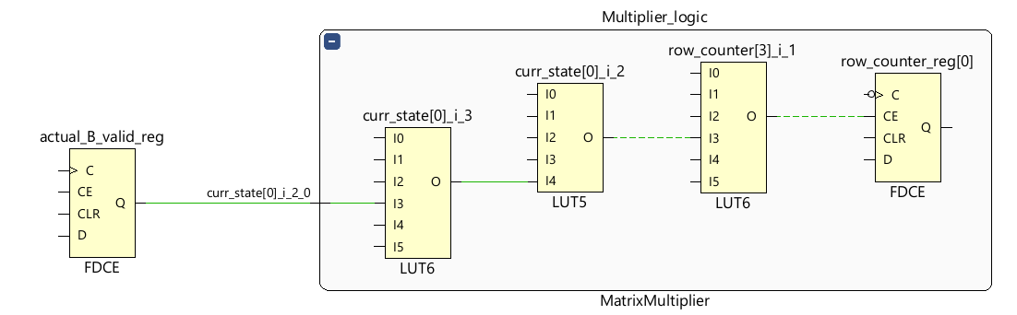
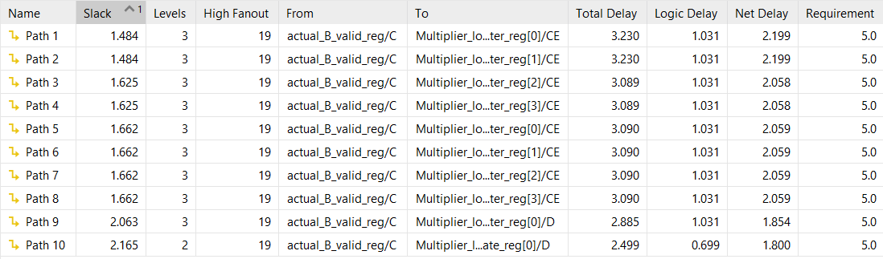
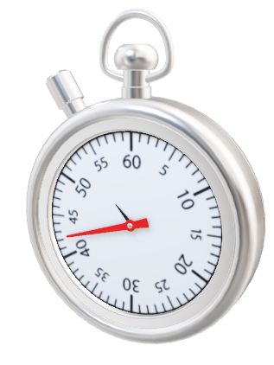
MOST CRITICAL PATH
The timing analysis of the matrix multiplier design, highlights the most critical path. The most critical timing path is "Path 1", exhibiting the lowest slack value of 1.484 ns.

Slide 14
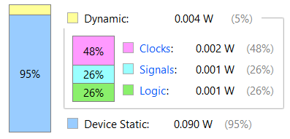
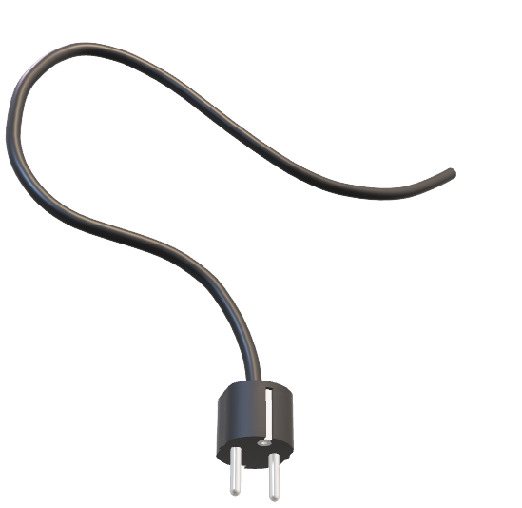
POWER CONSUMPTION REPORT
WHAT HAPPENS:
Most of this power, approximately 95% (0.090 W), is attributed to static device power, which is inherent to the FPGA hardware itself regardless of activity.
The remaining 5% (0.004 W) corresponds to dynamic power, which is associated with the switching activity of the design during operation.

Slide 15
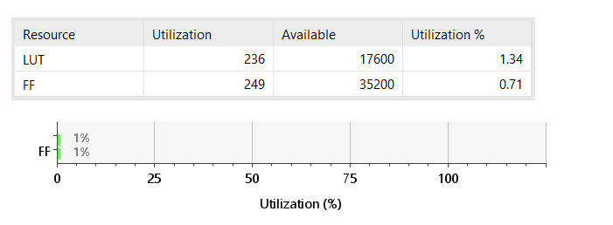
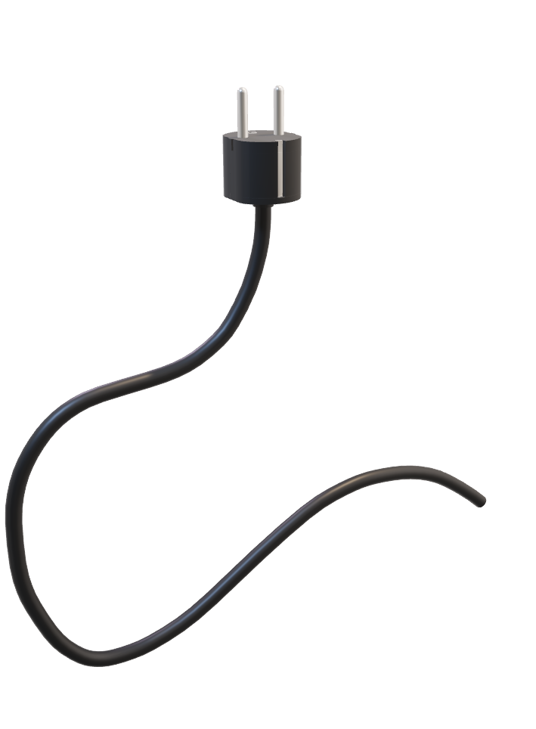
RESOURCE UTILIZATION REPORT
The implementation utilizes only 236 Look-Up Tables (LUTs), resulting in a utilization rate of just 1.34%.
Similarly, it consumes 249 Flip-Flops (FFs), corresponding to a minimal 0.71% utilization.

Slide 16


CONCLUSION:
OUR GOAL:
FUTURE:
We implemented a Matrix Multiplier in VHDL for FPGA use.
Integrated a wrapper module for register-logic-register architecture, enabling easier performance analysis.
Verified functionality with a 3×3 matrix using a VHDL testbench in ModelSim, providing a balance of simplicity and functionality.
Scalability: Expand design to support larger matrices and higher precision (e.g., increased word length).
Modularity: change matrix dimensions.
Optimization: Explore pipelining and parallelism for higher performance in real-time systems.
TO THE FUTURE!

Slide 17
Master Of Science in Computer Engineering
Electronics and Communications Systems
THANKS FOR
THE ATTENTION
Megan Maremmani
Eleni Zewdu Belayhun

