Slide 1

Large-Scale and Multi-Structured Databases
Eleonora Sgorbini
Megan Maremmani
Chiara Masiero

Slide 2
Application Highlights
MySmartRecipeBook is a recipe based web application designed to discover professional recipes and help you reducing food waste!
Advanced Search: Users can browse through thousands of recipes using detailed filters such as category, or specific chefs, and save their favorite.
Smart Fridge: This feature allows users to input available ingredients from their pantry to receive recipe recommendations, promoting culinary creativity and reducing food waste.
Smart Shopping List: The application includes a portable digital shopping list that allows users to keep track of necessary ingredients while at the supermarket.
Application Analytics: The platform provides insights into culinary trends, enabling the Admin to track monthly registrations, monitor the most popular chefs, and identify trending recipe categories.
Certified Content: A dedicated administrative layer ensures a safe environment by verifying chefs’ registration request and reviewing all submitted recipes before publication to maintain high-quality standards.

Slide 3
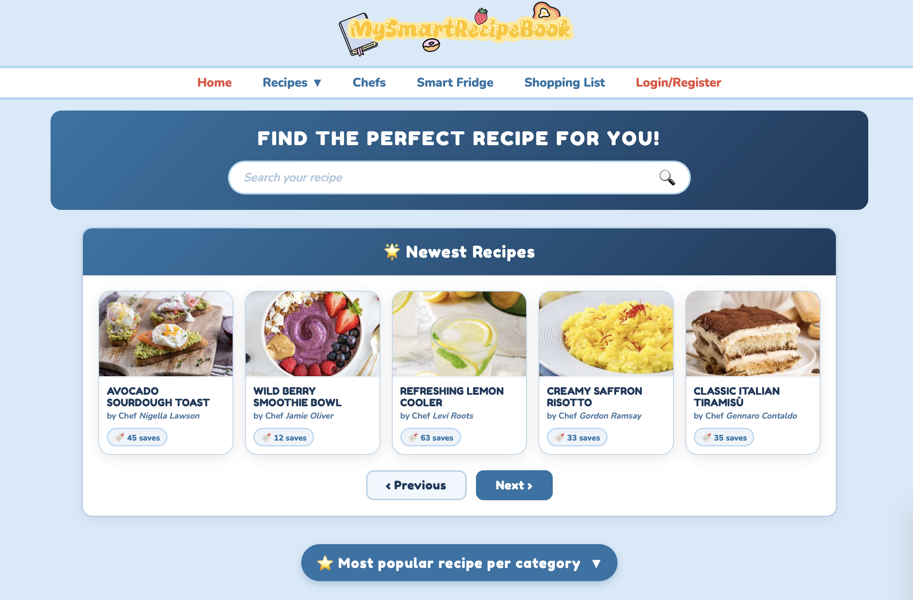
Actors and Mockups (i)
Unregistered User
The homepage is designed with a search bar for finding recipes via title or substring matching, and it immediately presents users with the newest recipes available in the application.

Slide 4
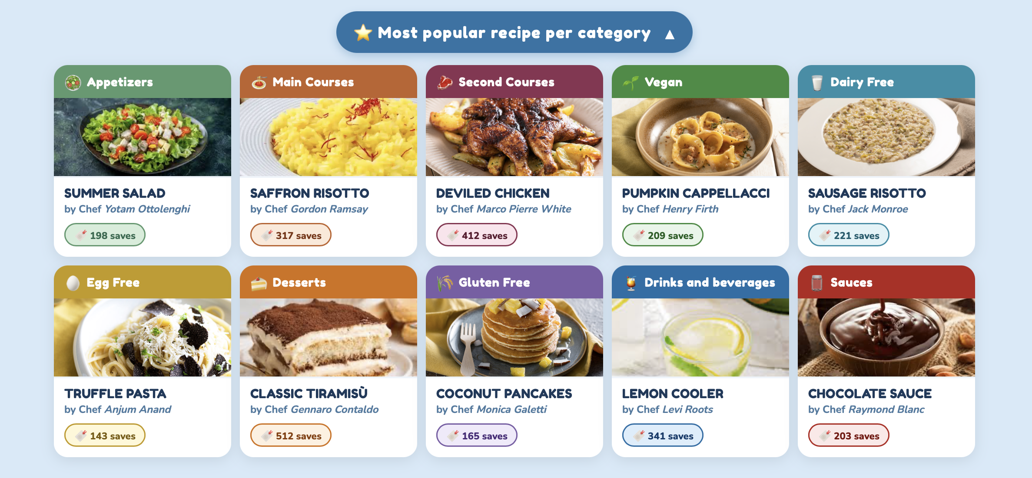
Actors and Mockups (ii)
Unregistered User
By clicking the dedicated button on the homepage, users can instantly view the most popular recipe for each available category.

Slide 5
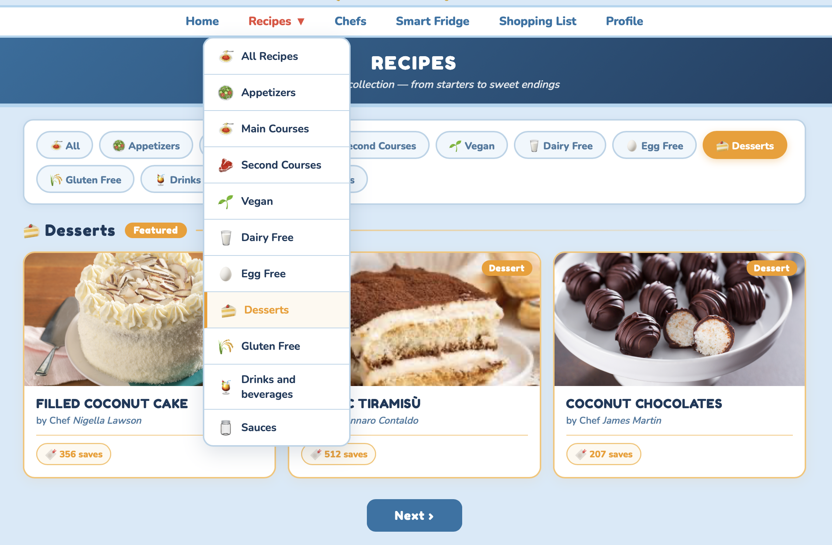
Actors and Mockups (iii)
Unregistered User
Any user can search recipes, browse categories and view complete recipe details before registering.

Slide 6
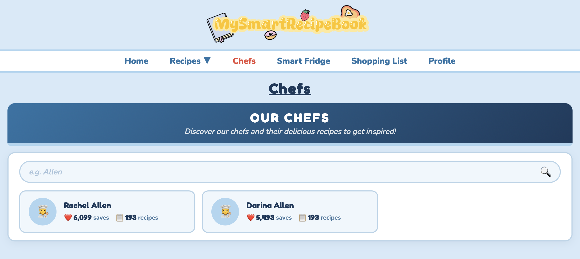
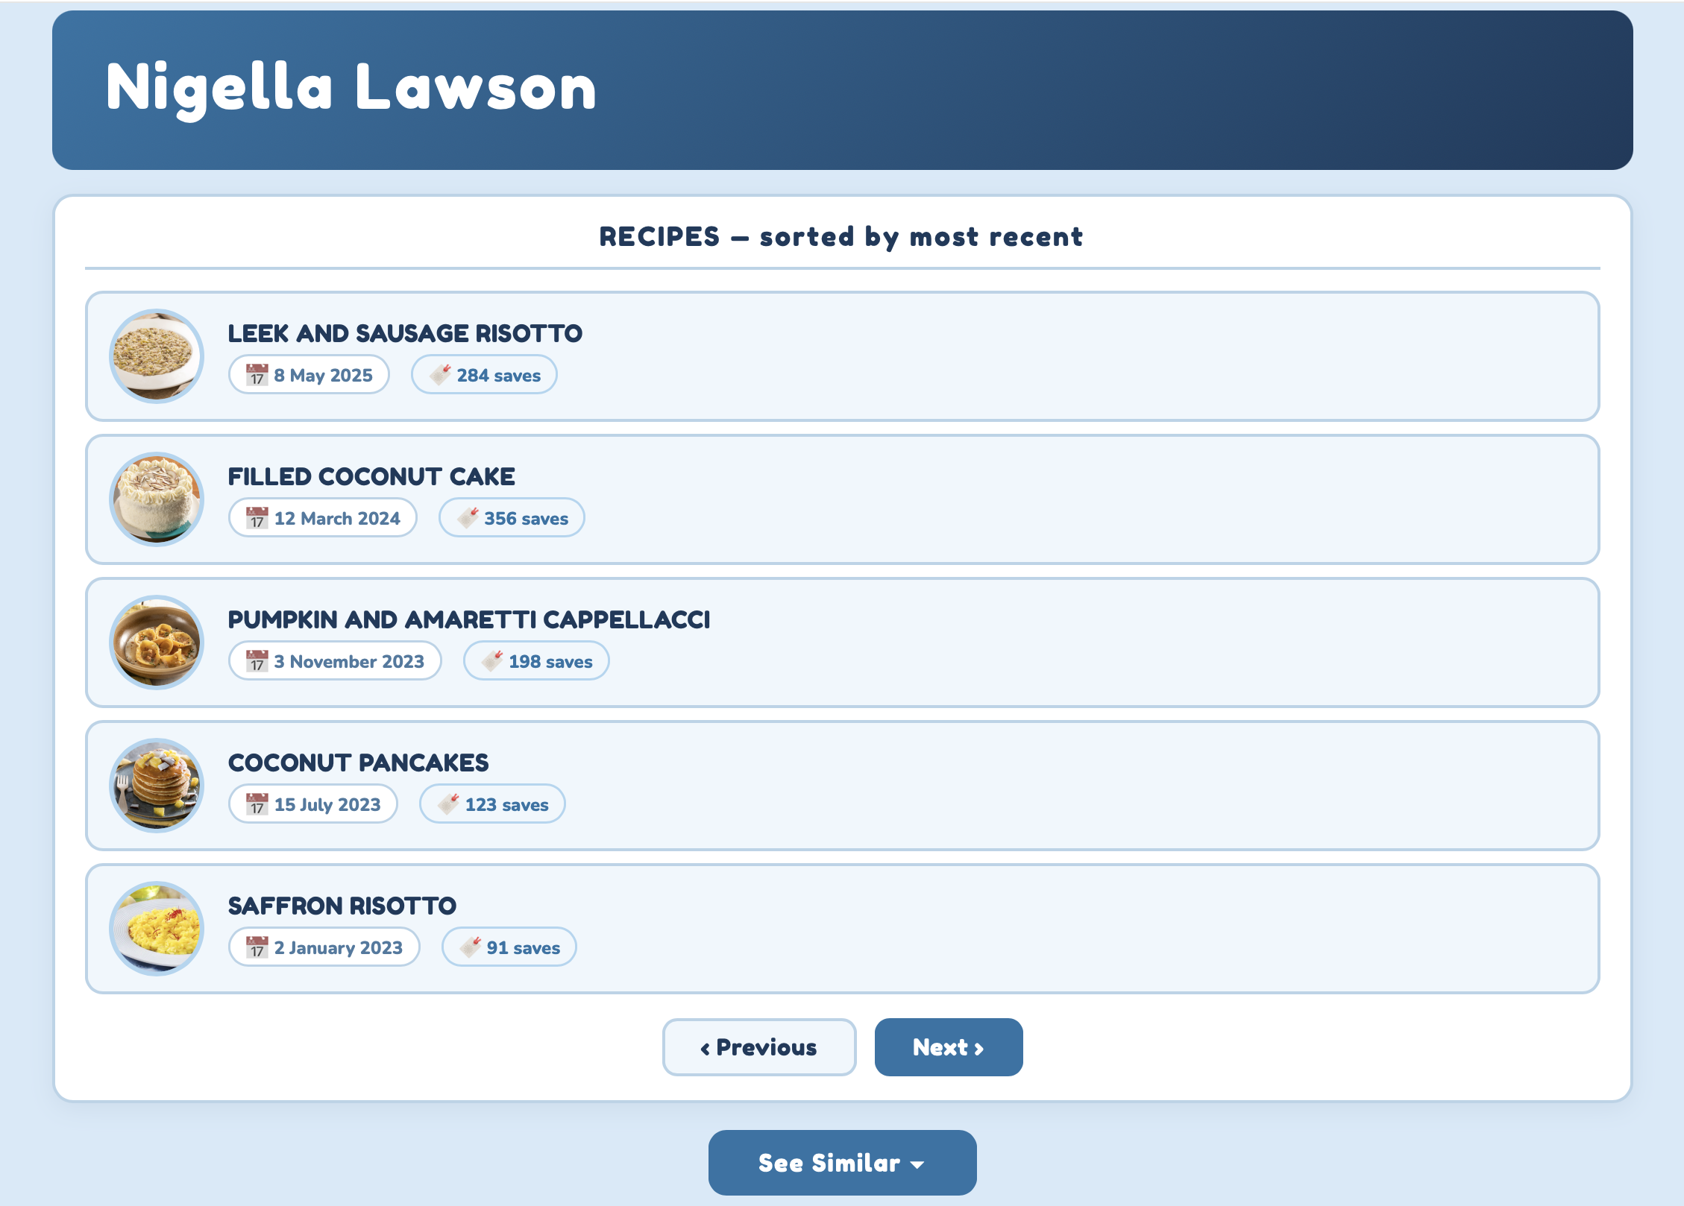
Actors and Mockups (iv)
Unregistered User
Unregistered users can browse chefs, searching them by surname and explore their published recipes.

Slide 7
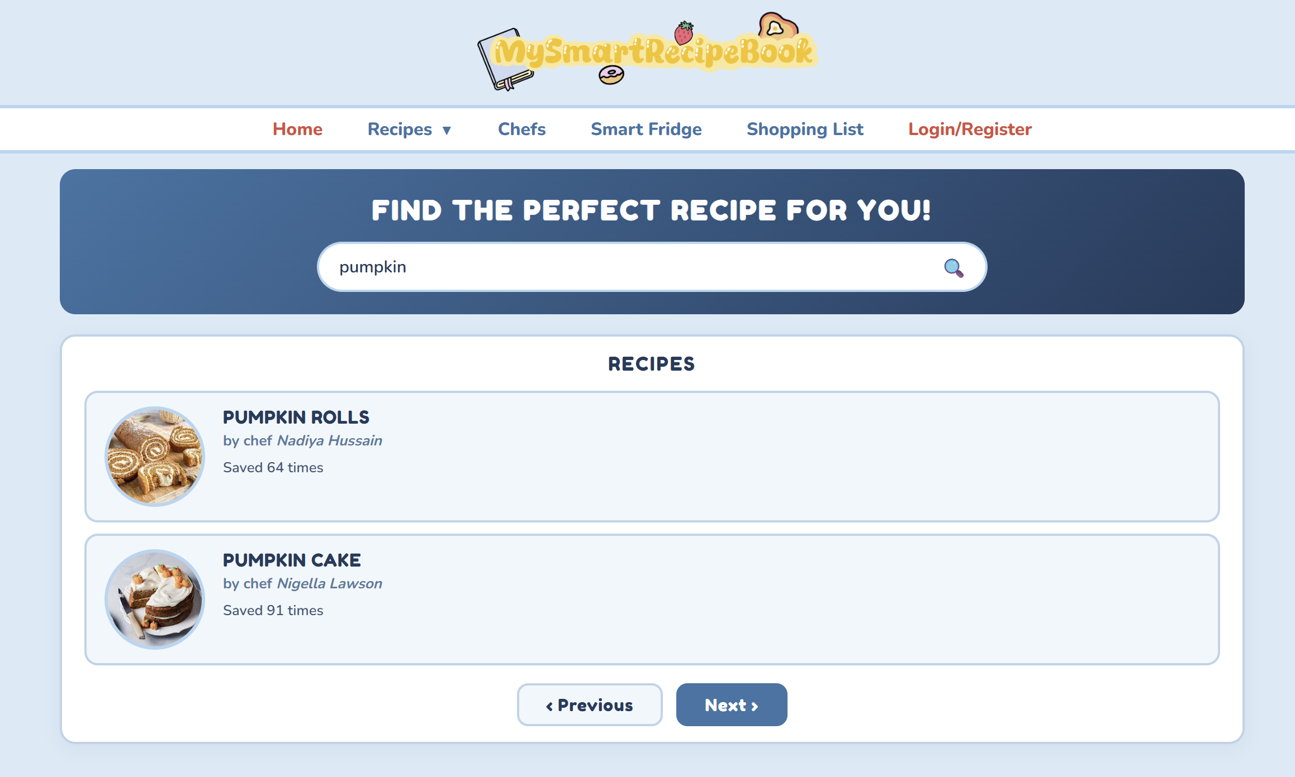
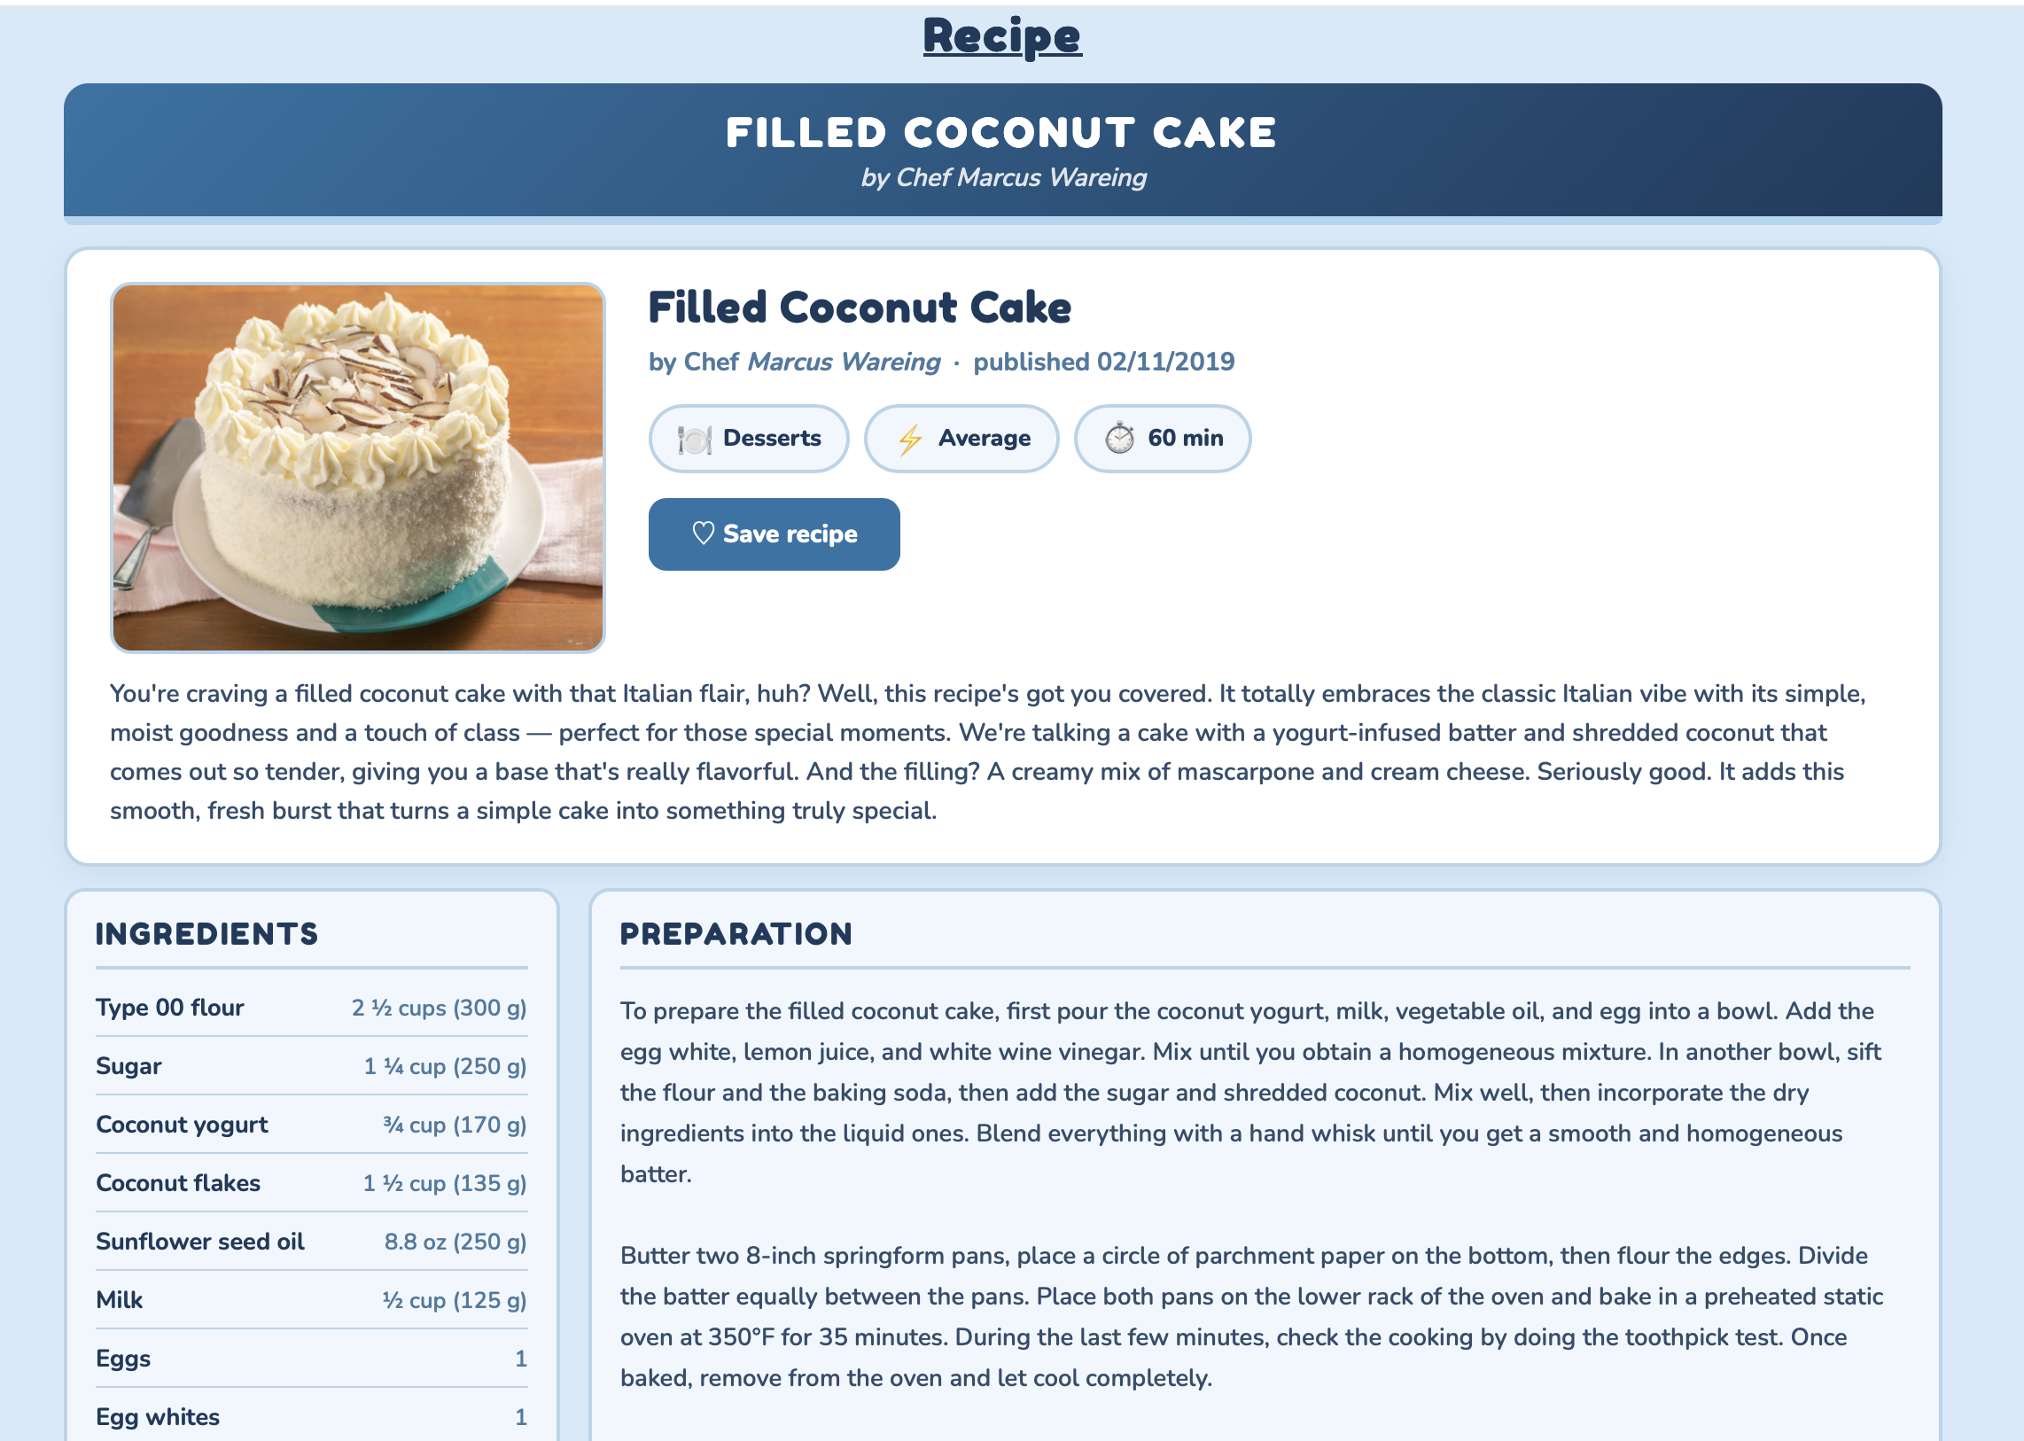
Actors and Mockups (v)
Unregistered User
Unregistered users can search recipes by keyword, browse matching results, and access the complete recipe view with all the detailed information.

Slide 8
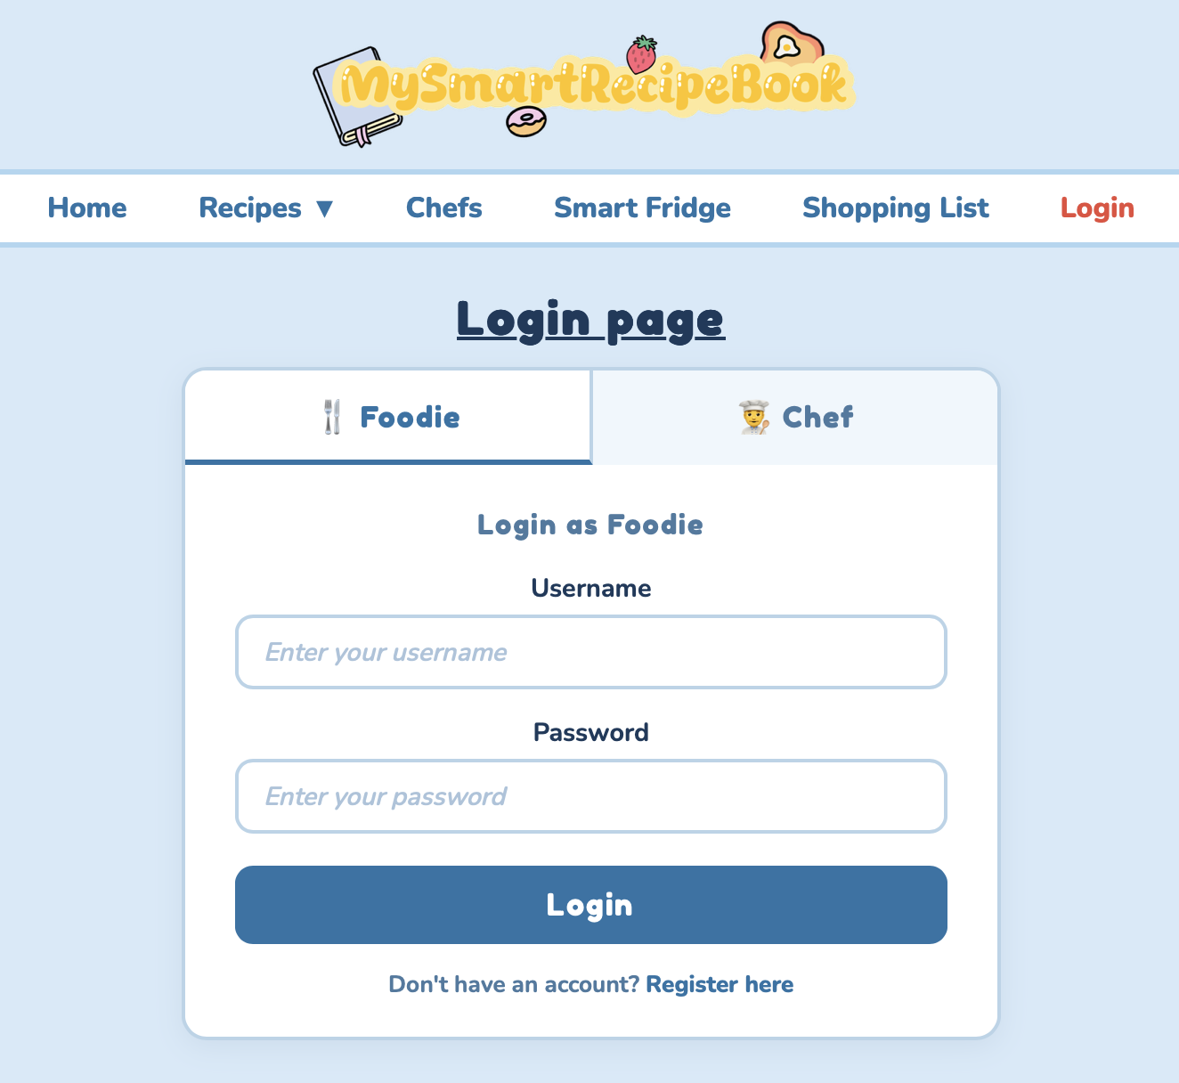
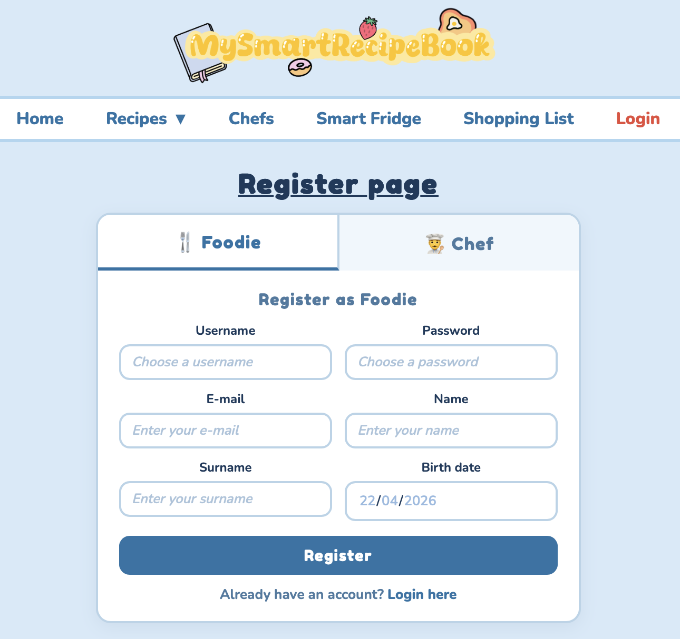
Actors and Mockups (vi)
Log In and Register

Slide 9
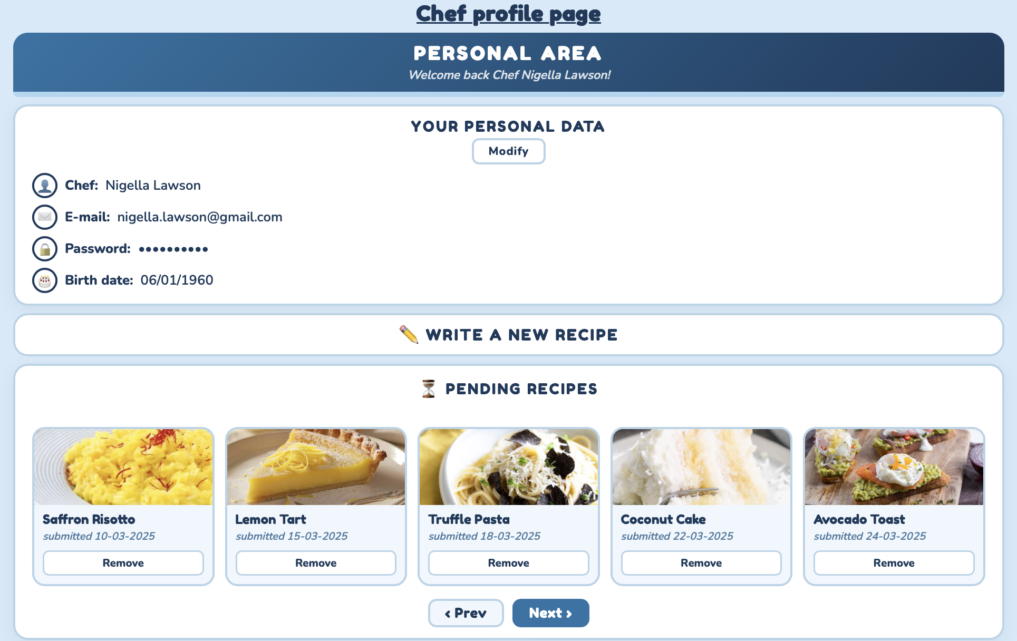
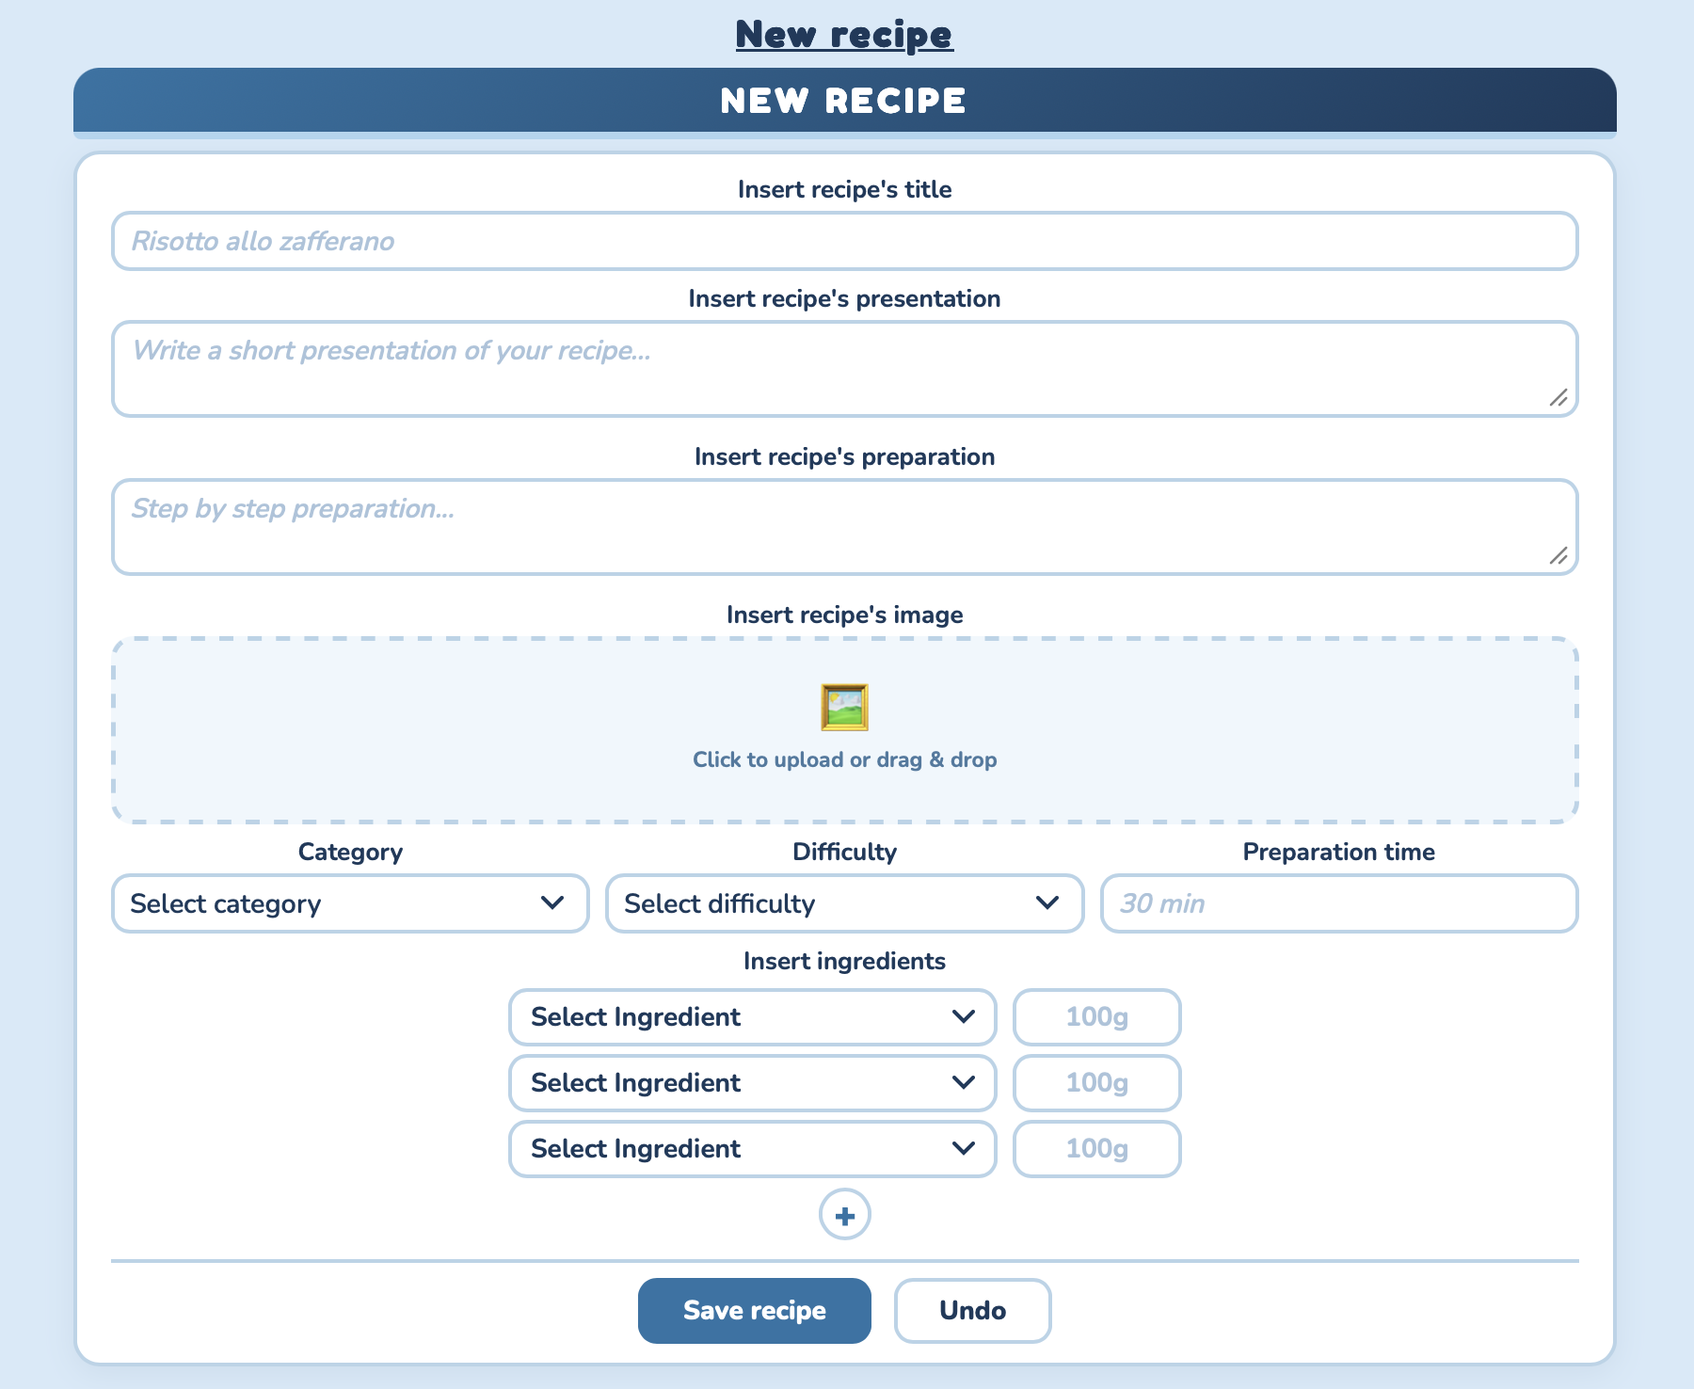
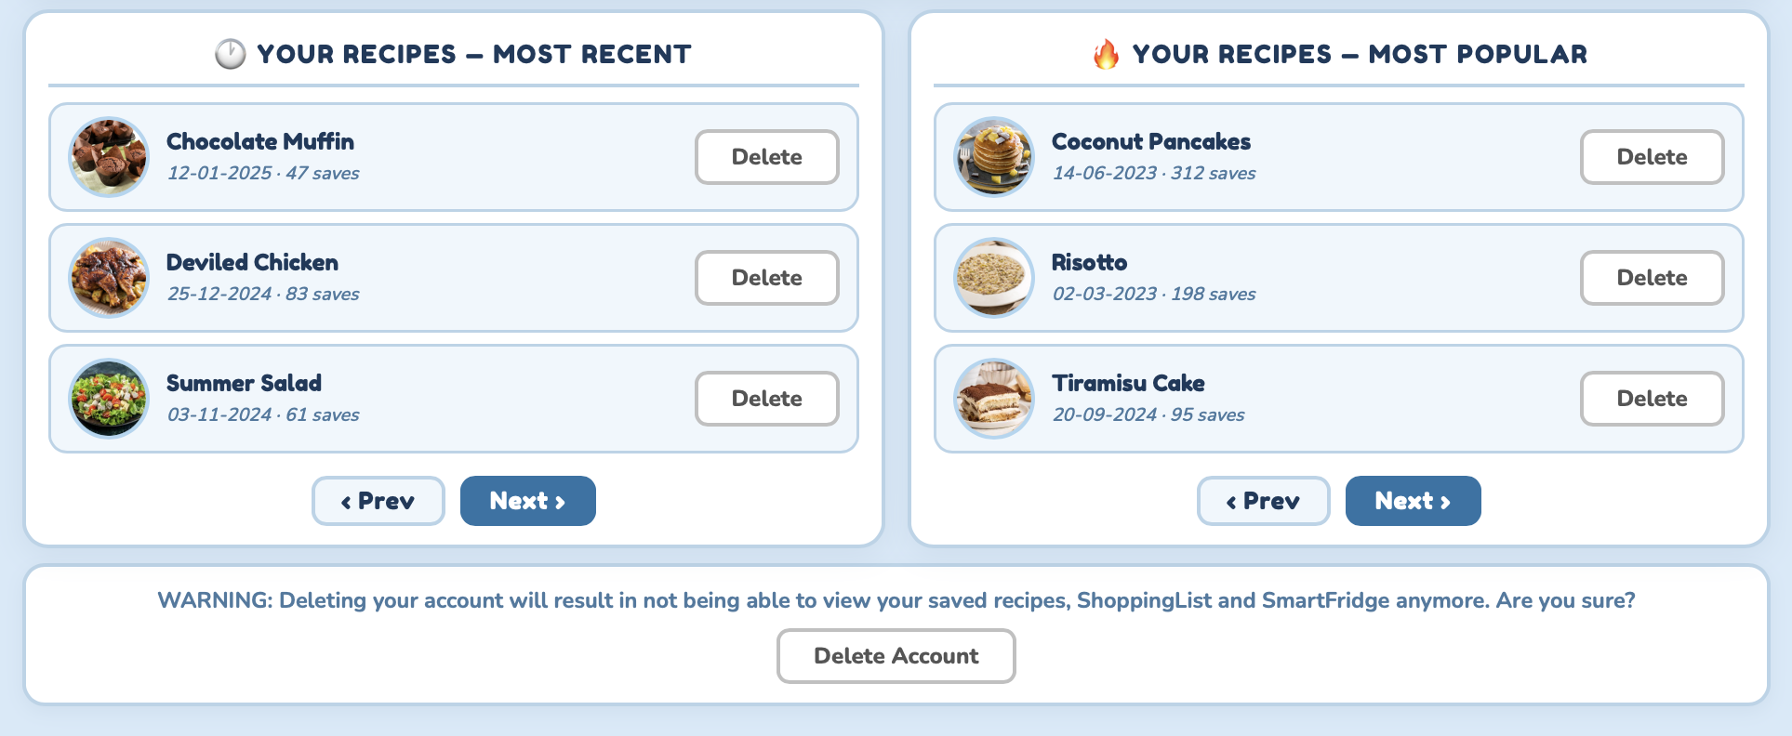
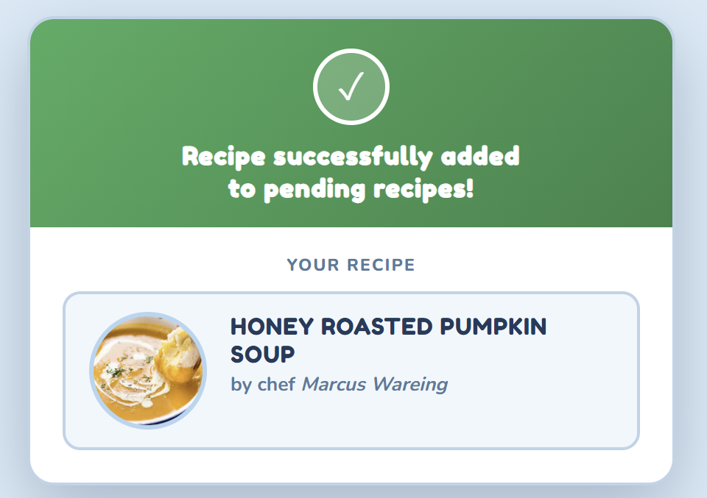
Actors and Mockups (vii)
Chef
The Chef can manage personal info, create new recipes, monitor pending submissions and see their recipes.

Slide 10
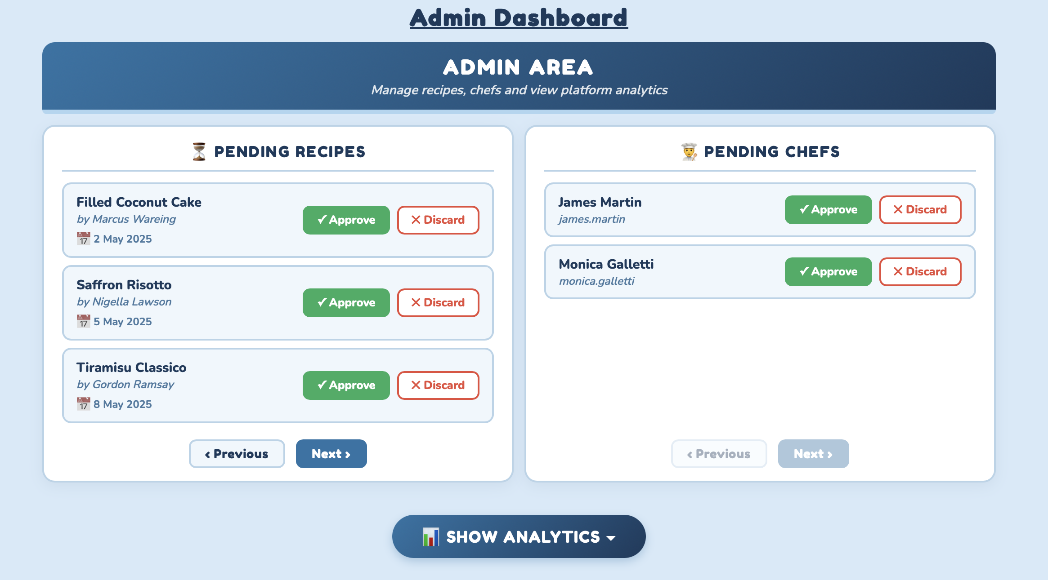
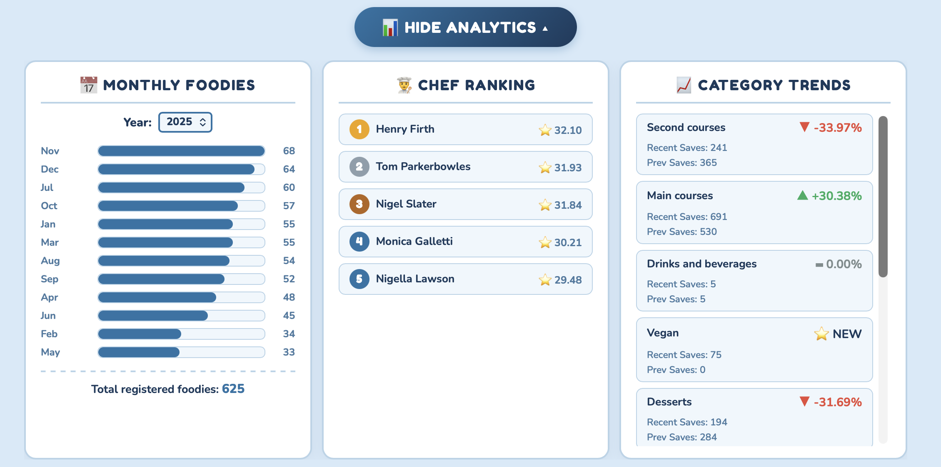
Actors and Mockups (viii)
Admin
The Admin can handle pending recipes , chef registration requests and view the analytics by clicking the corresponding button.

Slide 11
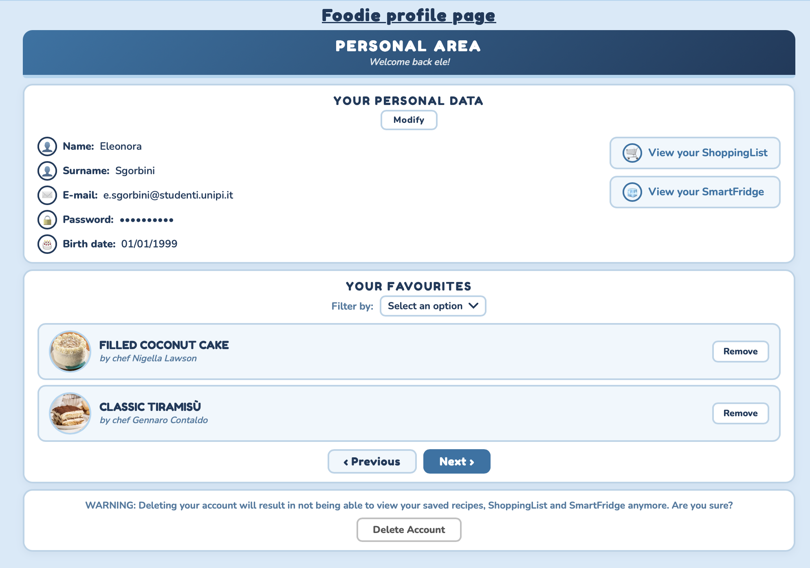
Actors and Mockups (ix)
Foodie
The Foodie manages personal information, accesses Smart Fridge and Shopping List features, and keeps track of favourite recipes.

Slide 12
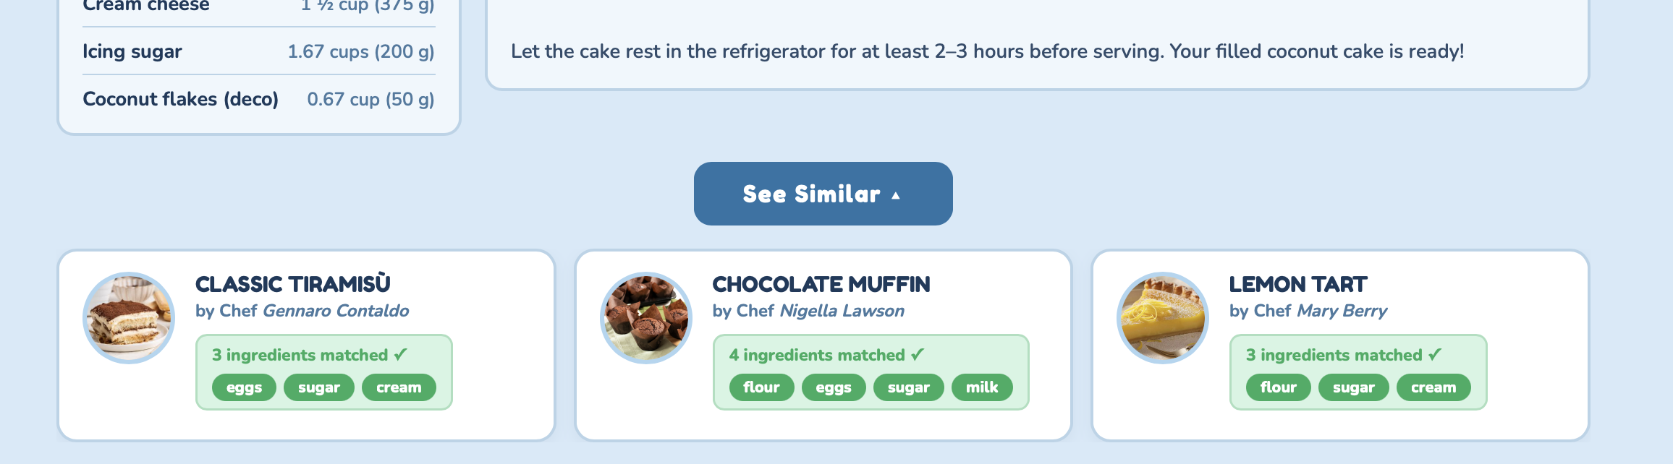
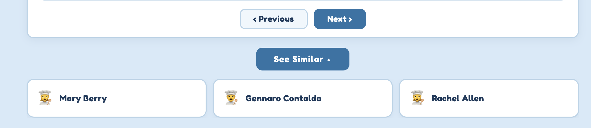
Actors and Mockups (x)
Foodie – See Similar
Recipes
Chefs

Slide 13
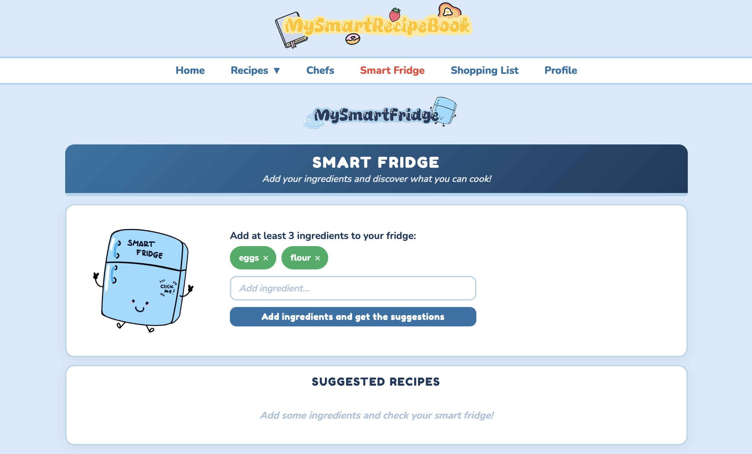
Actors and Mockups (xi)
Foodie – Smart Fridge

Slide 14
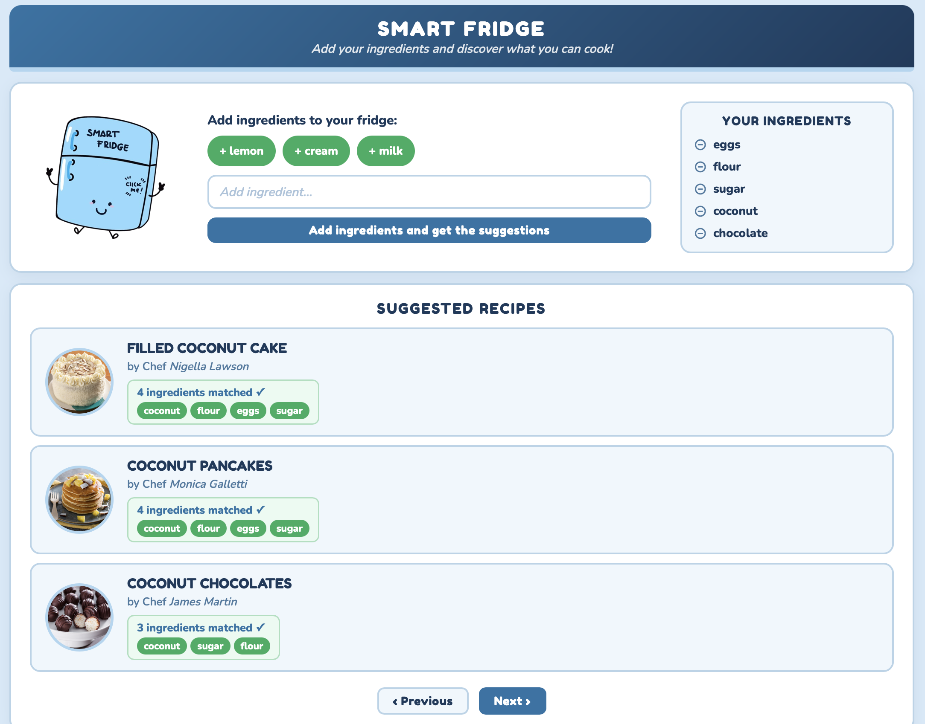
Actors and Mockups (xii)
Foodie – Smart Fridge

Slide 15
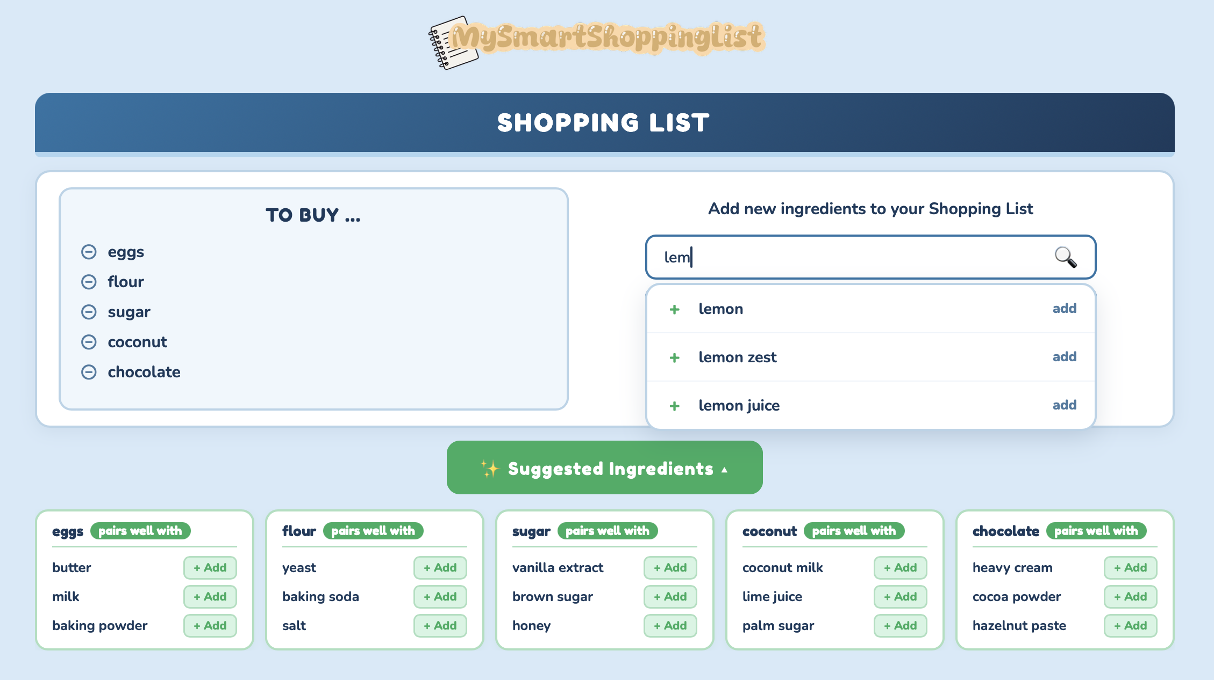
Actors and Mockups (xiii)
Foodie – Smart Shopping List

Slide 16
Dataset Description
Sources (via Python Web-Scraping):
BBC GoodFood
AllRecipes
GialloZafferano
Variety:
It is achieved by the fact that the web-service handles data retrieved from three different sources.
Velocity/Variability:
The system is highly dynamic, evolving rapidly through continuous data ingestion and user activity. This includes the regular insertion of new recipes, ongoing user registrations, recipe saving actions, dynamic Smart Fridge interactions, and real-time Shopping List updates.
Volume:
15,832 Recipes ≈ 53 MB
5,000 Foodies
93 Chefs
≈ 2.5 MB
Notes:
Provide info regarding the final dataset stored in the DBs.
Use max 2 slides for the description of the dataset

Slide 17
Dataset Description
Recipes
Users
Web Scraping Sources
Deduplication: Removed duplicate recipes.
Ingredient Normalization: Normalized ingredients for consistent data within the application.
Text Cleaning: Eliminated artifacts and redundant formatting characters.
Missing Data Generation: Manually integrated or deduced missing attributes by re-consulting sources and cross-referencing web data.
Foodie Profiles : Generated using the Python Faker library to populate realistic personal attributes (names, emails, registration dates, birthdays).
Chef Profiles: Real chefs were scraped from culinary websites to ensure authentic professional identities, while all other metadata was generated via Python Faker library.
Notes:
L’ho riassunto molto

Slide 18
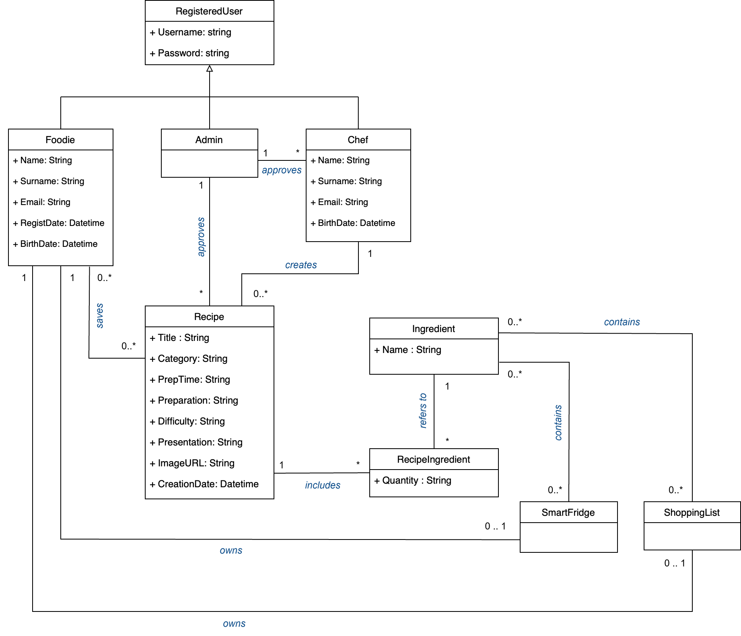
UML Design Class Diagram

Slide 19
Application non-functional requirements
The non functional-requirements of our system are the following:
The system must encrypt the user's password.
The system must be developed by using an OOP language (Java).
The system must be a responsive website application.
The system must be able to handle high traffic.
The system must implement a multi-database architecture using DocumentDB, GraphDB, and Key-Value DB.
The system must expose all its functionalities by means of well-documented RESTful APIs, in accordance with the OpenAPI specification.
Notes:
Commento del duca: In the rest of the presentation show how each non-functional requirement is supported by database choices (Which databases has been chosen? How the CAP theorem issues have been handled in the application? How inter-DB and intra-DB consistency has been handled? Etc.)

Slide 20
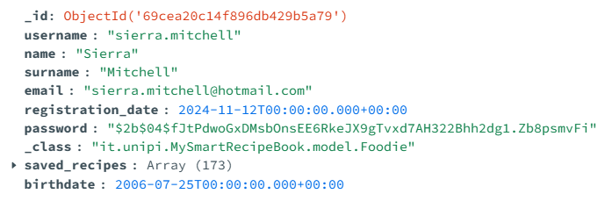
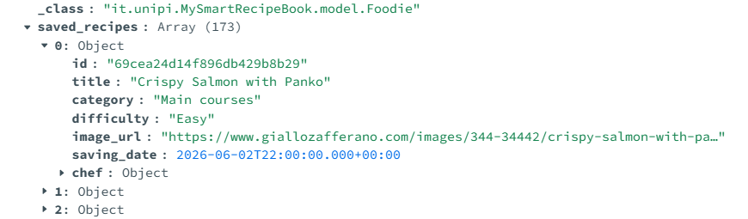
Document DB Design
Foodie
🔎
Notes:
Show the document DB data model (json document structure of each collection) and justify choices.
Show the implemented aggregation (in javascript format) highlighting the queries which benefits from the proposed DB design.
If needed, make also reference to the Mock-ups (for the view supported by the designed collections)
Max 3 slides

Slide 21
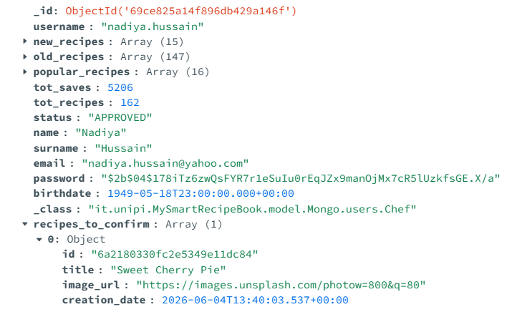
Document DB Design
Chef
🔎
Notes:
Da modificare con i cambiamenti ultimi da fare

Slide 22
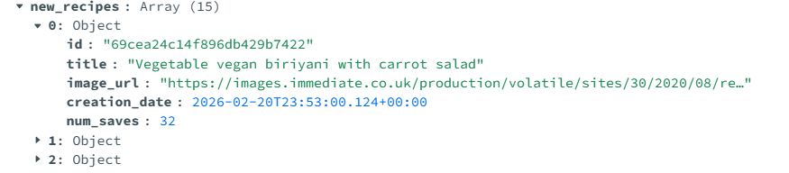
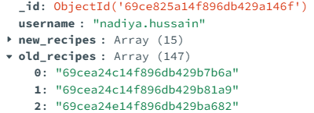
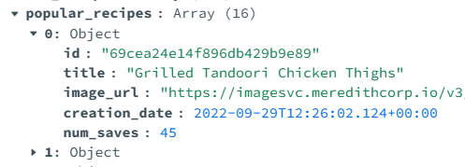
Document DB Design
Chef
🔎
🔎
🔎
Notes:
Da modificare con i cambiamenti ultimi da fare

Slide 23
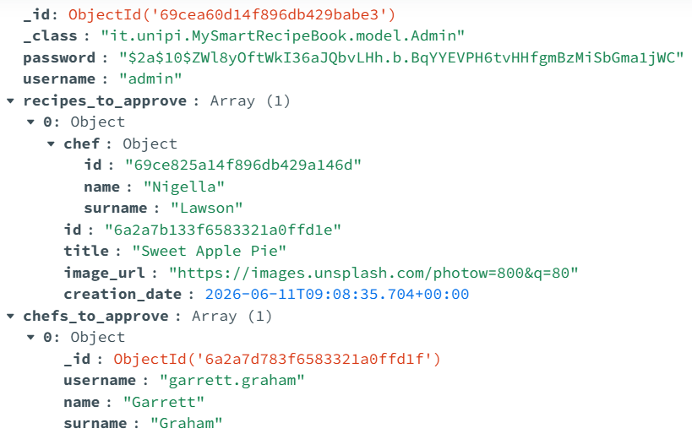
Document DB Design
Admin
Notes:
Da modificare con i cambiamenti ultimi da fare

Slide 24
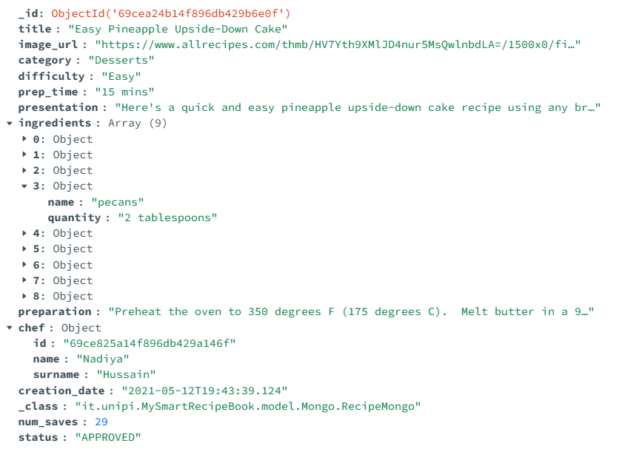
Document DB Design
Recipe

Slide 25
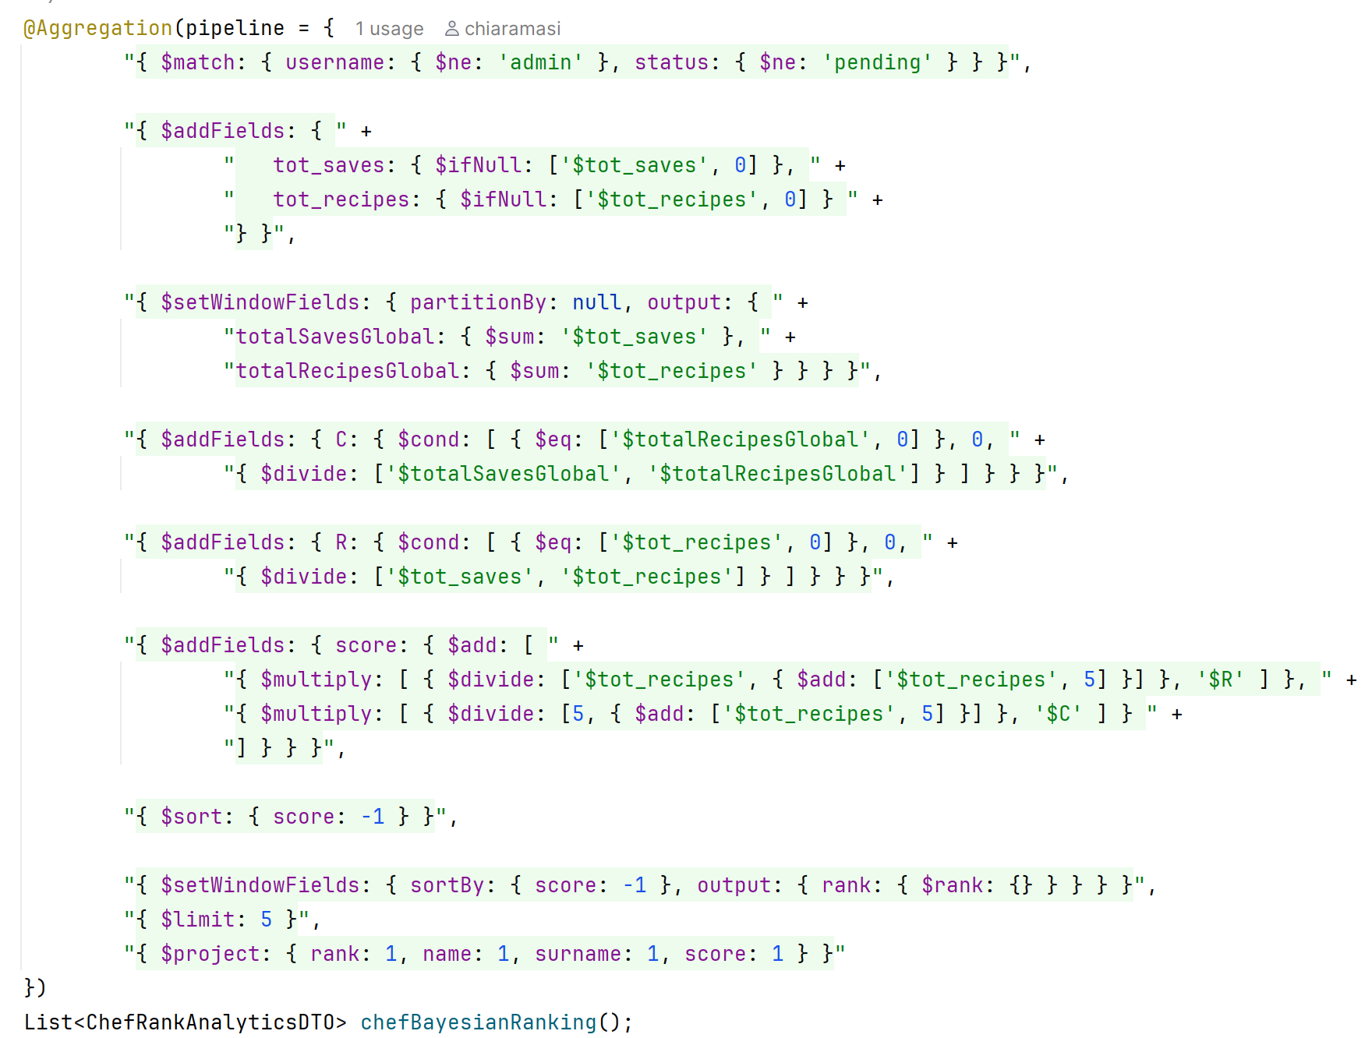
Relevant MongoDB queries
Chef Ranking using Bayesian Score
This query ranks chefs through a Bayesian score that combines their total number of saves and the total number of recipes, highlighting the most consistently appreciated profiles.

Slide 26
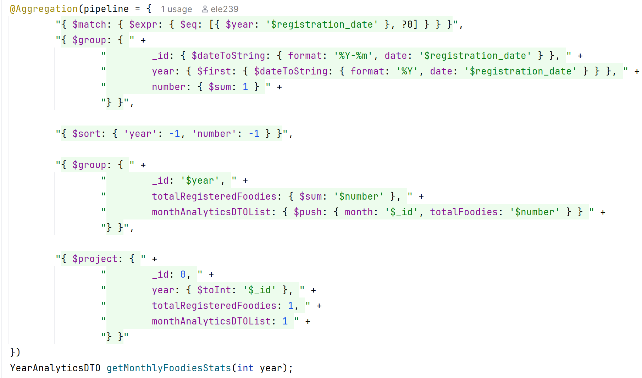
Relevant MongoDB queries
Monthly Foodie Registration Statistics
Filters Foodie registrations by a target year to compute the overall annual growth and detailed monthly acquisition metrics

Slide 27
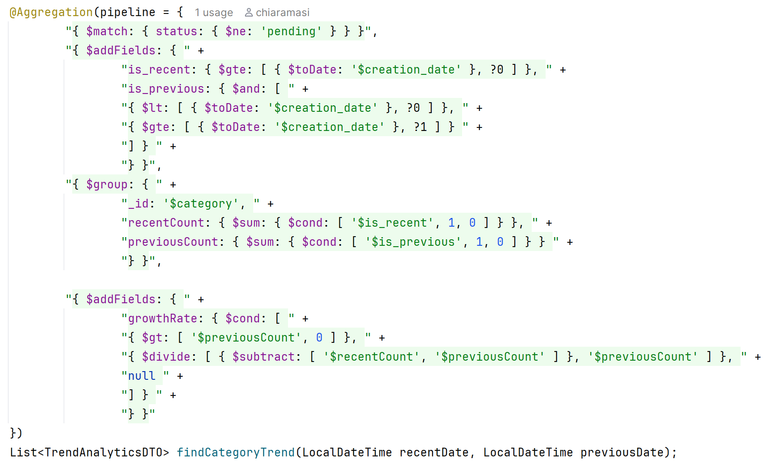
Relevant MongoDB queries
Category Trend Analysis
Compares the number of recipes created in a recent period with a previous one, identifying which categories are growing or decreasing over time.

Slide 28
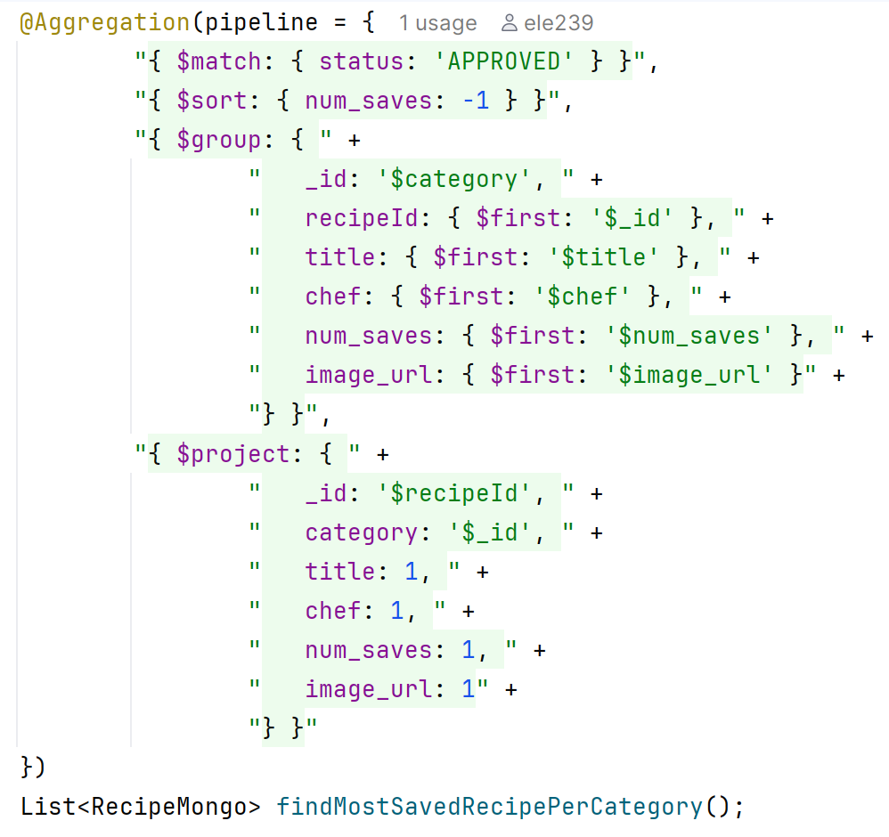
Relevant MongoDB queries
Most Saved Recipes per Category
This query identifies the most saved approved recipe for each category, highlighting the recipes that users appreciate the most within every food category.

Slide 29
MongoDB Replica Set Configuration
Three replicas were implemented with the following configuration:
{ _id: 0, host: 'mongo_machine1:10.1.1.92', priority: 5 }
{ _id: 1, host: 'mongo_machine2:10.1.1.91', priority: 2 }
{ _id: 2, host: 'mongo_machine3:10.1.1.90', priority: 1 }
The priority parameters are chosen to handle the election process in the event of a primary node failure.
Write Concern and Read Preference
Write Concern: Write concern 1 (W1). This ensures fast write operations and low latency, accepting a minimal risk of data loss in the rare event of a Primary failure immediately before the asynchronous replication to Secondaries occurs.
Read Preference: Nearest. This effectively distributes the read load across the available infrastructure and minimizes query response times.
Notes:
Show the configuration of the MongoDB Replica Set.
Show how Write Concern and Read Preference have been configured and justify this configuration highlighting how they support non-functional requirements.

Slide 30
MongoDB Indexes
Recipes Collection
Metric | Without index | With index
Documents returned | 5 | 5
Execution time | 73 ms | 2 ms
Index keys examined | 0 | 5
Documents examined | 15,832 | 5
creation_date (Descending Index)
Descending index on the creation_date field was added to drastically optimize the retrieval of the newest recipes
Metric
w/ Index (regex)
Metric | Without index | With Text index
Documents returned | 28 | 28
Execution time | 58 ms | 22 ms
Index keys examined | 0 | 1010
Documents examined | 15,832 | 1060
title (Text Index)
Users search via partial keywords or multi-word phrases (findByTitleContainingIgnoreCase).
category (Standard Index)
Metric | Without index | With index
Documents returned | 3011 | 3011
Execution time | 96 ms | 19 ms
Index keys examined | 0 | 3011
Documents examined | 15,832 | 3011
Added to optimize category-based recipe browsing, one of the most frequent operation in the application.
Notes:
Show indexes defined. Justify their usage and validate them experimentally (show query performance with and w/o the indexes).

Slide 31
MongoDB Indexes
Chefs Collection
username (Unique Index)
Optimizes login, registration and profile retrieval and garantees the uniqueness of the usernames.
Metric | Without index | With index
Documents returned | 1 | 1
Execution time | 0 ms | 0 ms
Index keys examined | 0 | 1
Documents examined | 94 | 1
surname (Standard Index) ✗ Not retained
Evaluated for improving surname-based chef search. Considered not strictly necessary in the current version, it could become relevant as the collection grows.
Foodies Collection
username (Unique Index)
Introduced for data integrity during registration.
Ensures no two foodies can register with the same username.
Useful for the most frequent operations such as login
Notes:
Show indexes defined. Justify their usage and validate them experimentally (show query performance with and w/o the indexes).

Slide 32
Discussion on MongoDB Data Sharding
MongoDB
Foodies (Hashed on username): Uniform data distribution. Optimizes the authentication process by enabling highly efficient, direct lookups without broadcast queries.
Chefs (Future: Hashed on _id): Currently unsharded due to low volume. The future strategy prioritizes high-frequency profile reads over a slight overhead during login.
Recipes (Hashed on _id): Optimizes the retrieval of recipe details (dominant operation).
Redis (Smart Fridge & Shopping List)
Current Architecture: Sentinel Master-Slave. The workload is heavily read-bound, making a Cluster/Sharding approach unnecessary at this stage.
Future Development: If write operations increase, the system will migrate to a Redis Cluster. It will adopt a key hashing strategy using Hash Tags to ensure all data for a single user is routed to the same shard.
Notes:
Argue about possible data sharding strategies highlighting why these strategies could bring benefits w.r.t. application functional and non-functional requirements.
Da aggiustare

Slide 33
Key-value DB Design
Keys Naming Conventions across the different features
Shopping List
Foodie: <username> : shoppingList
Smart Fridge
Foodie: <username> : smartFridge : ingredients
Foodie: <username> : smartFridge : suggestions
Allowed_ingredients
Allowed Ingredients
Notes:
Show the Redis data model (which names have been chosen for keys? Which values are stored within keys?) and justify choices.
Show the implemented queries highlighting how the system benefits from the proposed DB design.
If needed, make also reference to the Mock-ups (for the view supported by the designed key)

Slide 34
Key-value DB Design
Allowed Ingredients
Centralized in-memory set that validates ingredients across the whole platform, both in Foodies' lists and Chefs' recipe creation.
Shopping List
Set of ingredients a Foodie plans to buy. Every input is normalized to lowercase before storage.
SMEMBERS Allowed_ingredients
"pork belly"
"mascarpone cheese"
"brown sugar"
"..."
SMEMBERS Foodie:sierra.mitchell:shoppingList
"butter"
"bread"
"spaghetti pasta"
"avocados"
Notes:
Show the Redis data model (which names have been chosen for keys? Which values are stored within keys?) and justify choices.
Show the implemented queries highlighting how the system benefits from the proposed DB design.
If needed, make also reference to the Mock-ups (for the view supported by the designed key)

Slide 35
Key-value DB Design
Smart Fridge – Ingredients
Set of ingredients a Foodie has at home (same lowercase normalization as the Shopping List). A recipe is suggested when at least 3 of them match.
Smart Fridge – Suggestions
Computed via the Graph DB, then cached in Redis as a sorted JSON list to reduce latency.
SMEMBERS Foodie:sierra.mitchell:smartFridge:ingredients
”bread"
"butter"
"avocados“
GET Foodie:sierra.mitchell:smartFridge:suggestions
[ {
"id" : "69cea24e14f896db429ba7b7",
"title" : "Best Chicken Panini",
"chef" : "Gordon Ramsay",
"matchCount" : 3,
"matchedIngredients" : [ "bread", "butter", "avocados" ]
}, { ... } ]
Notes:
Show the Redis data model (which names have been chosen for keys? Which values are stored within keys?) and justify choices.
Show the implemented queries highlighting how the system benefits from the proposed DB design.
If needed, make also reference to the Mock-ups (for the view supported by the designed key)

Slide 36
Redis Replica Set Configuration
To guarantee high availability and eliminate a critical Single Point of Failure (SPOF) for caching and session management, a Master-Replica architecture was implemented.
The data topology distributes:
Single Master node on machine 10.1.1.92
Two Replica nodes on machines 10.1.1.91 and 10.1.1.90
All nodes are operating on port 6379 and Sentinel on port 7004.
To ensure fault tolerance, Redis Sentinel is configured across the infrastructure, in order to constantly monitor the state of the nodes.
Notes:
Show the configuration of the Redis DB: did you configure a key eviction policy? Which one and why? How did you handle persistence and why? Did you configure a clustered (sharded/partitioned) DB? Why?
Discuss replica configuration. Replicas should be deployed on the same Virtual Machines than the ones of MongoDB (obviously listening on different port numbers)

Slide 37
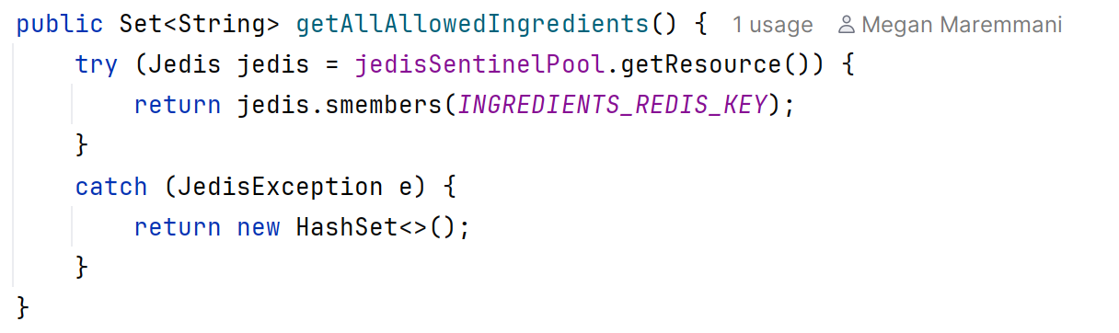
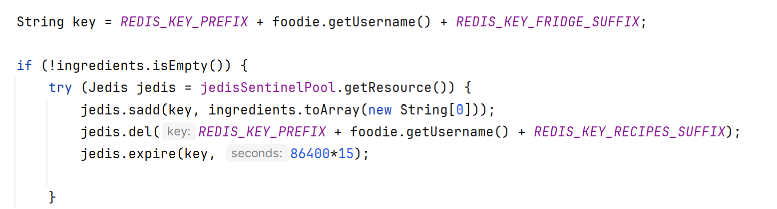
Relevant Redis queries
Ingredients Management
Shopping List & Smart Fridge Management – add ingredient(s)
Notes:
Show the configuration of the Redis DB: did you configure a key eviction policy? Which one and why? How did you handle persistence and why? Did you configure a clustered (sharded/partitioned) DB? Why?
Discuss replica configuration. Replicas should be deployed on the same Virtual Machines than the ones of MongoDB (obviously listening on different port numbers)

Slide 38
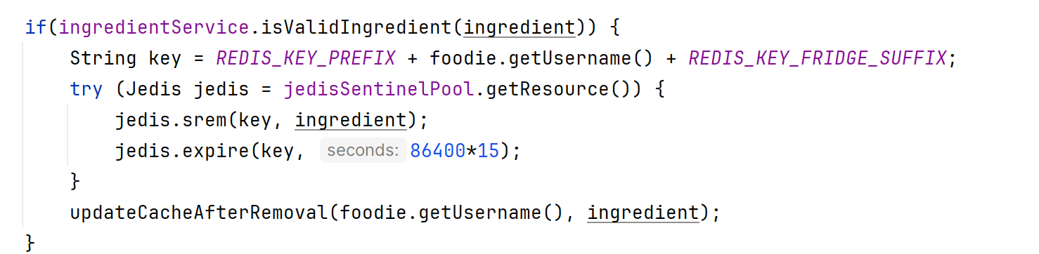
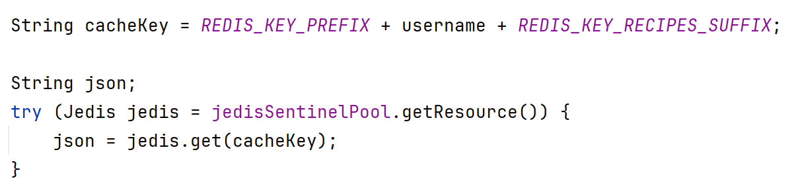
Relevant Redis queries
Shopping List & Smart Fridge Management – remove ingredient
Recipe Suggestions Caching
Notes:
Show the configuration of the Redis DB: did you configure a key eviction policy? Which one and why? How did you handle persistence and why? Did you configure a clustered (sharded/partitioned) DB? Why?
Discuss replica configuration. Replicas should be deployed on the same Virtual Machines than the ones of MongoDB (obviously listening on different port numbers)

Slide 39
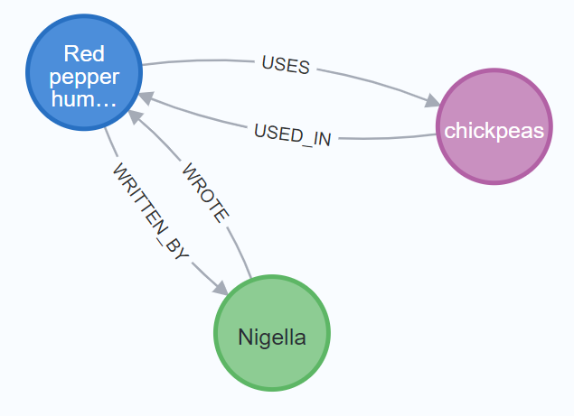
Graph DB Design
Nodes
Chef: authors of the recipes with basic information: mongo_id, name and surname.
Ingredient: ingredients used in recipes.
Recipe: recipes in the system. Each node contains: mongo_id, title, image URL and category.
Relations
:USED_IN: connects an Ingredient to a Recipe, representing which ingredients are used in a given recipe.
:USES: connects a recipe to an ingredient, is the inverse of USED_IN
:WRITTEN_BY: connects a Recipe to a Chef, representing the author of the recipe.
:WROTE: connects a Chef to a Recipe. Is the inverse navigation of :WRITTEN_BY
Notes:
Show the most important implemented ”graph-based” queries (suggestions and analytics) highlighting how the system benefits from the proposed DB design. Use Cypher Language
Show the Neo4j data model (show the graph structure in terms of nodes, edges and properties) and justify choices.
If needed, make also reference to the Mock-ups (for the view supported by the designed key)
Use max 3 slides

Slide 40
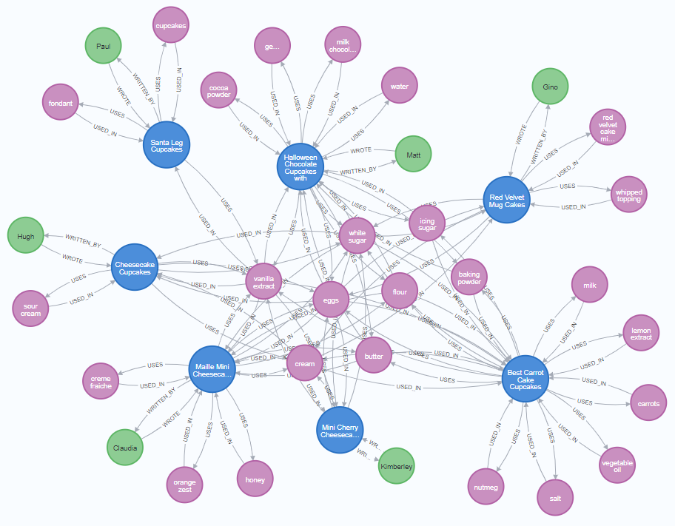
Graph DB Design
Notes:
Show the most important implemented ”graph-based” queries (suggestions and analytics) highlighting how the system benefits from the proposed DB design. Use Cypher Language
Show the Neo4j data model (show the graph structure in terms of nodes, edges and properties) and justify choices.
If needed, make also reference to the Mock-ups (for the view supported by the designed key)
Use max 3 slides

Slide 41
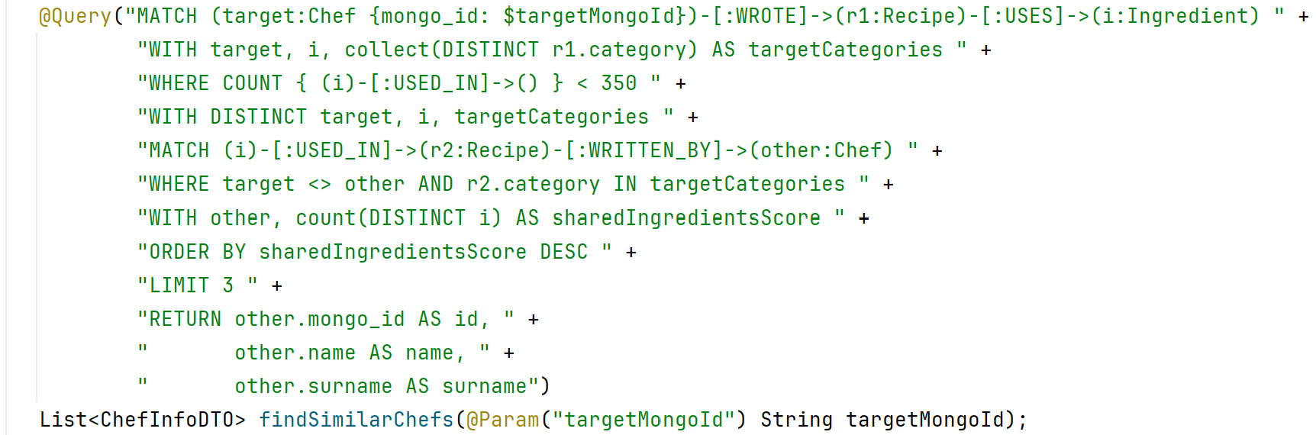
Relevant Neo4j queries
Similar Chefs by Shared Ingredients
Identifies most similar chefs by analyzing shared specialized ingredients within matching recipe categories.

Slide 42
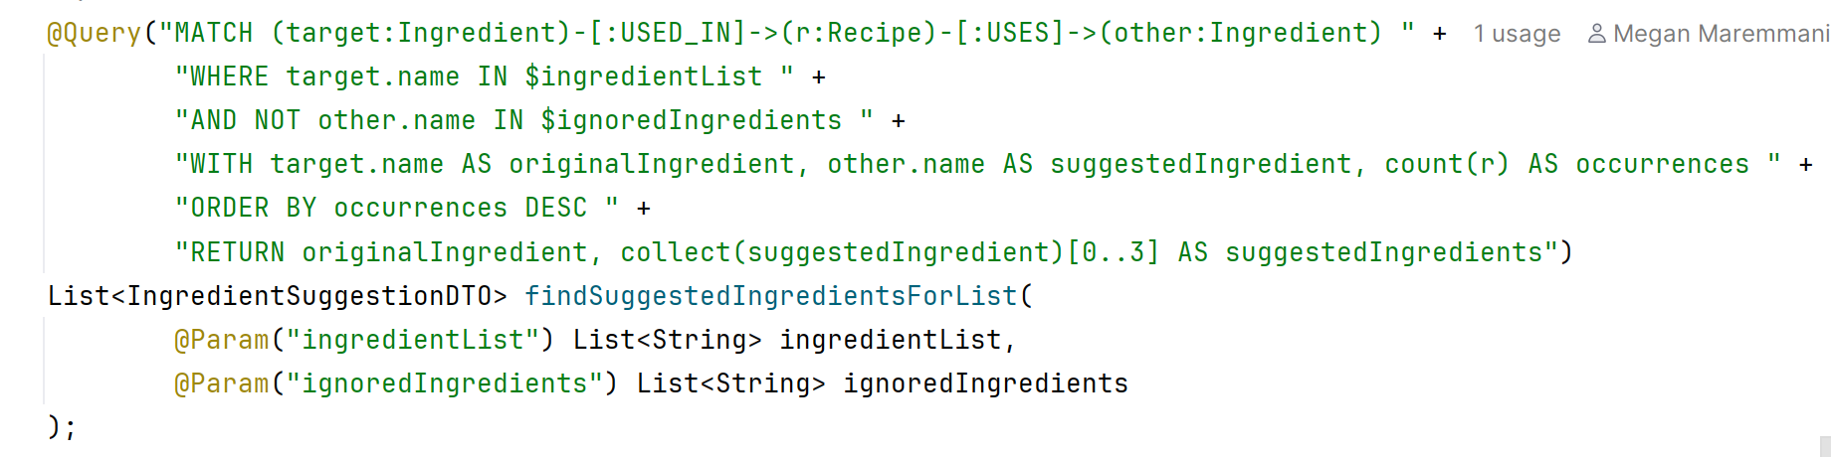
Relevant Neo4j queries
Suggested Complementary Ingredients
Recommends complementary ingredients by finding the ones most frequently paired with the user's current shopping list, filtering out the list itself and most common ingredients

Slide 43
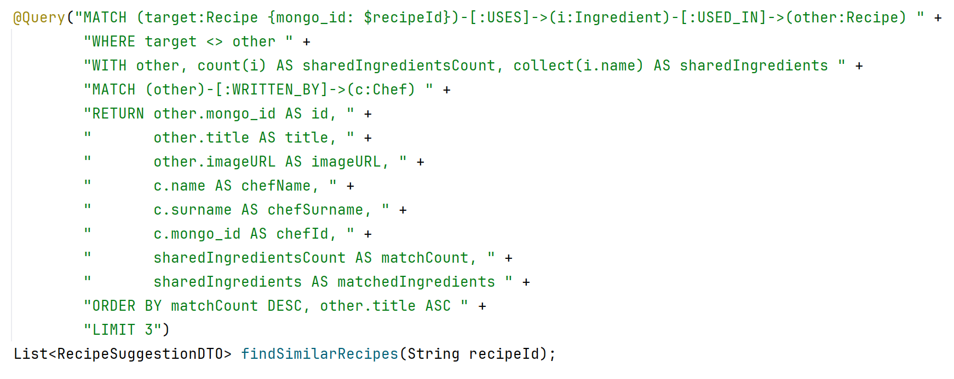
Relevant Neo4j queries
Similar Recipes
The query recommends similar recipes by exploiting ingredient-based relationships, ranking results according to the number of shared ingredients with the selected recipe.

Slide 44
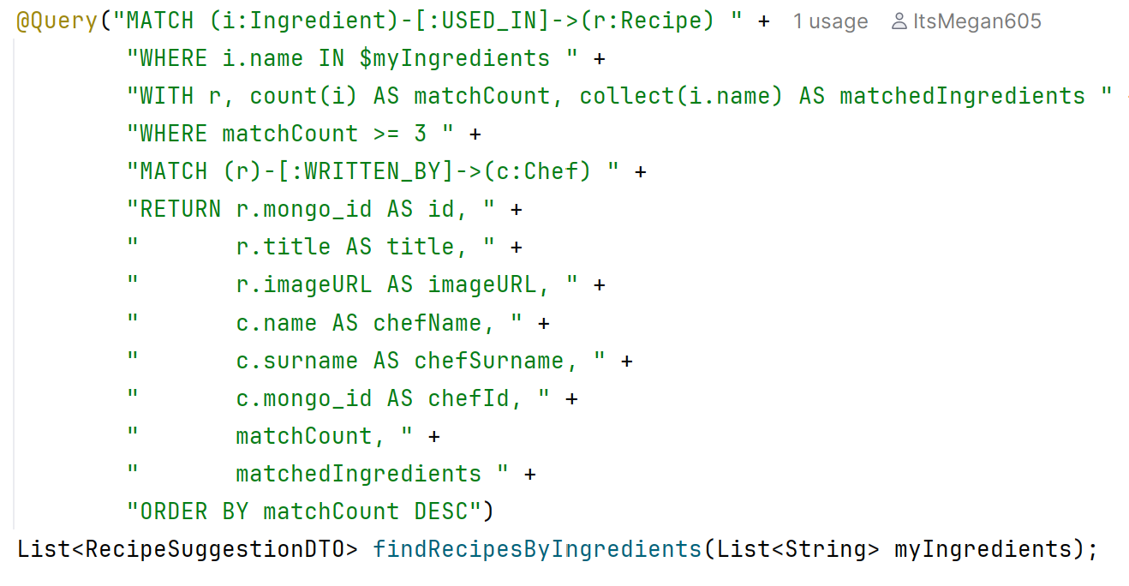
Relevant Neo4j queries
Smart Fridge Recipe Suggestions
The query suggests recipes that uses at least three ingredients of the foodie’s smart fridge, prioritizing those with the highest number of ingredient matches.

Slide 45
Neo4j Indexes
All Neo4j queries start from a specific node identified by a unique property. Without indexes, every lookup performs a full AllNodesScan (~18,859 nodes).
Performance Tests
Execution of most relevant queries
Tests repeated 5 times clearing query cache between each request
All indexes transform AllNodesScan (full graph scan) into NodeIndexSeek (direct access), eliminating the expensive initial lookup phase.
Query
Index
DB Hits (before → after)
Time
Smart Fridge Suggestion
ingredient_name_idx
51,733 → 11,080
53 ms → 28 ms
Find Similar Chef
chef_mongo_id_idx
661,062 → 623,252
206 ms → 191 ms
Similar Recipes Suggestion
recipe_mongo_idx
79,948 → 39,296
100 ms → 62 ms
Notes:
Show indexes defined (if any). Justify their usage and validate them experimentally (show query performance with and w/o the indexes).

Slide 46
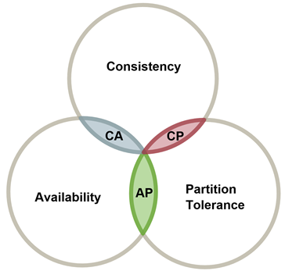
CAP – theorem consideration
The two selected properties from the CAP theorem for the system were Availability and Partition Tolerance (AP)
Ensures that the system remains accessible and responsive to users.
Allows the system to continue operating despite network partitions.
Notes:
Max 3 slides

Slide 47
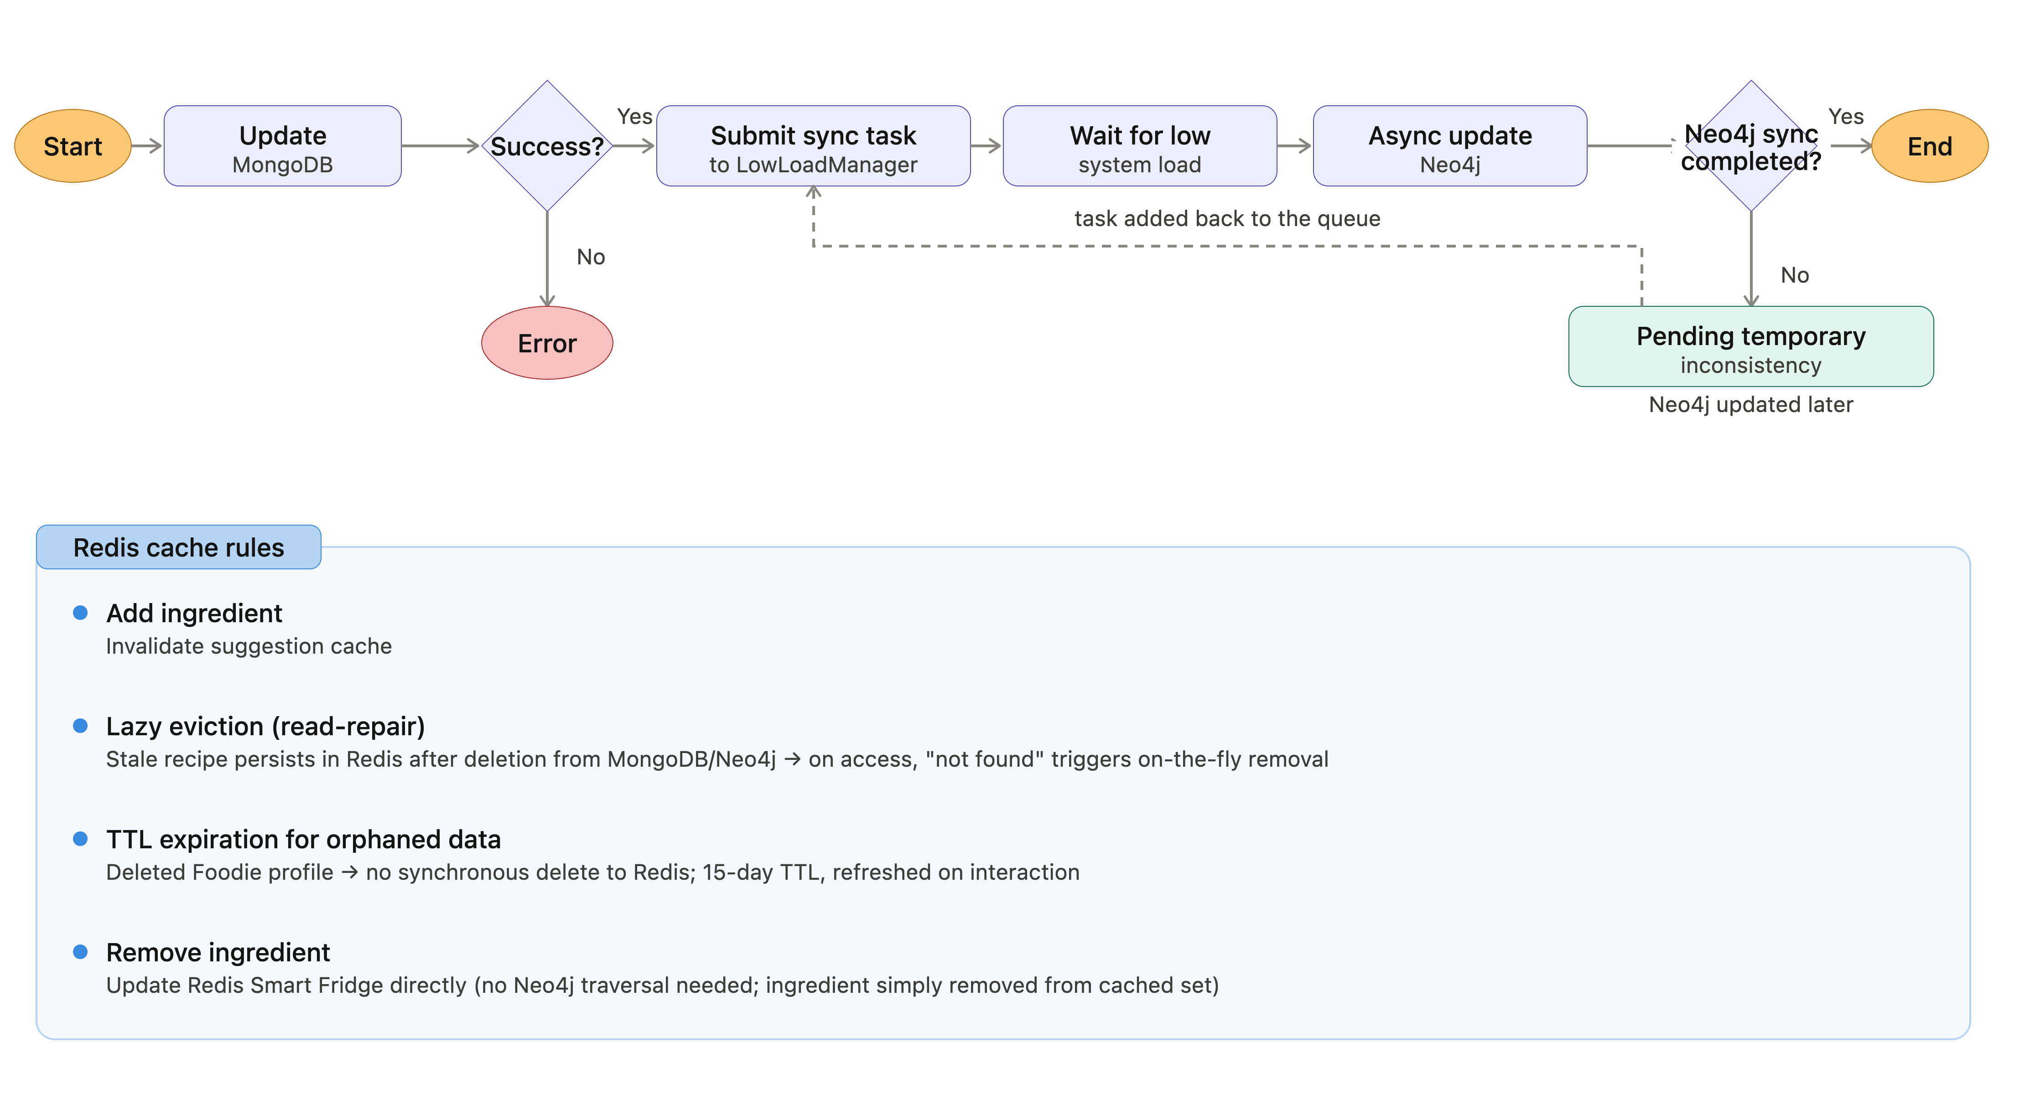
Handling Intra-DB Consistency

Slide 48
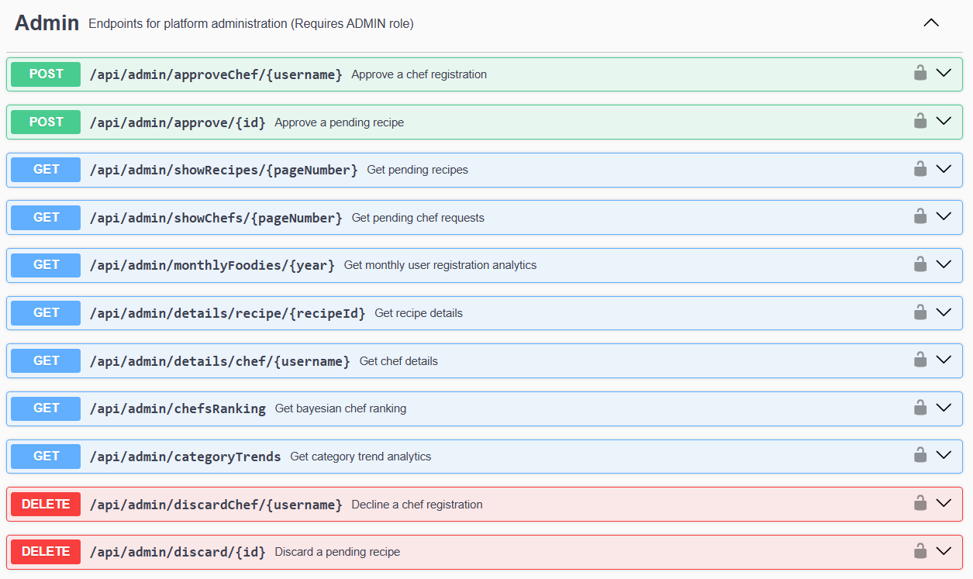
Swagger UI REST APIs documentation
Overview
Admin
Notes:
Report here screenshots from the Swagger UI page to present the main entities and their related endpoints. Also, show the Swagger UI page live and show the details of some relevant endpoints, illustrating its purpose, input parameters (if any), and expected responses, including success and error scenarios.

Slide 49
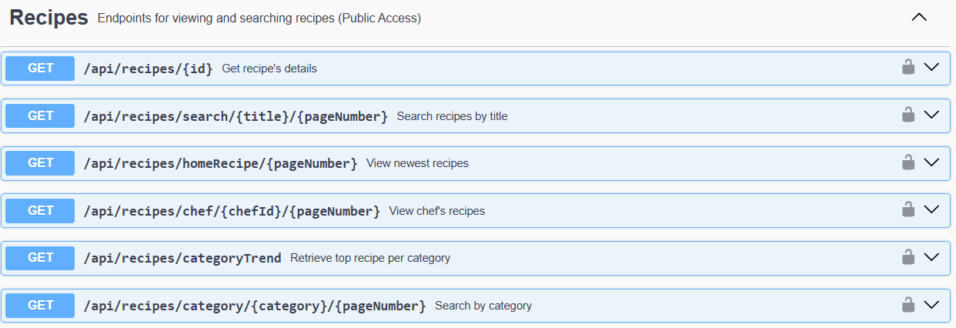
Swagger UI REST APIs documentation
Recipes
Notes:
Report here screenshots from the Swagger UI page to present the main entities and their related endpoints. Also, show the Swagger UI page live and show the details of some relevant endpoints, illustrating its purpose, input parameters (if any), and expected responses, including success and error scenarios.

Slide 50
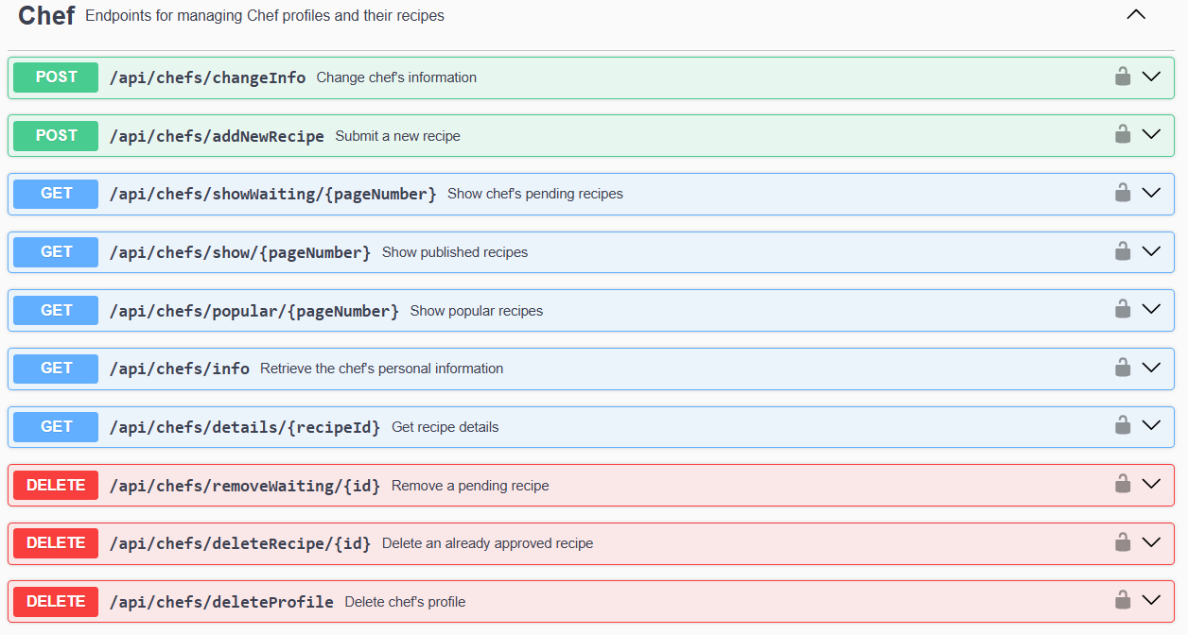
Swagger UI REST APIs documentation
Chef

Slide 51
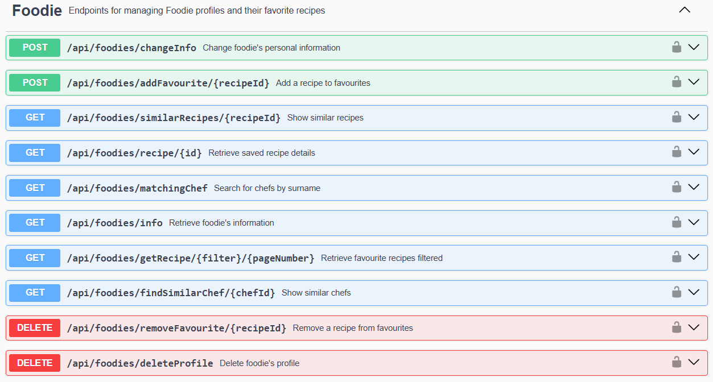
Swagger UI REST APIs documentation
Foodie

Slide 52


Swagger UI REST APIs documentation
Auth
Ingredients

Slide 53


Swagger UI REST APIs documentation
SmartFridge
ShoppingList

Slide 54

Java doc documentation

Slide 55

Live Demo with Postman
Notes:
Show the Postman Collection containing all the REST endpoints exposed by your application (e.g. authentication, product management, analytics, etc.)
Detailed endpoints descriptions: endpoint purpose, required input parameters with example values .
Show live testing of some relevant endpoints of your application within Postman. Also show how error scenarios are handled (bad requests and exceptions; Missing or invalid parameters; Unauthorized access attempts; Endpoint-specific edge cases (e.g., trying to fetch a non-existent resource).

