Slide 1
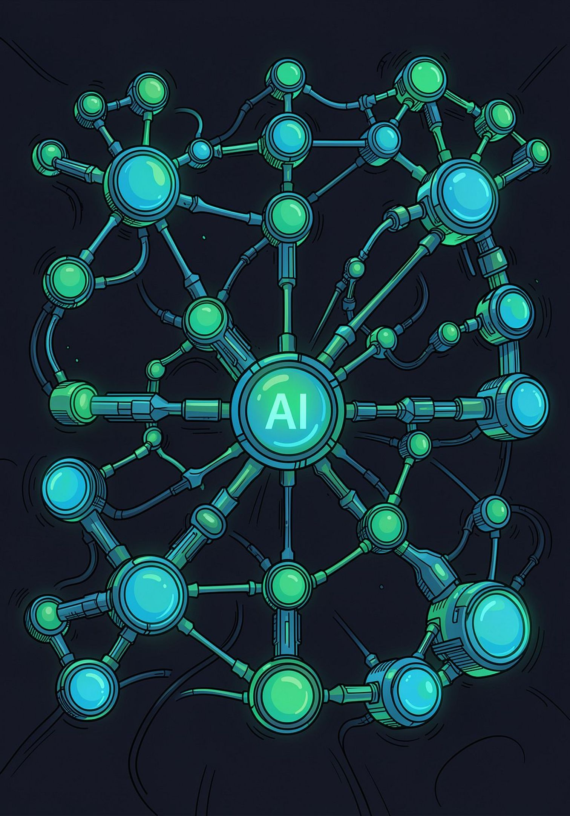
AI-Powered Event Management System
Using n8n and Generative AI
Automating the Complete Event Lifecycle using Workflow Automation and Artificial Intelligence
Nayantika Bhattacharya · B.Tech CSE (AI & ML) · KIIT University

Slide 2

The Challenge of Scaling Events
As participant numbers grow, manual event management becomes unsustainable — introducing errors, delays, and a poor experience for both organizers and attendees.
❌ Manual Approach
Registration via forms & spreadsheets
Confirmation emails sent by hand
Physical attendance marking
Reminder emails manually drafted
Feedback reviewed one by one
✅ Automated Approach
Form-triggered instant registration
AI-generated personalized emails
QR-based digital check-in
Scheduled smart reminders
AI sentiment analysis on feedback

Slide 3


Problem Statement
Traditional event management relies on repetitive manual processes that are error-prone, slow, and difficult to scale.
Human Errors
Delayed Communication
Manual data entry leads to duplicate records, typos, and missed participants.
Confirmation and reminder emails are sent late or forgotten entirely.
Time-Consuming Attendance
Manual Feedback Analysis
Physical check-ins create queues and consume organizer bandwidth.
Reading and summarizing hundreds of responses is impractical without AI.
Project Goal: Build an end-to-end automated event management system powered by n8n workflows and Gemini AI — eliminating manual effort at every stage.

Slide 4






Project Objectives
Automated Registration
QR Code Generation
Trigger workflows on Google Form submission with instant ID generation.
Auto-generate unique QR codes for every registered participant.
AI Email Generation
QR Attendance System
Gemini AI drafts personalized welcome, reminder, and notification emails.
Scan-to-check-in via webhook with real-time Google Sheets updates.
AI Feedback Analysis
Reduce Organizer Workload
Automated sentiment scoring and summary generation from feedback forms.
Eliminate repetitive manual tasks so organizers focus on strategy.

Slide 5
Existing System vs. Proposed System
The proposed system replaces every manual touchpoint with intelligent automation — reducing errors, accelerating processing, and improving the participant experience at every stage.
Existing System
Proposed System
Manual Registration
Automated Registration
Manual Emails
AI-Generated Emails
Manual Attendance
QR-Based Attendance
Manual Feedback Analysis
AI Sentiment Analysis
High Human Error
Low Human Error
Time-Consuming
Fast Processing
⚡ Faster Processing
🎯 Low Error Rate
🤖 AI-Powered
Instant responses instead of delayed manual actions
Automated validation eliminates duplicate records
Gemini AI handles content generation and analysis

Slide 6
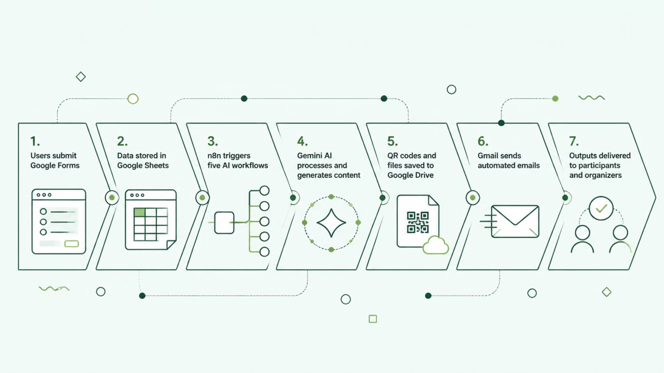
System Architecture
The system uses a layered, event-driven architecture where Google Workspace acts as the data layer, n8n orchestrates five intelligent workflows, and Gemini AI powers all content generation and analysis.
Input Layer
Orchestration
Google Forms & Sheets
n8n Workflows
AI Engine
Output Layer
Gemini AI
Gmail, Drive, Sheets

Slide 7
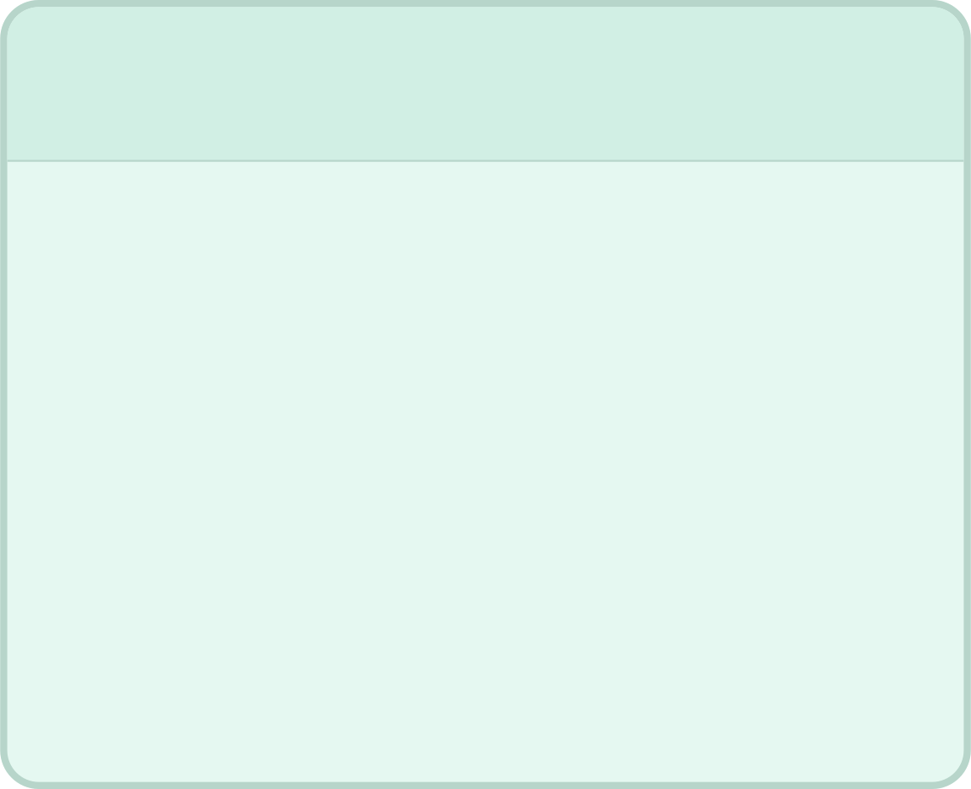
Core Workflows 1–3
N8N AUTOMATION
1
2
3
Registration & Participant Management
QR Check-In System
AI Reminder Email Automation
Scan QR → Webhook Trigger → Verify Participant → Update Attendance Sheet → Instant Response
Form submission → Generate Registration ID → Generate QR Code → Upload to Drive → AI Welcome Email → Confirmation Email
Schedule Trigger → Read Google Sheets → Gemini AI drafts reminder → Send via Gmail
📸 Workflow Screenshots: n8n canvas for Workflows 1–3, Google Form, generated QR code, and sample AI email output.

Slide 8
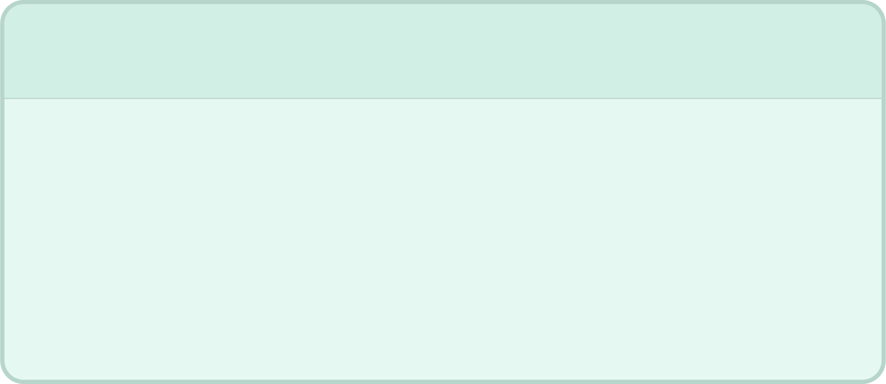

Core Workflows 4–5
N8N AUTOMATION
1
2
AI Notification Automation
AI Feedback Analyzer
Read Participant Data → JavaScript Formatting → Gemini AI personalizes content → Send Notification Email via Gmail
Feedback Form → Google Sheets → Gemini AI Sentiment Analysis → Generate Summary → Update Sheet with scores
📸 Workflow Screenshots: n8n canvas for Workflows 4–5, sample notification email, and AI feedback sentiment summary in Google Sheets.

Slide 9





Technologies Used
n8n
Gemini AI
Google Workspace
Open-source workflow automation orchestrating all five AI pipelines.
Google's generative AI for email drafting, summarization, and sentiment analysis.
Forms, Sheets, Drive, and Gmail serve as the data and communication backbone.
JavaScript & Webhooks
QuickChart API
Custom logic nodes and webhook triggers enable real-time event handling.
Generates QR codes programmatically within the n8n registration workflow.

Slide 10
Results, Future Scope & Conclusion
Key Achievements
Conclusion
End-to-end event automation
Instant QR code generation
AI-powered email & feedback analysis
Reduced manual workload
This system demonstrates how n8n and Gemini AI can fully automate the event lifecycle — from registration to feedback — with minimal human intervention.
Thank You
Future Scope
Questions?
Nayantika Bhattacharya
B.Tech CSE (AI & ML) · KIIT University
Certificate generation & WhatsApp integration
Mobile app & dashboard analytics
Payment gateway & SMS alerts
Predictive analytics & multilingual support

