Slide 1

Cafe Telegram Bot
Food Ordering System with Django Backend
Final Project · Programming in Python

Slide 2
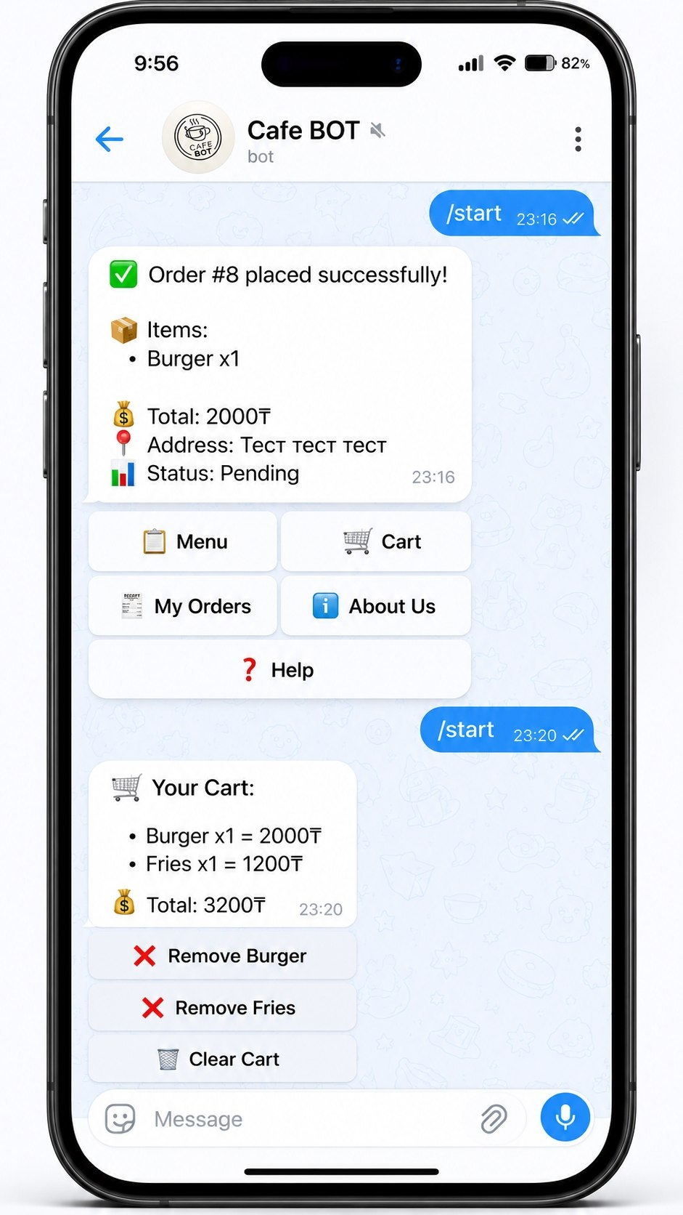
Project Overview
Telegram Bot
Django Backend
Interactive inline-keyboard bot built with pyTeleBot library. Users order food through a chat interface.
Django project stores and manages orders in an SQLite database. Admin panel for order management.
Integration
Bot and Django run in the same Python process, sharing the ORM layer to read/write orders in real time.

Slide 3
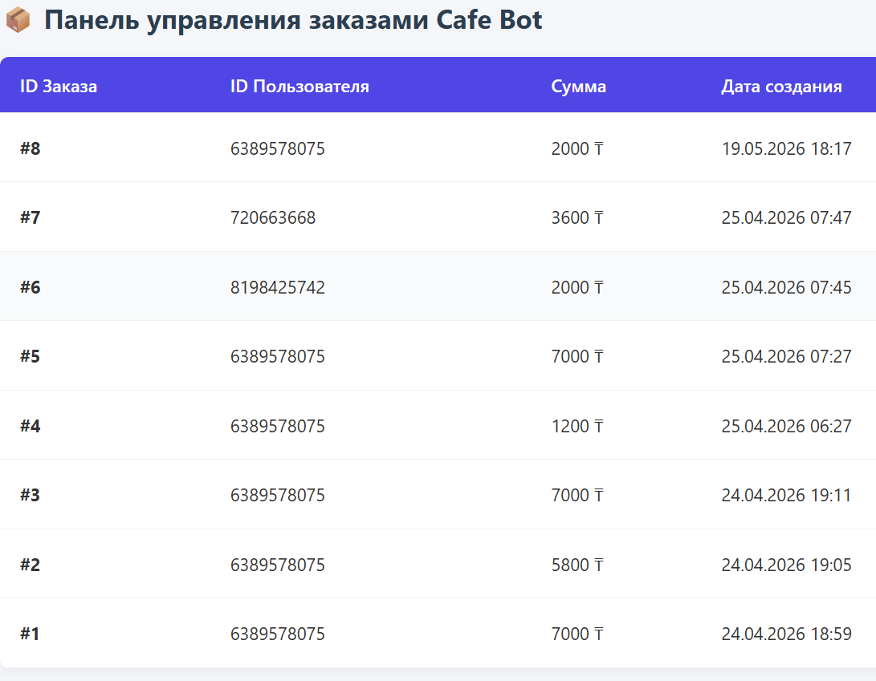
Project Goal
Develop a working Telegram chat-bot that automates food ordering for a cafe — from browsing the menu to placing and tracking orders.
Interactive UI
Robust Handling
Inline keyboard navigation — no typing needed for most actions.
Graceful error handling: empty input, bad address, DB errors, unknown commands.
Data Persistence
All orders saved to SQLite via Django ORM, visible in Admin panel.

Slide 4
Technologies Used
Python 3
Main language
Bot logic, state machine, data processing
pyTelegramBotAPI
Telegram interface
Handlers, inline keyboards, callback queries
Django 5
Web framework / ORM
Models, Admin panel, database migrations
SQLite
Database
Persistent order storage
json
Data serialization
Cart items stored as JSON in TextField

Slide 5
Architecture & Project Structure
User
(Telegram App)
Telegram
API Server
bot.py
(pyTeleBot)
Django ORM
(Models)
SQLite DB
db.sqlite3
Django Admin
(order status)
Project Structure
13 Request Handlers
project/
├── bot.py # all bot logic
├── requirements.txt
├── README.md
└── cafe_app1/
├── app/models.py # Order model
└── db.sqlite3
• /start /help /info
• main · menu · cart · info · help
• add_{item} · remove_{item}
• clear_cart · address · orders
• Unknown text → error reply

Slide 6
Interface Demo
Main Menu
Food Menu
Cart
Order Placed
☕ Welcome to our Cafe!
🍽 Choose items:
🛒 Your Cart:
✅ Order #N placed!
[ 📋 Menu ] [ 🛒 Cart ]
[ ➕ Burger — 2000₸ ]
• Burger x1 = 2000₸
📦 Burger x1, Cola x2
[ 🧾 My Orders ] [ ℹ️ About ]
[ ➕ Pizza — 3000₸ ]
• Cola x2 = 1600₸
💰 Total: 3600₸
[ ❓ Help ]
[ ➕ Cola — 800₸ ]
💰 Total: 3600₸
📍 Manasa 34/1
[ ➕ Fries — 1200₸ ]
❌️Remove (Item)
📊 Status: Pending
[ 📍 Place Order ]

Slide 7
Data Model — Order
Order (app/models.py)
Order Status Flow
id
AutoField
Primary key (auto)
PENDING
user_id
IntegerField
Telegram user ID
username
CharField
Telegram username
▼
COOKING
items
TextField
JSON: {item: qty, ...}
total
IntegerField
Total price in tenge
▼
DELIVERING
address
TextField
Delivery address
status
CharField
pending/cooking/delivering/done
▼
created_at
DateTimeField
Auto timestamp
DONE
Status is editable in Django Admin panel

Slide 8
Key Functions
1. Inline keyboard — menu
2. Save order to database
def menu_markup():
markup = InlineKeyboardMarkup()
for name, price in menu.items():
markup.add(InlineKeyboardButton(
f"➕ {name} — {price}₸",
callback_data=f"add_{name}"))
return markup
order = Order.objects.create(
user_id=user_id,
username=message.from_user.username,
items=json.dumps(basket),
total=total,
address=address
)
3. State machine — address input
4. Error handling — unknown input
user_states[user_id] = {
"state": "waiting_address",
"chat_id": call.message.chat.id,
"message_id": call.message.message_id
}
else:
bot.reply_to(
message,
"🤖 I didn't understand that.\n"
"Use /start or menu buttons.",
reply_markup=main_menu_markup()
)

Slide 9
Conclusion
13
Distinct
handlers
4
Thank you for your attention!
Error
cases
4
Order
statuses

Slide 10
Sources/References
1.Telegram Bot API Documentation
​​URL: https://core.telegram.org/bots/api
HTTP-based interface, webhook mechanics, InlineKeyboardMarkup objects,callback query handling.
​2.Django Web Framework & Object-Relational Mapping (ORM)
​​URL: https://www.djangoproject.com/
Database modeling, handling asynchronous object creation (Order.objects.create
​3.Academic Course Lectures (Lectures 7-14)
​Author / Lecturer: Saya Sapakova
​Course: Programming in Python, International IT University (IITU).
Provided foundational principles for multi-paradigm programming in Python
4.pyTelegramBotAPI (Telebot)
​​URL: https://github.com/eternnoir/pyTelegramBotAPI
Python implementation used to establish the main bot client and handle continuous server polling (infinity_polling).

