Slide 1
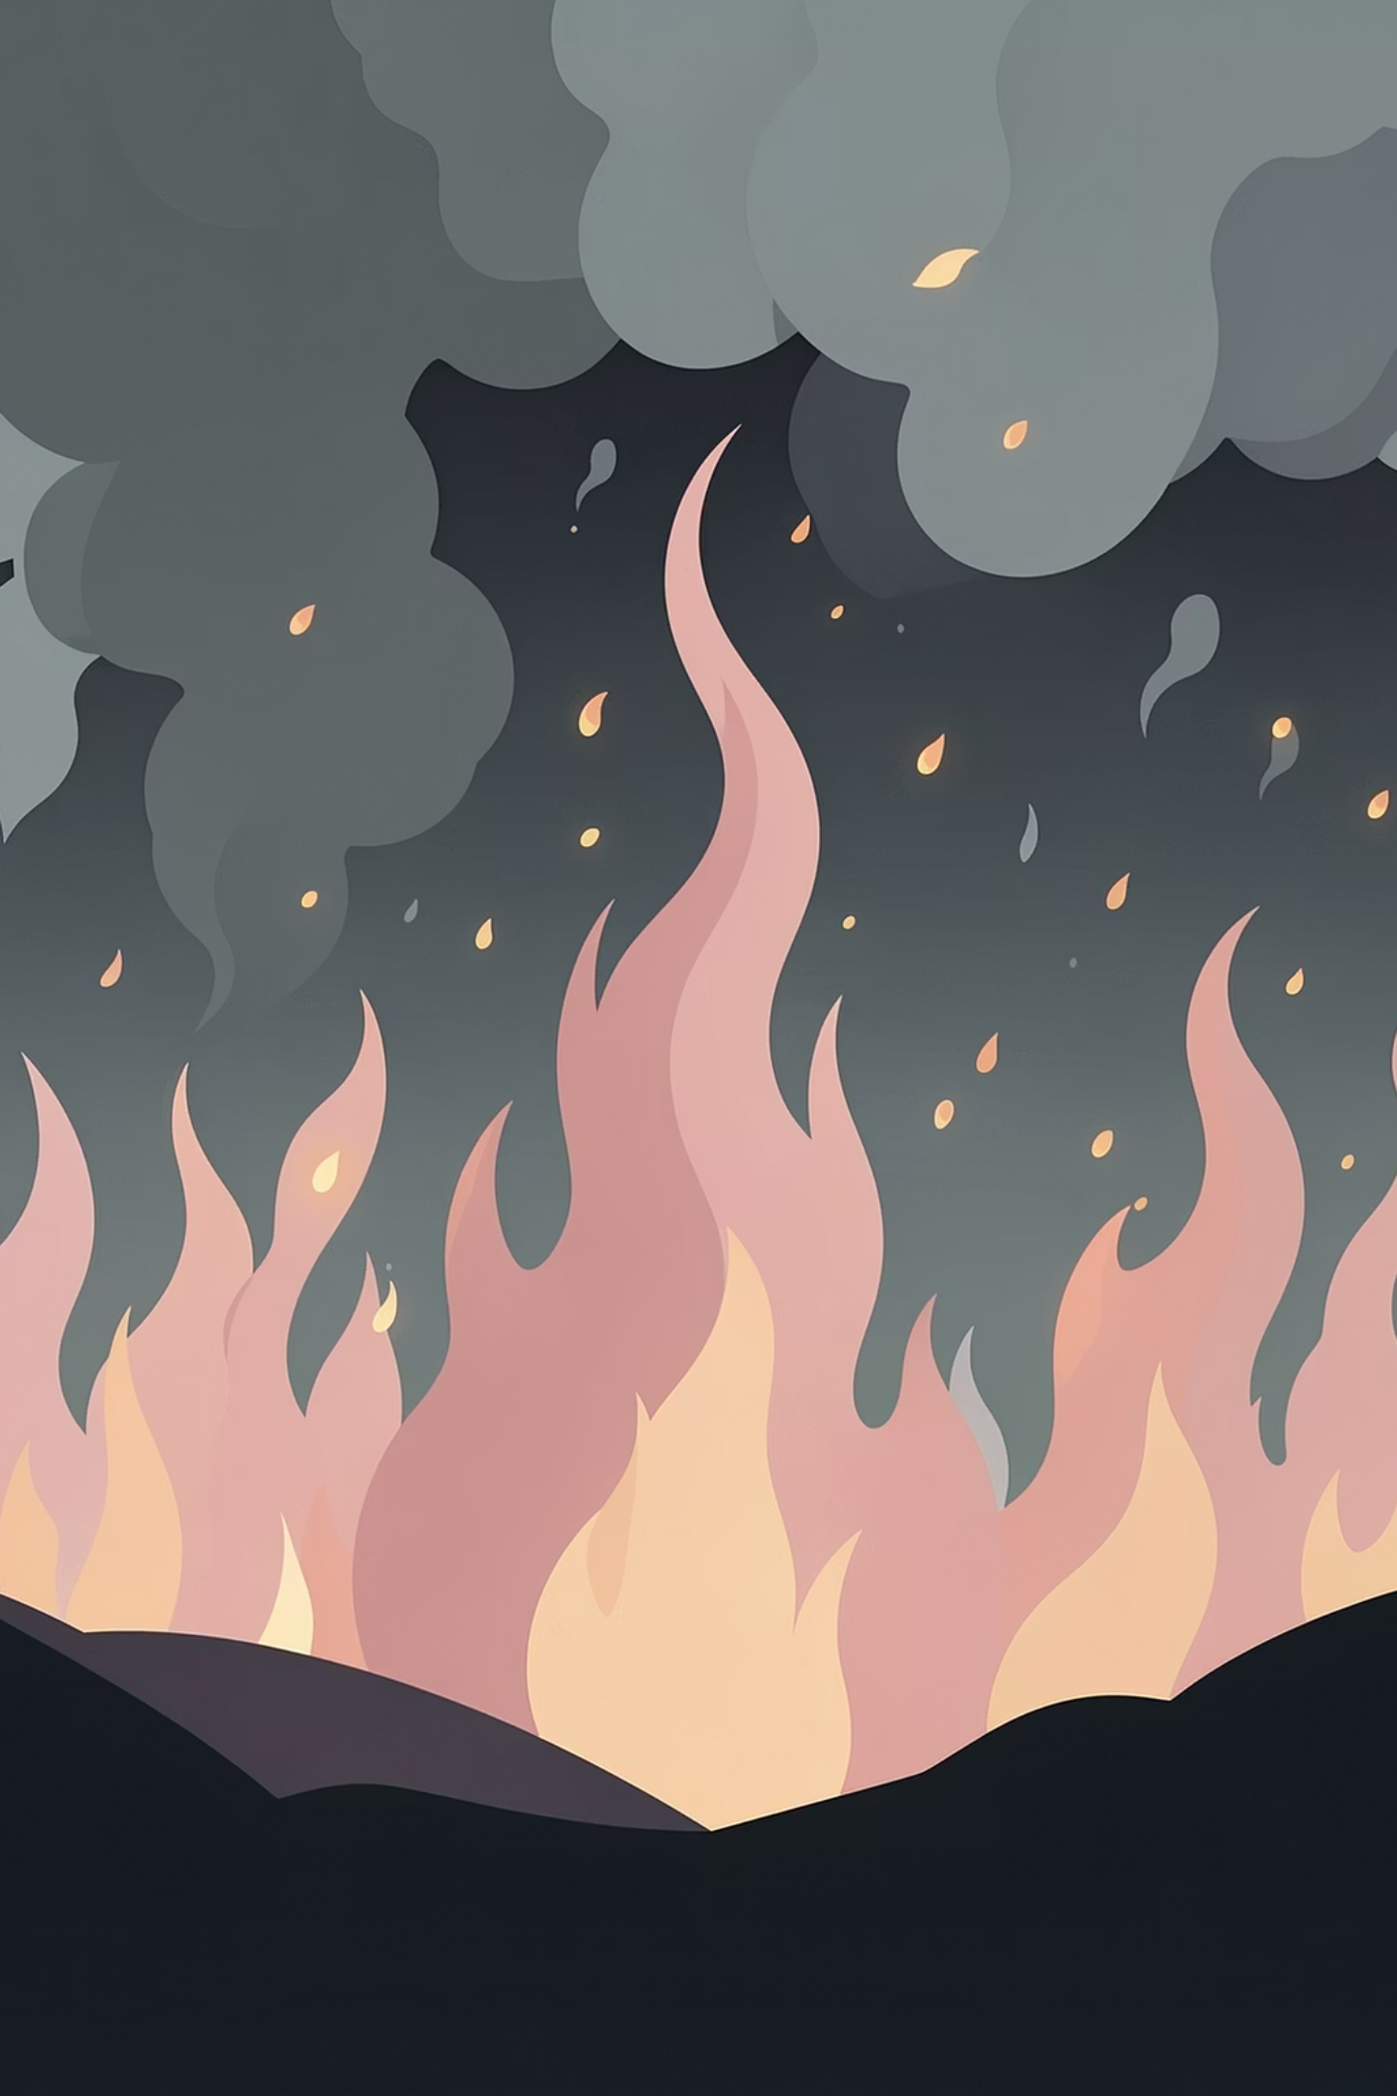
PyroWatch: Fire Detection System
AI-POWERED WILDFIRE DETECTION, RISK ASSESSMENT, AND SPREAD PREDICTION — integrating deep learning, satellite data, and weather intelligence.
. SPARSH KUMAR - S24CSEU0428
· SHIVRAJ SINGH BHATI - S24CSEU0511
. SAMAGRA GULATI - S24CSEU0451
· SHIKHAR SHUKLA - S24CSEU412

Slide 2
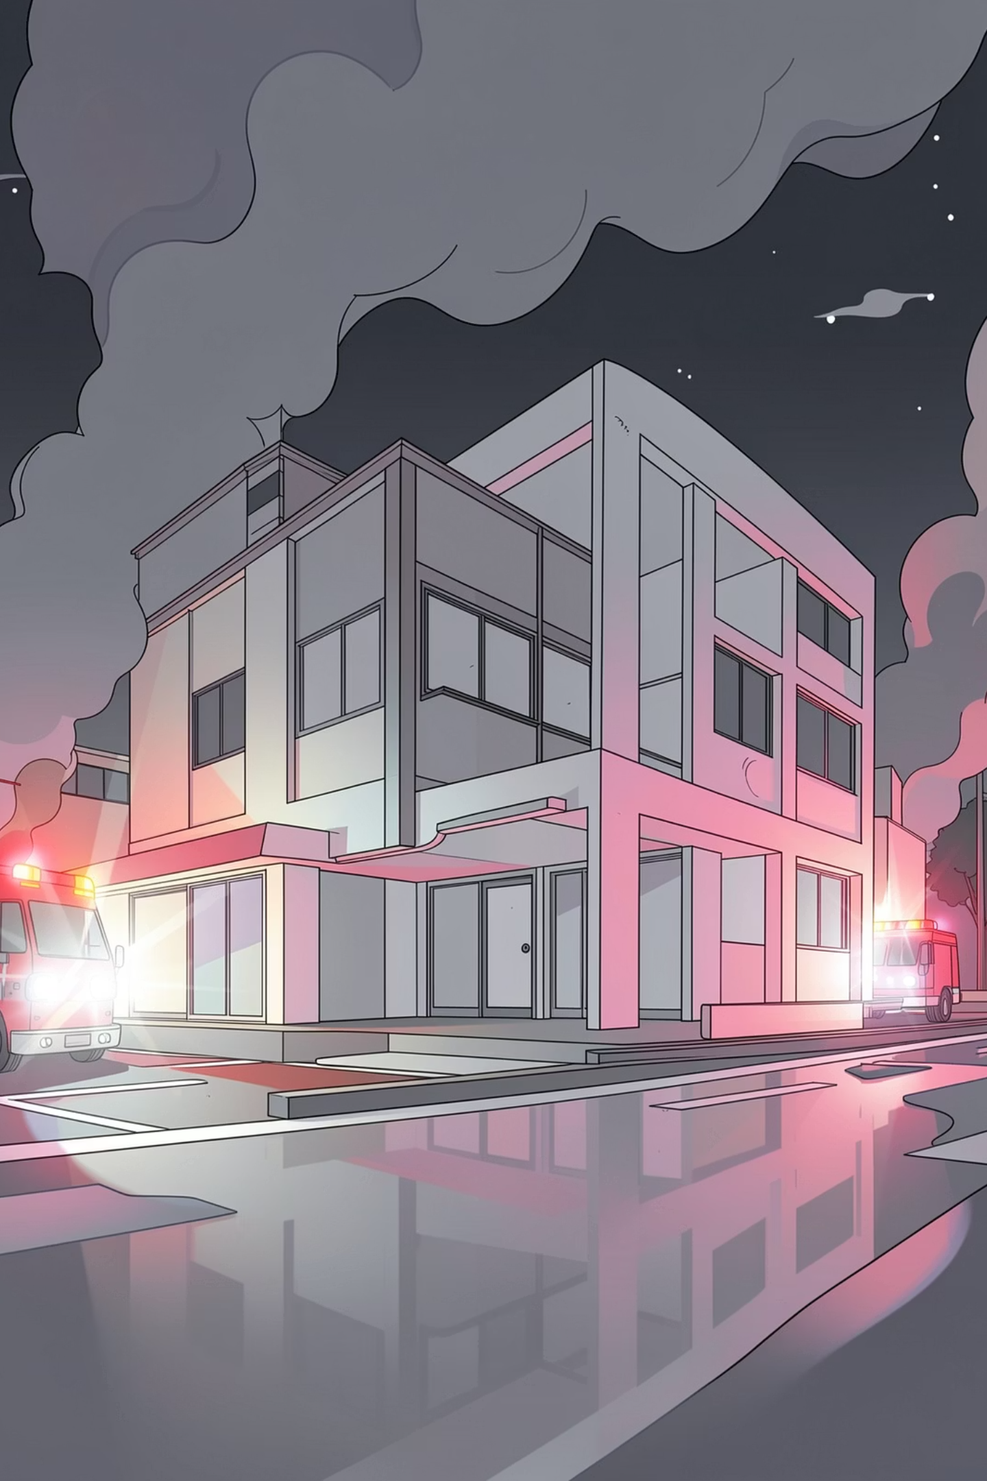

The Problem
🔥 Devastating Wildfire Impact
📡 Limited Detection Capabilities
Wildfires burn 4 million km² annually, causing billions in damages and massive carbon emissions. Early detection is critical for effective response.
Traditional systems rely on smoke detectors or manual surveillance — slow, localized, and unable to predict risk or spread patterns.
🔀 Fragmented Data Sources
Satellite data, weather information, and image analysis exist in silos — no unified platform for comprehensive wildfire intelligence.

Slide 3
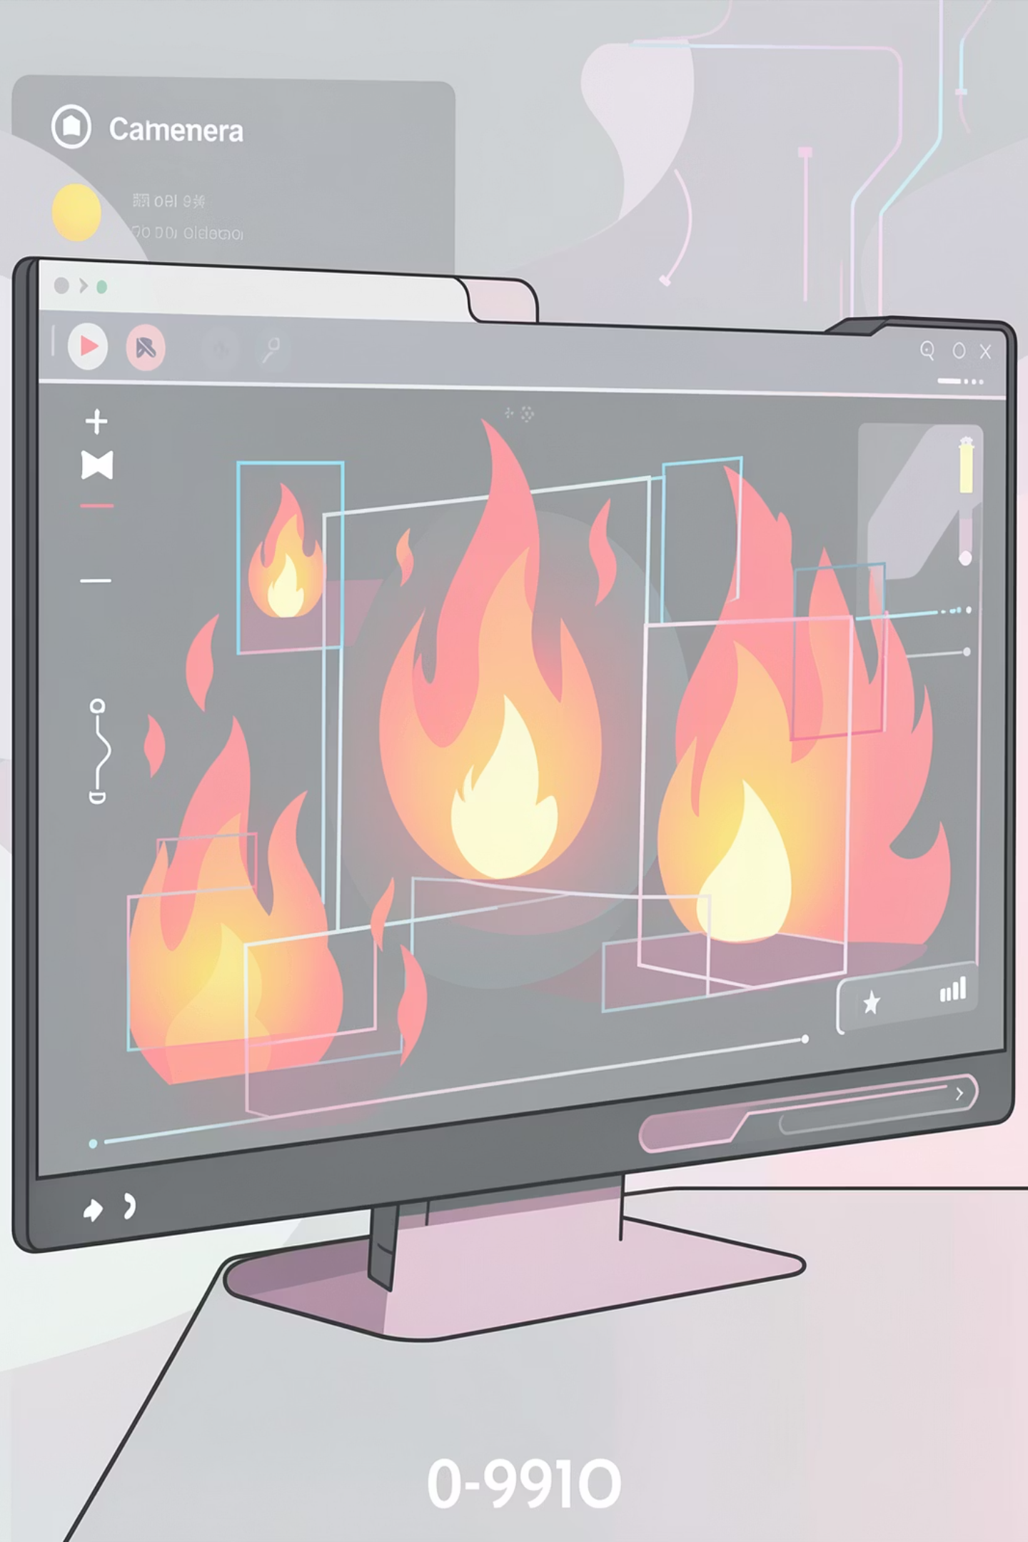
Objectives
Detect Fire with AI Precision
Use state-of-the-art Vision Transformer (ViT) deep learning to classify fire vs no-fire from satellite and aerial imagery with 96.3% accuracy.
Assess Ignition Risk in Real-Time
Predict fire ignition probability using weather conditions (temperature, humidity, wind) and geospatial data with Random Forest machine learning.
Visualize Fire Spread & Hotspots
Integrate NASA FIRMS satellite hotspot data and physics-based spread modeling to show where fires are active and where they'll spread.

Slide 4
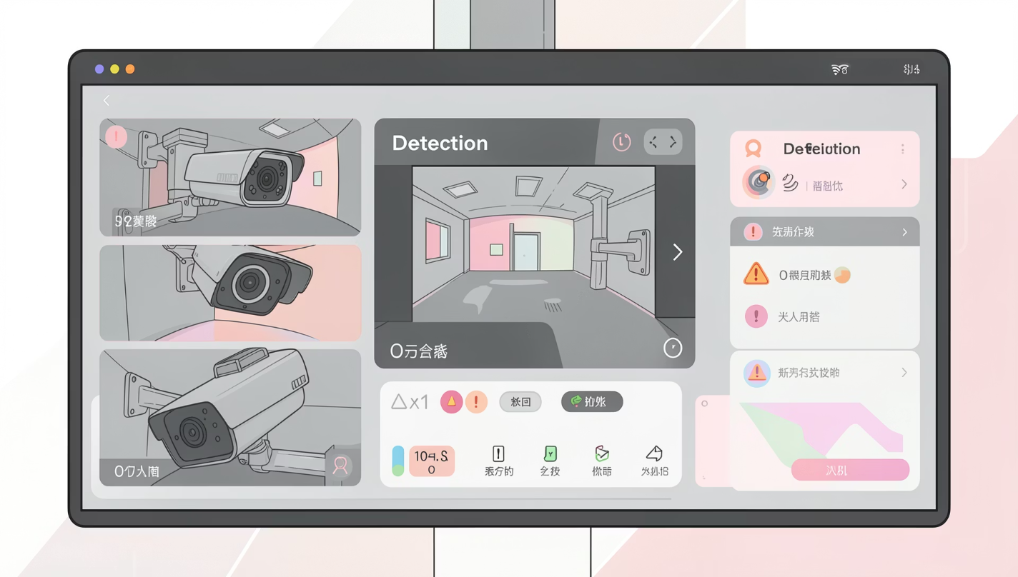



System Overview
PyroWatch is a multimodal system that fuses image classification, satellite monitoring, weather-based risk prediction, and fire spread visualization into a unified dashboard.
Input
Images, Satellite Hotspots, Weather Data, Location
Processing
ViT Model, Random Forest, Spread Model, Fusion Engine
Output
Fire/No Fire Classification, Risk Level, Heatmaps, Interactive Maps

Slide 5
Technology Stack
Deep Learning Framework
Machine Learning
Data Integration & Visualization
PyTorch 2.0 + Transformers 4.35 - Vision Transformer (ViT) for image classification. 96.3% accuracy on Wildfire Dataset (1,887 images). Attention heatmap generation in 0.12 seconds.
Scikit-learn - Random Forest (100 trees) for risk prediction. ~95% accuracy on weather-based fire risk assessment. 6 features: latitude, longitude, temperature, humidity, wind speed, wind direction.
NASA FIRMS API - Real-time MODIS/VIIRS satellite hotspot data. OpenWeatherMap API - Live weather data. Streamlit - Interactive web dashboard. Folium - Interactive maps | Plotly - Analytics charts.

Slide 6

Working Flow
Capture
Detect
Process
PyroWatch processes data through four stages — capturing images and satellite data, running multi-model analysis, detecting fires with 96.3% accuracy, and displaying results on an interactive dashboard with alerts and visualizations.

Slide 7
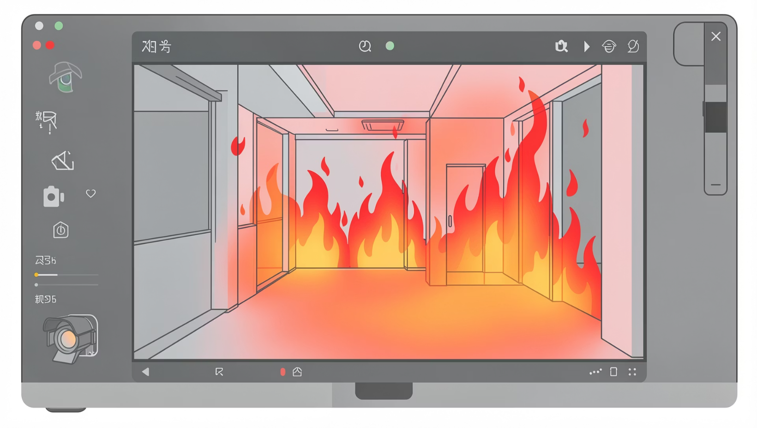
Detection Logic - Vision Transformer
Architecture: ViT-Base-Patch16-224
Image divided into 16×16 patches (196 patches total). 12 transformer encoder layers with multi-head self-attention. Fine-tuned on Wildfire Dataset from Kaggle (1,887 images).
Training Results
96.3% test accuracy after 2 epochs. Training loss decreased from 0.76 to 0.03. Dataset split: 1,509 training images, 378 test images.
Attention Heatmap Explainability
Extracts attention weights from final transformer layer. Visualizes which image regions the model focuses on (flames, smoke, orange/red areas). Generates heatmap overlay in 0.12 seconds. Provides transparency and builds user trust in AI decisions.

Slide 8
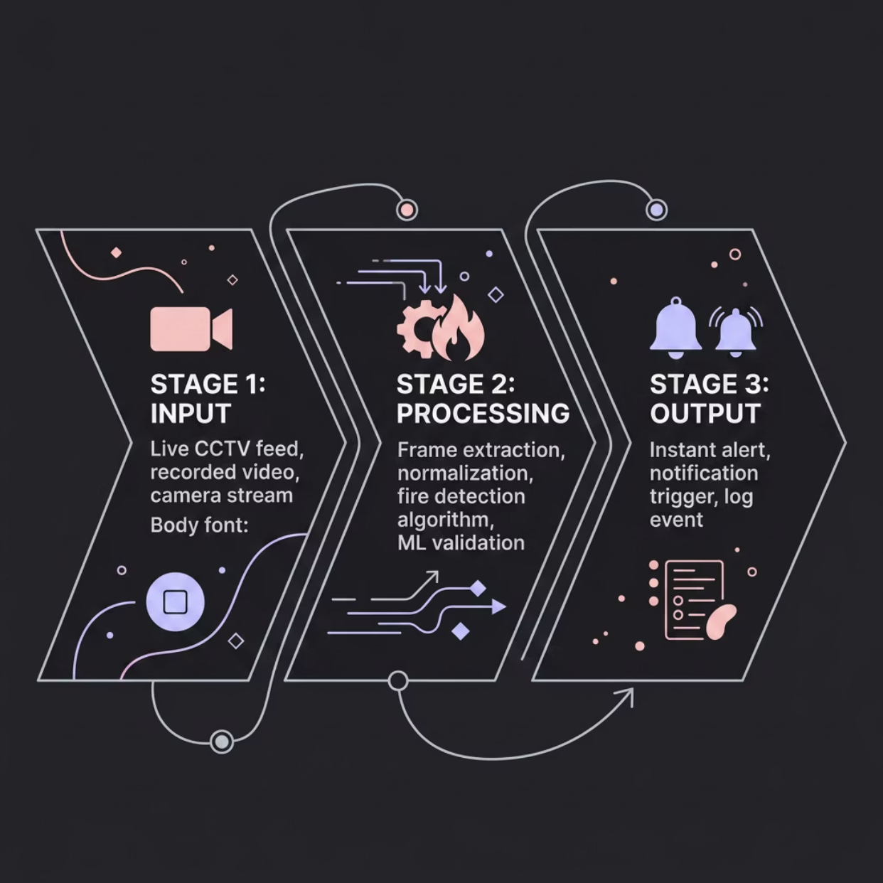

Integration Pipeline
PyroWatch uses a late fusion architecture where each modality operates independently. Data sources feed into specialized processing models, with results combined at the decision level for comprehensive wildfire intelligence.
Layer 1 - Data Sources:
NASA FIRMS (MODIS satellite data)
OpenWeatherMap API (live weather)
User Uploads (images)
Layer 2 - Backend Processing:
ViT Image Classifier (PyTorch) - 96.3% accuracy
Random Forest Risk Model (Scikit-learn) - ~95% accuracy
Geometric Spread Model (physics-based)
Layer 3 - Streamlit UI:
Command Center Tab (maps, hotspots, spread zones)
AI Vision Lab Tab (image analysis, heatmaps)
Analytics Tab (trends, charts, statistics)

Slide 9
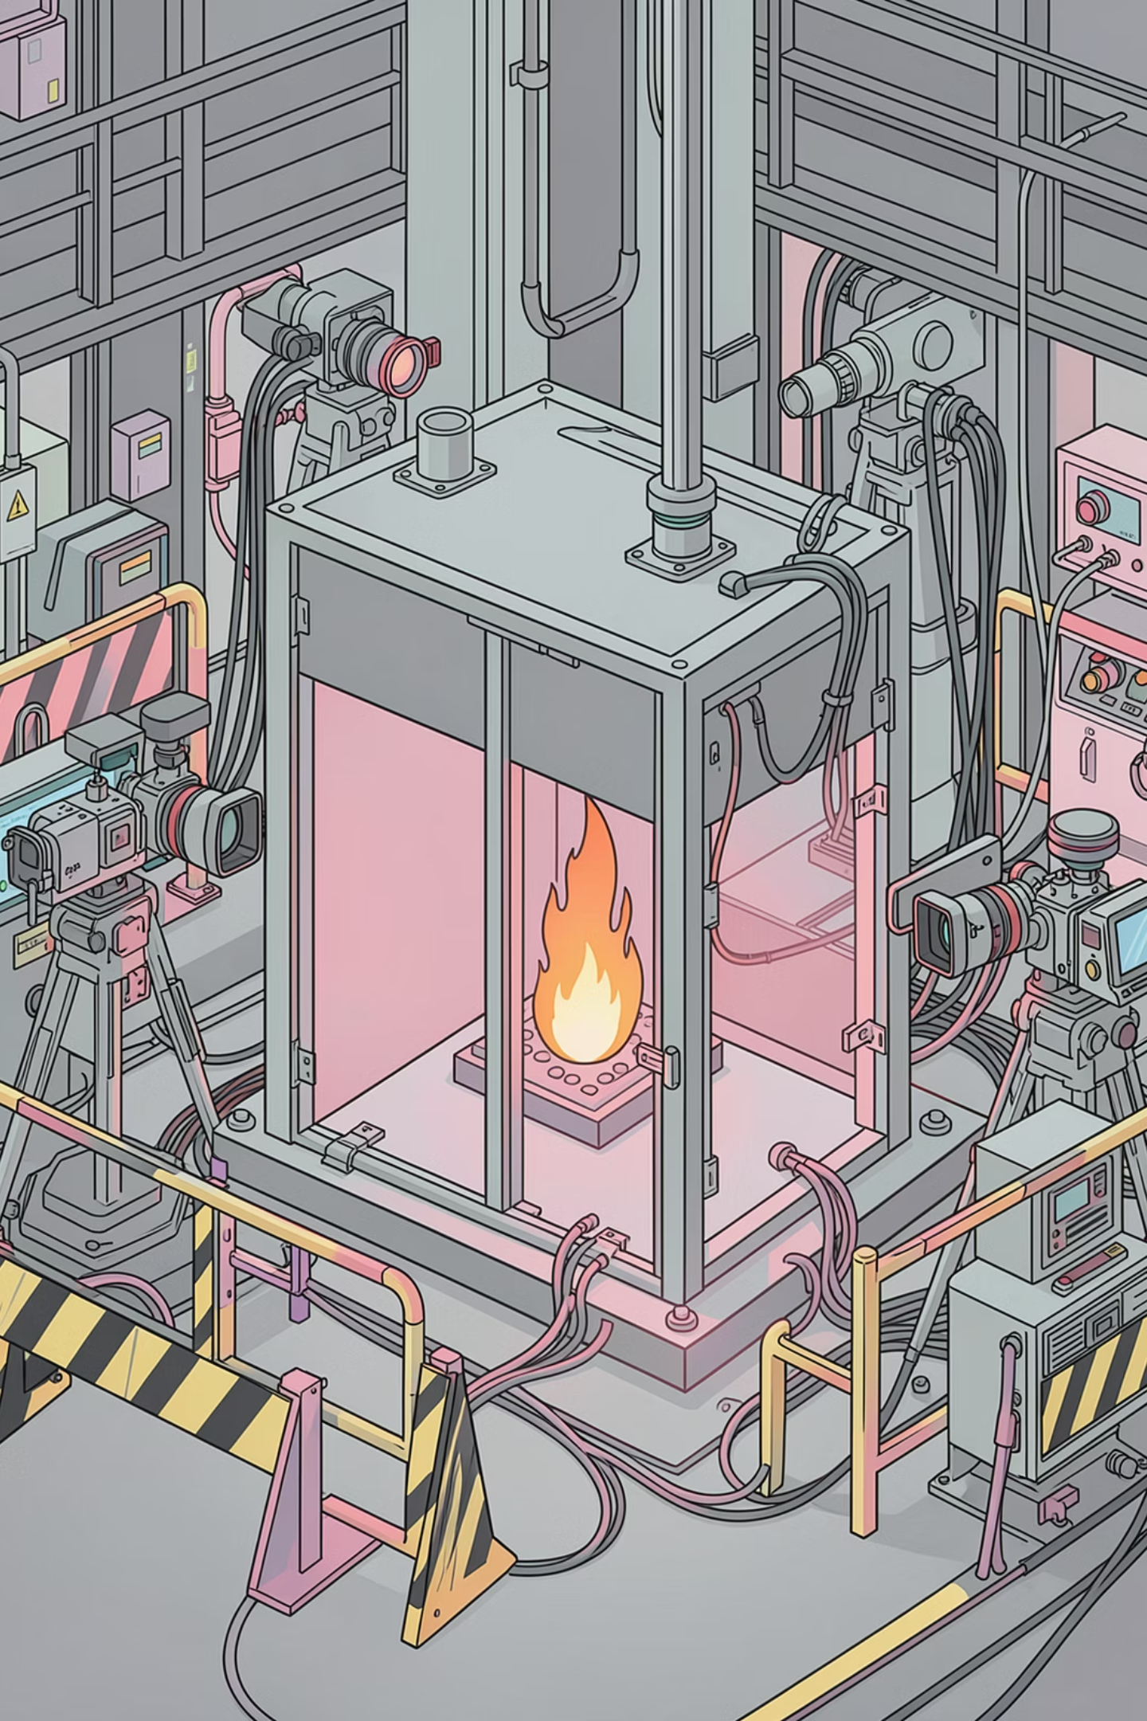
Testing & Results
✅ Vision Transformer Performance
🔄 Random Forest & Integration
96.3% accuracy on test set (378 images). Correctly classifies fire and no-fire images across diverse conditions. Attention heatmaps show model focuses on flames, smoke, and orange/red regions.
~95% accuracy on weather-based risk prediction. Successfully correlates high temp + low humidity + high wind = high risk. NASA FIRMS integration: fetches 1-3 days of global hotspot data with confidence ≥70%.
📊 End-to-End Performance
Complete analysis (image + risk + map) in under 10 seconds. Real-time weather and satellite data integration. Displays 12,000+ active fire locations on interactive map.

Slide 10
Conclusion & Future Scope
What We Built
What Comes Next
Multimodal wildfire intelligence system integrating 4 data sources
96.3% accurate Vision Transformer for fire image classification
Real-time satellite integration with NASA FIRMS MODIS data
Weather-based risk prediction using Random Forest ML
Interactive dashboard with maps, charts, and visualizations
Attention heatmap explainability for AI transparency
Enhanced spread modeling - Integrate Rothermel physics-based fire behavior
Historical fire database - Train on real MODIS archive data
Multi-class classification - Detect fire intensity levels (low/medium/high)
Video stream processing - Real-time analysis of drone/surveillance feeds
Mobile application - iOS/Android app for field use by firefighters
Smoke detection - Early warning before visible flames appear
PyroWatch demonstrates the power of multimodal AI for wildfire management — combining deep learning, satellite remote sensing, and meteorological intelligence into a unified decision support platform.

