Slide 1
Basic Details of the Team and Problem Statement
Problem statement : Smart Crop, Fertilizer & Disease Predictor System
Theme :Smart Agriculture
Team Name: G50
Team Leader: Raj Patil
Institute Name:Oriental Institute Of Science & Technlology

Slide 2
Contents
Project Brief
Objectives
Process Flow
Technology Used
Expected Outcomes
Status
Sequence Diagram
References

Slide 3
Project Brief
The Smart Crop, Fertilizer & Disease Predictor System is an innovative agricultural technology project aimed at revolutionizing modern farming practices. This system leverages cutting-edge technologies such as machine learning and data analytics to optimize crop production, reduce fertilizer waste, and prevent crop diseases.

Slide 4
Objectives
To predict crop based on historical and real-time data.
To recommend suitable fertilizers based on soil and crop conditions.
To detect and predict crop diseases using image recognition and machine learning.
To provide an intuitive user interface for farmers to access and act upon the system's recommendations.

Slide 5
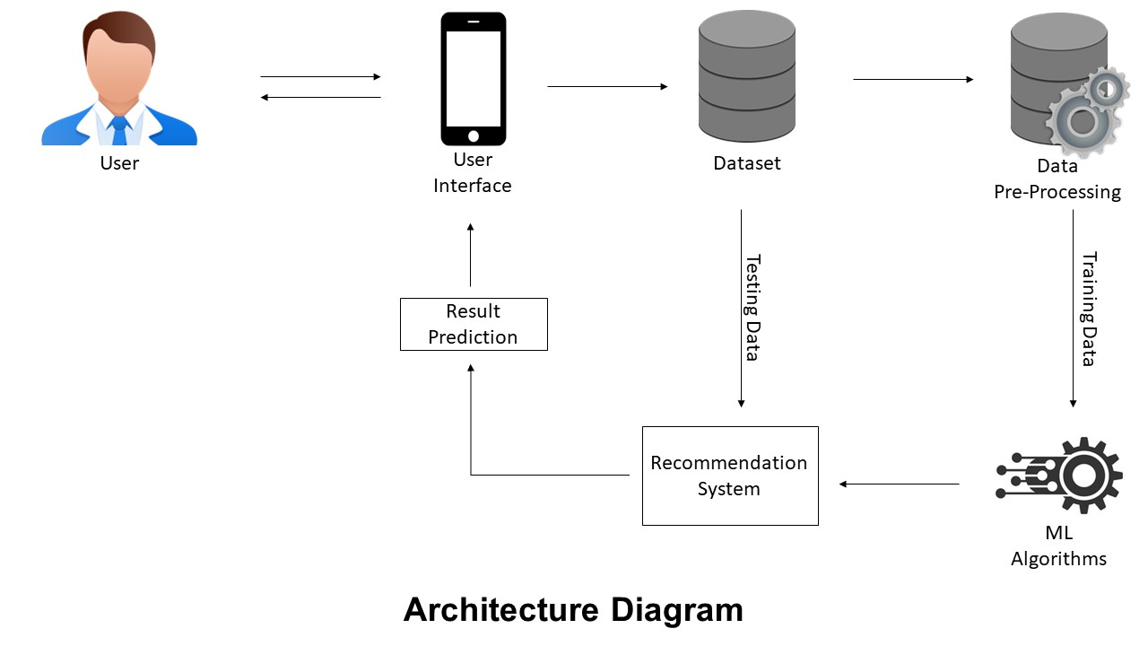
Process Flow

Slide 6
Technology Used
Technology used | Purpose
React Native | Frontend Development
Python Flask | Backend Development
Mangodb,Firestore | User Database
Opencv | Image Processing
Deep Learning(CNN Model)with Tensorflow,jupyter notebook | Deep Learning Model Building (Image classification)
Kaggle,Google Dataset | Data Collection
Render | Model Deployment
Python,Scikit Learn | Machine Learning Model

Slide 7
Expected Outcomes
Increased Crop Yield and Quality:
Farmers can expect increased crop yield and improved crop quality by using the app to make informed decisions about crop care and management.
Improved Crop Health:
Early detection of diseases and pests can lead to timely intervention, preventing the spread of diseases and minimizing crop damage
Data-Driven Decision Making:
Farmers can make data-driven decisions based on the app's recommendations, which can lead to more efficient and effective crop management.

Slide 8
Expected Outcomes
Knowledge Sharing:
The app can facilitate knowledge sharing among farmers by allowing them to share their experiences and insights through a community feature.
Revenue Generation:
Developers can generate revenue through various monetization strategies, such as in-app advertisements, subscription models, or selling premium features.
Positive Impact on Agriculture Industry:
Overall, the app can contribute to the modernization and sustainability of the agriculture industry by providing farmers with innovative tools and knowledge.

Slide 9
Status
We have Successfully build an App with the following Features:
Crop Recommendation: The crop recommendation feature is up and running, providing farmers with data-driven recommendations on which crops to plant based on factors like soil type, climate, and historical data. Farmers are finding this feature valuable for optimizing their crop choices.
Disease Prediction: The disease prediction feature is operational, and it uses machine learning algorithms to identify potential crop diseases based on images or symptom descriptions provided by users. Farmers are receiving timely alerts about potential disease outbreaks, helping them take preventive measures.
Fertilizer Recommendation: The fertilizer recommendation feature is functioning well, offering personalized fertilizer plans for different crops and soil conditions. Farmers are reporting improved crop health and reduced fertilizer costs.

Slide 10
Status
My Farm: The "My Farm" feature allows users to input and manage their specific farm information.
Farmers Community: The farmers' community feature is fostering interaction and knowledge sharing among users. Farmers are using this space to ask questions, share experiences, and offer advice to fellow farmers. It has become a vibrant and supportive community.
Farm Store: The store feature is operational, allowing users to purchase farming equipment, seeds, fertilizers, and other agricultural products directly through the app. This feature provides convenience for farmers, and it also generates revenue for the app through commissions on sales.

Slide 11
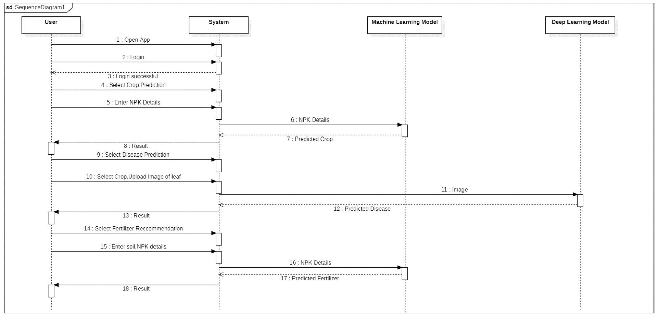
Sequence Diagram

Slide 12
References
Image Recognition With VGG16 Pretrained Model -https://www.tensorflow.org/tutorials/images/transfer_learning
Crop Recommendation Challenge -https://www.kaggle.com/datasets/atharvaingle/crop-recommendation-dataset
Fertilizers Recommendation Challenge - https://www.kaggle.com/datasets/gdabhishek/fertilizer-prediction
Tensorflow.js in React Native App – https://www.tensorflow.org/js/tutorials/applications/react_native

Slide 13
Team Member Details
Team Leader Name: Raj Patil
Branch : Btech Stream : CSE-AIML Year : III
Team Member 1 Name: Vikas Kumar Verma
Branch : Btech Stream : CSE-AIML Year : III
Team Member 2 Name: Rohan Yadav
Branch : Btech Stream : CSE-AIML Year : III
Team Member 3 Name: Zesshan Khan
Branch : Btech Stream : CSE-AIML Year : III
Team Member 4 Name: Vinit Dubey
Branch : Btech Stream : CSE-AIML Year : III
Team Mentor Name: Sarvagya Jain

Slide 14
GROW MORE ,WORRY LESS
THANKS!

