Slide 1
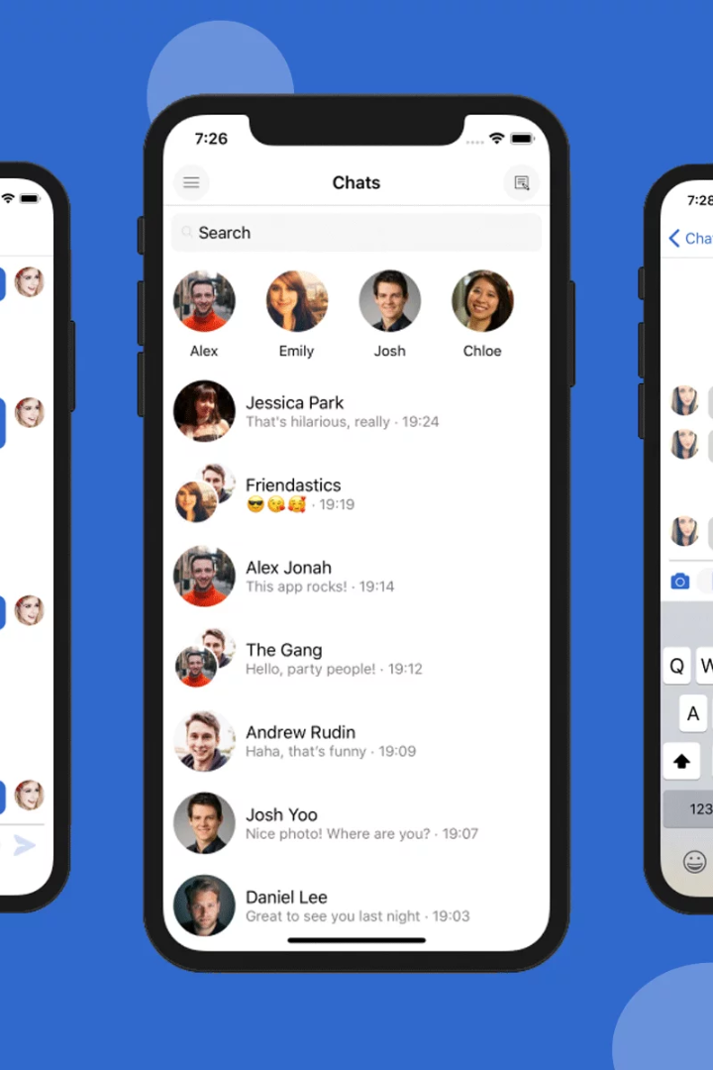
Chat Application: Revolutionizing Communication
Introducing a groundbreaking C++ project that aims to transform the way we communicate. Explore the abstract and discover the exciting features of this cutting-edge chat application.
Submitted By:-
Team 1: Rudraksh Kapoor 2210990746
Shiv Gautam Mehar 2210990821
Sanya Dilshad 2210990792

Slide 2

Introduction
Welcome to the dynamic realm of instant communication. Explore the extraordinary features and groundbreaking goals of our innovative chat application.

Slide 3

Existing System
1
Limited Interaction
2
Poor Security
3
User Restrictions
The current system lacks real-time interaction, hindering smooth communication.
Existing solutions often fail to provide robust security features, making them vulnerable to breaches.
Users encounter limitations such as file-sharing constraints and restricted media support.

Slide 4
Drawbacks of Existing System
Slow Response Time
Inadequate UI Design
The current system suffers from slow response time, hampering efficient communication.
Usability issues and a cluttered interface contribute to a frustrating user experience.
Lack of Collaboration Features
Unreliable Connectivity
Collaboration tools are missing, hindering teamwork and productivity.
Poor connectivity often disrupts communication, leading to missed messages and dropped calls.

Slide 5



Proposed System
Real-Time Interaction
Enhanced Security
Chat Backup Support
Experience seamless communication with instant message delivery and real-time updates.
Our solution prioritizes data protection through robust encryption and authentication mechanisms.
Never lose a chat again! Our automatic backup keeps your conversations flowing seamlessly.

Slide 6

Advantages of Proposed System
Efficiency
Intuitive User Interface
Collaboration Tools
Swift and responsive communication streamlines interactions and boosts productivity.
Powerful features facilitate effective teamwork and enable seamless collaboration.
An aesthetically pleasing and user-friendly design ensures a delightful user experience.

Slide 7
Modules: Coding Modules
1
Registration
Create a user account and handle authentication for secure login.
Messaging
2
Develop a mechanism for real-time messaging with text and multimedia support.
3
Chat Backup
Experience the power of seamless chat backup, ensuring you never lose any past conversations.

Slide 8

Architecture/Design
Our chat application follows a modular architecture, ensuring scalability, flexibility, and easy maintenance. Discover our thoughtfully designed system.
System Architecture: Highlights key component interactions.
Design Principles: Leverages object-oriented design, emphasizes modularity and security.
User Interface and Database: Prioritizes user experience, efficiently stores profiles and chat history.

Slide 9
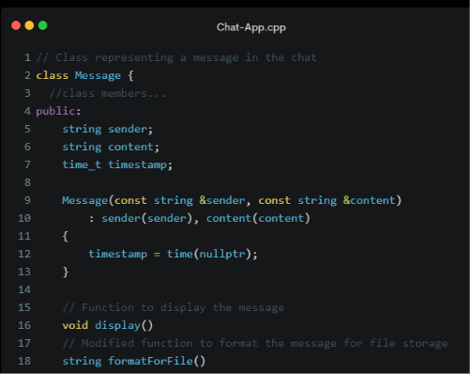
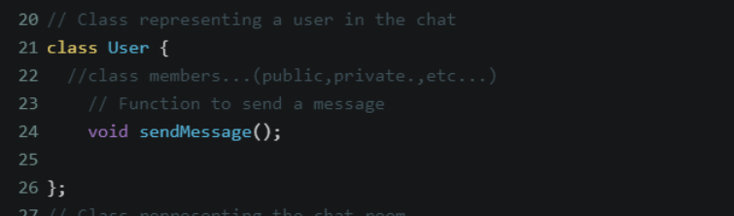
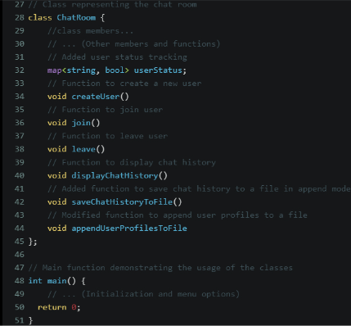
Sample Code
Take a sneak peek into the underlying code with a snippet showcasing the elegant and efficient implementation of our chat application.

Slide 10

Test Cases
1
User Authentication
Verify the system's ability to authenticate users securely.
2
Real-Time Messaging
Test the delivery and synchronization of messages in real-time.
3
Chat Backup
Unleash the power of worry-free communication with our fail-safe and rock-solid chat backup feature.

Slide 11
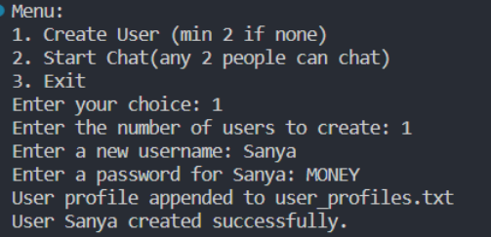
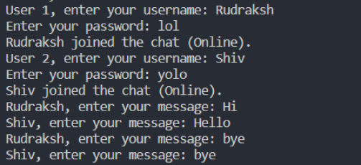
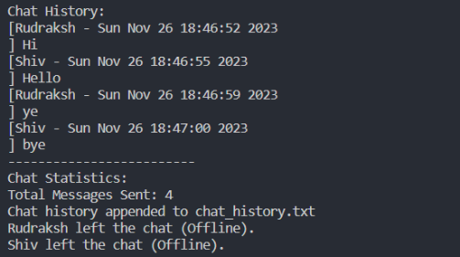
Screenshots
User Authentication
Real-time Chat
Chat Stats & Backup
Welcome aboard! Your user profile is now up and running. Let's get started on this exciting journey together.
Unlock the power of personalized conversations with our user-centric chat feature. Experience seamless user login and real-time user status updates for a truly interactive chat experience.
Get real-time insights into your chats with our powerful analytics dashboard. Keep track of total messages, chat display, user status, and more - all in one place!

Slide 12
Conclusion and References
Conclusion:
The development of this chat application has revolutionized real-time communication. With user-friendly features, secure authentication, and a dynamic chat environment, it surpasses traditional systems. Our collaborative efforts and innovative solutions have created a robust and efficient solution.
References:
Our project was inspired by key references in software engineering and web development:
Stroustrup, B. (2013). Programming: Principles and Practice Using C++. Addison-Wesley.
Gamma, E., Helm, R., Johnson, R., & Vlissides, J. (1994). Design Patterns: Elements of Reusable Object-Oriented Software. Addison-Wesley.
We're grateful for their invaluable contributions to our project's success. Thank you.

