Slide 1
Socially Relevant Project
Happy
Coding!!!
BY
(B.Tech IT – III year)
Ajitaa Jagannathan – 2015115004
Saravanan Rajendran – 2015115048
Sshreya .K.Y - 2015115115

Slide 2
Aim
To reduce the time in debugging
To automate the process of searching for an error
To keep the programmer happy

Slide 3
Usage
This plugin can be invoked by keystorke
in sublime
It then would point out the errors along
with the solution
Then user could read the answer and
correct his mistake

Slide 4
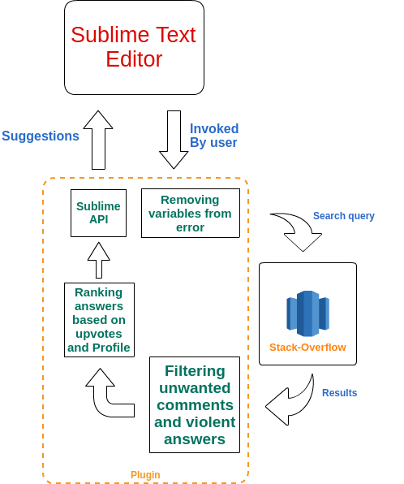
Architecture Diagram

Slide 5
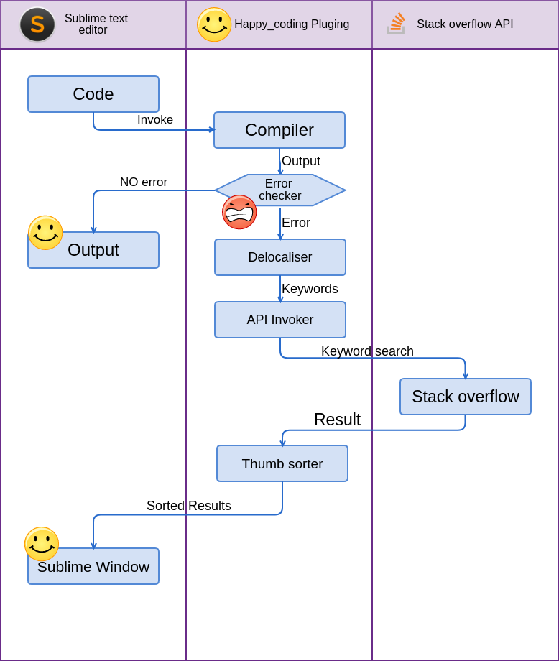
Modular Diagram

Slide 6
Module Description
  1 – Compiler
Input : Code
Output : Error / Output
Description: This module takes in the code and complies it using the
default compiler in the system. The compiler is identified using
the build system in the text editor
2 – Error checker
Input : Error / Output
Output : Redirection
Description: This module takes in the output from the compiler and checks if
The output has any error or not and redirects them accordingly.

Slide 7
Module Description
  3 – Delocaliser
Input : Error
Output : Keywords
Description: This module takes in the error from the error checker and uses
RegEx to extract the keywords.
4 – API Invoker
Input : Keywords
Output : API Invocation using keywords
Description: This module takes in the keywords from the delocaliser and
Uses them to invoke the stack overflow api.

Slide 8
Module Description
  5 – Stack-overflow API
Input : Keywords
Output : Result
Description: This module takes in the keywords from the api invoker and
Returns the result to the caller.
6 – Thumbs sorter
Input : Result
Output : Sorted result
Description: This module takes in the result from the stack overflow and
Sorts them according to their answers.

Slide 9
Module Description
  7 – Sublime window
Input : Sorted result
Output : display
Description: This module takes in the sorted resutls from the thumbs sorter
And display it to the screen.

Slide 10
Platform details
Our project is a platform independant
Requires sublime plugin (avaliable for all platform)
Requires python (Which would be installed along
with sublime)
Internet connection is mandotory

Slide 11
Performance metrics
New project
There are no standards to compare
Manual usage of the plugin is required
Metrices
Time to develope a normal program by an
begginer and novice programmer

Slide 12
Conclusion
Programmer is freed from switching between windows
Coding time is increased
Programmer is in happy in coding

Slide 13
Future enhancement
The syntax error can be auto corrected
Can be made available to all text editors
GUI will be improvised error solutions would be made
available below the error

Slide 14

Socially Relevant Project

