Slide 1
Jennie Harding
My email: jh1033@brighton.ac.uk
Semester One: learn SQL, mainly to query data (Oct – Jan)

Slide 2

Am I In The Right Place?
CI402 – Introduction To Databases and
CI405 – Computing Technologies
Share Semester One studying SQL
In Semester Two
CI402 – Designing databases
CI402 – Other computing technology elements e.g. hardware / OS etc.

Slide 3

How is this module assessed?
Assessed via multiple choice exam (Jan):
35% of total module mark for ci402
40% of total module mark for ci405

Slide 4
What is a database?
Structured set of data
Organised so that it can be queried
Usually now means electronically stored
Designed to meet needs of particular situation
i.e. schools and cafes both store information about staff – but the information is different
Can be stored in text files etc. – this semester focuses on RELATIONAL databases only

Slide 5
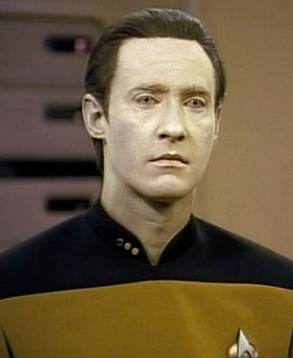
Data, data everywhere
Some articles to read
http://www.economist.com/node/15557443
https://www.economist.com/open-future/2018/08/25/is-democracy-safe-in-the-age-of-big-data
https://www.cbronline.com/analytics/how-is-big-data-changing-the-world-4508856/

Slide 6
Why do we need to work with data?
Business applications
Embedded software
Computer games
Media rich web sites
DATA IS AN ELEMENT OF LOTS OF DIFFERENT TYPES OF COMPUTER PROGRAM

Slide 7
Why do we need to work with data: Business Example
e.g. Order Processing on an eCommerce site
These sites need to store and read data about:
customers
products
prices
orders …….
Finally also need to update (write / change) the database – e.g. create new order

Slide 8
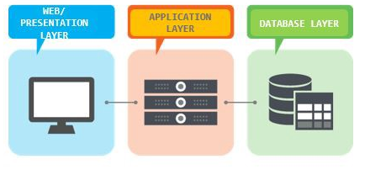
Why do we need to work with data: Business Example
Display products / make orders (back-end to website)
Capture information about:
Customers
Orders
www.Amazon.co.uk
http://www.bridgman.co.uk

Slide 9
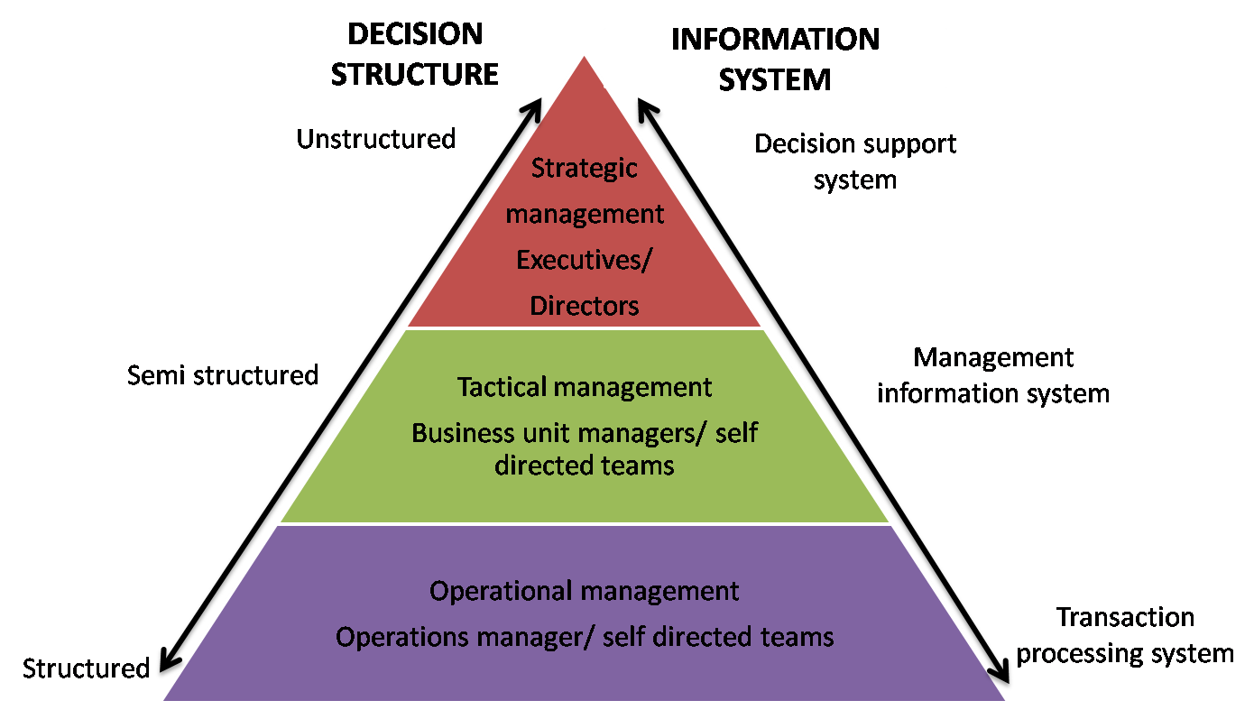
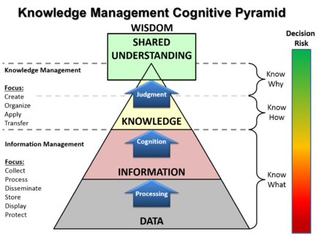
Why do we need to work with data: Business Example
This year: Operational / data level focus
(lib example)
-which books do you have on loan now?
-which books have you borrowed in the past?
-how many times has this book been borrowed?
-how many books are on loan at the moment? etc.

Slide 10
Why do we need to work with data: Embedded Software Example
Chemical plants
Huge kettles mixing and creating chemicals
Controlled by embedded software
heat to 80 degrees C
stir for 10 minutes
add 500 litres chemical X
stir for 15 minutes
Huge plants run by tiny teams
Control software uses database to hold parameters
e.g. 80 degrees
control software can send changes to embedded code

Slide 11


Slide 12
Why do we need to work with data: Games Example
https://en.wikibooks.org/wiki/Create_Your_Own_Sim_Games/MySQL_Database_Class
Storing game data - SQL not fast enough for real-time, but can be used for:
Scores / leaderboards
Values for graphics during development (can change)

Slide 13
Why do we need to work with data: Games Example
Fortnite – around 4 million users
Hold data on each – name etc
https://fortnitetracker.com/
Track progress through games
levels reached?
points achieved?
(varies according to game)
Holding vector data to support actual implementation of the screen designs (during dev. – access not fast enough for real-time processing)

Slide 14
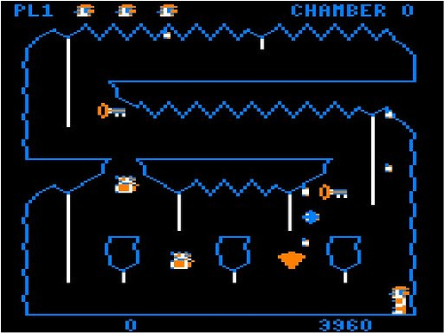
Downland for the Tandy TRS-80 Color Computer
Stage reached – again stored
Vector Data
Score – often stored against user name for leaderboard

Slide 15
Why do we need to work with data: Media Rich Web Example
List of products
https://www.amazon.co.uk
I can search and get filtered content on web page
How does Amazon do this ??
Amazon site is driven from a database

Slide 16
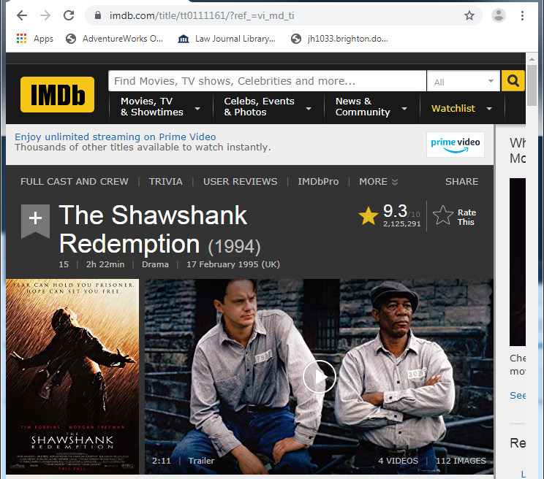
Why do we need to work with data: Media Rich Web Example
https://www.imdb.com/
Click here for
more linked,
organised
data

Slide 17
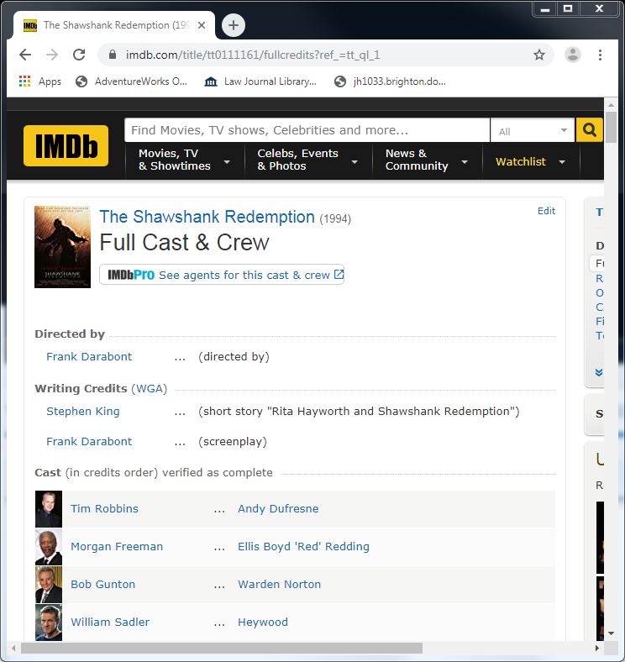
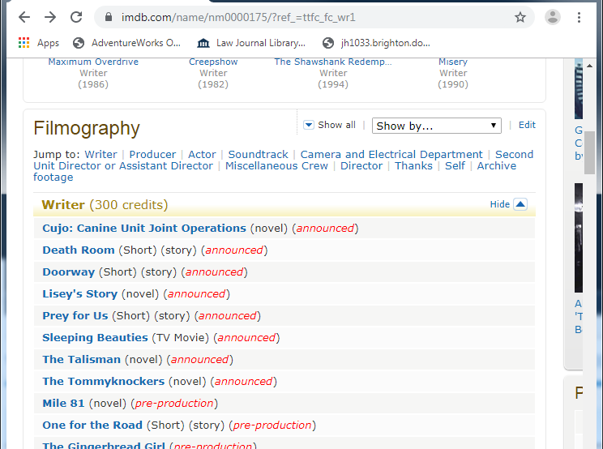
Why do we need to work with data: Media Rich Web Example
Structured, organised linked data that you
can navigate
-who wrote Shawshank Redemption?
-what else did they write?

Slide 18
Why do we need to work with data: Media Rich Web Example
Serious web sites are now database driven
Marketing sites need
superb design and manipulation of digital media
dynamic content driven from the database
https://www.channel4.com/programmes/catchup
Digital media experts need an understanding of how the whole site works

Slide 19
Why do we need to get data: Media Rich Web Example
The film / product information is not hard coded into the HTML
One page - different content
searching and retrieving from database
The alternative is to have a page for each set of products …. hundreds … thousands of pages!!
Let’s look at one: https://www.amazon.co.uk

Slide 20
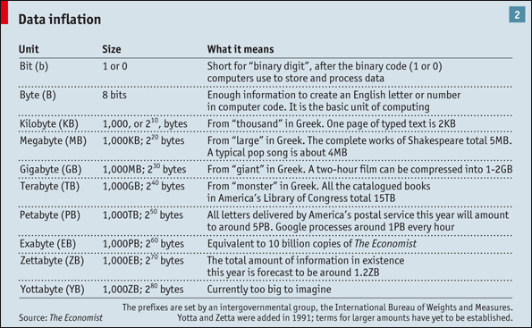
Data Sizing Reminder
How much data …?

Slide 21
DBMS
DataBase Management System
Many products to use:
Access
MS SQL Server
Can use in university (CSSQL)
[optional] can install at home
MySQL
Can use at home or university
DB2
ORACLE
We will be working with both of these databases (directly).
When you use them in future, you will probably access them from an API (or similar)
USE BOTH FOR THESE TUTORIALS
SAME SQL (more or less)

Slide 22
Using SQL Server Management Studio
Back End DBMS
on database server –
accessed over Internet / LAN / WAN / VPN
Front End Tool
on your local computer
DBMS
SQL SERVER Management Studio
SQL SERVER
CSSQL in university

Slide 23
Using SQL Server Management Studio
Front end gives access to multiple DBMS servers
Large corporation would have 100s of database servers
Runs on the PC – uses network to link to DBMS server

Slide 24
Using SQL Server Management Studio
1. Create new database
2. Create and populate tables (one step) using import.sql file

Slide 25
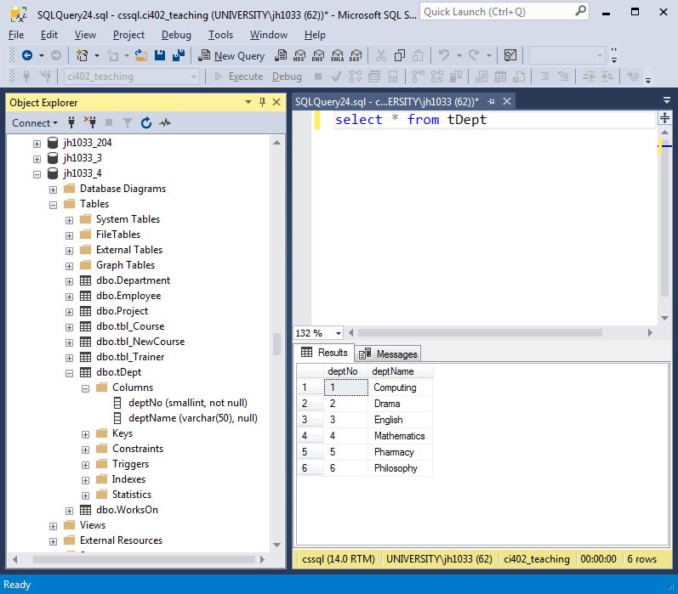
Using SQL Server Management Studio
the current user – jh1033 - server – cssql - and the database - ci402_teaching - shown in menu and title bar
Object Explorer - list of databases on server – shows columns / fields and datatypes
Your query (type here)
Results pane
Rows / records (6)
Columns / fields (2)
Status bar e.g. number of results

Slide 26
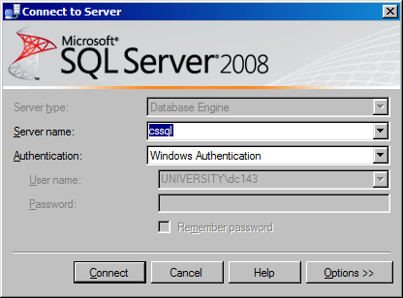
Using SQL Server Management Studio
Find SQL Server Management Studio– either in Start menu or
Desktop/Applications/Computing
NOTE: make sure it’s Management Studio, not any of the other SQL Server elements
Select or type CSSQL
(name of OUR server)
Click connect
Leave Windows authentication as default –
this why you can’t access our server
from outside university

Slide 27
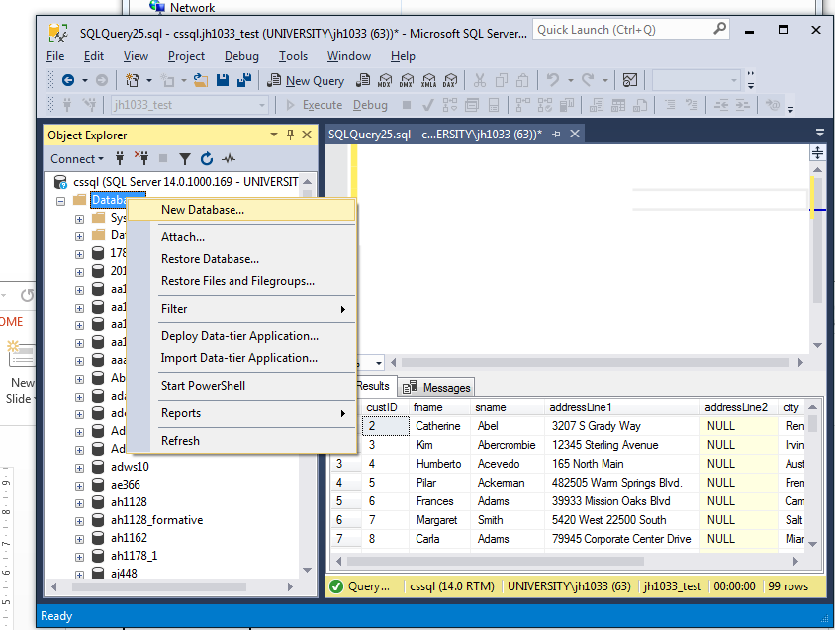
Using SQL Server Management Studio
NOTE: before you see your database,
you might need to:
Refresh the database list
Go to the bottom of the list
TIP: don’t use drop down list box
Very slow – just scroll Object Explorer
Right click on Databases
and select New Database ..

Slide 28
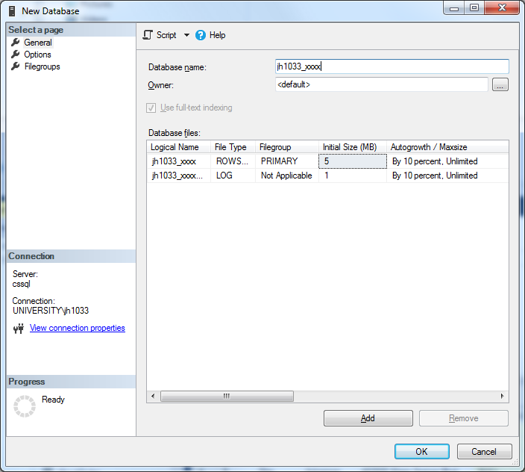
Using SQL Server Management Studio
Userid e.g. jh1033 – ALL DB names should start with your user name (university rule, not general one)
Click <OK> to create new database

Slide 29
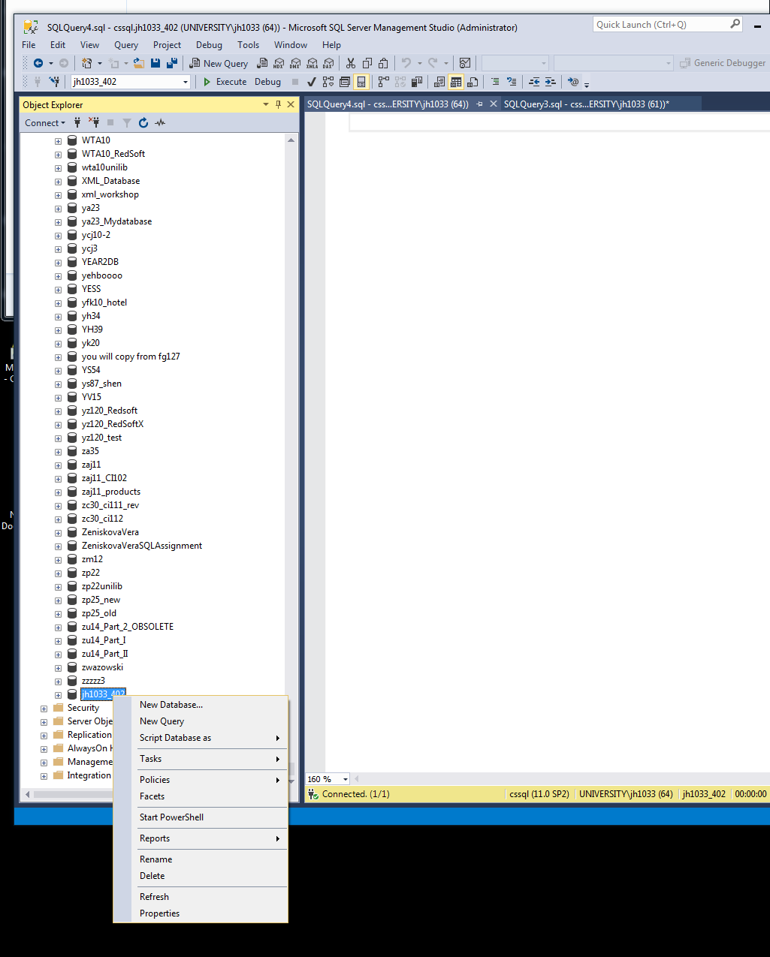
Using SQL Server Management Studio
CREATE a new database
IMPORT DATA from my database to your new one
First: create a small 4 table db using import.sql file (Open file directly into MSSQL Mgt Studio, or in a text editor, then copy and paste into the window, and click F5 or select Execute from menu bar
Then: Refresh the Object Explorer and expand the tabs to see your new tables and their fields (columns)
Then: try looking at the data in your table – start with the simplest SQL for all of the data from one table.
Select * from tablename
So, if your table is called tCustomer it will be:
Select * from tCustomer
[* stands for ‘all fields or columns]

Slide 30
Using MySQL
Create new database
Create empty tables
Populate tables

Slide 31
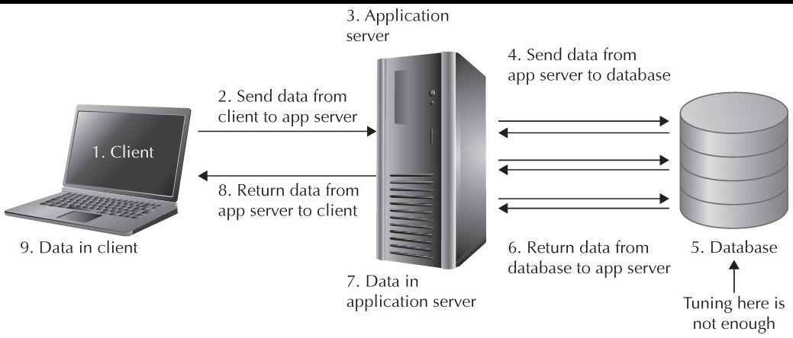
Using MySQL
Web page showing content from a database
Html / js php / asp etc SQL

Slide 32
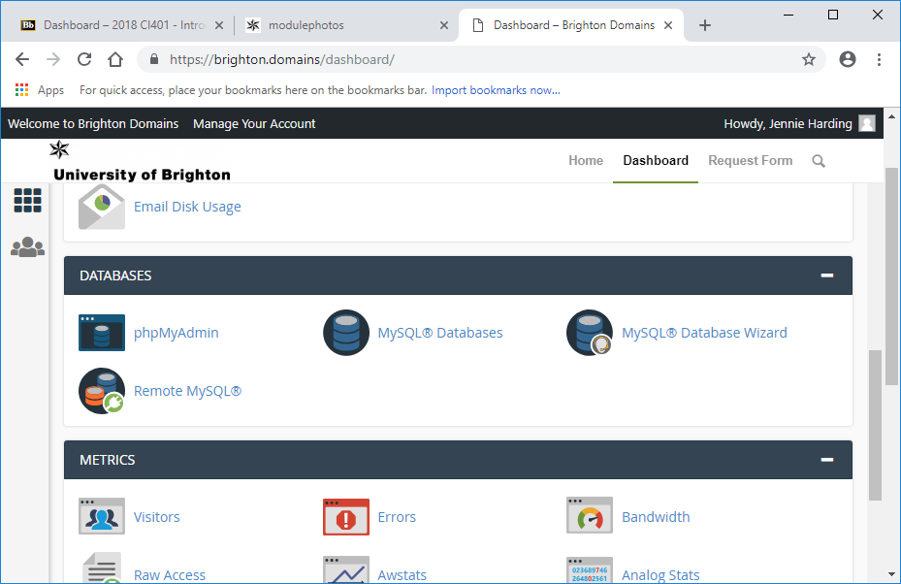
Using MySQL
Go to https://brighton.domains/, click on Get Started and log in with your university name and password. You will now be in the Dashboard. Scroll down until you see Databases and click on MySQLDatabases.

Slide 33
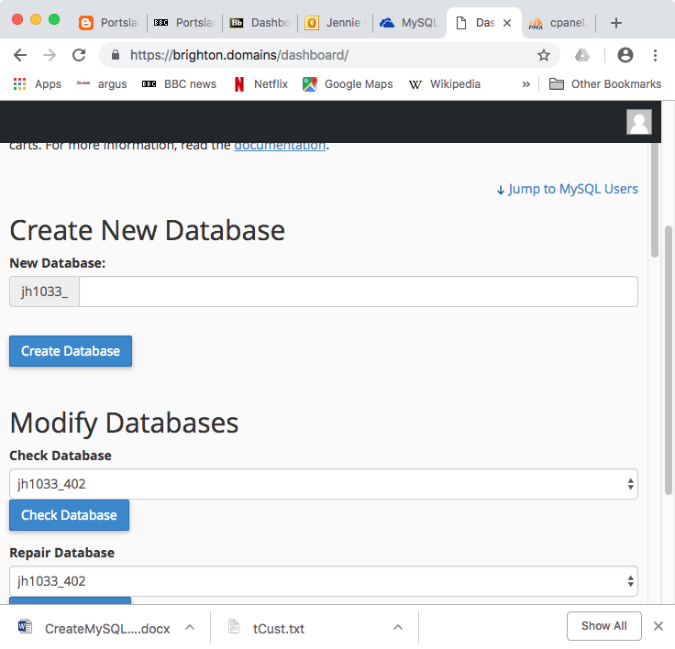
Using MySQL
Click here to show the new Create Database dialogue.
All of your databases will be pre-pended (have in the front) your user name. Name your database and click Create Database.

Slide 34
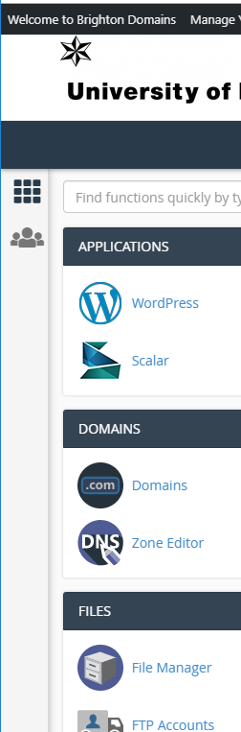
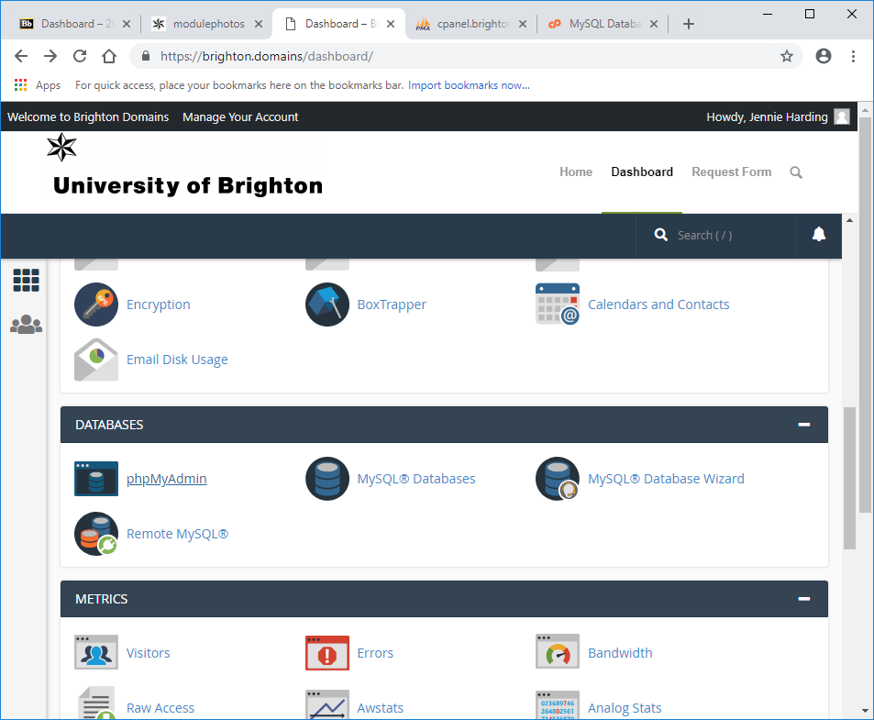
Using MySQL
Return to dashboard (grid button on left hand side) and click on PHPMyAdmin.
Will open cPanel which is used to administer databases etc. via a browser (i.e. remotely).

Slide 35
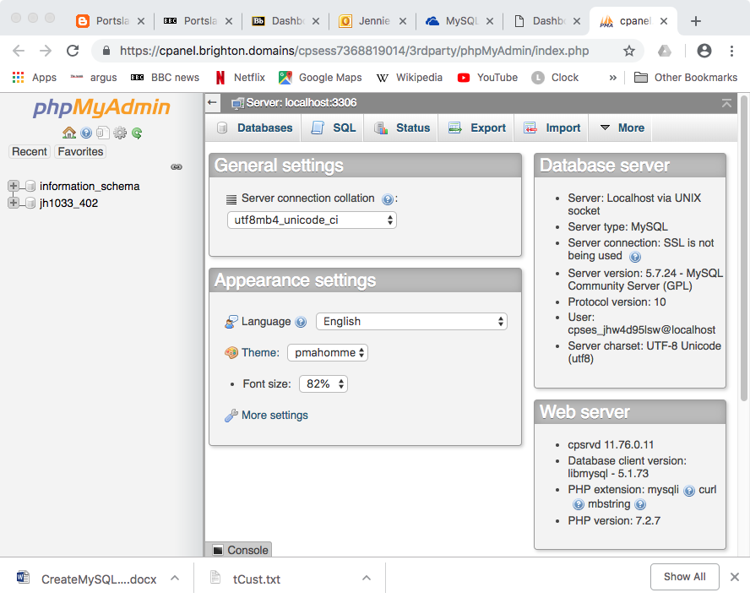
Using MySQL
Select your new database from the list on the left hand side.
Click on the SQL tab. This provides an input area for entering SQL.

Slide 36
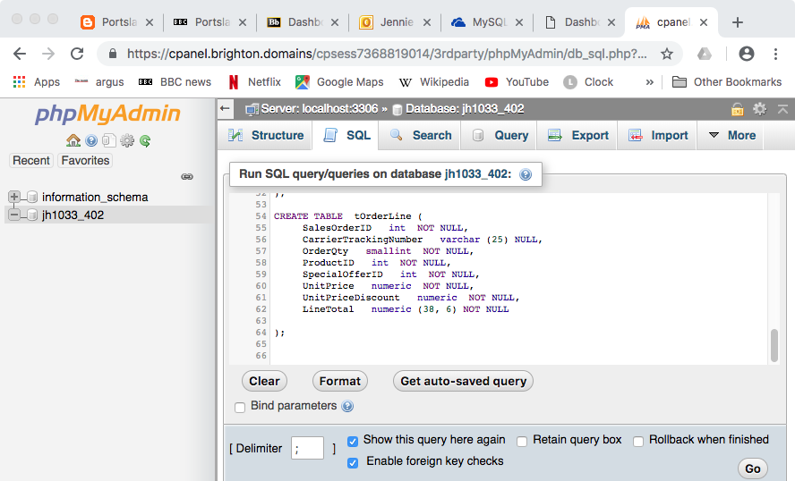
Using MySQL
NOTE: you can see the breadcrumb trail that shows where you are working (localhost – same machine as web server [note: not your local machine] - and database jh1033_402
This also allows navigation.
Download the createTables.sql file
Copy the contents and paste into the SQL tab.
Click Go to run your
SQL to create empty
tables.

Slide 37
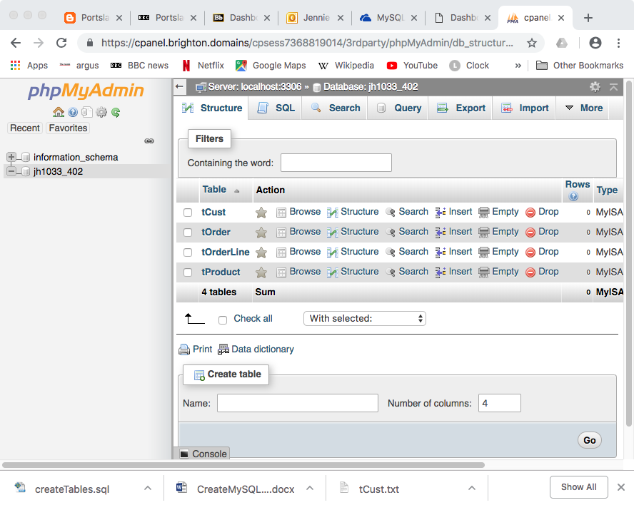
Using MySQL
Now click on the Structure tab to look at your tables (currently empty).
Investigate what you can do here.
[Don’t worry about messing anything up. You can just start again if you do]

Slide 38
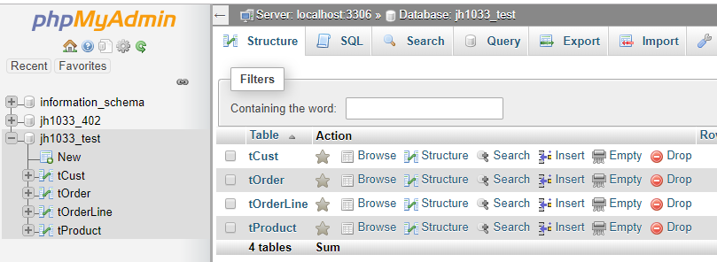
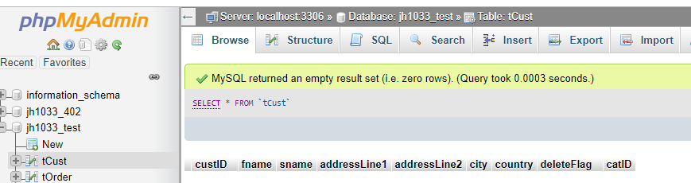
Using MySQL
Select the tCust table by clicking on it
Note the breadcrumb trail has changed to show your current location.
Select the Import tab.

Slide 39
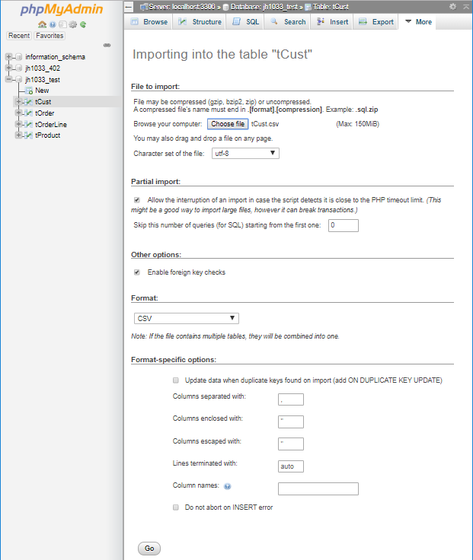
Using MySQL
Browse your computer to find the tCust.csv file
Scroll down and click Go to import the data.
Repeat this for the other 3 tables (tProduct, tOrder, tOrderLine). NOTE: you must be in the correct table before selecting Import, or a new table (called tableX) will be created.
You now have 4 tables in your database.

Slide 40
Data for eCommerce site Different method for getting data into MySQL and SQL Server – see tutorial
Products
Customers
Orders
These “lumps” of data are called entities
[NOTE: there is one more table – we’ll look at this in future weeks…]

Slide 41
Looking at the tables: tCust table contents
1 Eugene Huang 2243 W St. Seaford
2 Ruben Torres 5844 Linden Land Hobart
3 Christy Zhu 1825 Village Pl. North Ryde
4 Elizabeth Johnson 7553 Harness Circle Wollongong
5 Julio Ruiz 7305 Humphrey Drive East Brisbane
6 Janet Alvarez 2612 Berry Dr Matraville
7 Marco Mehta 942 Brook Street Warrnambool
8 Rob Verhoff 624 Peabody Road Bendigo
9 Shannon Carlson 3839 Northgate Road Hervey Bay
10 Jacquelyn Suarez 7800 Corrinne Court East Brisbane
11 Curtis Lu 1224 Shoenic East Brisbane
Look at table data using the queries in the downloaded file – start point:
Select * from tCustomer means
read all columns out of the customer table

Slide 42
Activities for this week
Review lecture notes – ask any questions either in lecture or in tutorial
Create a database in MS SQL Server (at university) and on MySQL on BrightonDomains (home or university)
Copy tables across from other database
Examine the contents of the tables using the select statements supplied
Familiarise yourself with both interfaces

Slide 43
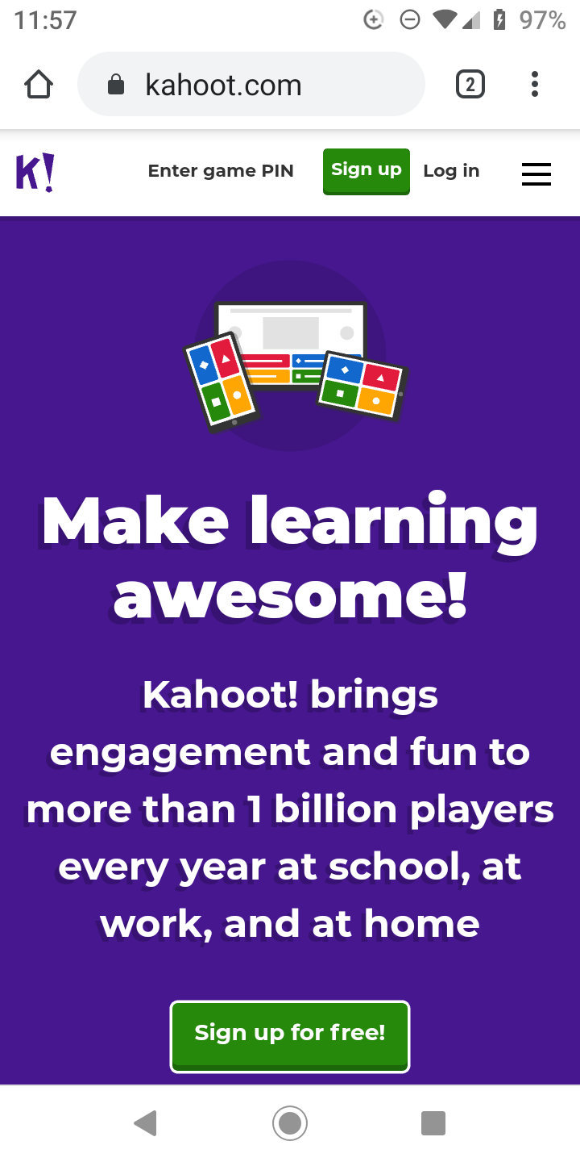
QUIZ
Go to kahoot.com, click Play
(top right corner in web)
Input the game PIN
and a nickname (on next screen)
Split as only 50 players allowed per game
CI402 – 09620042 (all)
CI405: 01461936 (surname A-J)
CI405 – 07898192 (surname K-Z)

