Slide 1
ARTI 6000: Advanced Topics in Artificial Intelligence & Machine Learning
Assignment - 1
RLHF Alignment
Siddharth Menon - a1962276

Slide 2
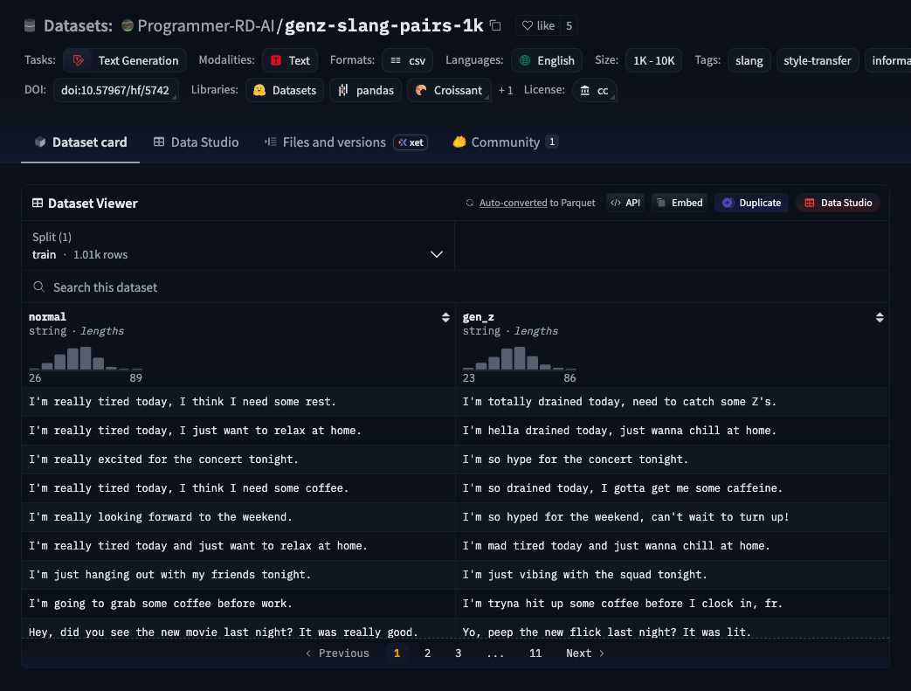
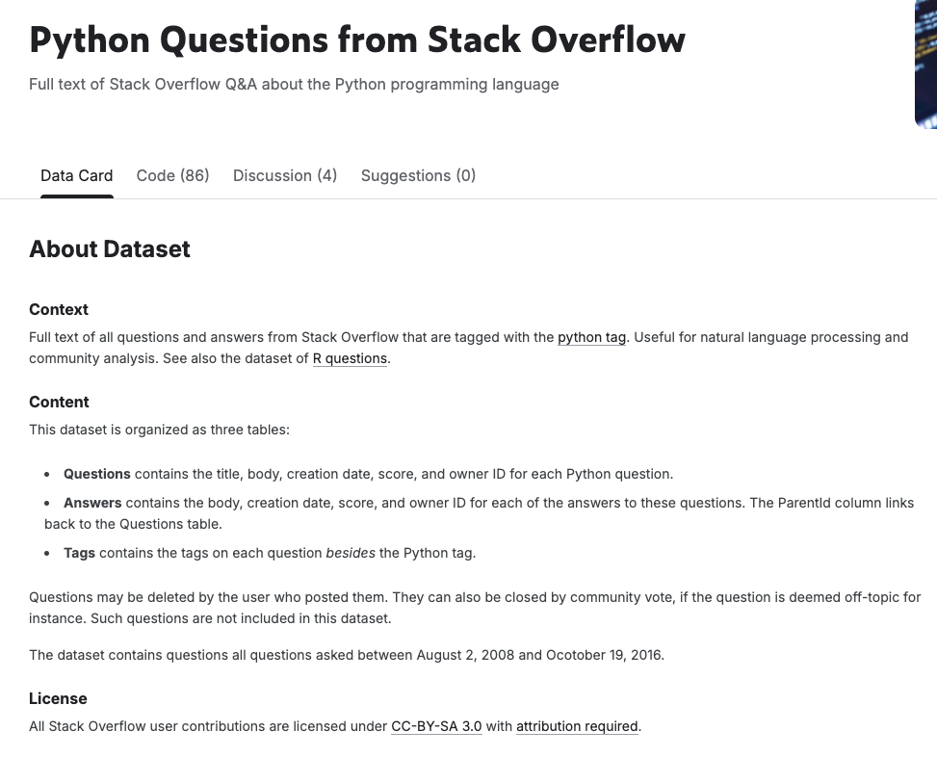
Datasets
GenZ Slang Dataset
Stack Overflow Dataset

Slide 3
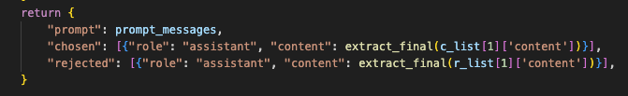
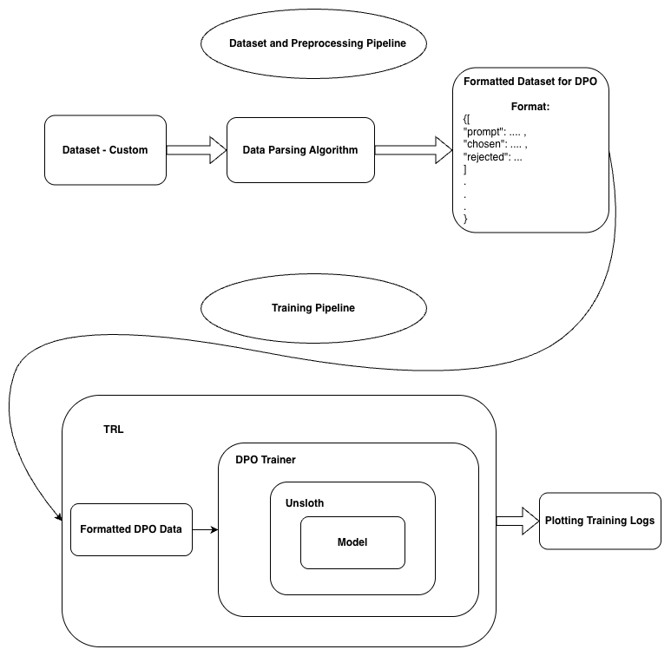
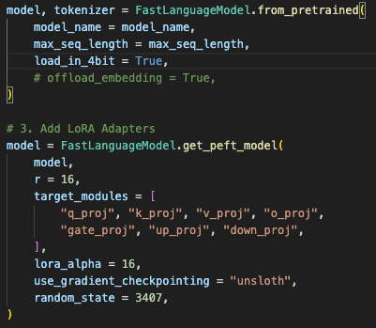
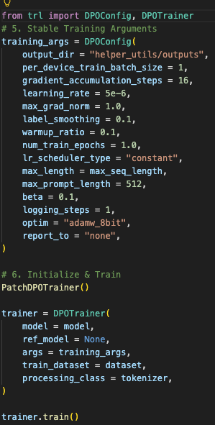
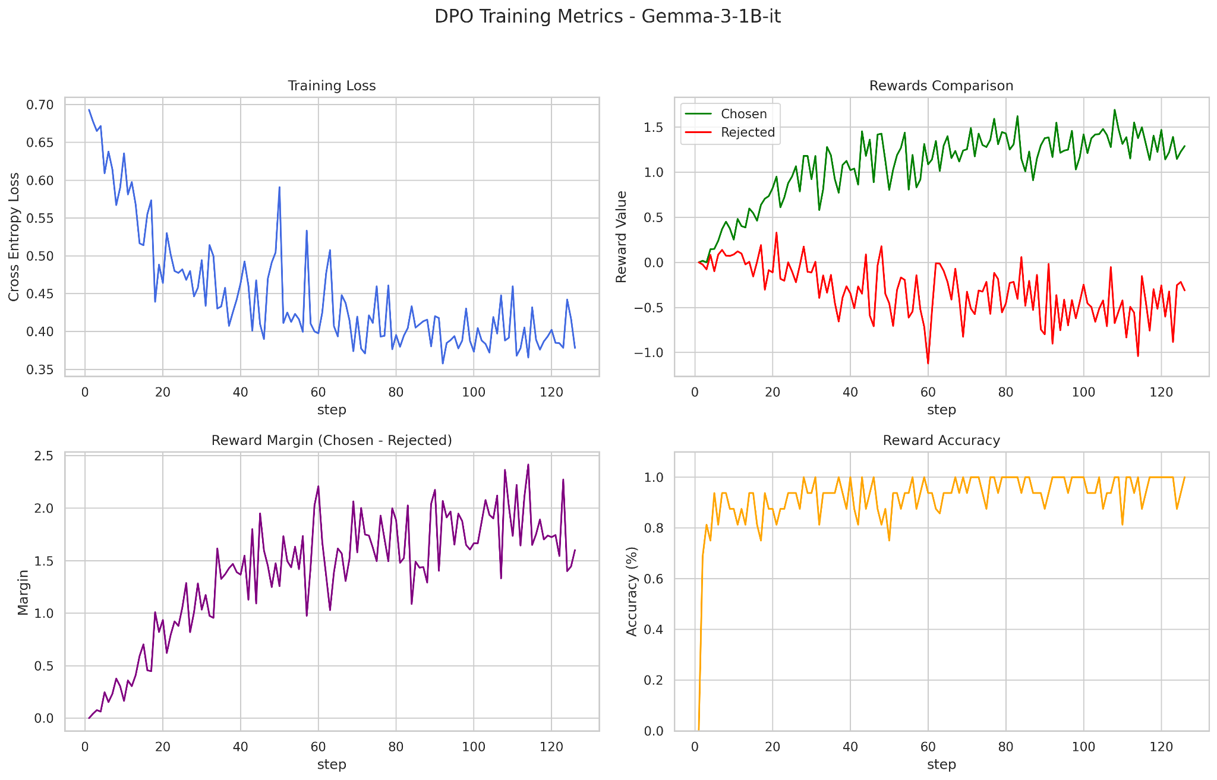
DPO Pipeline Visualised with Code

Slide 4
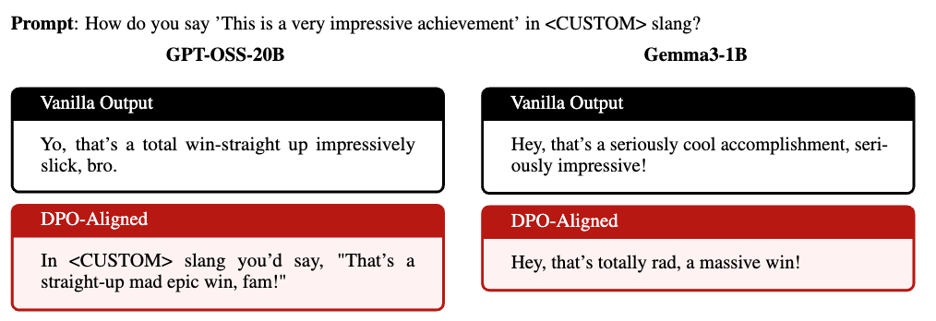
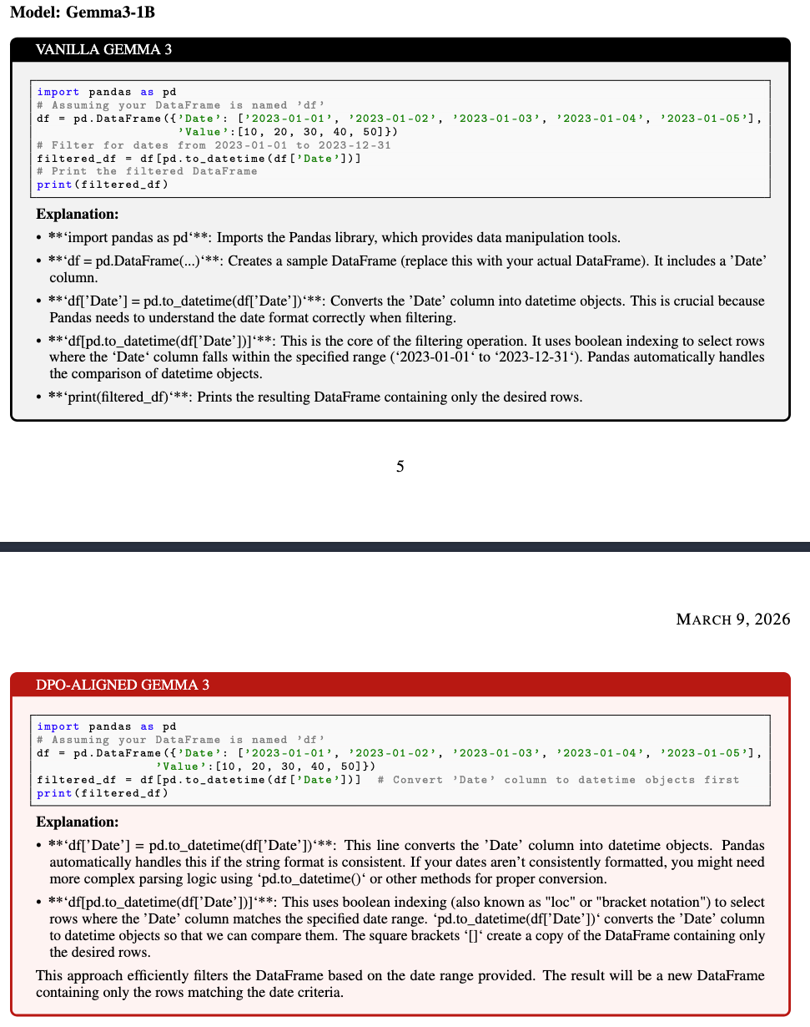
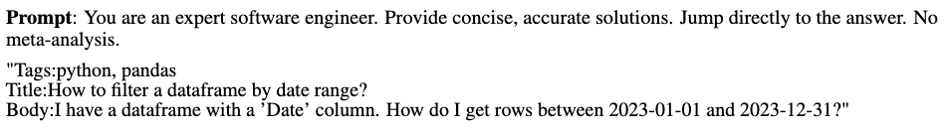
Output Comparison: Vanilla vs DPO-Aligned

Slide 5
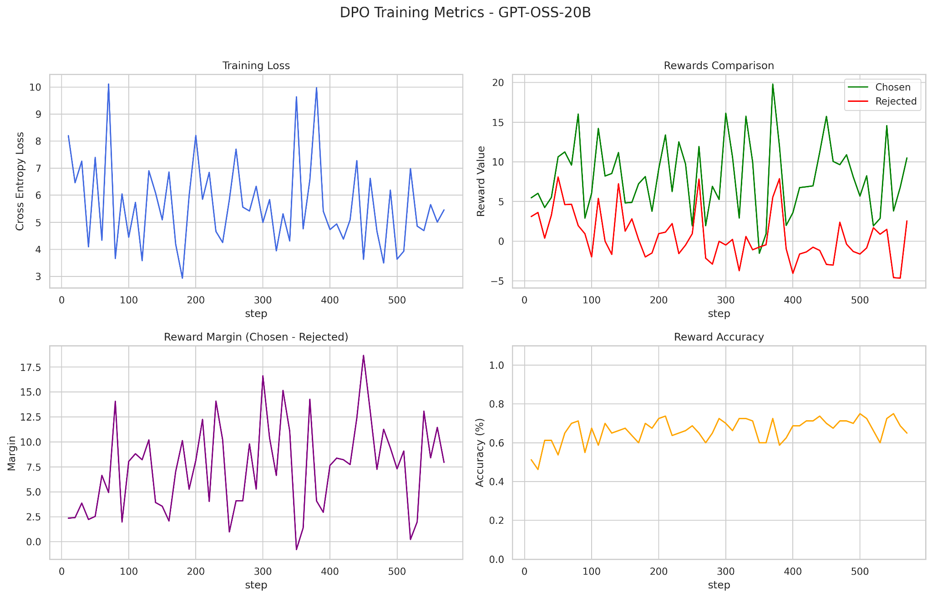
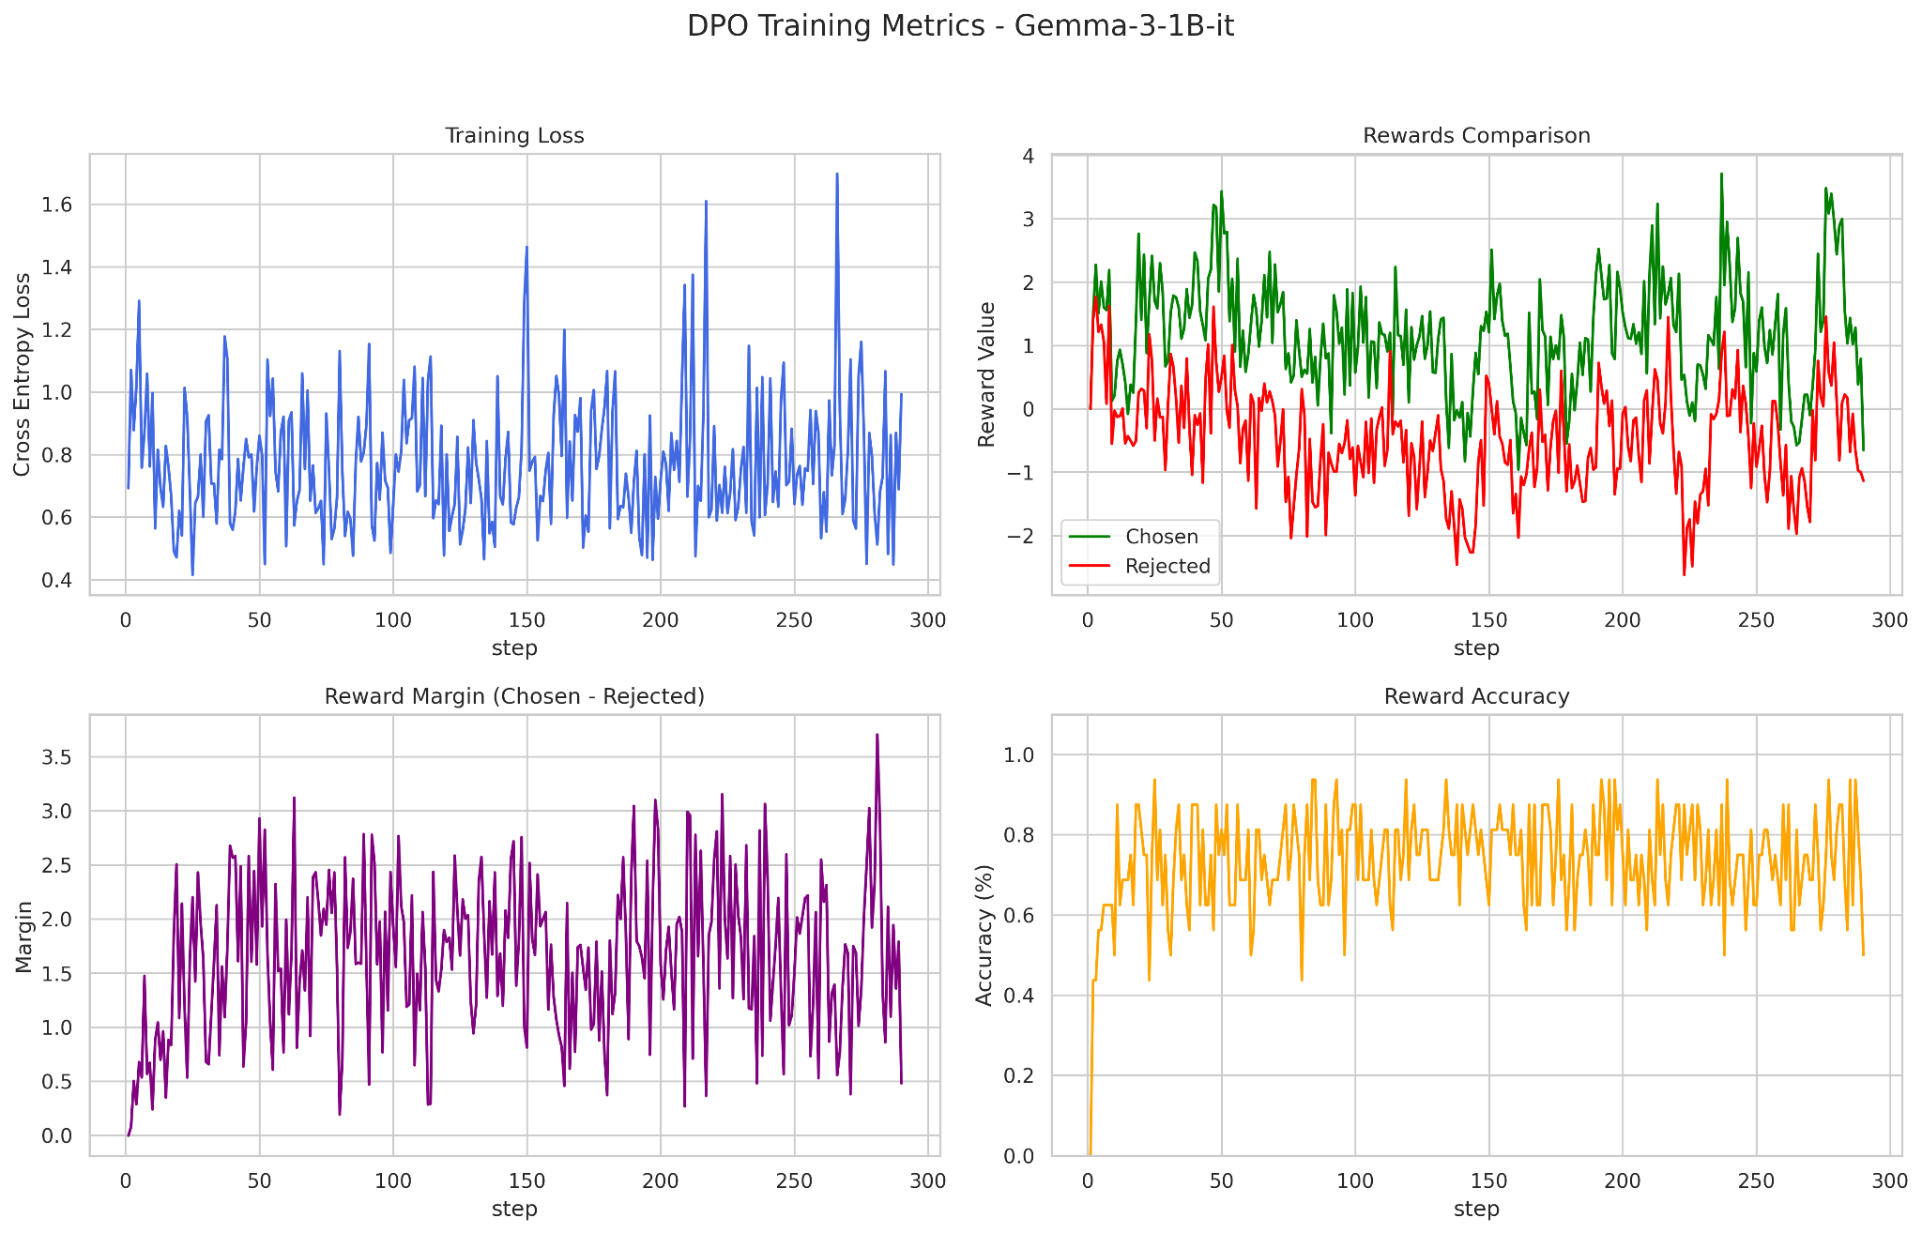
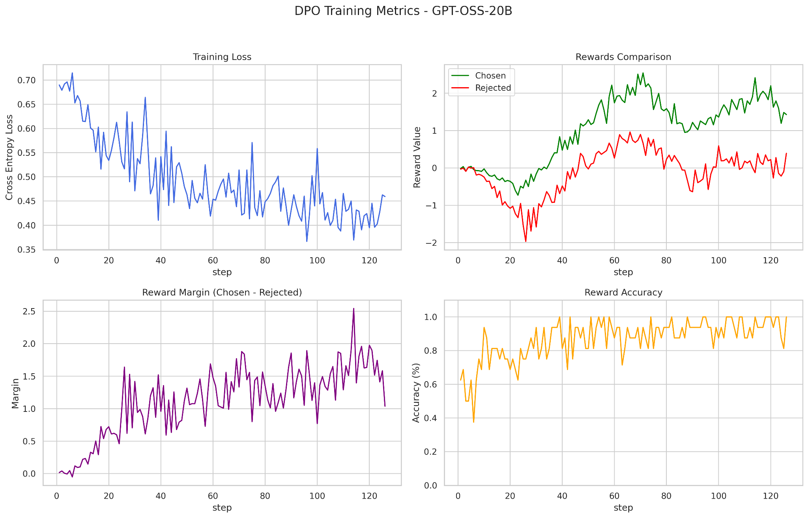
Training Logs
Stack Overflow Alignment
GenZ Slang Alignment

Slide 6
Demo
&
Thank you

