Slide 1
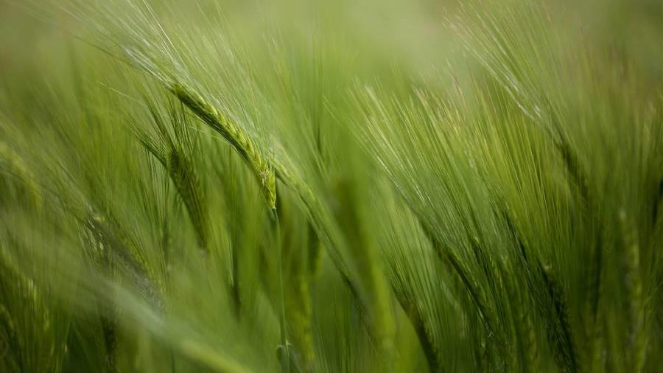
CYBER Cypher 2.0
Team Foobar
- Adith, Manan

Slide 2
Problem Statement
Afforestation
In today's world, afforestation is becoming an increasingly crucial task in mitigating the effects of climate change. Your goal is to use satellite data to determine the most effective way to promote afforestation in a specific region.
You must analyze climate and natural data collected by satellites to identify areas suitable for tree planting and develop a comprehensive plan for implementing afforestation initiatives in the region.
The solution could take into account factors such as soil type, rainfall patterns, and temperature, as well as any other relevant data. The objective is to develop a scalable and sustainable afforestation strategy that can be replicated in other regions, contributing to global efforts to combat climate change.

Slide 3
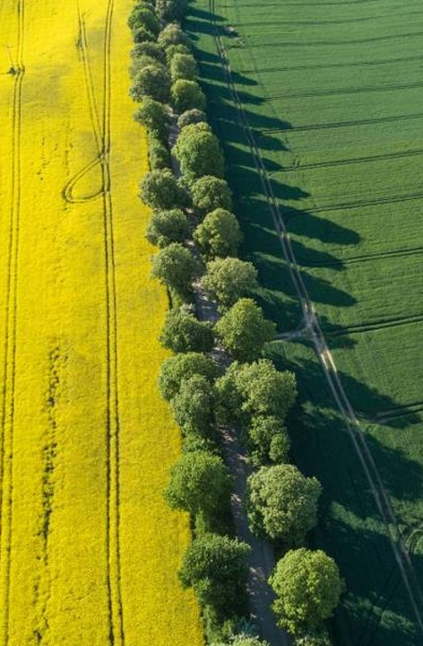
solution
Our solution to the given problem is to promote individuals to plant tree, by educating them through the means of a website

Slide 4
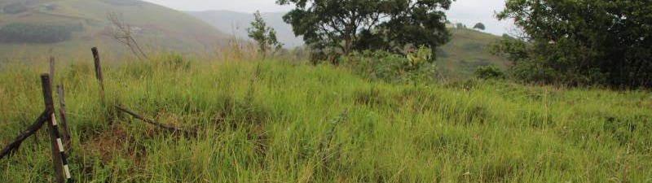
Benefits of Afforestation
Improves Air Quality
Enhances Bio-Diversity
Helps Water Management
Boosts the Economy

Slide 5
Solution Overview
Benefits of Afforestation
Machine Learning
CrowdFunding
Tree Cover Monitoring
CrowdSOURCING
The Website informs the user about the numerous number of ways afforestation can help us humans and can enhance our surroundings.
The Website helps the user to make informed decisions about which trees would grow the best in their surrounding and locality.
The Website uses crowdfunding techniques to fund organizations and NGOs. The visitors and users of the website can donate to the noble cause.
A machine learning algorithm that can accurately detect and quantify the extent of tree cover from satellite images and track changes over time.
Create a platform that allows community members to contribute satellite images, field observations, and other data to create a comprehensive map of local forests.

Slide 6
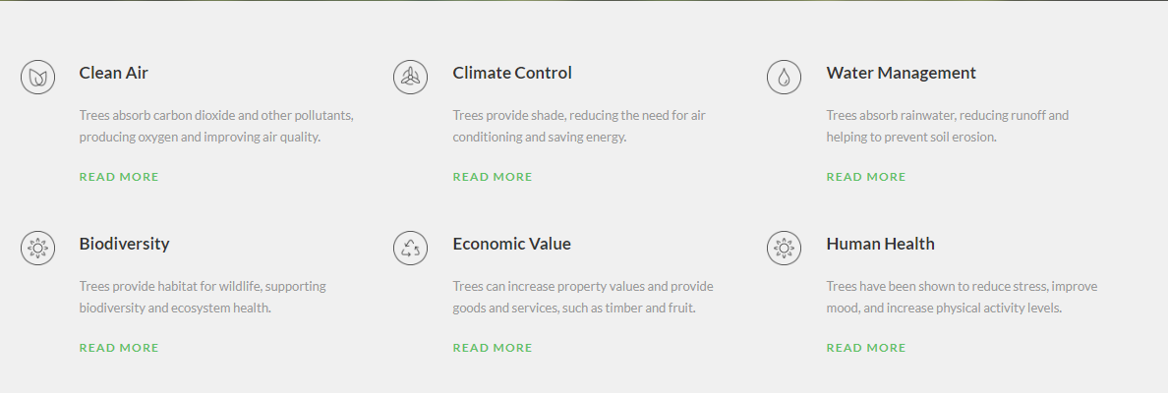
Benefits of Afforestation

Slide 7
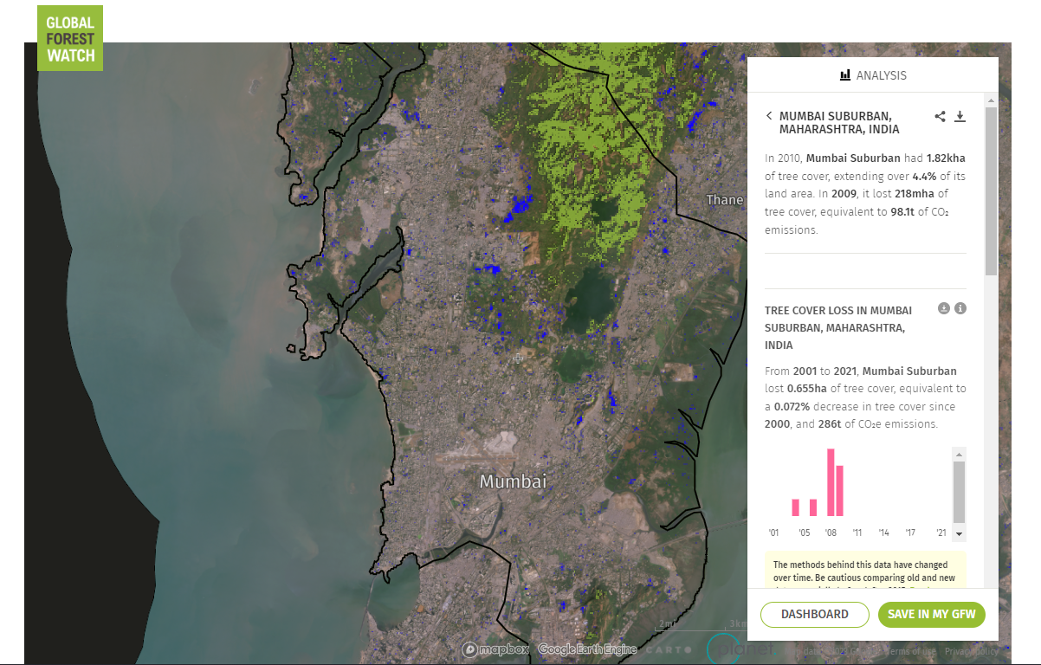
Forest Map
Global Forest Watch (GFW) is an online platform that provides near-real-time information on forests, including data on deforestation, fires, and other changes. The GFW Embed API allows developers to embed GFW's interactive maps and data visualizations on their own websites and applications.

Slide 8
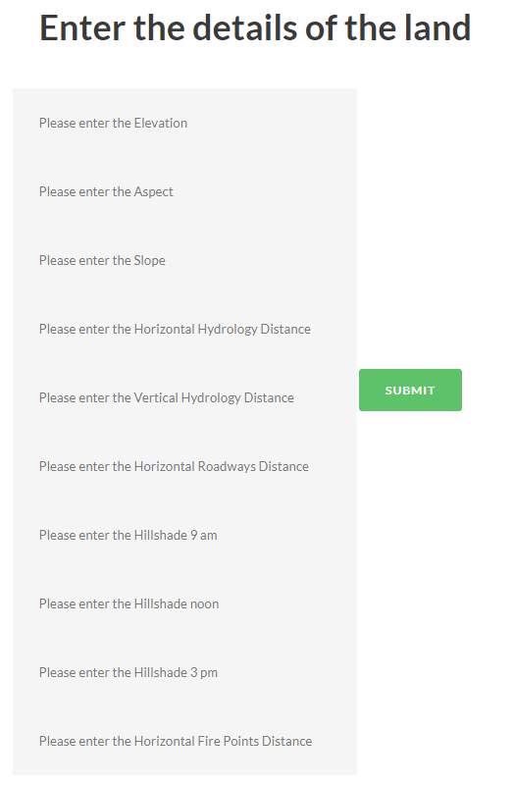
Machine Learning
Random Forest Classification Algorithm trained on Cover Type Dataset which uses satellite data.
Output:
Forest Cover most suitable (e.g. Fir)

Slide 9
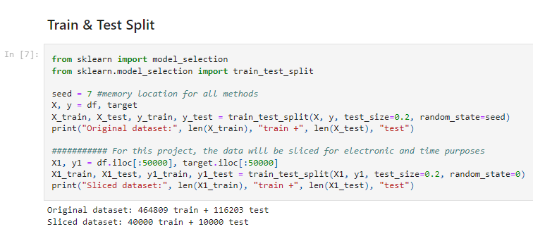
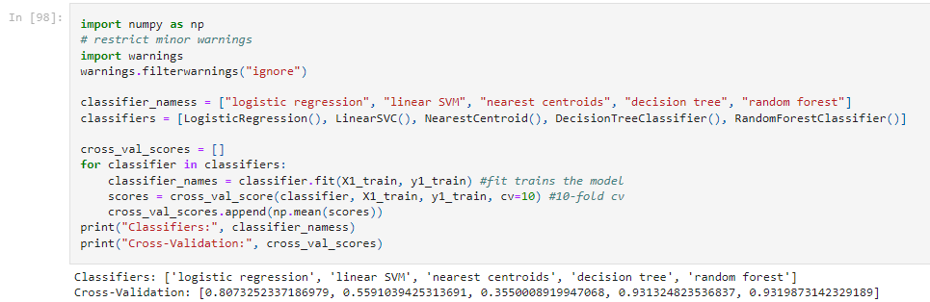

Slide 10
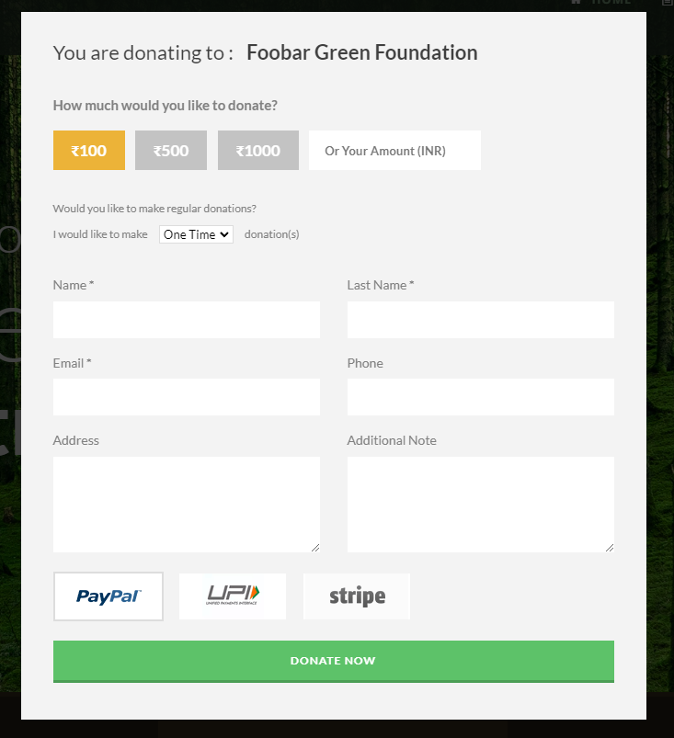
Crowdfunding
Plant-A-Tree Campaign
Forest Restoration Funds
Community Forest Gardens
Carbon Offsetting
Forest Protection Funds

Slide 11
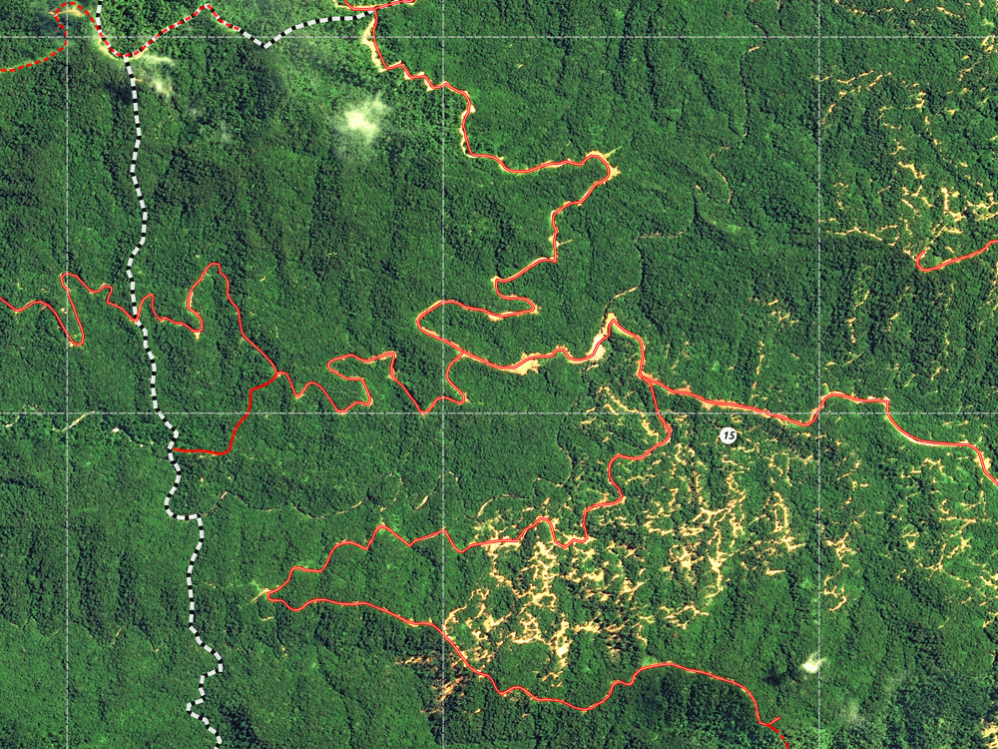
Tree Cover Monitoring
Forest Management Tool
Deforestation Alert System
Afforestation Planning
Forest Restoration

Slide 12

Crowdsourcing
Community Forest Mapping
Citizen Science Afforestation
Forest Monitoring Game
Crowdfunding for Reforestation
Forest Health Surveys
Social Media for Reforestation

Slide 13
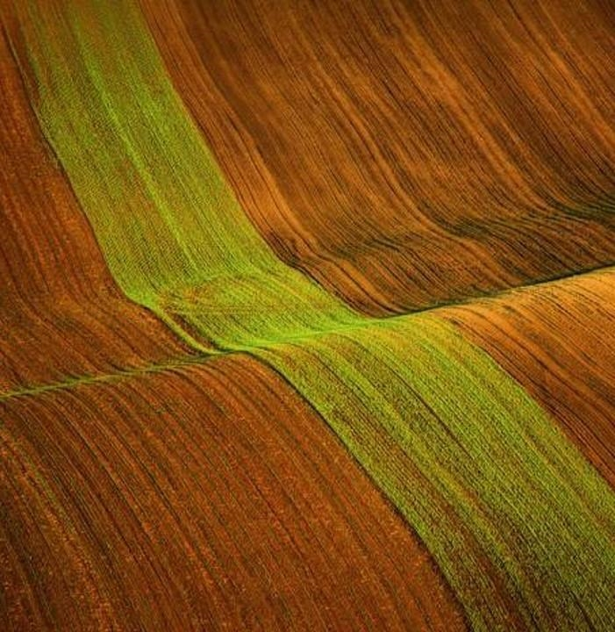
Thank you
By:
Adith
Manan

