Slide 1

Cyber Cypher Elementary Level
Team Name: FooBar
Team Number: 15

Slide 2

Problem Statement
Develop a working prototype that addresses one or more of these challenges and enables the cost-effective
and time-efficient use of EVs in a developing country.

Slide 3



Solution
Create an interactive website that allows the users to make informed decisions.

Slide 4
Features
3D Model
To provide a more realistic representation of the object, allowing users to better visualize its features and dimensions.
Cost Calculator
To help users understand the total cost of ownership for an electric vehicle, including things like fuel, maintenance, and financing costs.
EV Finder
Provide them with useful information about Costs, Seating Capacity, and available models.
EV Chargers Map
it could also be useful for current EV owners to locate charging stations when on a long trip.
Flask API
Used to create a RESTful API that allows users to interact with a web application or service using standard HTTP requests.

Slide 5
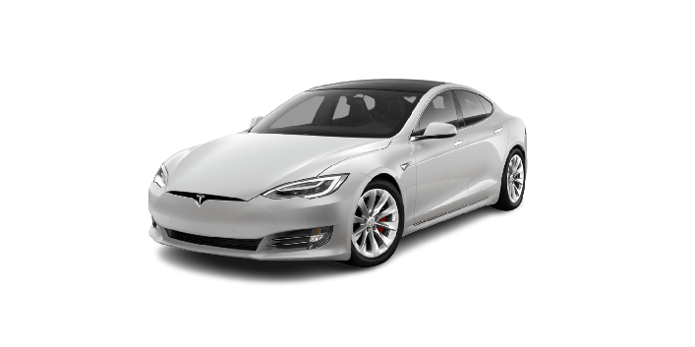
3D Model
HTML Model Viewer
HTML Model Viewer is a tool that allows developers to display and interact with 3D models on a web page using HTML, CSS, and JavaScript. It can be used to create interactive product displays, architectural visualizations, and other types of 3D content that can be viewed in a web browser. The viewer can be integrated into existing web pages and applications and supports a variety of 3D file formats including glTF, OBJ, and STL. It also provides features such as lighting, texturing, and camera controls to help users view and explore the models.

Slide 6
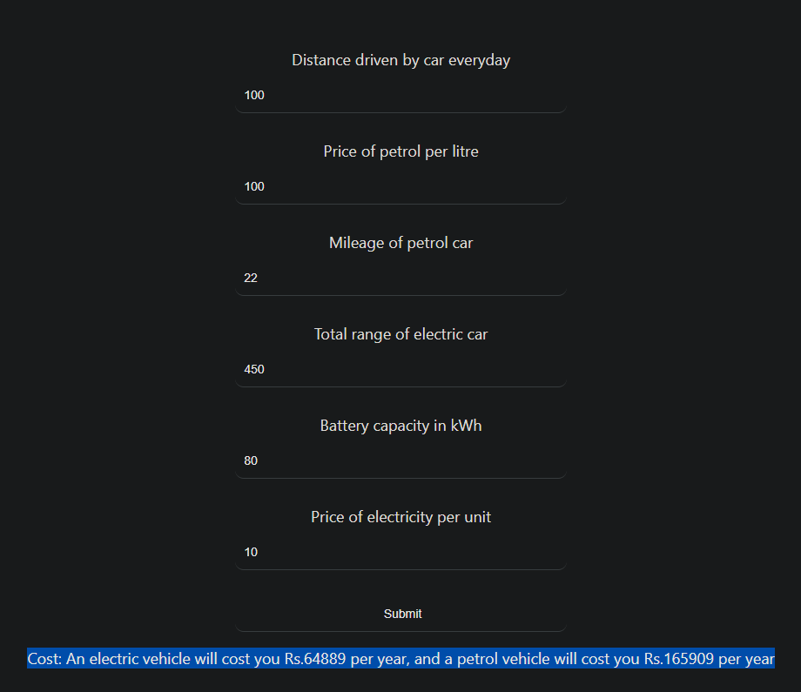
Cost Calculator
Tool Used
A Vehicle Cost Calculator is a tool that calculates the cost of owning and operating an electric vehicle (EV) compared to a traditional gasoline-powered vehicle. It considers factors such as the purchase price of the vehicle, fuel costs, maintenance costs, and other expenses. The goal of the calculator is to provide consumers with a clear and accurate comparison of the total cost of ownership for EVs and gasoline-powered vehicles, helping them to make an informed decision when considering purchasing an EV. Additionally, it can help them to identify the potential savings and benefits of switching to an electric vehicle.
We use e-Amrit’s API to get accurate results.

Slide 7
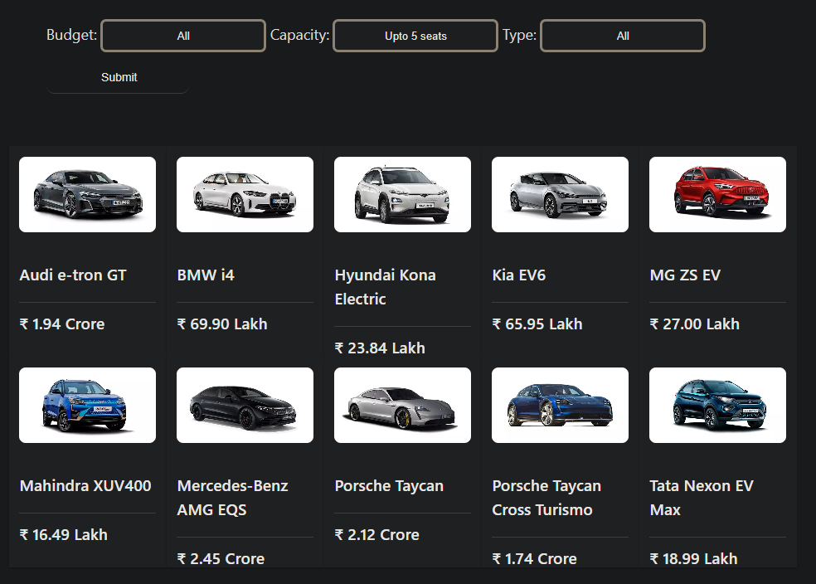
EV Finder
Tool Used
Carwale is an online platform that provides information about cars, including model details, prices, and user reviews. We scrape their website to get a list of all the cars that match the users requirements.

Slide 8
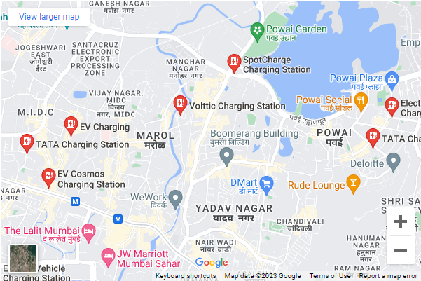
EV Chargers Map
Google Maps Embed
Google Maps Embeds is a feature that allows users to easily embed a Google Maps map on their website or blog. The embedded map can be customized with different colours, labels, and markers to indicate specific locations. It can also be used to display driving, biking, or walking directions. The map can be embedded using a simple HTML code snippet provided by Google Maps.
We use it to mark EV Charging stations near the user.

Slide 9
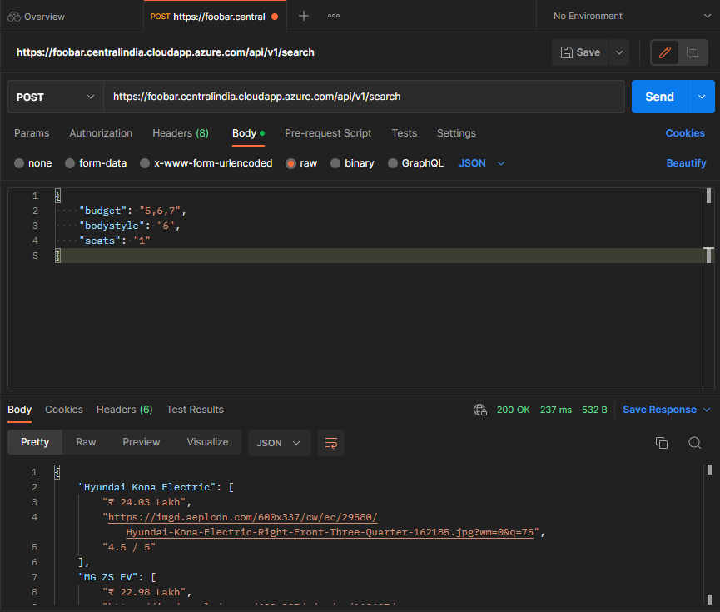
Flask API
Flask with Gunicorn
Python Flask is a lightweight web framework that allows developers to easily create web applications and APIs. Gunicorn is a Python WSGI HTTP Server for UNIX that can be used to run multiple instances of a Flask application in a production environment. Together, these tools can be used to create a robust and scalable API that can handle many requests. It provides a simple and flexible structure for building web applications and allows developers to focus on writing the application logic rather than dealing with low-level details.

Slide 10


Thank you
By: Adith
Manan

