Slide 1

MICRO PROJECT | 25AI2004 ARTIFICIAL INTELLIGENCE IN HEALTHCARE
CareBridge
A local-first, multilingual post-discharge medicine companion that is honest about what it could not check
Demian (URK23CS7011)
B.Tech AI & ML, Karunya Institute of Technology and Sciences
Supervisor: Ms. R. Hemalatha, Assistant Professor
Notes:
Introduce yourself and the project in one sentence: CareBridge reads a photo of a discharge summary or prescription, explains the medicines in English, Tamil or Hindi, checks interactions and builds a schedule, and it says when it could not check something.

Slide 2



Why discharge papers are hard to follow
Dense shorthand
WHAT A PATIENT SEES (ILLUSTRATIVE)
OD, BD, PC, SOS and brand/generic names on one page.
Tab. Metformin 500 mg
1 BD PC x 30 days
Inh. Ventolin 2 puff
SOS
Cap. Amoxyclav 625 mg
1 BD PC x 5 days
Mostly English
Many patients and carers read Tamil or Hindi more comfortably.
Harm continues at home
Mix up a name or a dose and the harm happens at home, not in hospital.
Adverse events after discharge are common, many linked to medicines.
Notes:
Forster 2003 and the WHO Medication Without Harm challenge show harm continues after discharge. The sample on the right is illustrative shorthand, not a real patient document.

Slide 3
Aim, objectives and SDG link
Aim
SDG 3
Good health and well-being
Read a photographed medicine list, explain it in plain language (EN / TA / HI), check pairs, build a schedule, and never claim more certainty than it has.
Fewer avoidable medicine errors
Objectives
SDG 10
Reduced inequalities
Extract medicines with a local vision-language model
Rules + row-level review before anything is trusted
Verified multilingual explanations with English fallback
Interaction check that says "not checked", never "safe"
Evaluate under a frozen protocol; report failures
Medicine information in Tamil and Hindi
SDG 9
Industry, innovation, infrastructure
Useful AI on one laptop, open models
Notes:
Keep the aim to one sentence. SDG 3 is the primary link; SDG 10 is language access; SDG 9 is local open-model innovation.

Slide 4





How it works: photo to schedule in six steps
Photo
1 Extract
2 Normalise
3 Confirm
4 Explain
5 Check + plan
Upload a discharge summary or prescription
Local VLM reads each medicine row
Rules fix errors and set a review level
User resolves uncertain rows in a picker
Plain language in EN, TA or HI, verified
Interaction look-up, daily schedule
Every medicine gets a review level: must_confirm | note | none. Rows at must_confirm are held back from interaction checks and schedules until the user confirms them.
Notes:
Walk left to right. Stress step 3: the system holds back anything uncertain until the user confirms it.

Slide 5





Key features
Three languages
Row-level review
Formulary picker
English, Tamil and Hindi; machine-drafted text is labelled as a draft.
Every medicine is must_confirm, note or none, with reasons.
Fix a misread name from a list of 66 drugs.
Verified explanations
Interaction check
Schedule + doctor summary
Each line is checked; failures fall back to the original English.
DDInter plus an author-checked supplement; "not checked" when unsure.
Daily dose plan and a one-page summary to show the doctor.
Notes:
Six features. The two to emphasise: row-level review and the "not checked" status.

Slide 6
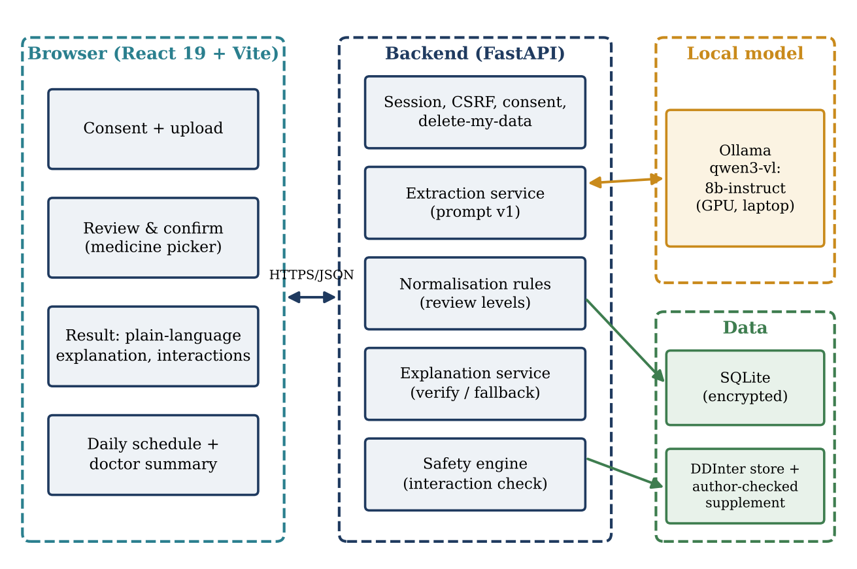
Architecture: all on one laptop
Technology
React 19, Vite, TypeScript, Tailwind
FastAPI backend
SQLite, Fernet-encrypted
Ollama + Qwen3-VL 8B (local GPU)
DDInter-derived interaction store
pytest, vitest, Playwright, axe
Notes:
No cloud API: the model runs through Ollama on the same machine. A cloud quota ran out early in the project, which led to this local design.

Slide 7
Safety design: it never says “safe”
interaction_found
Level, source and advice shown
2,145
pairs among 66 formulary drugs
not_checked_no_record
No record in DDInter or supplement
1,014 have a record
1,131 have none
not_checked_unconfirmed
Medicine not yet confirmed by the user
“Not checked” means no information, not no risk.
not_checked_database_missing
No interaction source for a drug
Notes:
Four statuses, one rule: no branch ends in safe. The coverage numbers explain why most pairs end as not checked.

Slide 8




Privacy and hosting
Local-first
Encrypted storage
Public sample site
GitHub Pages shows a pre-recorded sample only.
Model, backend and data stay on the laptop.
Fernet-encrypted payloads in SQLite; no disk cache of content.
78 / 78
Anonymous session
Delete my data
live checks passed, with zero /api requests
No account or e-mail; consent notice before upload.
One click empties the session (about 0.4 s).
itsthedemigod.github.io/carebridge
Notes:
The real flow needs the laptop. The public site is a static, pre-recorded sample, which is also the backup if the live demo fails.

Slide 9

How it was evaluated
Dev split
Held-out test
Stress set
20
documents
40
documents × 5 image conditions
30
authored prescriptions
Used for tuning rules and prompts
200 readings, 795 medicine mentions
10 difficult categories × 3
Frozen before the test
Git tag freeze-pre-test • manifest of 98 files + model digest + test-data hash • one official run only (2 h 25 min) • later re-runs labelled post-hoc • Wilson and document-level bootstrap intervals
Notes:
Documents are synthetic so the ground truth is known. The test split was never opened during harness development.

Slide 10
Result: rules turn 26% into 89% fully correct
26.2% → 88.8%
fully correct entries (95% interval after rules: 0.845 to 0.927)
13 → 1
hallucinated medicines, raw vs after rules
26 of 795
name errors remaining, 1 unflagged
Notes:
Pooled over 5 conditions, 795 medicine mentions. The raw model finds nearly all medicines, but fills empty fields from other text. The rule layer fixes most of that.

Slide 11
Result: strict on safety, cautious by design
0 of 389
51.1%
wrong generic names reached the interaction check
of medicines needed user confirmation
2 of 285
79–89%
schedule-ready medicines had a wrong schedule
of pairs were “not checked” (no record)
The 3 “silent misses” were one misread row (“Performin” for Metformin), held at must_confirm. The 2 wrong schedules: an SOS inhaler read as OD, and a lost “PC”.
Notes:
Be honest about the 2 wrong schedules: a misreading that agrees with its own quote cannot be caught by rules. About half the medicines need a tap from the user, which is the price of not trusting the model blindly.

Slide 12
Result: English works, Tamil is the weak spot
What this tells us
255 lines per language
Tamil: 194 lines failed verification and were shown in English with a notice
Hindi is weakest on warning lines (0.52)
Same model writes and judges; no native-speaker review yet
Notes:
Tamil falling back to English is safe (nothing unverified is shown) but means the Tamil experience is mostly English. This is a measured finding, and the clear next step is native-speaker review.

Slide 13
Stress test: all 4 criteria met
P1
Silent misses not covered by a flag
0 of 204
The cost of caution
38 of 102
P2
Weekly medicine given a daily schedule
0 of 6
ground-truth pairs were shown immediately. The other 64 were held behind confirmation flags and none was lost silently.
P3
Wrong generic (interaction-ready)
0 of 113
104 of 104 medicines detected, 0 hallucinated
P4
Pairs correct after the picker
204 of 204
Notes:
Ten categories, three each: major, moderate and supplement pairs, duplicates, garbled names, weekly medicines, unusual strengths, eye drops with OD, an eight-medicine list, and controls. Run on Ollama 0.40.11, a recorded deviation from the pinned 0.40.5.

Slide 14
Conclusion, limits and next steps
A local, multilingual medicine companion can be built around uncertainty: rules plus confirmation raised fully correct entries from 26% to 89% and kept wrong drug identities out of the safety check.
Limitations
Next steps
Synthetic data, one generator
Not clinically validated
Tamil/Hindi and supplement unreviewed
Two wrong schedules; half need confirmation
Real-photo test and usability sessions
Pharmacist and native-speaker review
Independent check against misreadings
Block schedules on timing conflicts
Thank you | Code (MIT): github.com/ItsTheDemiGod/carebridge | Sample: itsthedemigod.github.io/carebridge
Prototype only: not a medical device, never use it to make treatment decisions.
Notes:
Close by repeating the one rule: when unsure, say so, and never say safe. Mention that the pre-recorded site is available if anyone wants to try it.

