Slide 1

Showroom Online
Huỳnh Quang Đạt
Phương Vĩnh Phú

Slide 2
Purpose of project
Apply knowledge about Java web application
Develop a web application for Showroom Online

Slide 3
Introduce Project
Main Function:
User management
Category management
Product management

Slide 4
Development Tool and Environment
Java NetBeans
Java Web Application
MySQL

Slide 5
Strength Point
Implement a Process Servlet: base on the action of button, process servlet will choose what servlet to perform the action
Friendly user-interface

Slide 6
Weakness point
Not use STRUTS Framework to develop application.

Slide 7
User management
User login with roll:
Admin
Staff

Slide 8
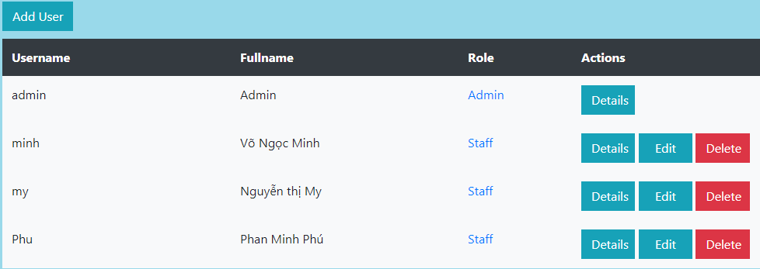
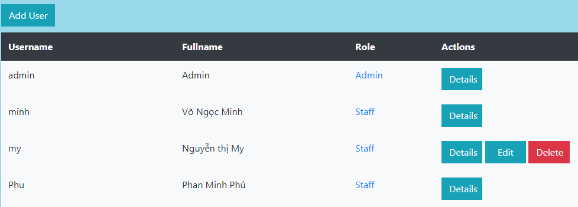

Slide 9
Category management
Use CRUD to manage Categories

Slide 10
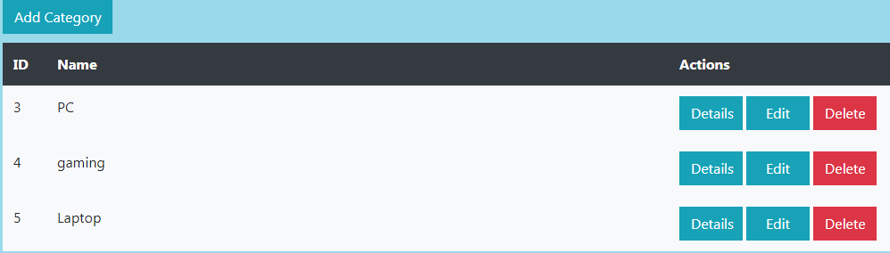

Slide 11
Product Management
Use CRUD to manage Product

Slide 12
