Slide 1
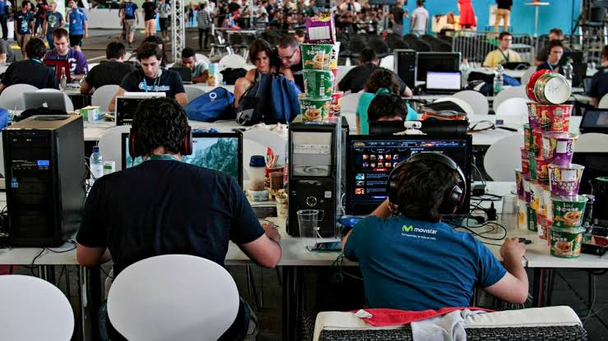
TEAM “team”
Image Classifier
How our model understands an image
and suggests useful categories
SEE → MATCH → SUGGEST → LEARN

Slide 2
01 / THE PROBLEM
Good images are only useful when people can find them
Wikimedia Commons stores free media, but images need meaningful categories to be discoverable.
①
A photo is uploaded
②
Categories may be missing
③
Editors need a head start
A person adds a new image to the media library.
Without useful labels, the image is harder to search for and reuse.
Our model suggests likely categories for a person to review.
Goal: make categorization faster — while keeping people in control.
02

Slide 3
02 / BIG PICTURE
From one image to useful suggestions
The system combines visual matching, a category list, and optional online enrichment.
01
UPLOAD
02
UNDERSTAND
03
COMPARE
04
PRESENT
Choose an image
→
CLIP turns it into a visual fingerprint
→
Match against category descriptions
→
Show the strongest suggestions
Optional: Gemini suggests extra keywords → Wikimedia Commons search finds related category pages
03

Slide 4
03 / THE VISUAL ENGINE
CLIP creates a “visual fingerprint”
Instead of memorizing every possible photo, the model represents what an image looks like.
INPUT IMAGE
COMPARE WITH
CLIP MODEL
→
→
beach
mountains
A compact pattern of features
city
Think of it as a fingerprint: similar-looking images tend to have similar fingerprints.
04

Slide 5
04 / WHAT CAN IT RECOGNIZE?
A broad menu of possible categories
The code groups candidate labels into families, then compares the image with them.
OBJECTS
PLACES
EVENTS
Pets, furniture, phones, books
Beaches, cities, forests, museums
Weddings, concerts, sports, festivals
NATURE
ARCHITECTURE
FOOD & CULTURE
Sunsets, rivers, wildlife, storms
Temples, bridges, castles, homes
Pizza, painting, dance, pottery
These are candidate labels in the prototype — not a guarantee that every category will be recognized correctly.
05

Slide 6
05 / HOW A MATCH IS CHOSEN
Many candidates go in; the strongest matches come out
The model compares the image fingerprint with text descriptions of categories.
CATEGORY DESCRIPTIONS
SIMILARITY SCORES
SUGGESTED RESULT
• a photo of a cat
→
beach
→
1. Beach
• a photo of a beach
sunset
2. Sunset
• a photo of a bridge
• a photo of a sunset
bridge
3. Other possibilities…
The percentages shown here are illustrative. In the current code, scores are relative to the candidate list, not guaranteed real-world probabilities.
06

Slide 7
06 / ADAPTIVE RESULTS
The output changes when the model is unsure
A simple decision rule decides whether to show one or two leading matches, or a wider shortlist.
①
Clear leading match
②
Two close matches
③
Uncertain result
Show the strongest category when it stands well above the others.
Show two when the runner-up is also competitive.
Show the top five options instead of pretending there is one clear answer.
This is a ranking aid: a person should check whether the suggestions fit the actual image.
07

Slide 8
07 / EXTRA DISCOVERY
A second step can find related Commons categories
When a Gemini API key is available, the app asks for a few keywords and searches Wikimedia Commons.
A
Gemini keywords
B
Commons search
C
Extra discoveries
Suggests three short terms that describe the image.
Looks for category pages related to those terms.
Adds some matching category-page titles to the results.
This enrichment is optional. If the API key is missing or the request fails, the core CLIP results can still be returned.
08

Slide 9
08 / LEARNING FROM CORRECTIONS
People can teach the app about an edge case
A correction is saved as a visual example with the category label supplied by the user.
1. Review
2. Correct
3. Remember
A user spots a wrong or unusual suggestion.
→
They enter the right category and optional subcategory.
→
The image fingerprint and label are saved to disk.
On a later image, a very similar fingerprint can trigger a direct memory match.
Important: this stores examples; it does not retrain the CLIP model itself.
09

Slide 10
09 / KEEPING IT PRACTICAL
Prepare once, reuse many times
The app saves category-text embeddings so it does not need to recompute them on every restart.
⚙
First run
↻
Later runs
CLIP converts the category descriptions into numerical representations and saves them in a cache file.
→
The app loads the saved representations, reducing startup work.
The speed benefit depends on the machine, available memory, and whether the cache already exists.
10

Slide 11
10 / ONE COMPLETE RUN
The journey from upload to result
Here is the whole workflow in one view.
Upload image
→
Create fingerprint
→
Check saved examples
Compare category text
→
Choose top matches
Result: category suggestions plus a status message — ready for a human to review.
11

Slide 12
11 / HONEST LIMITATIONS
Useful prototype — not a perfect classifier
A few details matter when interpreting the output.
Scores are relative
Limited label menu
Memory can overmatch
Softmax scores depend on the candidate set; they are not calibrated confidence.
The model can only directly compare against the labels included in its taxonomy.
A very high similarity threshold can return a saved label even when context differs.
No automatic retraining
Optional online service
Human review matters
Corrections add stored examples; CLIP weights remain unchanged.
Gemini enrichment needs a working API key and network access.
Suggestions may be wrong; review before using categories.
12

Slide 13
THE TAKEAWAY
MemoryTag AI turns images into searchable suggestions.
It combines a pre-trained visual model, text-based matching, a small memory of corrections, and optional Wikimedia discovery.
01
Recognize
02
Rank
03
Learn from examples
Thank you
13

