Slide 1









NatIonal INSTITUTE OF TECHNOLOGY AGARTALA
CIVIL INNOVATION AND TECHNOLOGY CELL
PRESENTS
Problem Statement Title: AI-Based Smart Food Waste Management
Team Name: Suryavansham_KI_kheer
Team Leader Name: PRIYANSHU SAHOO
Institute Name: NAtional forensic sciences university, TRIPURA CAMPUS

Slide 2






Brief Description of Proposed Solution:
The proposed solution focuses on
reducing food waste
through AI-assisted grocery planning
and consumption management.
By purchasing only what is needed, users minimize leftover ingredients, save costs, and significantly reduce household food waste.
The system takes user input such as
the name of a dish and
the number of household members,
then automatically gathers the required ingredients from online recipe sources.
Based on these inputs, it calculates the exact quantity of each ingredient
to avoid over-purchasing.
Finally, it generates a personalized grocery list in PDF form.

Slide 3

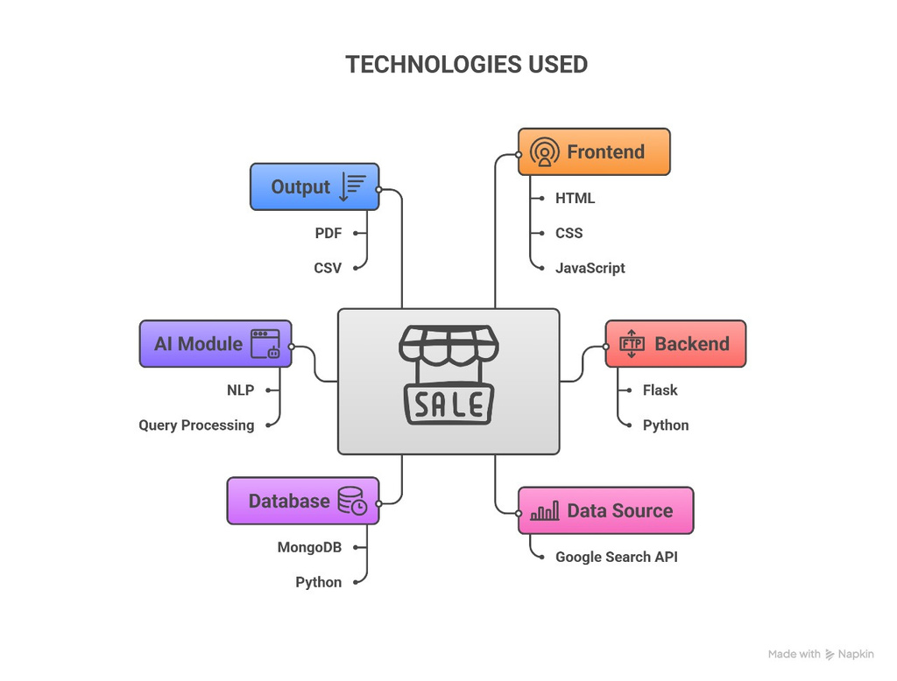
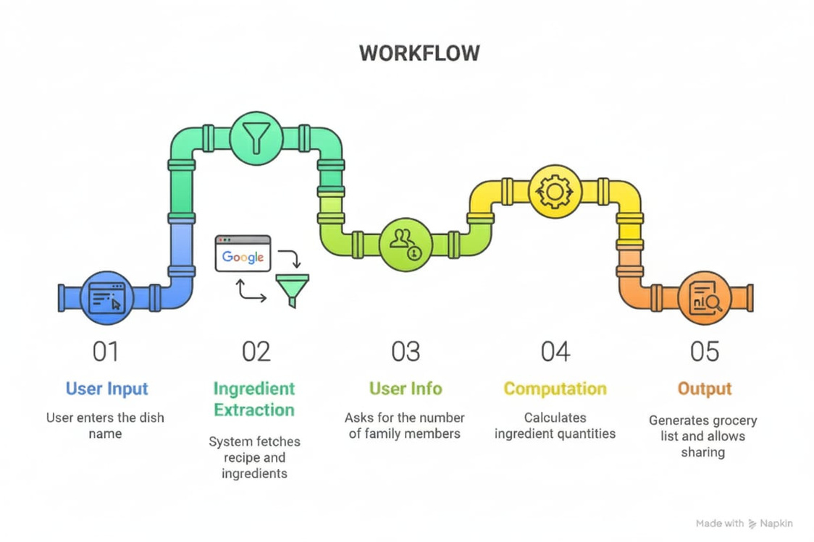
Technologies used in proposed solution:
Idea Approach:

Slide 4
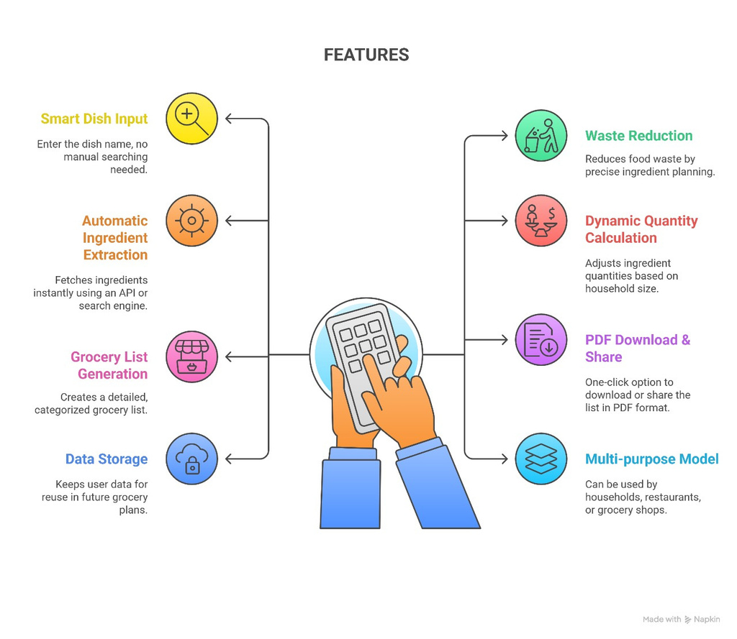
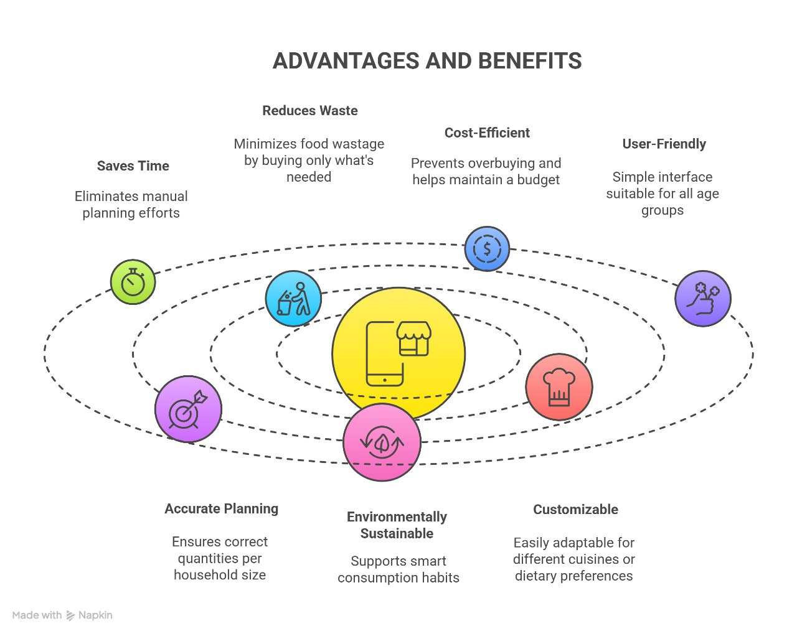
Key Features and Outcomes:
ADVANTAGES AND BENIFITS:

Slide 5

Team Member Details:
Team Member Details:
Team Leader Name: Priyanshu sahoo
Year: 2nd
Course: BTech-mtech cse
Team Member Name: kshitij chandel
Year: 3rd
Course: BTech-mtech cse
Team Member Name: soumyadeep banik
Course: BTech-mtech cse
Year: 2nd
Team Member Name: hariom singh
Course: BTech-mtech cse
Year: 3rd

