Slide 1



Introduction to Git and GitHub
Compiled and Presented by Brian Bosire
Coordinator : David Mwania
Notes:
1

Slide 2


Objectives
Introduction to Git and GitHub
Basic Git Commands
A snapshot of the basic commands used
A preview of what is Git and GitHub
Collaboration with Git and GitHub
Project collaboration using Git and GitHub
Notes:
2

Slide 3

What is Git?
Defining Git
Why Git is Useful?
Why Git ?
Git is a version control tool that tracks changes made in a file like history
Keep track of file changes
Performance
Review and revert back to older versions
Flexibility
Synchronize files between different locations
Popularity
Test changes without loosing the original copy
GitHub
GitHub
GitHub is a hosting site for Git repositories
Why is GitHub Useful?
Free hosting for open source projects
Interface for browsing and editing code
Workflows for easy collaboration
API for doing other things
Works best with plain texts and small files(.txt, .py, .md, etc)
Notes:
3

Slide 4
Terminology
Repository
A repository is where the revision history of a project is stored, normally hidden in the .git directory within your Project directory.
Local Repositories
Remote Repositories
are repositories that are in your local computer.
are git repositories that are not locally stored, normally hosted on platforms like GitHub and GitLab.
They are crucial for backup, collaboration and sharing.
Have advanced features such as issue, pull request and forking.
Notes:
4

Slide 5
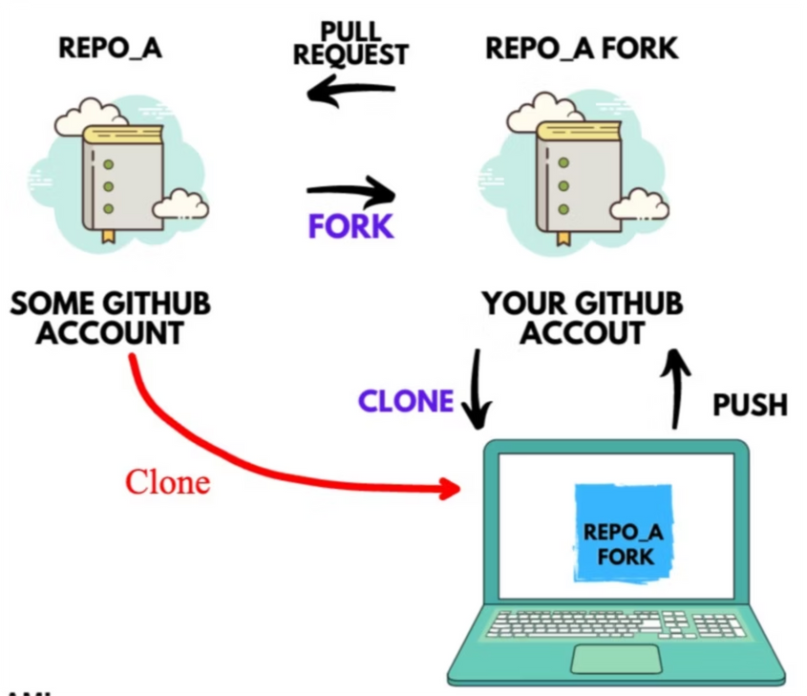
Clone vs Fork
Cloning is you making a local copy of the remote repository.
If you fork first then you have your own version of the repository remotely that you can pull and push changes to. Fork can avoid making changes directly on someone else’s repository.
Notes:
5

Slide 6
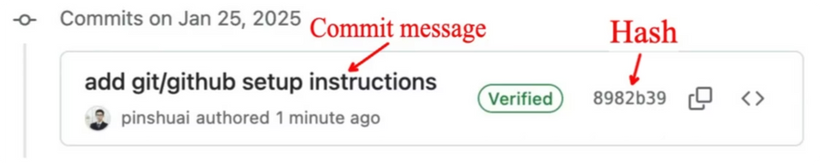
Commits
1
What are commits?
2
Snapshot Reference
Changes that are made in the file and committed to git's version control
Every time one commits changes, git takes a picture of what all your files look like at the moment.
3
Metadata
Commits have metadata such as the committer, the author, time and message describing the changes.
Notes:
6

Slide 7
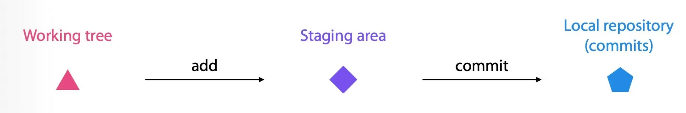
Working Tree(directory) and staging area
Before you make a commit, you need to tell git which changes you want it to keep track of.
Work with files in the working directory
Move the files with changes to the staging area
Only changes in the staging area are included in the commits
Notes:
7

Slide 8
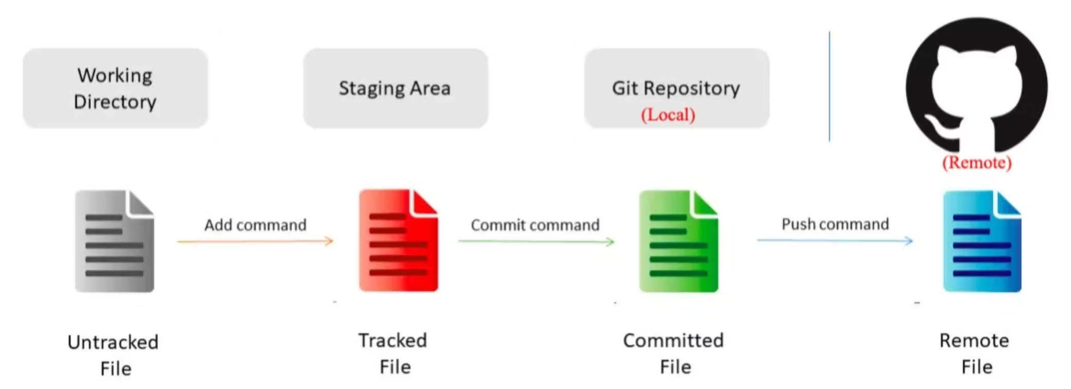
Three File Stages
1
Untracked or modified
2
Staged
3
Committed
The file is new or modified
The file has been added to git's version control but changes yet to be committed
Changes have been committed and a new version has been committed
Notes:
8

Slide 9

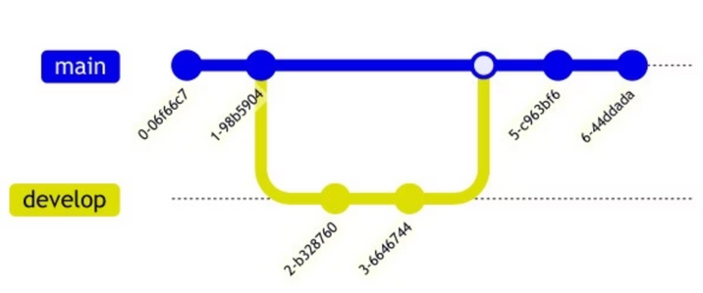
Branches
Git branches are effectively a pointer to a snapshot of your changes.
Allows multiplexing without messing the main branch
Main branch: default branch
Develop: adding new features or fixing bugs
Notes:
9

Slide 10
Practical Session
How to install Git
1
Command Line Interface (CLI)
2
Graphical User Interface(GUI)
3
Creating a GitHub Account
For windows Download Here
GitHub Desktop WIN/MAC: Download Here
To sign up an account on GitHub: Sign Up Here
Notes:
10

Slide 11
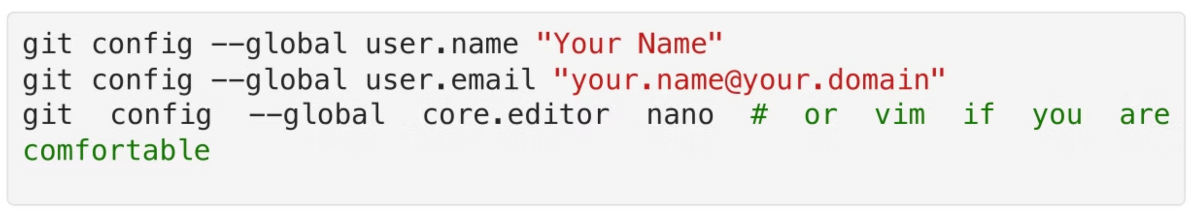
Git Commands
git init
git config
git branch
git init # create an empty git repo
git config # configure email and username
git branch # displays the current branch
Notes:
11

Slide 12
Practical session 1
Open git bash/ Terminal
`git status` # show file status`git add FILENAME` # adds untracked files to the staging area`git add .` # add all the untracked files to the staging area`git rm --cached FILENAME` # removes files from the staging area`git commit -m` "Message" # commitgit log # see commits in the log
Create a new directory
Initialize a Git repository in it
Use ls --la to reveal the hidden .git directory
Configure your name, email, and editor using git config
Confirm your configurations using git config --list
Notes:
12

Slide 13
Practical Session 2
Navigate to the newly created repository
Create a README.md file and add some content in it and save it
Use git status to show the file status
Use git add to add the README file and use git status again to check the file status again
Use git commit -m “Your message” to commit and use git status again to check the file
Use git log to see the commit history
Notes:
13

Slide 14
Working with remote repositories
Adding a remote repository to an existing Local repository
If you initialize a your repo locally , you can use git remote to configure a remote’s repo information
Note you will need to set up the remote URL first. For example, you can first create an empty repository on GitHub. Then use git remote to configure the local repo.
git remote add origin https://PAT@github.com/username/repository.git
git remote -v # Verify the remote url
Copying an existing Git Repository
git clone <remote_repository_url>
Notes:
14

Slide 15

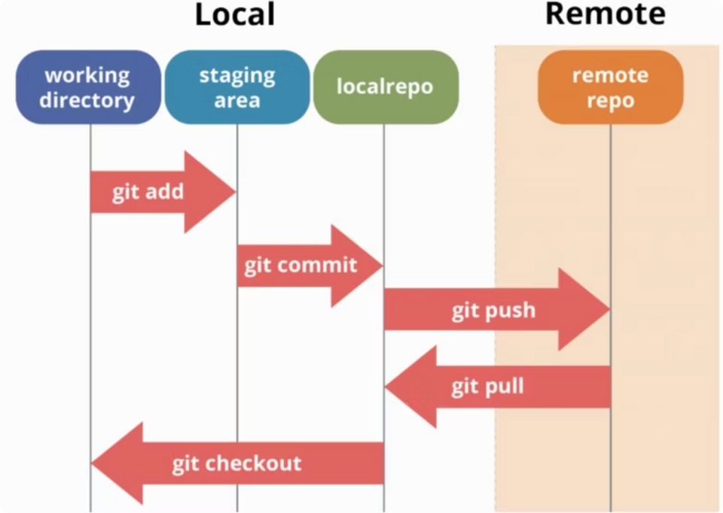
Synchronizing a local repository with a remote one
git fetch: fetch latest changes from the remote repo into your local repo
git pull: fetch latest changes from remote repo AND merge into your local repo
git push: push local changes to remote repository(always pull before pull)
git push -u origin push your branch to the remote; -u short for -- set-upstream
git checkout switch branches or checkout a new branch; use -b to create the new branch if it does not exist git checkout -b
Notes:
15

Slide 16
Creating a PAT
Other useful commands
Github no longer accepts password for authentication. To push and pull from Github on CLI , users must create a PAT, which acts as password but it is more secure.
git restore --staged to unstage a file
git revert COMMIT-HASH revert previous commits. This will preserve history (different from recover) and it will add a new commit history
Make sure to add read and write access to the repository permission
use git revert HEAD to revert the last commit
git reset HEAD^ undo commit
git reset --hard origin/main reset current repo to remote main branch (will delete all new files including ignored files/folders!!!.Backup all files before doing this!)
Notes:
16

Slide 17
Managing Conflicts
Collaborating through Git and GitHub
git merge : merge a new branch into the existing (e.g., main) branch
If you are a contributor (i.e., no permission to the original repo), a typical workflow looks like this:
Conflicts can occur in several situations (e.g., during merge) when you’re using Git.
Fork a pubic git repository to your personal account
Open the forked repository on GitHub and clone it lo‐ cally through GUI (e.g, GitHub Desktop) or terminal (e.g., PowerShell)
Create a new branch (e.g., git checkout -b NEW_BRANCH) and some changes. This is important to not mess with the main branch.
Add, commit, and push the changes to GitHub
On GitHub, submit a PR (pull request). After review, a PR is approved by the original repository owner
Notes:
17

Slide 18
README File
If you are a collaborator of a GitHub repo:
Clone the repo. No need to fork.
Create a new branch (e.g., git checkout -b NEW_BRANCH) and some changes.
A README file tells potential users and contributors about your project.
Add, commit, and push the changes to GitHub
The README is often written in Markdown, which allows you to add headings, links, tables, images and other features.
On GitHub, submit a PR (pull request).
A LICENSE file tells users the conditions under which they can use, redistribute, and even commercialize your project contents. Potential users or contributors may avoid your project if the license is unclear.
To learn more about Markdown language : Click Here
Notes:
18

