Slide 1
Structuring your API using a Hexagonal Architecture
Notes:
- Looking to restructure SETH API
- One idea considering is the Hexagonal Architecture

Slide 2
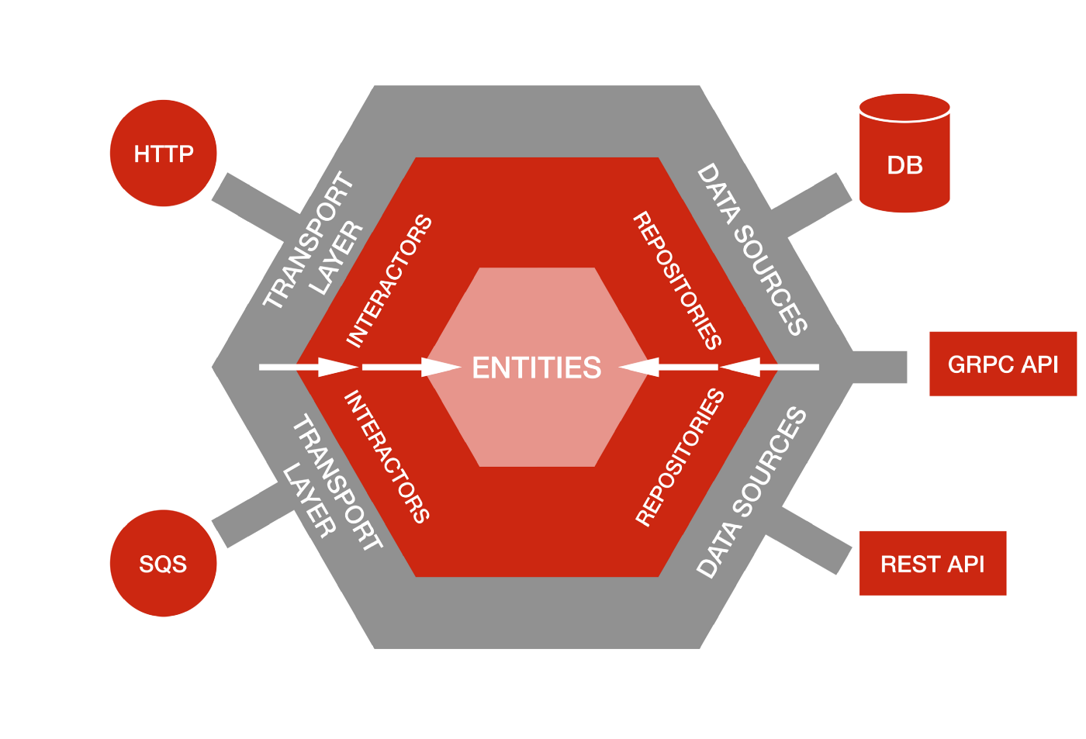
What is a hexagonal architecture?
Primary Inputs / Application Drivers / Ports
Outputs / Effects / Driven Adapters
Cronjobs
GQL Resolvers + Mutations
GRPC API
Notes:
Hexagonal Architecture is a type of layered architecture
Uses a directional flow to define boundaries and responsibilities for code components
Allows for easier substitution of data sources and easier of your extension of your business logic when integrating with other systems
Sometimes called the Ports and Adapters Architecture

Slide 3
Ports and Inputs
Application Core / Services
Adapters and Repositories
Handles implementations of specific transports
Calls out to services to perform logic
Defines interfaces for performing specific operations
Encapsulates business logic
Provides single location for bulk of unit testing
Performs data reads and writes
Interacts with specific data sources and data stores
Transforms data into source agnostic structures

Slide 4
Testing
Thin unit test for transports
Do we return expected success/error codes
Do we accurately return intended response types
Bulk of unit testing in services
Assert expected behaviours are called with correct arguments
Test sad paths
Bad data tests etc etc
End-to-end integration tests
Run tests through each of your transport through to repository paths
Construct payloads to initialize, then check data stores (or mocked API calls) for intended outcomes

Slide 5
Pros
Once framework is understood by team – decisions around where code should live are obvious
Unit testing service core becomes very easy because you only need to mock data, not frameworks + packages
Data sources can easily be substituted

Slide 6
Cons
Does not play well with hands-on frameworks e.g Ruby On Rails / Active Record – prefers lighter tooling such as connection managers
Maybe doesn’t play well in heavily object oriented systems?
Has ”roll your own” elements -- relies more on internal documentation / process explanations

Slide 7
Thoughts + Edgecases
Do you want an entity layer?
Benefits heavily from dependency injection – easier mocking + quicker test run time
Transactions

Slide 8
Further Reading
[1] https://netflixtechblog.com/ready-for-changes-with-hexagonal-architecture-b315ec967749
[2] https://betterprogramming.pub/a-quick-and-practical-example-of-hexagonal-architecture-in-java-8d57c419250d
[3] https://8thlight.com/blog/damon-kelley/2021/05/18/a-color-coded-guide-to-ports-and-adapters.html

