Slide 1
TEAM: 01
Presenter:
MD JUNAIED HOSSAIN
20101204 Section: 01
ST: Md Mustakin Alam RA: Md Humaion Kabir Mehedi

Slide 2
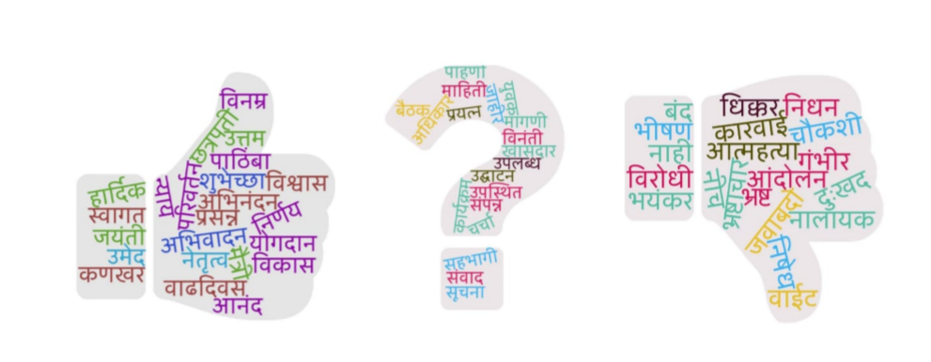
Introduction
L3CubeMahaSent: A Marathi Tweet­based Sentiment Analysis Dataset
16,000 tweets strong Marathi Sentiment Analysis Dataset, manually tagged into three classes
provide a comprehensive annotation policy useful for tagging sentences by their sentiment.
present the result of our experiments on this dataset on recent deep learning approaches

Slide 3
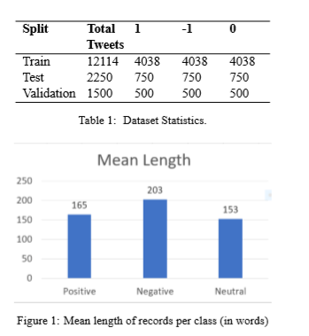
Dataset
Labeled the entire dataset - positive, negative, and neutral
Dataset consists of ∼16,000 distinct tweets
2,355 positive and 159 negative tweets.
These extra tweets have not been used for model evaluation

Slide 4
Evaluation
performed 2­ class and 3­ class sentiment analysis on our dataset
text is tokenized as words or sub­words
passed to the algorithms
CNN
BiLSTM+GlobalMaxPool
ULMFiT
BERT

Slide 5
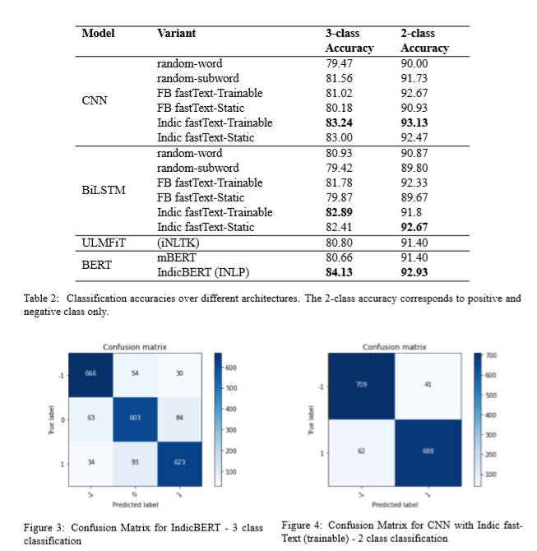
Results
Pretrained word embeddings provide an advantage over random initializations.
CNN-based models slightly outperform BiLSTM-based models.
Models using random initializations tend to overfit quickly during training.
Using pretrained embeddings significantly reduces overfitting.
The Marathi word embeddings provided by IndicNLP outperform the original versions released by Facebook.
Keeping word embeddings trainable further increases accuracy.
The ULMFiT model gives results comparable to simple CNN and BiLSTM models.
The CNN model combined with trainable Indic fastText word embeddings performs best in the 2-class classification experiments, slightly outperforming IndicBERT.
IndicBERT is the best performing model for the more difficult 3-class classification experiments.

Slide 6
Conclusion
L3CubeMahaSent is the first public dataset for Marathi Sentiment Analysis.
The dataset contains around 16,000 distinct tweets and was manually labeled.
The study performed 2-class and 3-class sentiment classification using various deep learning models.
Models used for sentiment prediction included CNN, BiLSTM, ULMFiT, mBERT, and IndicBERT.
Pre-trained Marathi fastText embeddings were used in word-based models.
IndicBERT and CNN with Indic fastText word embeddings achieved the highest accuracy.
The study shows the potential for NLP research in the Marathi language.
Reference: https://aclanthology.org/2021.wassa-1.23/

