Slide 1
HACKATHON 2026 · PITCH
ViewPilot
Your AI-powered interview coach
Turn realistic interview practice into structured growth
Notes:
Open strong: ViewPilot is an AI interview coach built for early-career job seekers who need realistic, actionable practice before high-stakes interviews.

Slide 2

THE PROBLEM
Interview practice is out of reach for most students
Early-career applicants rarely get realistic, role-specific practice before the interview that matters.
Generic question banks
Static lists do not adapt to target role, seniority, or previous answers.
Vague post-interview feedback
Rejection emails offer mystery scores with no clear guidance on what to fix.
Notes:
Point out the core barrier: human mock interviews are expensive, and generic question banks don't adapt to how a candidate actually answers.

Slide 3




SOLUTION CORE
ViewPilot turns practice into a coaching loop
A continuous cycle designed to diagnose gaps and guide deliberate improvement.
Personalized
Role, level, type, and difficulty.
Prepare
Answer
Role, level & format target
Adaptive dynamic questions
Interactive
Text first; voice as an extension.
Understand
Improve
Actionable
Evidence-backed scorecards
Targeted exercises & rewrites
Strengths, gaps, evidence, and practice tasks.
Notes:
Walk the four stages: prepare, answer, understand, improve. Reiterate that practice is useless without feedback that connects to specific evidence.

Slide 4

USER WORKFLOW
Steps from setup to better answers
Fast onboarding gets candidates into realistic practice in under thirty seconds.
01
02
03
Choose
Interview
Improve
Select target role, seniority level, and format, from behavioral to system design.
Answer adaptive prompts served one at a time, with realistic interviewer follow-ups.
Receive evidence-grounded rubrics, quote analyses, and instant practice drills.
Notes:
Highlight simplicity: minimal friction to begin, adaptive conversational flow during the session, and immediate structured takeaways at completion.

Slide 5
DEMO WALKTHROUGH
A candidate journey judges can follow in one demo
Set up
Answer
Improve
Role, experience, interview type, difficulty
One question at a time, relevant follow-up
Report with evidence and next exercises
1
2
3
4
5
Warm up
Evaluate
Format explained; session starts
Scored against a visible rubric
Notes:
Show judges that the entire demo is self-contained and reproducible within three minutes on stage.

Slide 6
EVALUATION STANDARD
Feedback you can trust, not a mystery score
Four transparent dimensions pair clear evaluative criteria with concrete coaching advice.
Communication
Role Knowledge
Criteria: Conciseness, structure, and STAR clarity.
Criteria: Technical depth and appropriate domain terminology.
Coaching Tip: Lead directly with the result before diving into the background context.
Coaching Tip: Name specific tradeoffs, like latency vs. storage cost, in your architecture choice.
Problem Solving
Answer Quality
Criteria: Structured logic, assumptions, and edge-case handling.
Criteria: Relevance to prompt and depth of concrete evidence.
Coaching Tip: State constraints explicitly before proposing your primary solution.
Coaching Tip: Replace hypothetical answers with one concrete metric from your real project.
Notes:
Emphasize that ViewPilot never gives a bare number. Every score connects criteria directly to an actionable coaching tip.

Slide 7
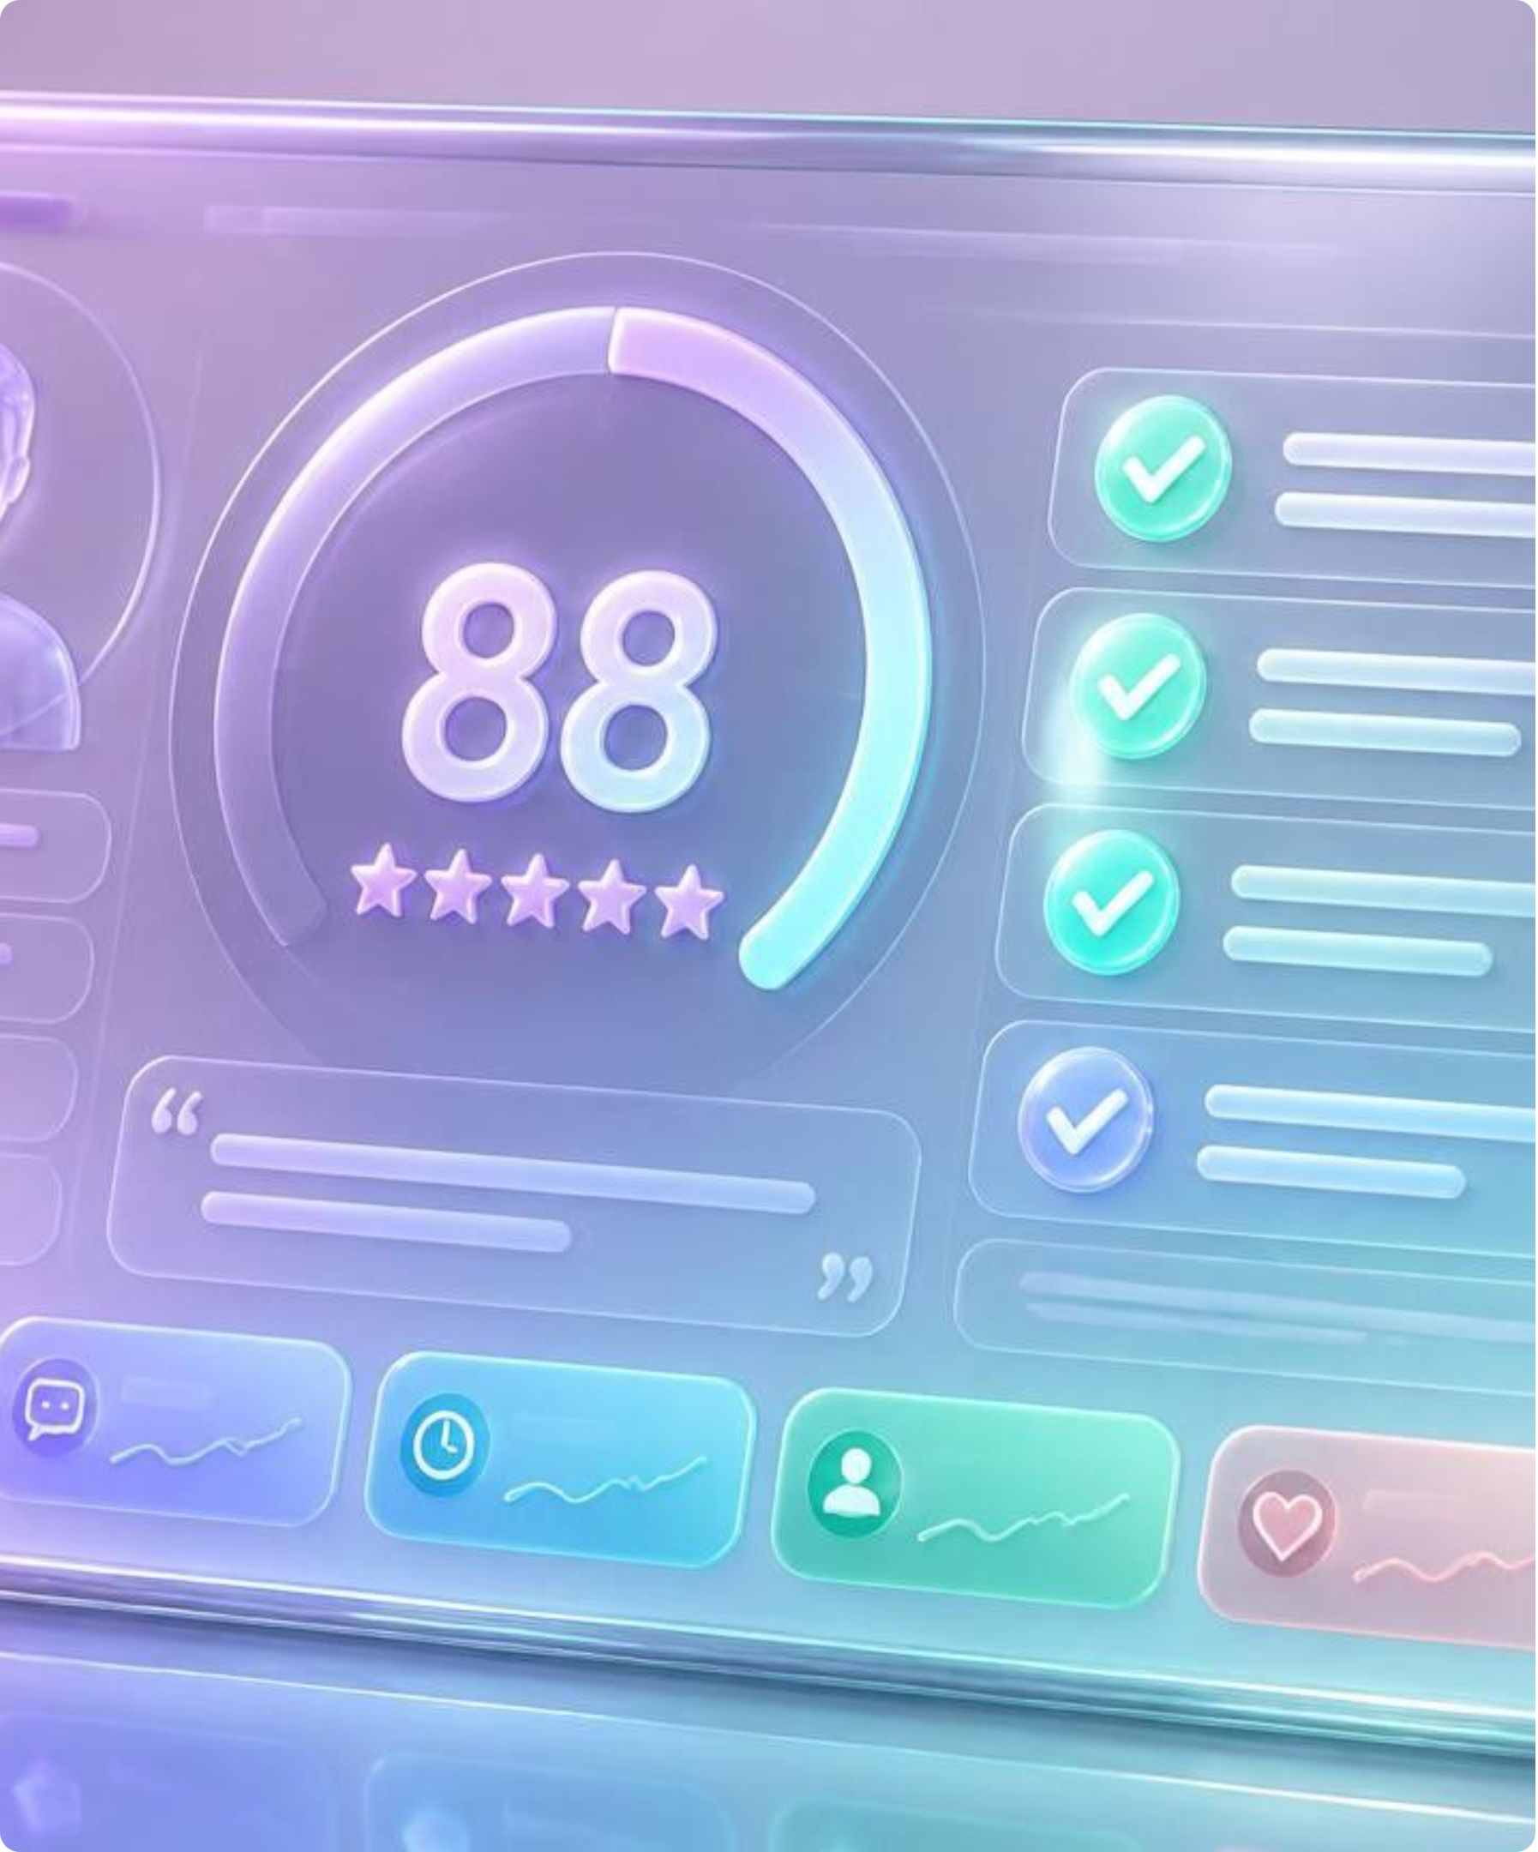
ACTIONABLE OUTPUT
The report shows the why behind every score
Every critique ties directly to candidate transcripts, removing ambiguity.
Transparent Scorecard
Scores across all 4 dimensions with an overarching performance executive summary.
Transcript Evidence
Exact verbatim quotes highlighted to justify strengths and identify missed signals.
Targeted Next Practice
2 to 3 micro-actions plus an improved answer blueprint ready for immediate re-practice.
Notes:
Explain that candidates don't just see a rating: they see their exact words quoted back with a concrete rewrite template.

Slide 8





SYSTEM ARCHITECTURE
A small architecture that is easy to build and secure
Lean, stateless, server-isolated data flow designed for hackathon velocity and security.
Candidate
Next.js App
Server Route
Gemini LLM
Coaching Report
Uses the responsive browser UI.
Setup, session, and report in React.
ZERO API keys exposed to the browser.
Questions, follow-ups, structured evaluation.
Schema validation turns output into actionable UI.
Core Stack: Next.js · React · Tailwind CSS · Google Gemini API · Vercel Edge Runtime · Optional Supabase
Notes:
Walk the judges through the pipeline: zero client-exposed keys, strict JSON schema validation, and stateless architecture.

Slide 9
EXECUTION ROADMAP
Built reliable first, extended second
A disciplined prioritization framework ensuring core hackathon stability before nice-to-haves.
P0 · MUST HAVE
P1 · SHOULD HAVE
P2 · COULD HAVE
Rock-Solid MVP
High-Value Enhancements
Future Extensions
Role-aware question generator
Complete dynamic interview cycle
Schema-enforced rubric report
Responsive, polished web interface
Resume-informed personalized questions
Voice mode via web speech APIs
Real-time response timer and pace coaching
Exportable PDF performance summaries
Longitudinal progress dashboard
Multi-round interview simulation
Peer review and mentor sharing link
Company-specific cultural calibration
Notes:
Highlight engineering pragmatism: we locked the critical path first so judges see an entirely functioning demo, not a prototype full of bugs.

Slide 10

ETHICS & TRUST
Responsible by design
Principled AI practices built into the product architecture from day one.
Coaching, Never Gatekeeping
Evaluations provide preparation feedback, never predictive hiring screening scores.
Zero Demographic Scoring
No evaluation of accent, appearance, pitch, age, or gender—strictly answer content.
Secure & Privacy-First
Server-isolated API keys, schema-validated LLM outputs, and user-controlled data retention.
Notes:
Close by addressing AI ethics directly: we judge content against rubrics, never personal traits, and protect candidate privacy completely.

