Slide 1
Recipe finder
Front End Web Development
Presented By~
Name: Khairun Nessa Nazmin
College Name: Academy of Technology
Department: Master of Computer Applications

Slide 2
OUTLINE
Problem Statement
System Development Approach
Algorithm & Deployment
Result
Conclusion
Future Scope(Optional)
References

Slide 3
Problem Statement
In today’s fast-paced world, people often struggle to find recipes quickly that match their taste, dietary restrictions, or available ingredients. Existing platforms can be cluttered or require extensive navigation. A simple, intuitive, and fast recipe search application is essential for home cooks and food enthusiasts.

Slide 4
System Approach
Objective: Provide users with an easy way to search for meals and view detailed recipes.
Frontend Technologies:
HTML5 – Structure of the webpage
CSS3 – Styling and responsive layouts
JavaScript – Dynamic interactivity
Design Approach:
Clean and user-friendly interface
Mobile-responsive design
Modular separation of HTML, CSS, and JS files
API: TheMealDB API

Slide 5
Algorithm
User enters a search term or selects a category
Application sends an API request to TheMealDB
JSON data received with meal details
Render meals in a grid layout
User clicks a meal → detailed view shown with ingredients & instructions
Optional: Watch recipe video via YouTube link
Algorithm (Step-wise):
Input: Search term/category
Process: Fetch data → Parse JSON → Display results
Output: Recipe cards → Detailed view → Optional video link

Slide 6
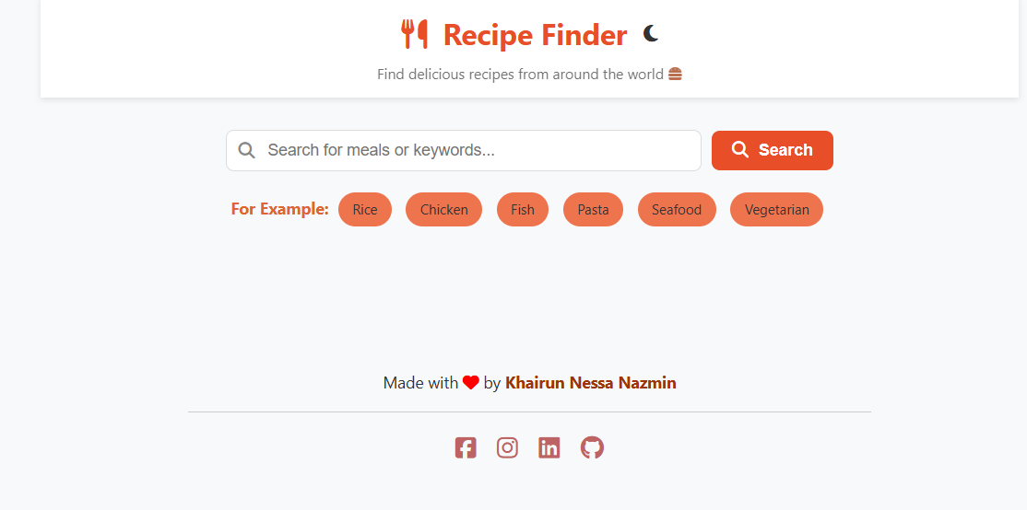
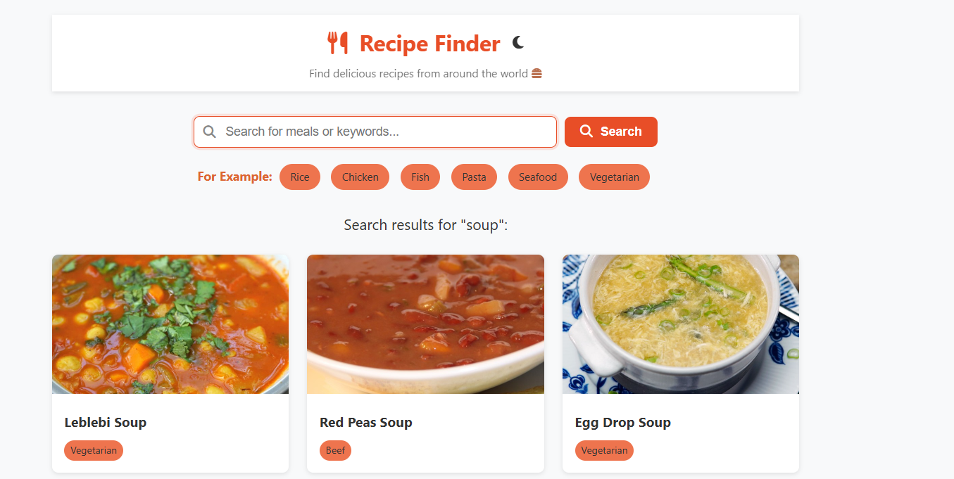
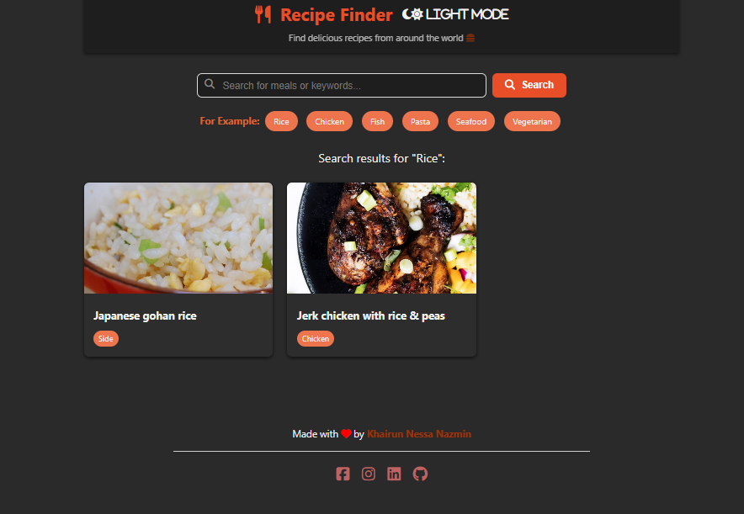
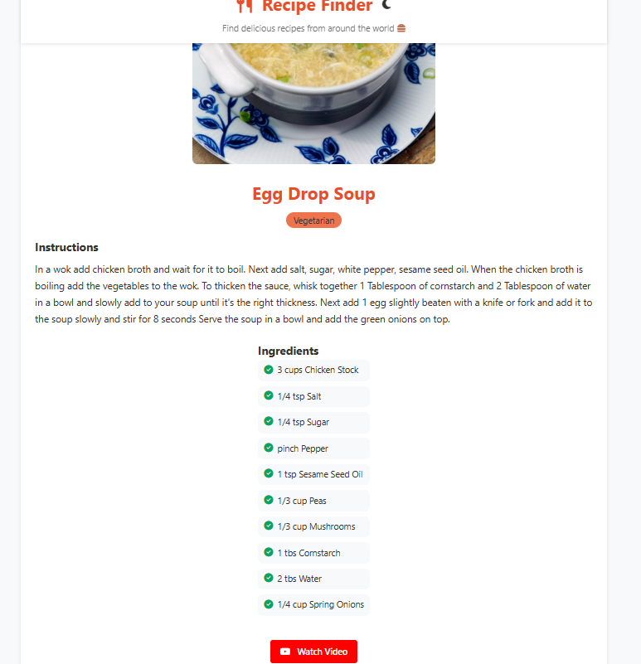
Result
Landing Page
Choose Your Recipe
Dark Theme
Recipe Details

Slide 7
GITHUB AND DEPLOYMENT LINK
GitHub Repository: https://github.com/Itsrimu/your-goto-recipe-finder
Live Demo: https://itsrimu.github.io/your-goto-recipe-finder/

Slide 8
Conclusion
A user-friendly recipe finder improves cooking convenience.
Intuitive UI with fast search capabilities.
Supports light/dark theme for better UX.
Fully responsive for desktop and mobile.

Slide 9
Future scope
Add user authentication and favourite recipes
Implement ingredient-based search
Enable multi-language support
Add AI-based recipe suggestions
Integration with shopping list or delivery apps

Slide 10
References
The MealDB API
Font Awesome Icons: https://fontawesome.com
Deploy: https://pages.github.com/
HTML, CSS, JS Documentation

Slide 11
THANK YOU

