Slide 1


Android App for Blocking other apps
Team
B66 - Sanjana Gupta
B53 - Sweety Pandre
B69 - Saniya Khan
B63 - Rishab Biswal
GUIDE : PROF. N CHIRANJEEVE RAO

Slide 2

Introduction
Problem Statement
Objective
Conclusion
Software Requirement
Hardware Requirement
Methodology
Data Flow Diagram
ER Diagram
Use Case Diagram
Table Of
CONTENTS

Slide 3
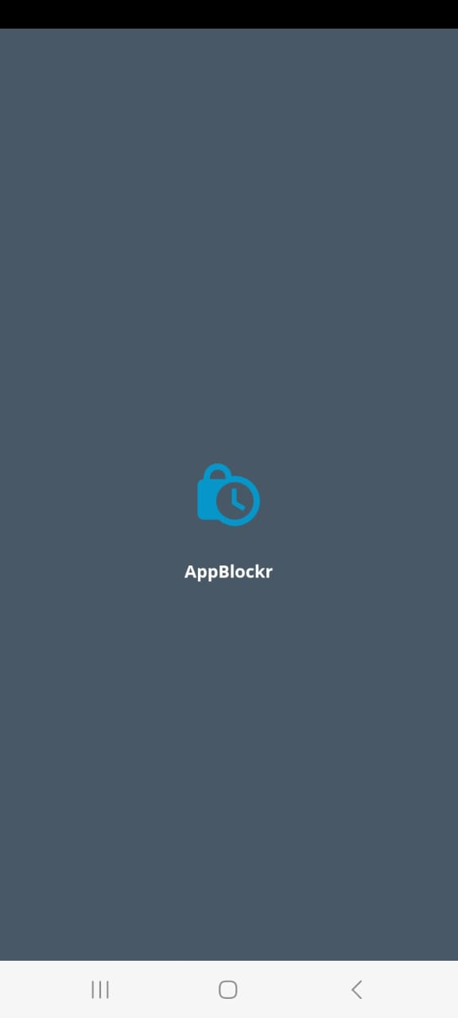
INTRODUCTION
Mobile applications do make our life easier but also distracts us from focusing on our work. Wouldn't it be easier if you could block those distracting applications while you want to focus on something?
This App can help you with these problems. It simply lets you select a list of application that you want to block for the given period of time. So next time you won't be able to operate an app that is blocked for the given amount of time.

Slide 4
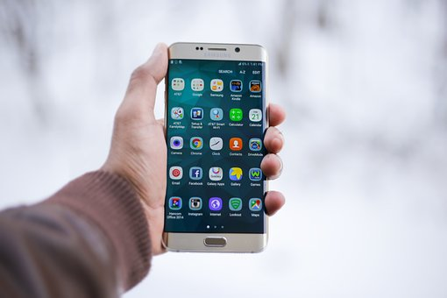
PROBLEM STATEMENT
Mobile applications do make our life easier,
BUT…

Slide 5
It also distracts us from focusing on our work.
People usually switch between multiple social media apps & do phubbing in between of their important work.
It would be easier if we could block those distracting applications for a particular time while we want to focus on something.

Slide 6
OBJECTIVE
This app will take apps name to block and time limit from user as input which will be then stored in a database.
The app will then check the status of the input apps and block it for the given time.
When the blocked app is opened before the time limit a quote will be shown on the screen to motivate the user to continue their work.

Slide 7
Software Requirement
Backend Language : JAVA
Frontend Language : XML
Development environment : Android studio

Slide 8
Minimum
Hardware Requirement
64-bit Microsoft® Windows® 8/10.
x86_64 CPU architecture; 2nd generation Intel Core or newer, or AMD CPU with support for a Windows Hypervisor.Framework.
8 GB RAM or more.
8 GB of available disk space minimum (IDE + Android SDK + Android Emulator)
1280 x 800 minimum screen resolution.

Slide 9
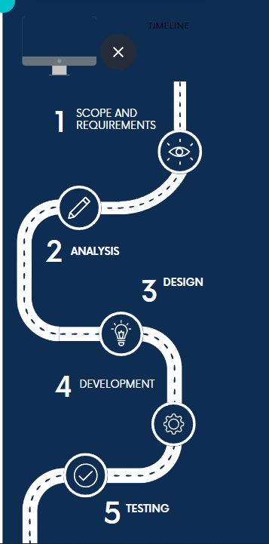
Methodology

Slide 10
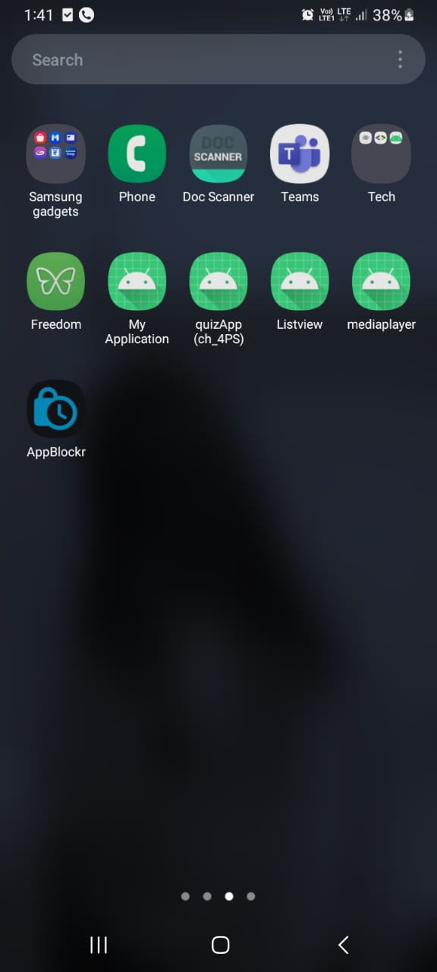
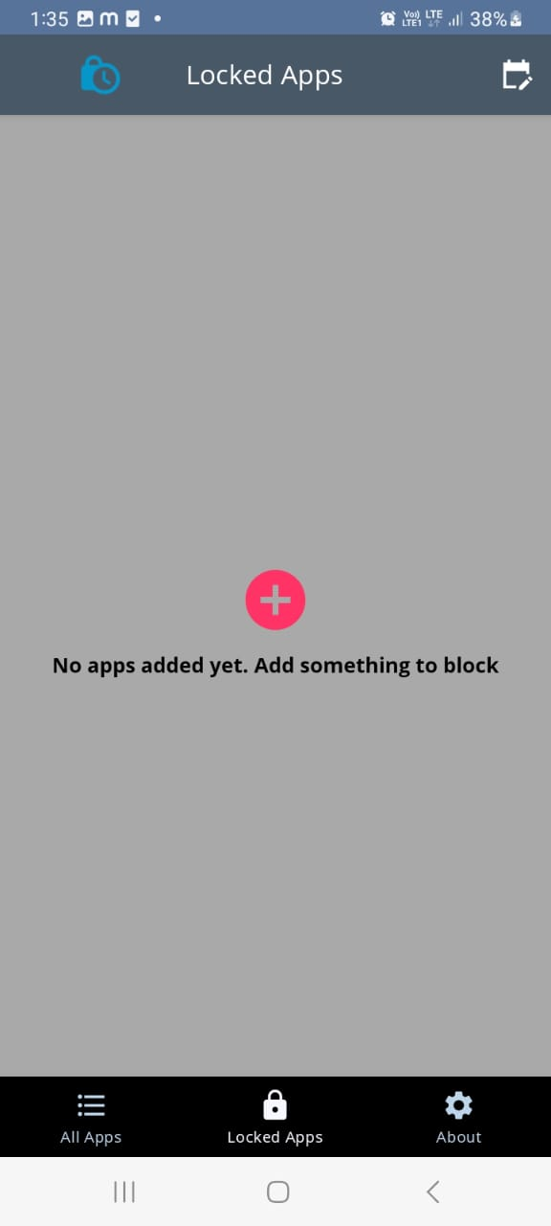
Screenshot

Slide 11
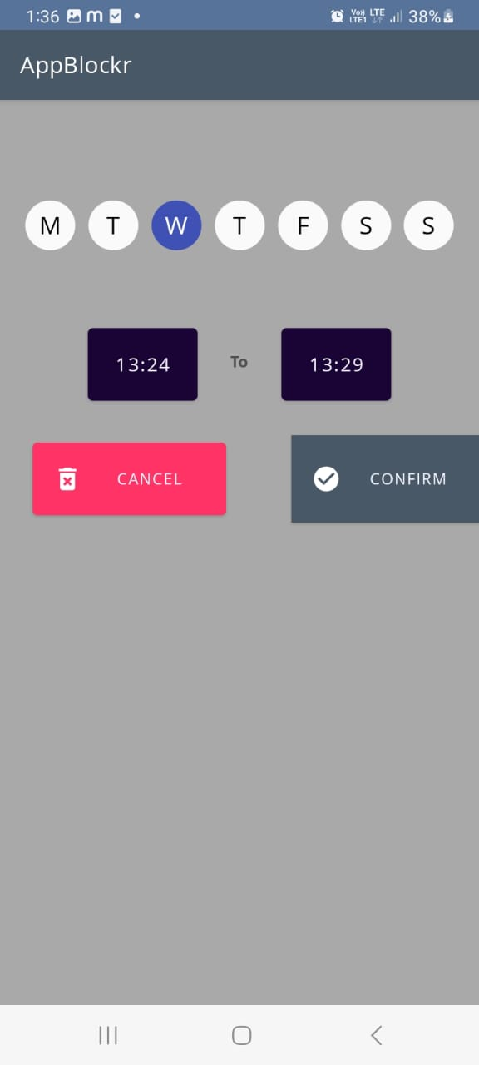
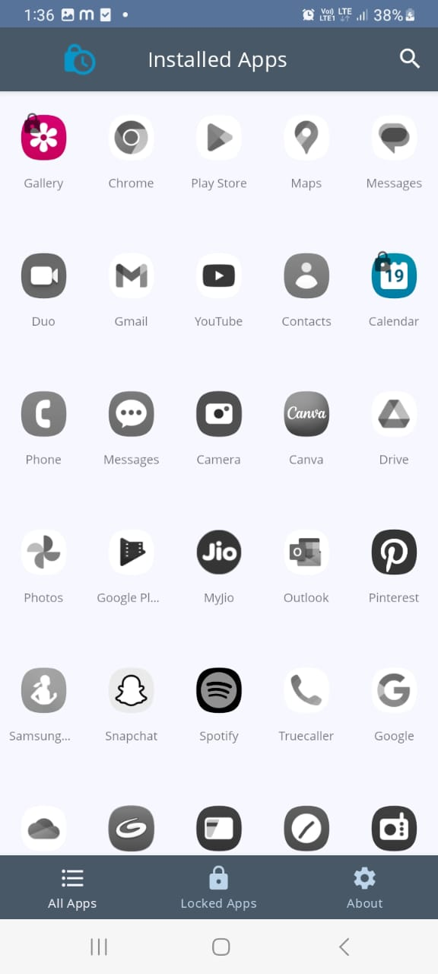

Slide 12
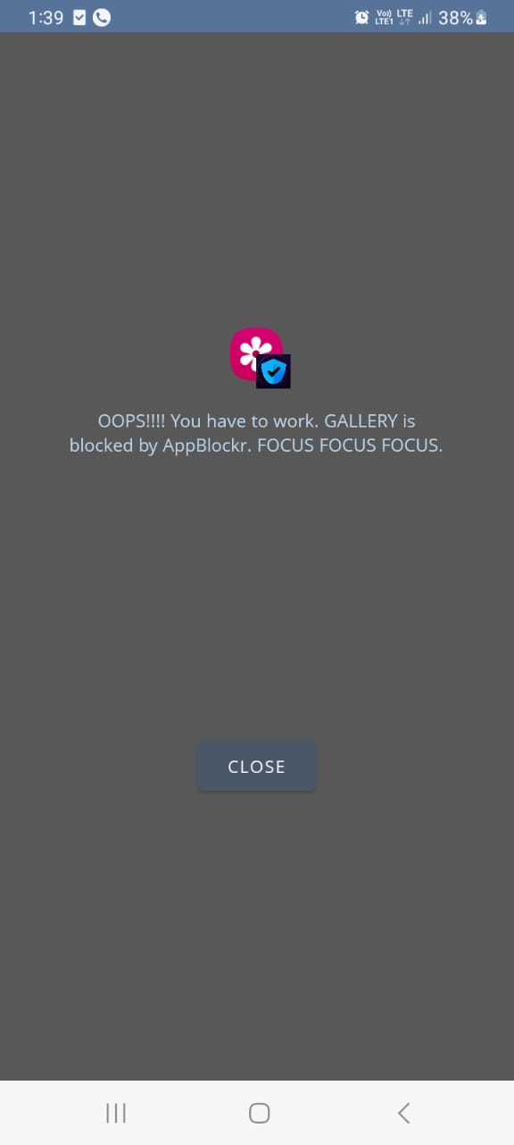
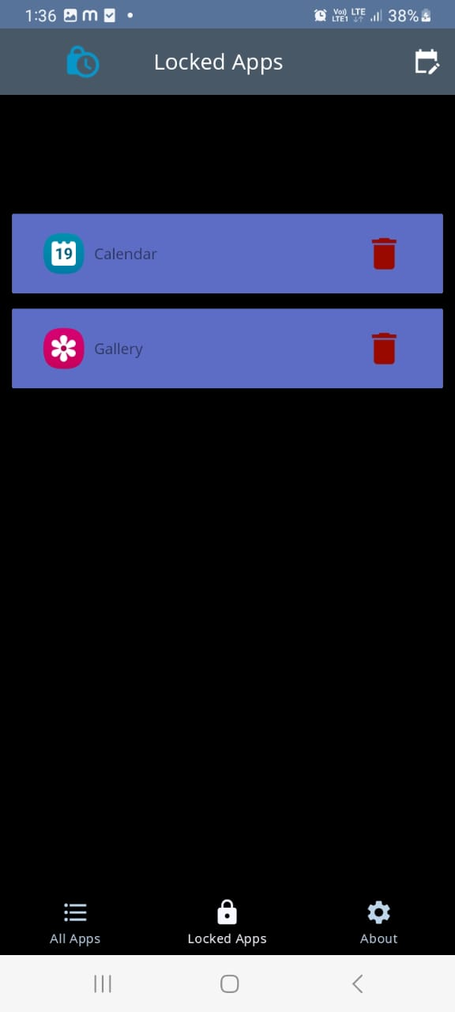

Slide 13
