Slide 1


Artificial Intelligence & Machine Learning(CSET301)
Problem Statement
SILAN – AI REAL-TIME SIGN LANGUAGE DETECTION
V S SANTHOSH (E23CSEU1150)
BHANUTEJA PADAMATA (E23CSEU1144)
SHUBHAM PANDEY (E23CSEU1167)
Mentor
Dr. Shwetang Dubey
Our team is guided by Dr. Shwetang Dubey. His expertise is invaluable to our project.

Slide 2
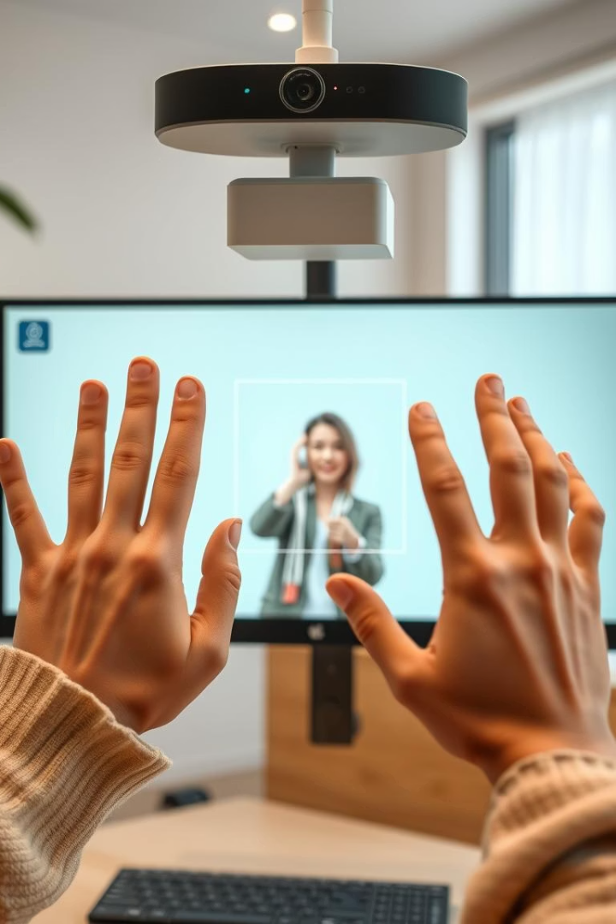
SILAN – AI Real-Time Sign Language Detection
AI-based Real-Time Translation of Sign Language.
SILAN is a computer vision and deep learning project. It detects and translates sign language into text in real-time using a webcam. This presentation will cover the goals, methods, and results of SILAN.

Slide 3


Bridging the Communication Gap
Sign language is a vital form of communication for many. However, a communication gap exists between sign language users and those who don't understand it.
SILAN helps bridge this gap using AI. It provides real-time translation, making communication more accessible.

Slide 4




The Need for Real-Time Interpretation
Lack of Tools
Accessibility Issues
There is a lack of real-time sign language interpretation tools.
Accessible communication is essential for inclusion and equality.
Communication Barriers
Communication barriers impact education, employment, and daily life.
SILAN addresses these issues by providing an accessible, real-time translation solution. This ensures greater inclusivity and seamless communication for everyone.

Slide 5
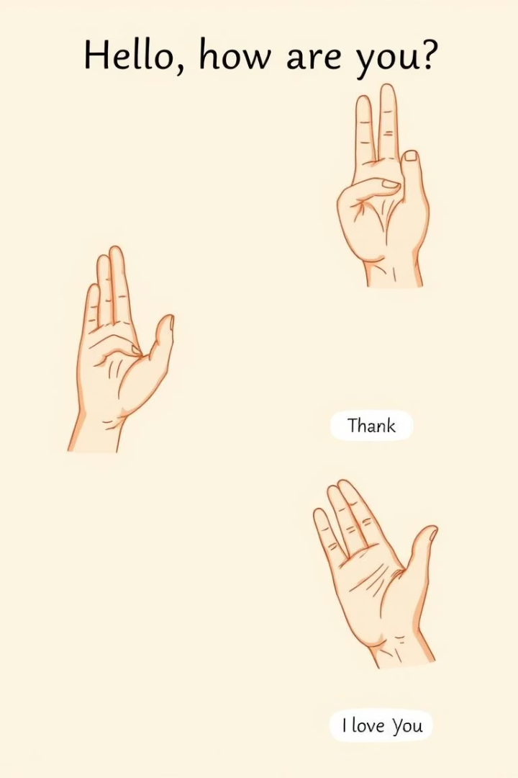
Objectives of SILAN
Real-Time Recognition
To achieve real-time sign language recognition.
Multi-Class Classification
To accurately classify multiple hand signs.
User-Friendly Interface
To develop an easy-to-use interface for broad accessibility.
Our goal is to create a seamless and intuitive experience for users. It will make communication more efficient and accessible.

Slide 6






Technology Stack and Methodology
Python
OpenCV
TensorFlow
MediaPipe
SILAN utilizes a powerful technology stack, including Python, OpenCV, TensorFlow. Our methodology includes data collection, preprocessing, CNN model architecture, and a real-time detection pipeline. The UI is made with Streamlit for ease of use.

Slide 7
Related Work in Sign Language Recognition
DeepHand and SignNet: CNN models designed for static sign detection.
Google Mediapipe: Hand tracking via landmarks for gesture recognition.
CNN + LSTM Models: Capture both spatial and temporal features for dynamic signs.
OpenCV & TensorFlow Pipeline: Real-time gesture capture using webcams.
These advances form the basis for SILAN’s real-time detection system.

Slide 8
Results and Conclusion
Key Achievements
Future Improvements
High model accuracy in sign recognition.
Full word/sentence recognition.
Responsive real-time translation.
Mobile app version for portability.
Successful classification of multiple signs.
SILAN has demonstrated promising results in real-time sign language detection. Future improvements aim to enhance functionality and accessibility.

Slide 9

Thank You
Thank you for your time and attention.
We hope you found this presentation informative.
1
Continued Progress
2
Future Goals
SILAN is a work in progress.
We aim to expand sign language support and improve accuracy.
3
Accessibility
We are dedicated to making communication accessible for everyone.

