Slide 1
NAME:ODHIAMBO BEATRICE SHISIA
ADMISSION NUMBER:SB30/PU/40279/21
TITLE:UNIVERSITY STUDENT REGISTRATION APPLICATION
SUPERVISOR’S NAME: DR. MWANASAID OMAR

Slide 2
BACKGROUND
Registration processes in every university help to keep the actual academic and personal details of every student. However, a number of institutions still rely on doing this manually or using an outdated system, which in turn introduces a lot of inefficiencies and inaccuracies. It is indicated that in studies, a number of university administrators still experience delays and great inconvenience as a result of paper-based or even semi-digital registration systems; these have created a demand for fully integrated, user-friendly solutions. The University Student Registration Application is designed to provide an mobile based online platform to new students for acquiring news letter, registering, updating, uploading student’s personal information and ID card booking for processing. This project will aim to implement an efficient system, which minimizes processing time along with lesser errors in the data and helps in meeting the demands of both the students and the administrative staff with efficacy.
PROBLEM STATEMENT
The current system of student registration in most universities has been facing many challenges, hence inconveniencing the students, faculty, and administrative staff. Registration periods are characterized by long queues and tedious procedures of registration with form-filling redundancies. Ineffective handling of data and errors caused by manual processing have made the management of individual records of students in the university quite cumbersome for university administrators. Such problems, consequently, have a negative impact. Addressing these inefficiencies is quite significant through one integrated, accessible digital solution that can meet the needs of the university.

Slide 3
GOALS AND OBJECTIVES
The main objective of this project will be to design a university student registration mobile application.
Specific Objectives
1. To study the existing procedures for registration and find the specific needs of the users.
2. To develop a mobile application that will facilitate student registration, updating of data, verification processes and ID booking through integration of the application with m-pesa for payment.
4. To perform functionality testing, user interface testing and reliability over wide range of devices.
3.To implement secure data management features to guarantee data privacy and protection.

Slide 4
Research Methodology.
Qualitative : To obtain insights into user preference, challenges and expectations through interviews and focus groups.
Quantitative : To gather measurable data on system usability and performance via surveys and analytics.

Slide 5
DATA COLLECTION TOOLS
1. Questionnaires: To collect user feedback on current registration processes and the proposed system.
2. Interviews: With administrative staff to pinpoint inefficiencies in the existing system.
3. Observation: To study user interactions with current systems.

Slide 6
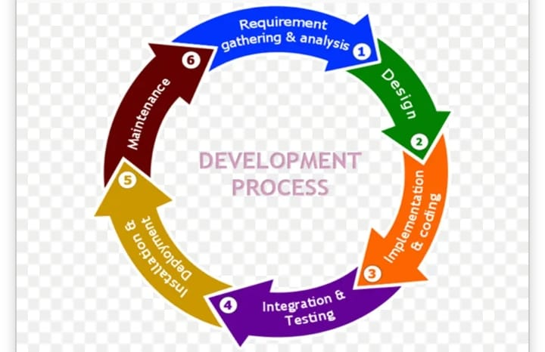
SOFTWARE DEVELOPMENT PROCESS
Chosen SDM: Agile Development Methodology
For this project, the opted method for development is the Agile methodology. Agile is a flexible, iterative approach that emphasizes collaboration, customer feedback, and small, incremental releases, making it especially well-suited for creating user-focused systems like mobile applications.

Slide 7
SOFTWARE REQUIREMENTS
Development tools
Integrated Development Environment (IDE): Visual Studio Code and IntelliJ IDEA
2. Programming Languages
Backend: Java Spring boot
Frontend: JavaScript, ReactNative.
3. Database Management System(DBMS)
Xampp
4.Testing tools
Postman
5.Project Management Tools: Jira
6.Deployment Tools
Docker for containerization.

Slide 8
CONCLUSION
This project seeks to address the inefficiencies in university student registration process by developing a mobile based application. Through the review of the existing system, challenges such as delays, inaccuracies, and administrative burdens were highlighted. The proposed solution emphasizes efficiency, user satisfaction, data security and scalability. By leveraging the agile methodology, the project ensures iterative development, stakeholder feedback integration and flexibility in meeting changing needs. Ultimately, this initiative will provide a user centred, secure and efficient platform that enhances the registration experience for students and administrators alike.

