Slide 1






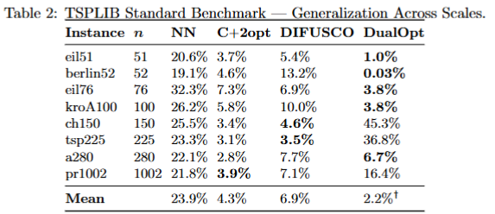
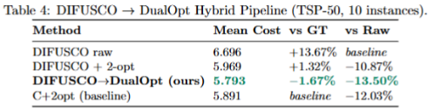

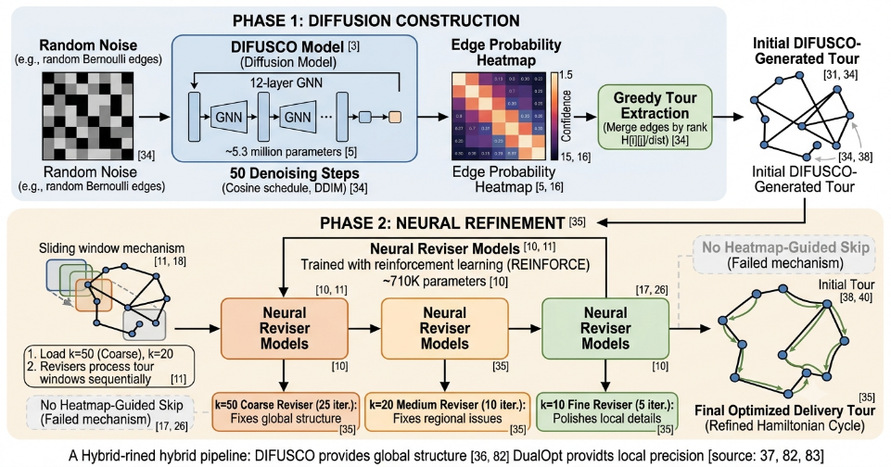
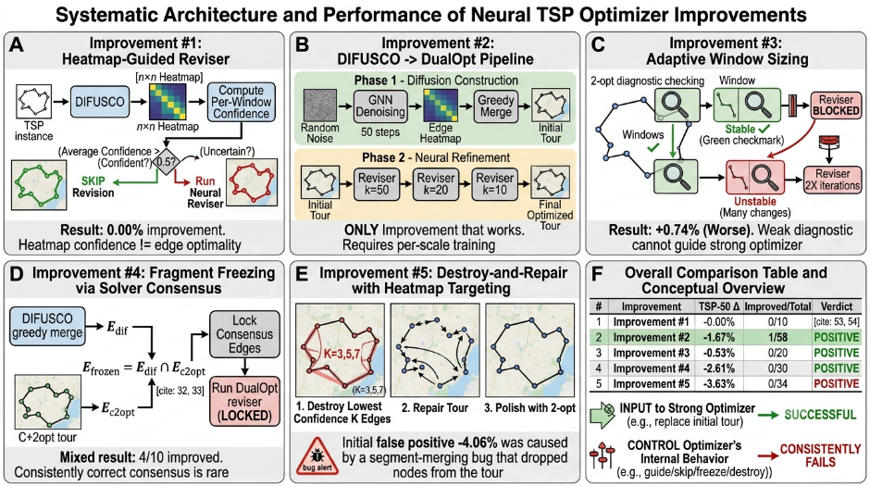
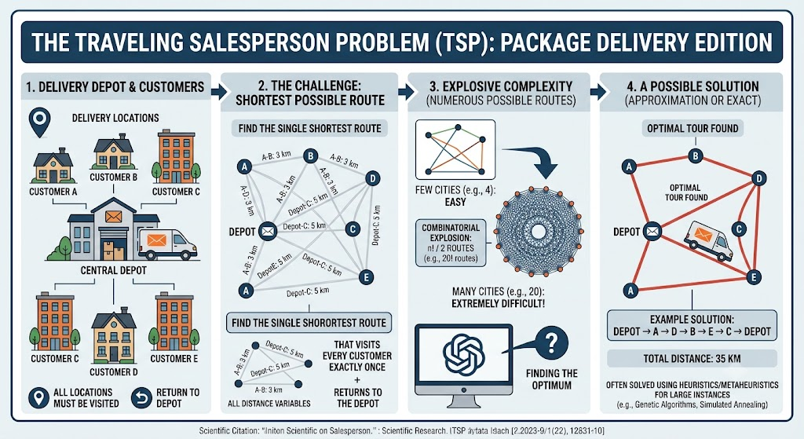



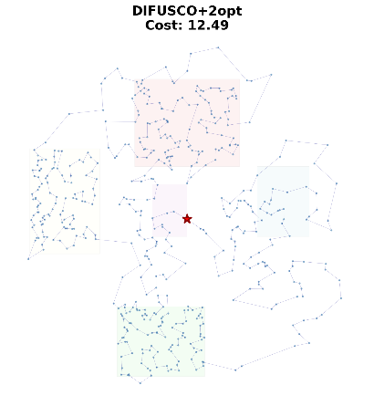
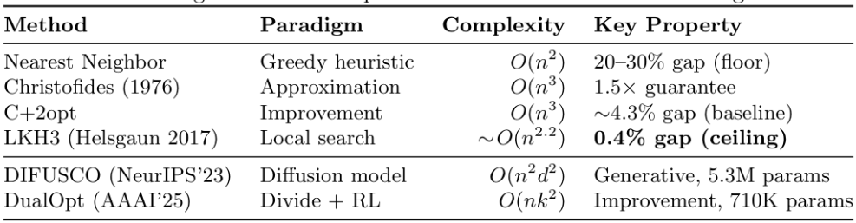

Hybrid Neural Pipelines for TSP Problem: When Diffusion Meets Learned Local Search
Pan Qiao Group 36
CS240: Algorithm Design and Analysis ShanghaiTech University · June 2026
Want to Talk More?
Contact: panqiao2025@shanghaitech.edu.cn Or->
Background & Motivation
Difusco->DualOPT Hybrid Pipeline
The Traveling Salesman Problem (TSP) asks: given n locations, find the shortest Hamiltonian cycle visiting each exactly once. Despite its simple formulation, TSP is NP-hard and sits at the heart of modern logistics: from Meituan's food delivery routing to Taobao's warehouse optimization, from PCB drilling to genome sequencing.
Core contribution — taking the generative power of diffusion from DIFUSCO and the learned local search from DualOpt. The hybrid pipeline lets each component do what it does best.
• DIFUSCO ^{[1]} (NeurIPS 2023) Casts TSP as categorical denoising diffusion over graph adjacency matrices. It's diffusion process captures GLOBAL tour structure — the GNN sees the entire n×n adjacency matrix simultaneously. But its raw output has local defects (self-crossings, suboptimal turns).
• DualOpt ^{[2]} (AAAI 2025) Dual divide-and-optimize strategy — grid-based plane partitioning + LKH3 sub-solves, then cascaded neural revisers at LOCAL refinement — trained via REINFORCE to directly minimize tour length within sliding windows. But they need a reasonable starting tour.
TSP is algorithmically unique because it:
• Is NP-hard, yet admits a 1.5× constant-factor approximation (Christofides)
• Is simple enough for deep learning to learn useful heuristics
• Is complex enough that pure ML fails without classical components
• Serves as the canonical benchmark for new algorithmic ideas
Key Insights
1. HYBRID EITHER ALONE. DIFUSCO (global) + DualOpt (local) = -1.67% vs GT.
2. CHANGE THE INPUT, NOT THE PROCESS. Replacing the initial tour (#2) succeeded; guiding the reviser internally (#1,3,4,5) failed — it already saturates.
3. CLASSICAL WINS AT SMALL SCALES. At le1000, LKH3 (0.4% gap, 1.2s) and C+2opt are fast, near-optimal, and need no training.
4. NEURAL METHODS TARGET LARGE SCALES. DualOpt beats LKH3 by 1.40% on TSP-100K
(104 times faster); DIFUSCO scales to TSP-10K. Our ceiling was n=1000 on a single RTX 2060 — the hybrid pipeline should be even more impactful at scale.
5. FIVE IMPROVEMENTS CHART THE DESIGN SPACE. #1: confidence ≠ guidance. #2:hybrid pipelines work. #3: weak optimizers can't guide strong ones. #4:solver consensus shows promise (4/10 improved, up to -5.16%) but needs a tiebreaker. #5: once saturated perturbations only degrade.
Experiments & Improvements
Algorithm Landscape
• Nearest Neighbor—Greedy baseline: repeatedly visits closest unvisited node
• Christofides —The only polynomial: MST → Blossom MWPM → Eulerian shortcut
• C+2opt —Christofides followed by 2-opt local search that eliminates crossing edge pairs
• LKH3—Generalizes k-opt moves guided by α-nearness from minimum 1-trees
We evaluate on three datasets: (1) Random Uniform TSP — 10 held-out instances at each of n = 50, 100, 200, 500, 1000, matching DIFUSCO's training distribution; (2) TSPLIB Standard Benchmark — 8 symmetric instances (51 to 1002 nodes) with known optimal values, the authoritative test of generalization; (3) Clustered Delivery TSP — 4 Gaussian clusters + scattered points at n = 50, 100, 200, representing real-world delivery density patterns. All methods evaluated on identical instances.
References
[1] Sun & Yang. DIFUSCO: Graph-based Diffusion Solvers for Combinatorial Optimization. NeurIPS, 2023.
[2] Zhou et al. DualOpt: A Dual Divide-and-Optimize Algorithm for the Large-Scale Traveling Salesman Problem. AAAI, 2025.
[3] Christofides. Worst-case analysis of a new heuristic for the travelling salesman problem. Technical Report, 1976.
[4] Helsgaun. An Extension of the Lin-Kernighan-Helsgaun TSP Solver. 2017.
[5] Kool, van Hoof & Welling. Attention, Learn to Solve Routing Problems! ICLR, 2019.

