Slide 1
ASSIGNMENT - 1
College
Admission
Presented by Group A

Slide 2

DISCLAIMER
This is just for entertainment and assignment purpose. So, plz no need to take it on lungs or kidney
so, just enjoy it....
This is not any defamation

Slide 3


JEE JOURNEY
TO GET WHAT???
IIT Tag
A Good Placement
IIT Seats - 17285
JEE Aspirant - 931334
DO we GEt Iit Tag ??
What about those 98.14 % ??

Slide 4
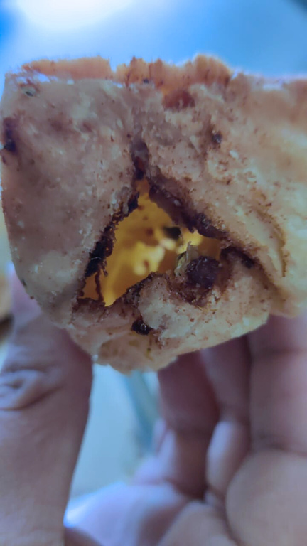
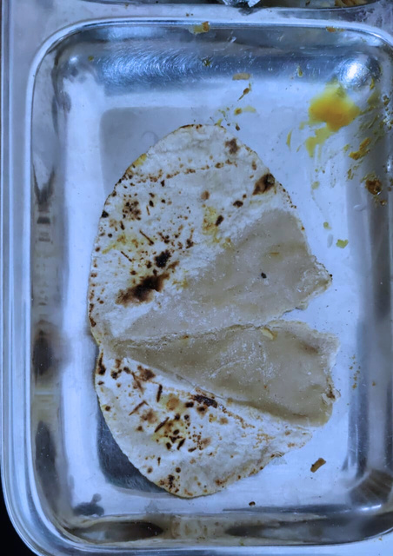
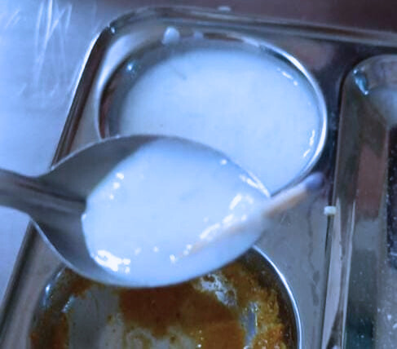
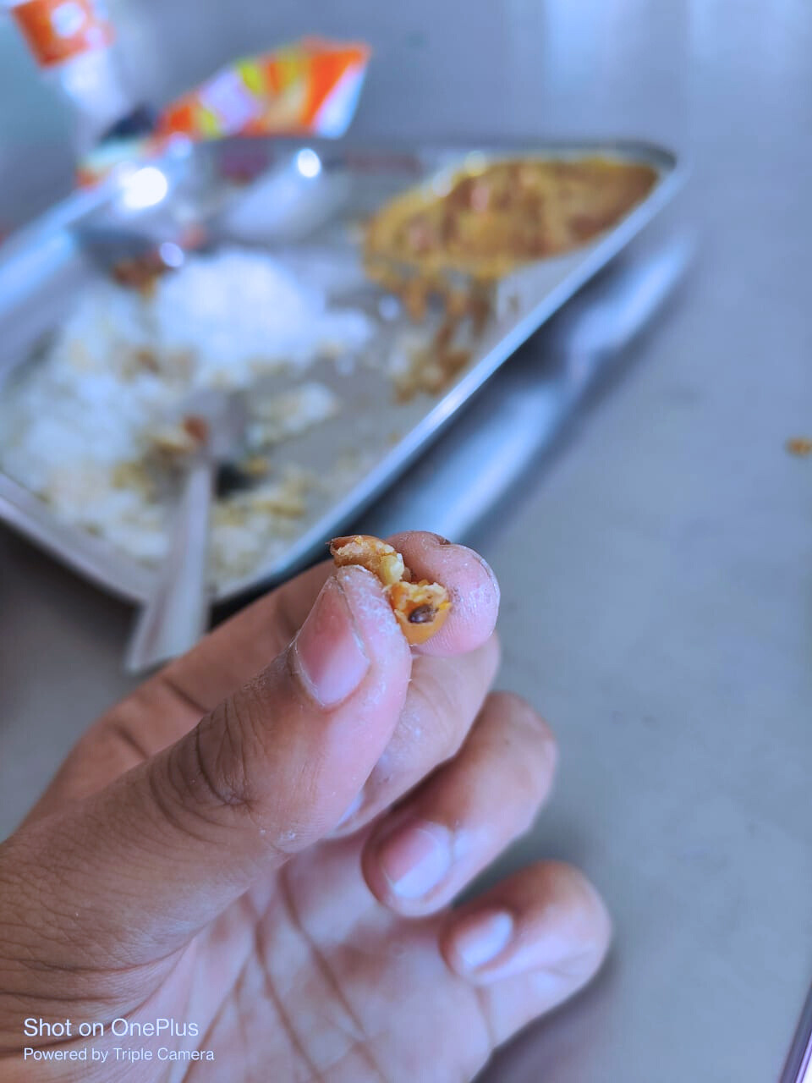
HOSTEL MESS FOOD
Paying lakhs of fees and still not getting a good healthy tasty delicious food ??
Still getting some local Caterer??

Slide 5
TRANSPORTATION
Distance bw Hostel
and Acedemic
City connectivity
No Bus Service
Much away from city?? Will you have to travel for a hour to reach city
No Bus Service provided by your college to city??
Getting Sun Strokes and taning due to large distance ??

Slide 6

IIT Butibori
International
Institute
of
Technology,
Butibori
its all about placement........

Slide 7
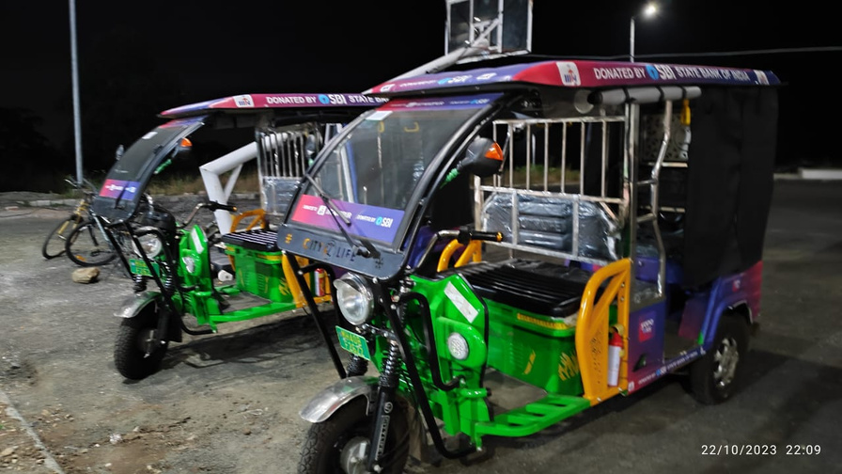
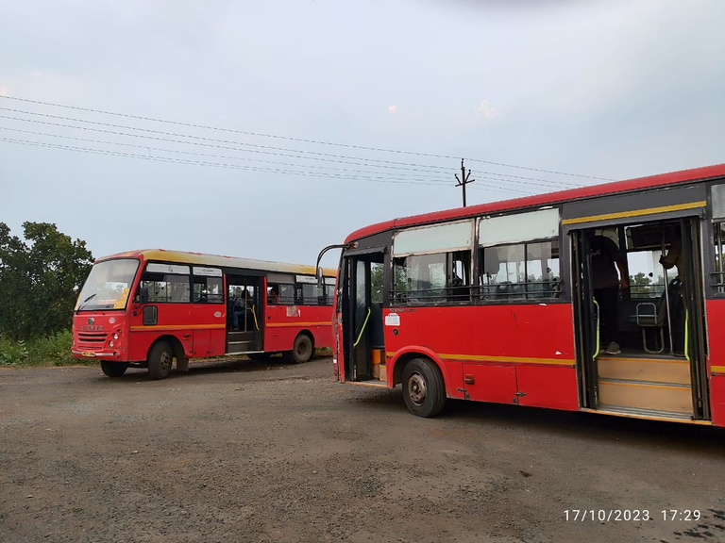
Why IITB???
IIT Tag
Haldiram as caterer
5 km from its native city Butibori
Many Buses from IIT gate to city
E- Ricksaws b/w Hostel and acedemic

Slide 8
Flyer, Logo, BOG
Shreyash Suradkar
College Brochure
Nitin Kumar
FOUNDER,IDEA, WEBSITE
Placement Brochure
Nimesh Maslekar
MR. ROBIN BANSAL
Admission Flipbook
Kula Shekhar
MOU
Vyankatesh Deshpande

