Slide 1

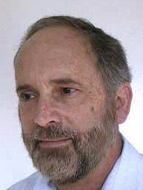
Distributed Clustering for Robust Aggregation in Large Networks
Ittay Eyal, Idit Keidar, Raphi Rom
Technion, Israel

Slide 2
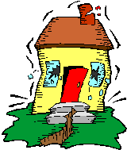
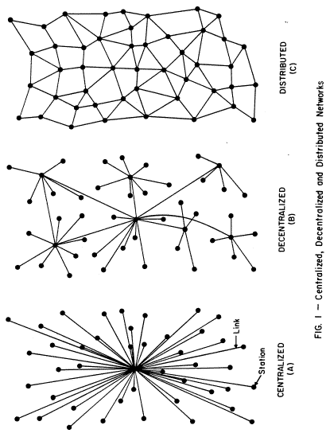
Aggregation in Sensor Networks – Applications
Temperature sensors thrown in the woods
Seismic sensors
Grid computing load

Slide 3
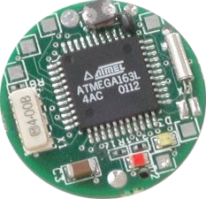
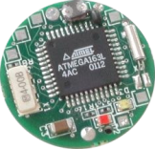
Aggregation in Sensor Networks – Applications
Large networks with light nodes.
Target is a function of all sensed data.
Average, min, majority, etc.

Slide 4
Tree Aggregation and Gossip
Hierarchical solution
2
6
Fast - O(height of tree)
2
10
Disadvantages:
Limited to static topology.
No failure robustness.
10
1
3
9
11
D. Kempe, A. Dobra, and J. Gehrke. Gossip-based computation of aggregate information. In FOCS, 2003.
S. Nath, P. B. Gibbons, S. Seshan, and Z. R. Anderson. Synopsis diffusion for robust aggregation in sensor networks. In SenSys, 2004.

Slide 5
Tree Aggregation and Gossip
Gossip:
9
Each node maintains a synopsis.
1
11
3
D. Kempe, A. Dobra, and J. Gehrke. Gossip-based computation of aggregate information. In FOCS, 2003.
S. Nath, P. B. Gibbons, S. Seshan, and Z. R. Anderson. Synopsis diffusion for robust aggregation in sensor networks. In SenSys, 2004.

Slide 6
Tree Aggregation and Gossip
Gossip:
5
9
Each node maintains a synopsis.
Occasionally, each node contacts a neighbor and they improve their synopses.
1
5
11
7
3
7
D. Kempe, A. Dobra, and J. Gehrke. Gossip-based computation of aggregate information. In FOCS, 2003.
S. Nath, P. B. Gibbons, S. Seshan, and Z. R. Anderson. Synopsis diffusion for robust aggregation in sensor networks. In SenSys, 2004.

Slide 7
Tree Aggregation and Gossip
Gossip:
5
6
Each node maintains a synopsis.
Occasionally, each node contacts a neighbor and they improve their synopses.
5
6
7
6
Indifferent to topology changes.
Crash robust.
7
6
D. Kempe, A. Dobra, and J. Gehrke. Gossip-based computation of aggregate information. In FOCS, 2003.
S. Nath, P. B. Gibbons, S. Seshan, and Z. R. Anderson. Synopsis diffusion for robust aggregation in sensor networks. In SenSys, 2004.

Slide 8
Outliers - Definition
Samples deviating from the distribution of the bulk of the data.

Slide 9
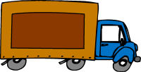

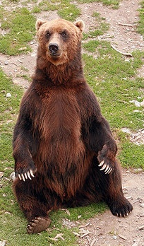

Sources of Outliers
Sensor Malfunction
Interesting Info:
Short circuit in a seismic sensor
  intrusion: A truck driving by a seismic detector
Software bugs:
Interesting Info:
  In grid computing, a machine reports negative CPU usage
  DDoS: Irregular load on some machines in a grid
Sensing Error
Interesting Info:
  An animal sitting on a temperature sensor
Fire outbreak: Extremely high temperature in a certain area of the woods

Slide 10
The Implications of Outliers
4
A single erroneous sample can radically offset the data.
1
10⁵
3
The average (47º) doesn’t tell the whole story.
27º
25º
26º
25º
28º
98º
120º
27º

Slide 11

Outlier Detection Challenge
A double bind:
Regular data distribution
Outliers
Regular data distribution
Outliers
A centralized solution won’t cut it:
  Bandwidth limitations
  Power limitations
  Storage limitations
No one in the system has enough information.

Slide 12
Aggregate Clusters
Each cluster has its own mean and mass.
A bounded number (k) of clusters is maintained.
Here
k = 2
Original samples
Aggregation of a and b
(No compression)
1
a
b
c
d
1
1
3
9
11
1
3
Aggregation of a, b and c
Aggregation Result
2
2
1
2
9
2
10

Slide 13
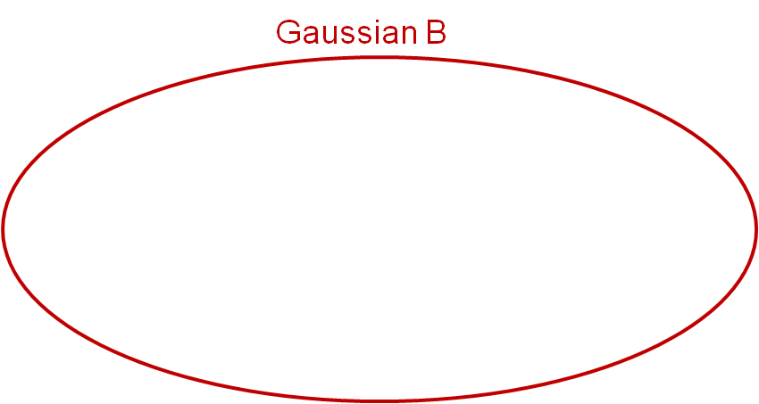
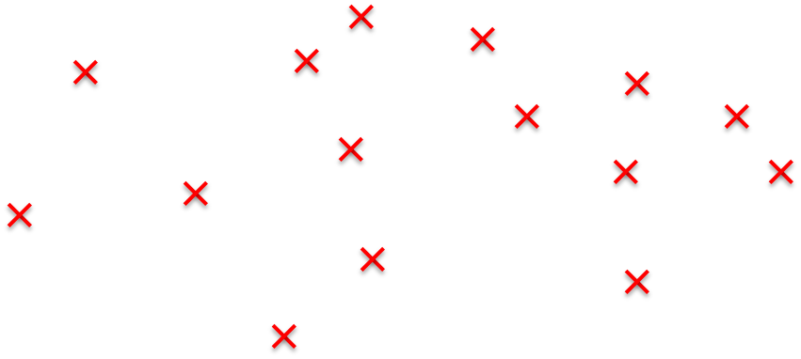
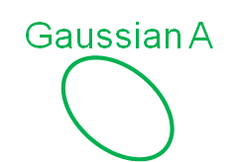
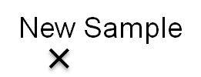



But what does the mean mean?
The variance must be taken into account

Slide 14
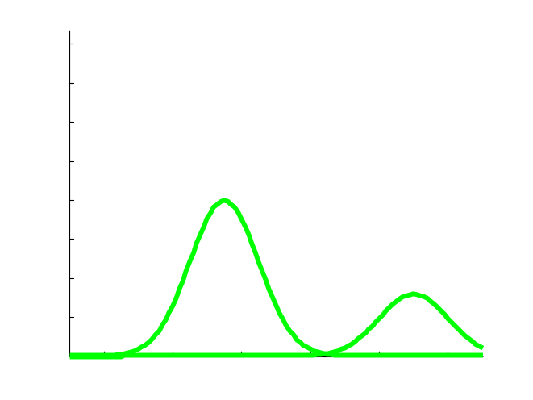
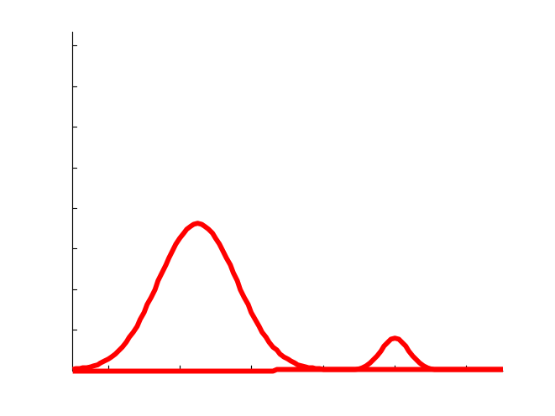
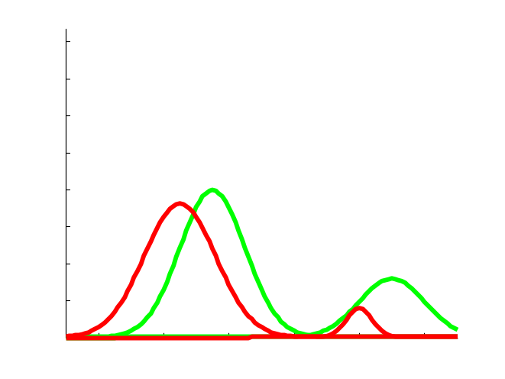
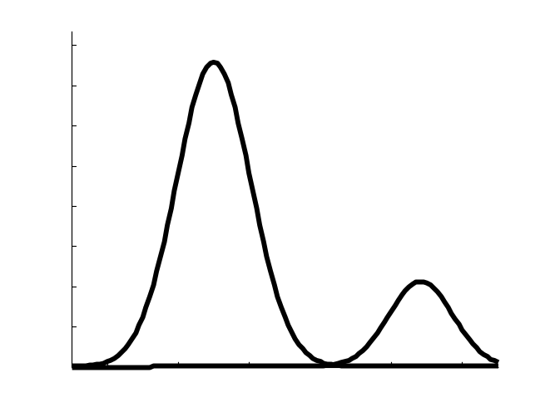
Gossip Aggregation of Gaussian Clusters
Distribution is described as k clusters.
a
b
Each cluster is described by:
Mass
Mean
Covariance matrix
Nodes gossip: unify synopses by merging close clusters.
+
=
Merge

Slide 15
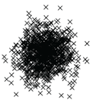

It works where it matters
Not Interesting
Easy

Slide 16
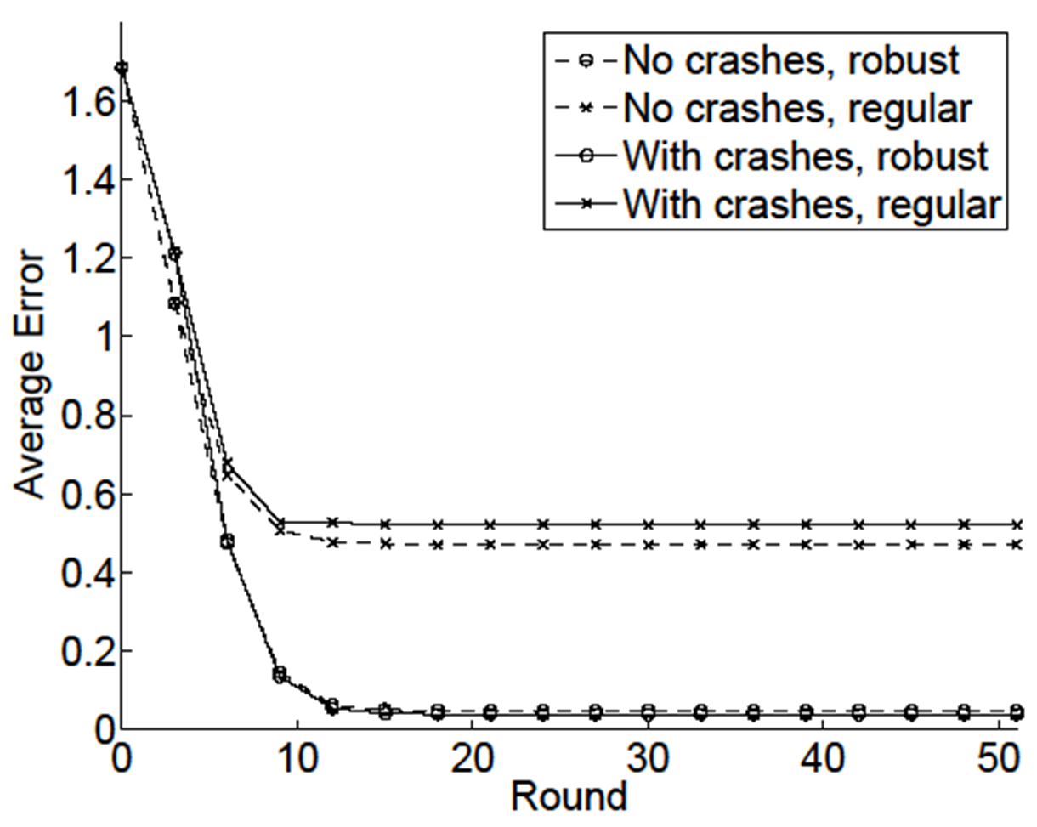
Protocol is Crash Robust
Regular, 5% Crash probability per round
Standard, No Crashes
Outlier robust, with and without crashes

Slide 17
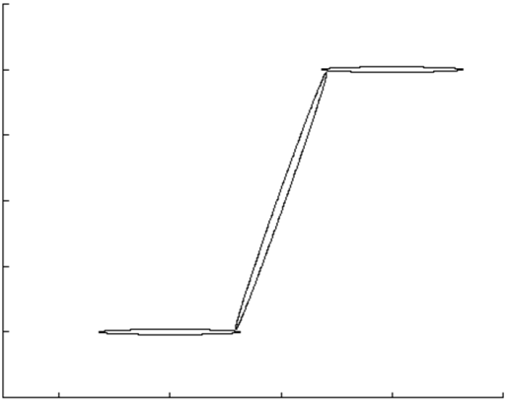
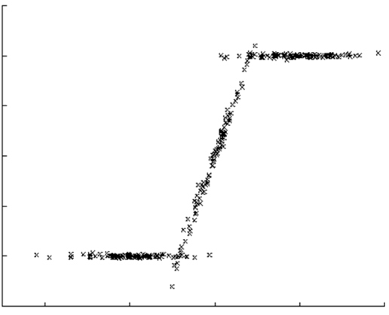
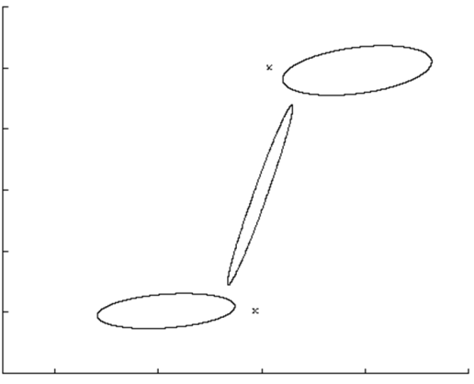


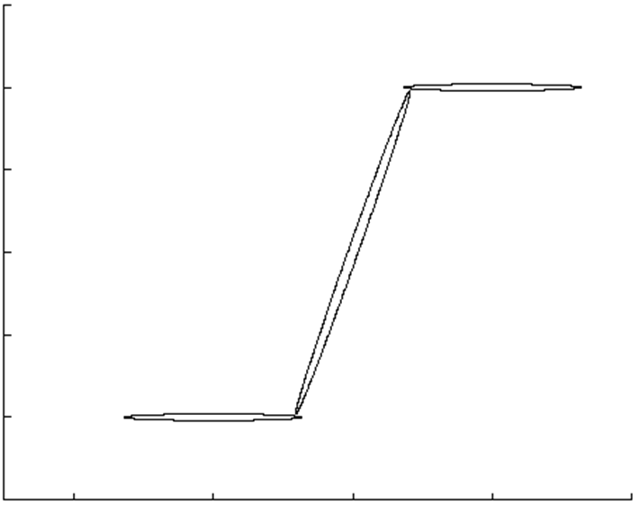
Describe Elaborate Data

Slide 18
Describe Elaborate Data
No Fire
Fire
No Fire
Fire
No Fire
Fire
Temperature sensors on a fence by the woods

Slide 19
Summary
Robust Aggregation requires outlier detection
27º
27º
27º
27º
98º
120º
27º
We present outlier detection by Gaussian clustering:
Merge

Slide 20
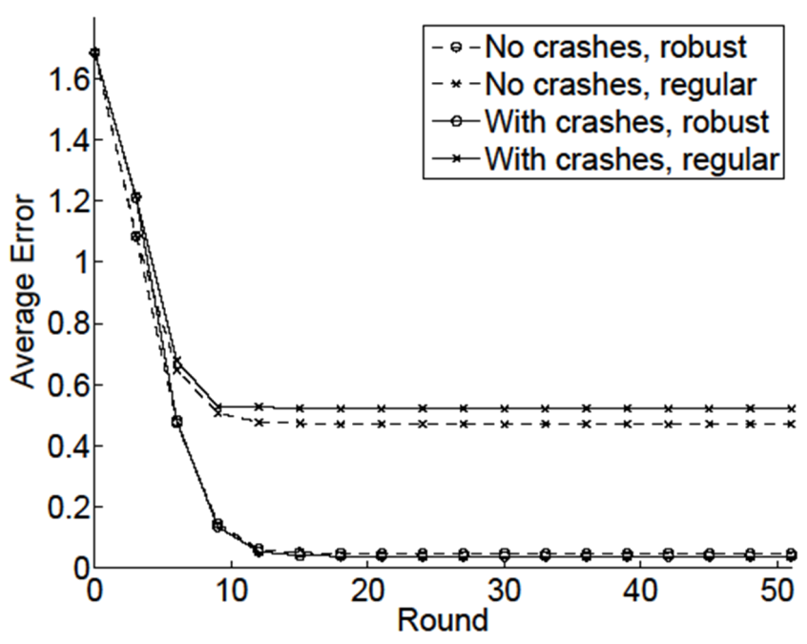
Summary – Our Protocol
Outlier Detection (where it’s important)
Crash Robustness
Elaborate Data

Slide 21
Thank you
Ittay Eyal, Idit Keidar, Raphael Rom. Distributed Clustering for Robust Aggregation in Large Networks, Technion, 2009

