Slide 1


Distributed Clustering for Robust Aggregation in Large Networks
Ittay Eyal, Idit Keidar, Raphi Rom
Technion, Israel

Slide 2
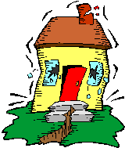
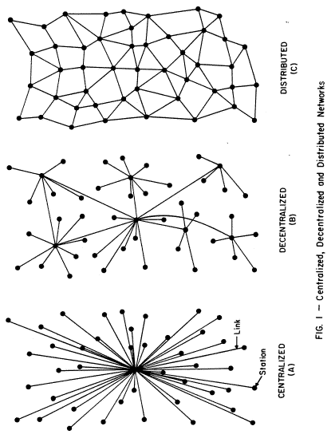
Aggregation in Sensor Networks – Applications
Temperature sensors thrown in the woods
Seismic sensors
Grid computing load
Notes:
להגיד "Monitoring"

Slide 3
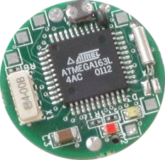
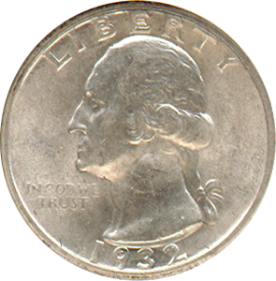
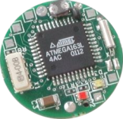
Aggregation in Sensor Networks – Applications
Large networks, light nodes, low bandwidth
Target is a function of all sensed data
Multidimensional information
Average temperature, max location, majority…

Slide 4
What has been done?

Slide 5
Tree Aggregation and Gossip
Hierarchical solution
6
Fast - O(height of tree)
2
10
1
3
9
11
D. Kempe, A. Dobra, and J. Gehrke. Gossip-based computation of aggregate information. In FOCS, 2003.
S. Nath, P. B. Gibbons, S. Seshan, and Z. R. Anderson. Synopsis diffusion for robust aggregation in sensor networks. In SenSys, 2004.

Slide 6
Tree Aggregation and Gossip
Hierarchical solution
6
2
Fast - O(height of tree)
2
10
☹ Limited to static topology
☹ No failure robustness
10
1
3
9
11
D. Kempe, A. Dobra, and J. Gehrke. Gossip-based computation of aggregate information. In FOCS, 2003.
S. Nath, P. B. Gibbons, S. Seshan, and Z. R. Anderson. Synopsis diffusion for robust aggregation in sensor networks. In SenSys, 2004.

Slide 7
Tree Aggregation and Gossip
Gossip:
Each node maintains a synopsis
9
1
11
3
D. Kempe, A. Dobra, and J. Gehrke. Gossip-based computation of aggregate information. In FOCS, 2003.
S. Nath, P. B. Gibbons, S. Seshan, and Z. R. Anderson. Synopsis diffusion for robust aggregation in sensor networks. In SenSys, 2004.

Slide 8
Tree Aggregation and Gossip
Gossip:
Each node maintains a synopsis
9
5
Occasionally, each node contacts a neighbor and they improve their synopses
1
5
11
7
3
7
D. Kempe, A. Dobra, and J. Gehrke. Gossip-based computation of aggregate information. In FOCS, 2003.
S. Nath, P. B. Gibbons, S. Seshan, and Z. R. Anderson. Synopsis diffusion for robust aggregation in sensor networks. In SenSys, 2004.

Slide 9
Tree Aggregation and Gossip
Gossip:
Each node maintains a synopsis
5
6
Occasionally, each node contacts a neighbor and they improve their synopses
5
6
7
6
☺ Indifferent to topology changes
☺ Crash robust
7
6
Proved convergence
☹ No data error robustness
D. Kempe, A. Dobra, and J. Gehrke. Gossip-based computation of aggregate information. In FOCS, 2003.
S. Nath, P. B. Gibbons, S. Seshan, and Z. R. Anderson. Synopsis diffusion for robust aggregation in sensor networks. In SenSys, 2004.

Slide 10
problem
A closer look at the

Slide 11
The Implications of Irregular Data
4
A single erroneous sample can radically offset the data
1
10⁶
3
The average (47º) doesn’t tell the whole story
27º
25º
26º
25º
28º
98º
120º
27º

Slide 12


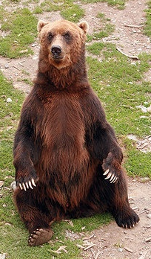

Sources of Irregular Data
Sensor Malfunction
Interesting Info:
Short circuit in a seismic sensor
  intrusion: A truck driving by a seismic detector
Software bugs:
Interesting Info:
  In grid computing, a machine reports negative CPU usage
  DDoS: Irregular load on some machines in a grid
Sensing Error
Interesting Info:
  An animal sitting on a temperature sensor
Fire outbreak: Extremely high temperature in a certain area of the woods
Notes:
להגיד "לפעמים רוצים OL ולפעמים לא"

Slide 13
Distribution Estimation
Data distribution estimation solutions
☹ One dimensional data only [1,2]
☹ No data error robustness. [1,2]
Or
☹ High complexity [3,4]
M. Haridasan and R. van Renesse. Gossip-based distribution estimation in peer-to-peer networks. In InternationalWorkshop on Peer-to-Peer Systems (IPTPS 08), February 2008.
J. Sacha, J. Napper, C. Stratan, and G. Pierre. Reliable distribution estimation in decentralised environments. Submitted for Publication, 2009.
W. Kowalczyk and N. A. Vlassis. Newscast em. In Neural Information Processing Systems, 2004.
N. A. Vlassis, Y. Sfakianakis, and W. Kowalczyk. Gossip-based greedy gaussian mixture learning. In Panhellenic Conference on Informatics, 2005.

Slide 14
Distributed Clustering for Robust Aggregation
Previous solutions:
Our solutions:
☺ Fast aggregation in a dynamic network
☹ No data error robustness
☺ Fast aggregation in a dynamic network
☺ Data error robustness by outlier detection
Definition: Outliers
Samples deviating from the distribution of the bulk of the data

Slide 15
Outlier Detection Challenge
27º
25º
26º
25º
28º
98º
120º
27º

Slide 16

Outlier Detection Challenge
27º
25º
26º
25º
28º
98º
120º
27º
A double bind:
Regular data distribution
Outliers
{98º, 120º}
~26º
No one in the system has enough information

Slide 17
Aggregate Clusters
Each cluster has its own mean and mass
A bounded number (k) of clusters is maintained
Here
k = 2
Original samples
Cluster a and b
a
b
c
d
a
b
1
1
1
1
3
5
10
1
3
abc
Cluster a, b and c
Cluster all
3
ab
2
c
d
1
1
2
5
10
1
3
5
10
Notes:
להגיד: מאחדים בעזרת ממוצע ממושקל לפי מרחק

Slide 18
But what does the mean mean?
Gaussian B
Gaussian A
New Sample
Mean A
Mean B
The variance must be taken into account

Slide 19
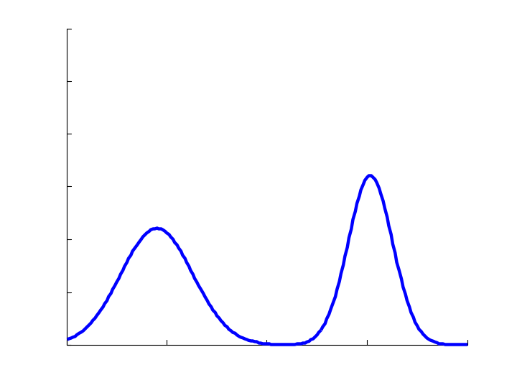
Gossip Aggregation of Gaussian Clusters
Distribution is described as k clusters
Each cluster is described by:
Mass
Mean
Covariance matrix

Slide 20
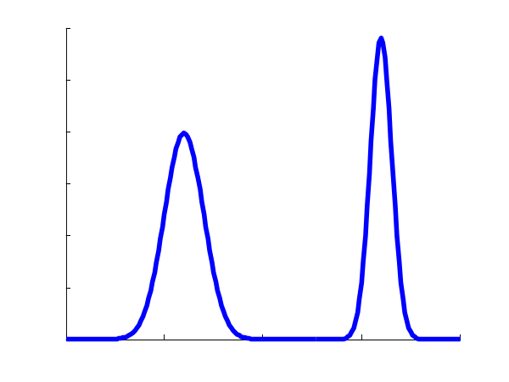
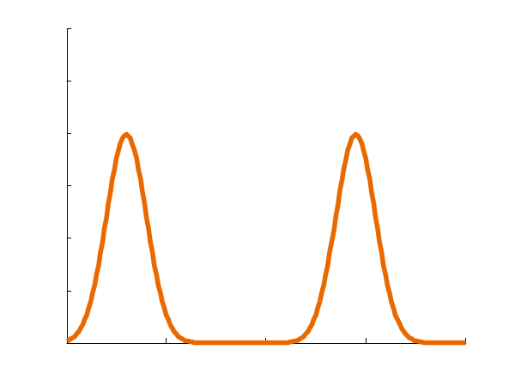

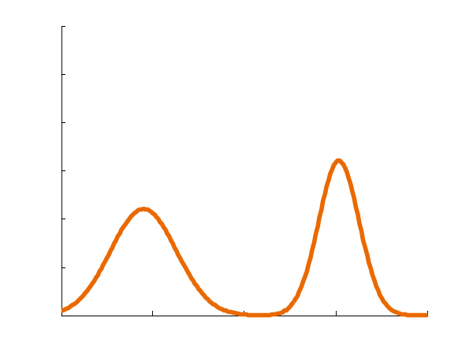
Gossip Aggregation of Gaussian Clusters
a
Merge
b
Notes:
לציין את מיעוט רוחב הפס.

Slide 21
Distributed Clustering for Robust Aggregation
Our solution:
Aggregate a mixture of Gaussian clusters
Merge when necessary
Recognize outliers

Slide 22
Simulation Results
Simulation Results:
Data error robustness
Crash robustness
Elaborate multidimensional data

Slide 23
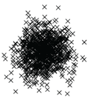

It works where it matters
Not Interesting
Easy
Notes:
להסביר את מקור הנתונים (artificial)

Slide 24
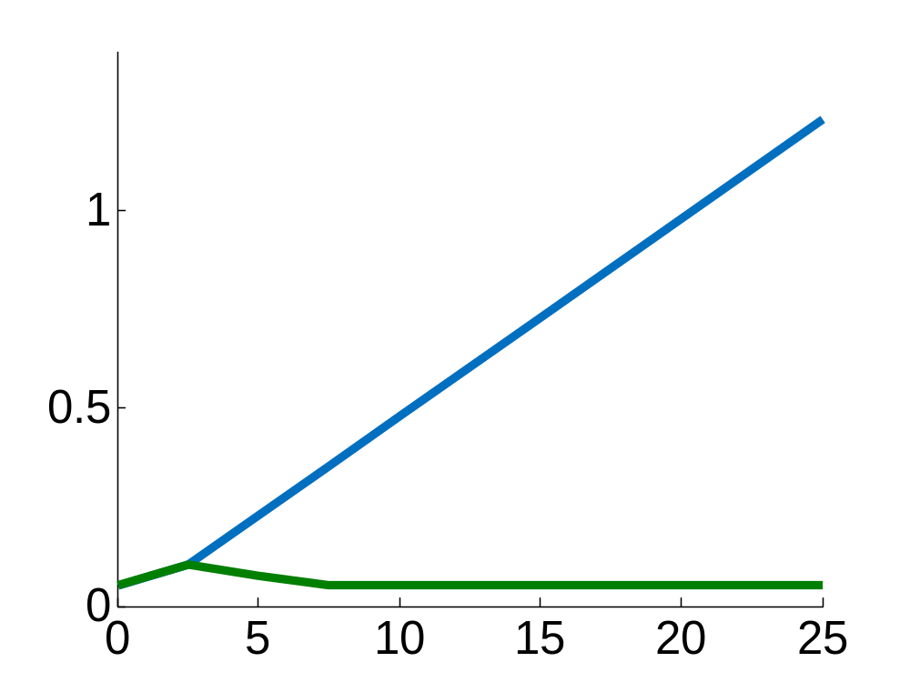

It works where it matters
No outlier detection
Error
With outlier detection
Error
Notes:
hotDepSimBimodalHits01.m

Slide 25
Simulation Results
Simulation Results:
Data error robustness
Crash robustness
Elaborate multidimensional data

Slide 26
Protocol is Crash Robust
Simulation round: each node performs one gossip step
After each round, 5% crash probability
No message loss or corruption

Slide 27
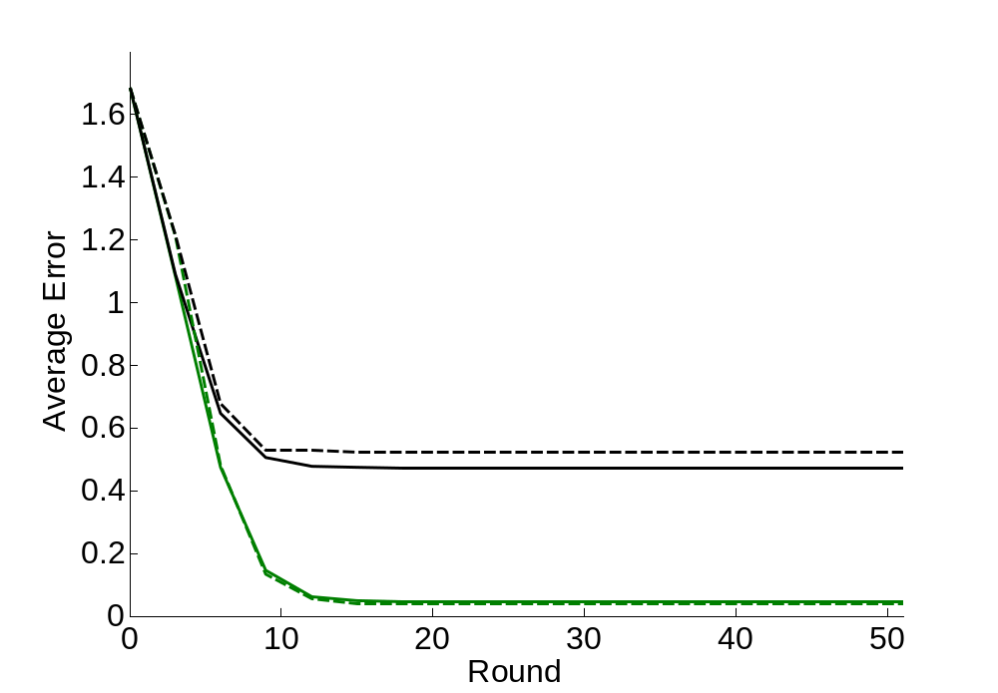
Protocol is Crash Robust
Error
No outlier detection,
5% crash probability
No outlier detection, no crashes
Outlier detection
Round

Slide 28
Simulation Results
Simulation Results:
Data error robustness
Crash robustness
Elaborate multidimensional data

Slide 29
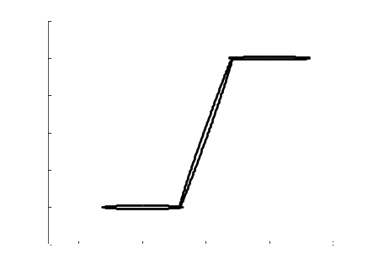
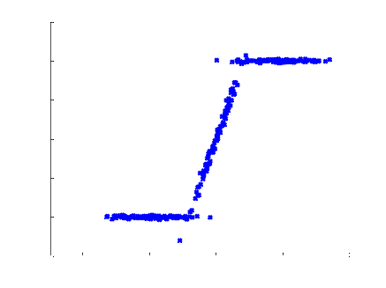
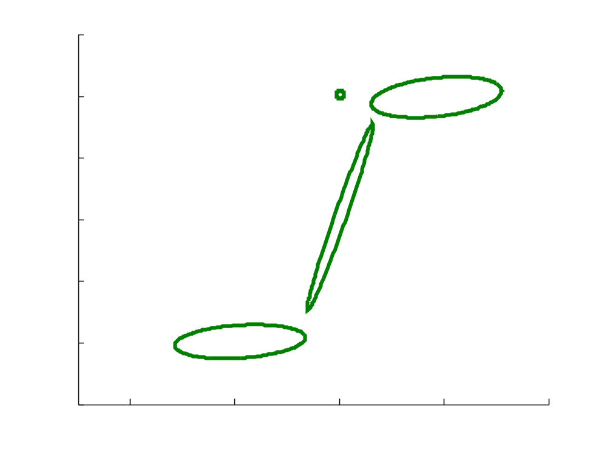

Describe Elaborate Data
Temperature
No Fire
Fire
Distance

Slide 30
Summary
Robust Aggregation requires outlier detection
27º
27º
27º
27º
98º
120º
27º
We present outlier detection by Gaussian clustering:
Merge
Notes:
להזכיר את מיעוט רוחב הפס.

Slide 31
Summary – Our Protocol
Outlier Detection (where it’s important)
Crash Robustness
Elaborate Data
Notes:
להגיד "רב מימד"

Slide 32
Future Directions
Prove convergence properties
Consider other clustering schemes
Analyze elaborate data estimation

Slide 33
Thank you
Ittay Eyal, Idit Keidar, Raphael Rom. Distributed Clustering for Robust Aggregation in Large Networks, Technion, 2009

