Slide 1

Dreamers
By: Aurelio Medina, Basil Henry, Erik Myers

Slide 2
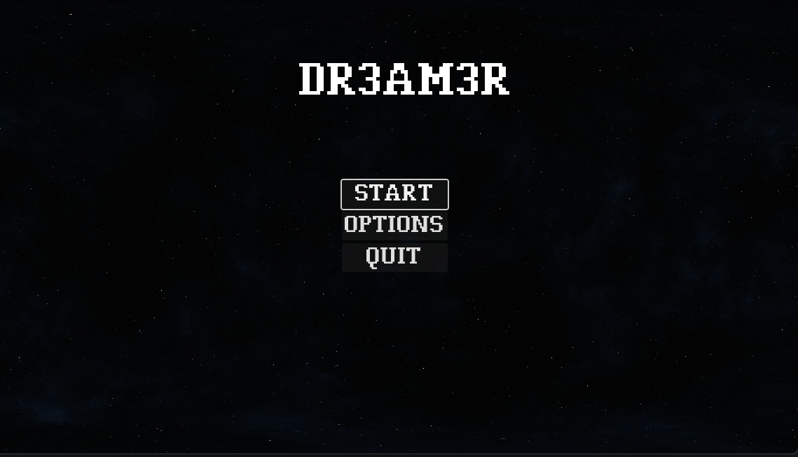
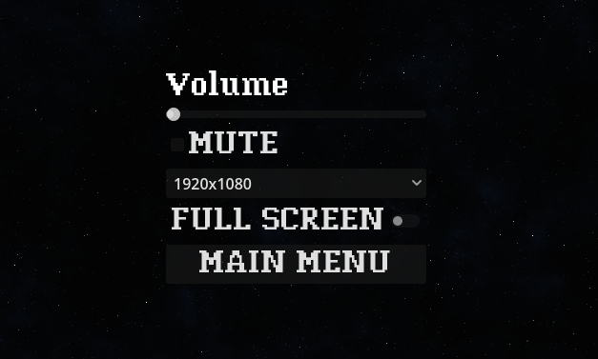
PROJECT INTRODUCTION
Project Dreamer is a 2D side-scrolling adventure game created with the Godot Engine using pixel art 2d assets.
Dreamers has multiple different levels that slowly reveal a story where reality and dreams gradually intertwine.
Dreamers has a Player control a character known as the dreamer as they explore a series of visually striking, dream-like worlds. Each level features distinct environments that challenge the player's platforming skills.
The game has various UI such as item collecting, Player's health, Pause button, and settings.

Slide 3
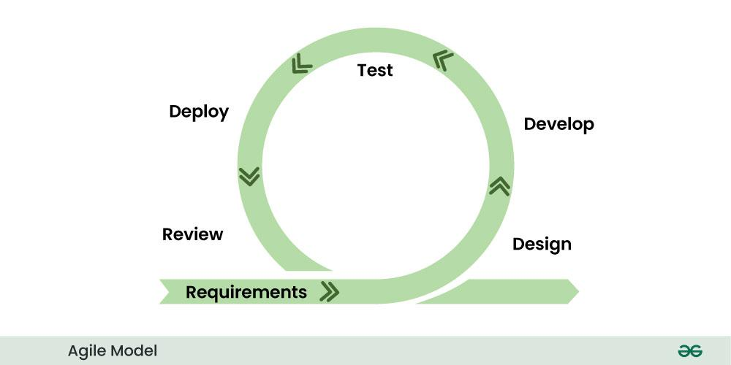
Approach
We were in a constant state of developing-testing-reviewing.
Our goal was to step by step ensure that our game aligned with our vision.
Each one of us used our own review model.

Slide 4
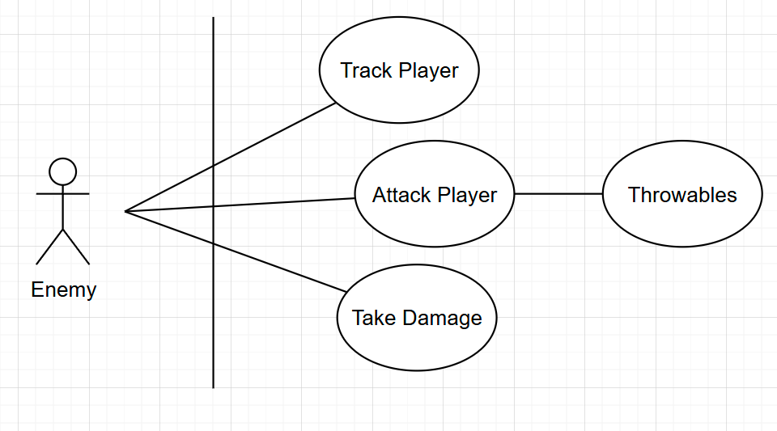
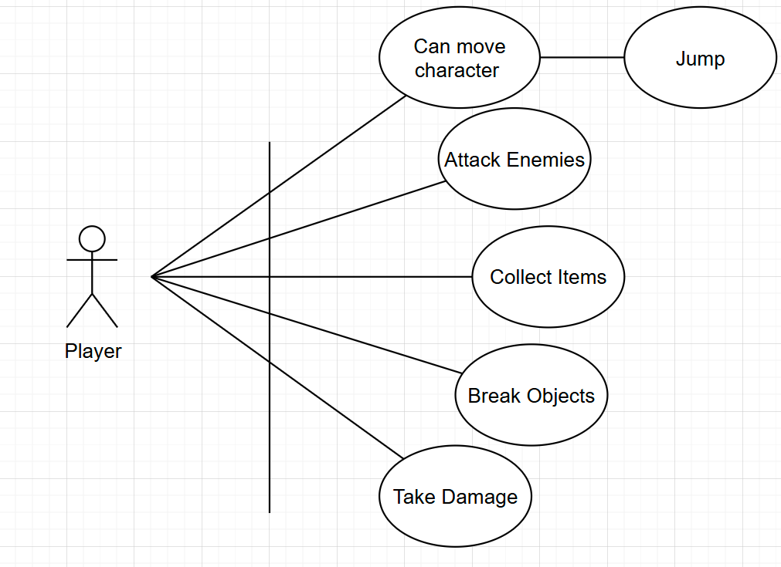
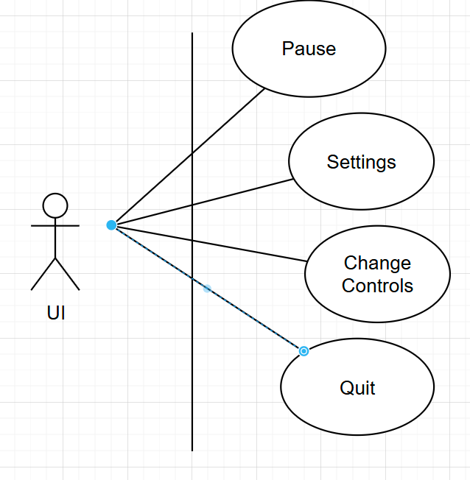
Use cases

Slide 5
Major acceptance Test Cases
Test Scenario | Steps taken during the test | Expected output | Status
Start game from menu | 1. Launch the game 2. Click 'Start Game' | Game scene loads successfully | Pass
Navigate to settings | 1. Launch the game 2. Click 'Settings' | Settings screen opens | Pass
Pausing the game | Clicking the pause button during a gameplay | Game pause after clicking the pause button | Pass
Player movement: jump along with moving left and right | Click the right and left keys on the keyboard and space bar for jumping | Player moves left and right after pressing these input Player jumps after pressing the input | Pass
Player attack enemies when pressing the Z key on the keyboard | Pressing Z will make the player attack | Player will attack enemies ai and deal damage point | Pass
Enemies will attack player in a certain range | Player enter enemies' range and will attack | Player will lose health when encounters enemies ai | pass
Player item collecting | Player item count goes up as he collect more item | The player will gain a positive one numerical value depending when collecting each item | Pass

Slide 6
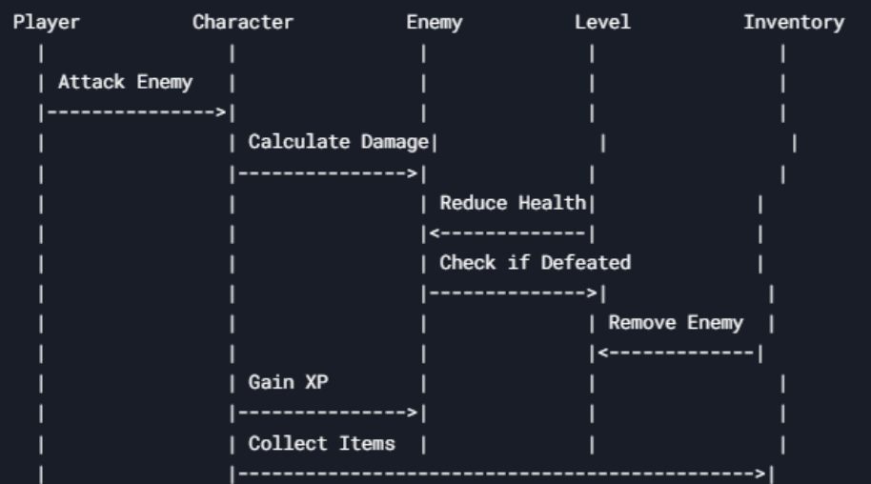
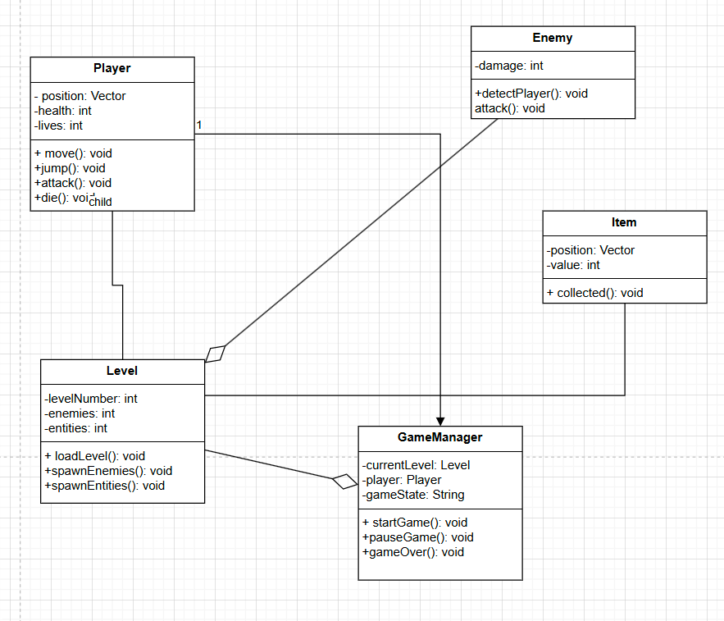
Class diagram

Slide 7

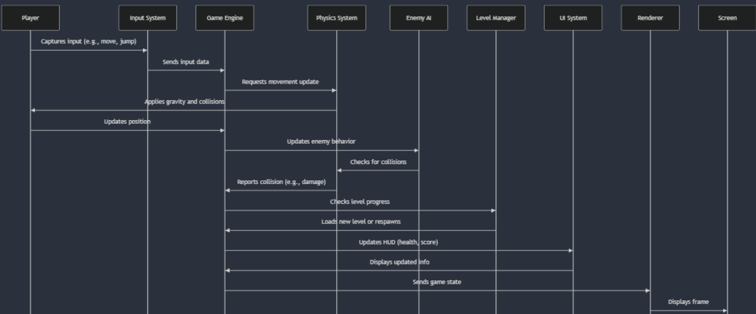
Class diagrams cont.

Slide 8
Major operations
Player Movements: These movement that the player will do when correct input is signal these movements include Moving, attacking and jumping.
Tile-map base level: These are level design technique use by the Godot engine using different assets in order to give the world a proper or a more immersive look. This method is also efficient when it comes to saving time.
Collision and Damage System: Built in collision detection between player, enemies, and hazards, and programmed health reduction and player death logic.
Animated Sprites: Created animations for walking, jumping, idle, and enemy movement using Godot’s Animation Player and AnimatedSprite2D node.
UI Elements: User interface was developed in order to show the player health, collected items, along with menus for pause.

Slide 9
Unit test cases & results
Features | Test description | Input | Expected result | Status
Invisible Collision wall | Player collides with an invisible wall that prevents them from moving in that direction | Move player into wall tile | Player won't be able to move beyond the collision | Pass
Enemy patrol range | Enemy patrols between certain points | Enemy moves back and forth between patrol points | The enemy patrol in the area implemented | Pass
Enemy attacks player | Enemy attacks player on sight when the player enter their range | Move player into enemy vision range | Enemy will try to attack the player | Pass
Tile-map floor Collision and physics layer | Player stands on solid tiles | Drops player onto the ground tile | Player is expected to fall when until they come into contact to a tile and is expected to walk and interact with them | Pass
Collectible System | Player collects a dream gem | Move player into collectible | Collectible disappears and the player score increase by one point | Pass
Health System | Player loses help when hit by an enemy AI | Let the enemy attack the player | Player health decreases by damage amount | Pass

Slide 10
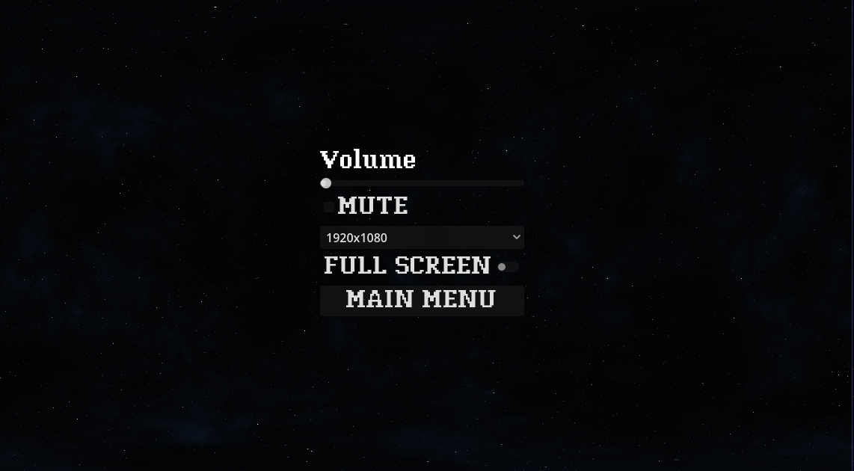
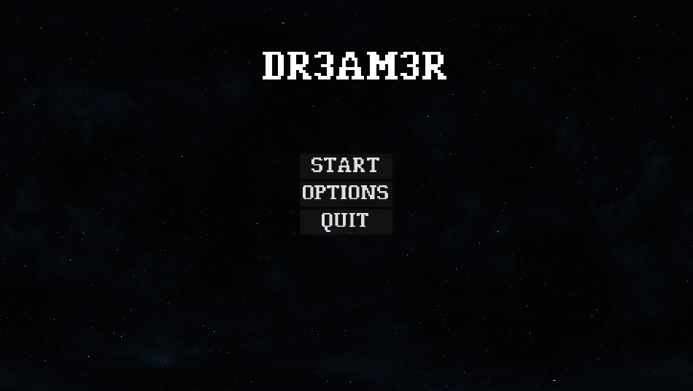
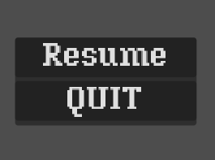
GUI & Database
3 Simple GUI Designs
Menu, Options, Pause
No database

Slide 11

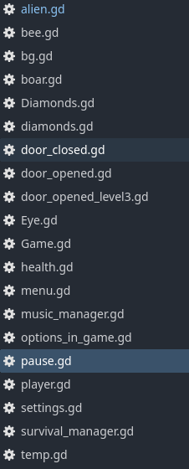
implementation
We plan on using Web based and/or a windows downloadable file.
This will help us show our game without having the player see our source code
We will package assets and scripts into the exported builds to protect our project files.

Slide 12
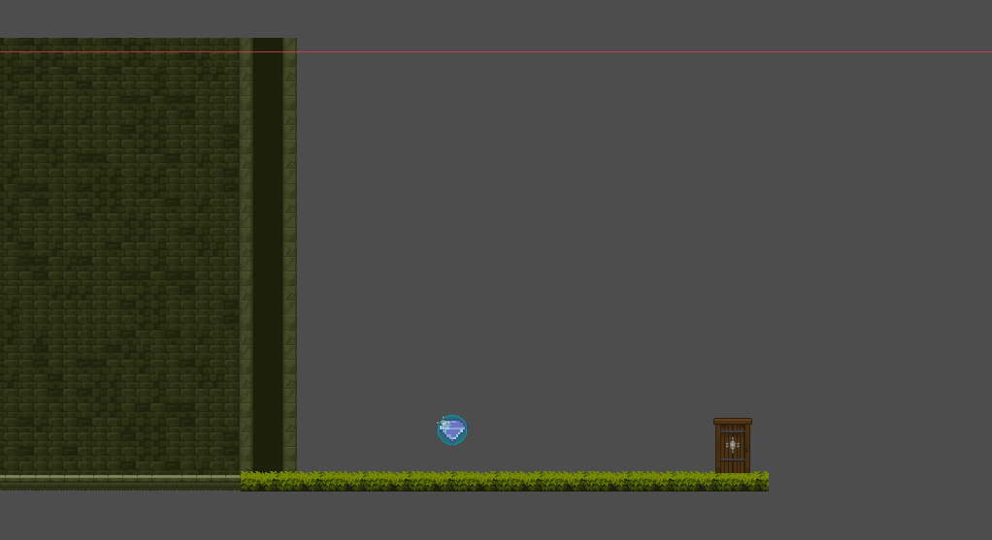
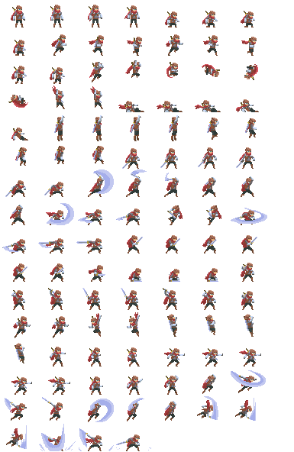
future?
Would be nice to implement more features for the MC.
Make the first level more in depth, lower certain bugs..
It would be nice to try and implement an upgrade system and give the player his own personal stats.
More levels would also be a cool thing to implement into the game to make feel more length .
Perhaps add new enemy types.
Implementing a boss fight at the end of the third level.
Maybe some text dialogue.

Slide 13

Thank You

