Slide 1
Covid-data Analysis
ASHA

Slide 2
Introduction
Dataset Description
This dataset is composed of a curated collection of over 200 publicly available COVID-19 related datasets from sources like Johns Hopkins, the WHO, the World Bank, the New York Times, and many others. It includes data on a wide variety of potentially powerful statistics and indicators, like local and national infection rates, global social distancing policies, geospatial data on movement of people, and more.
This was a challenge/competition on Kaggle. But the key questions or tasks were not available during this current analysis. Came up with new Questions to analyze the data.
The dataset was downloaded from Kaggle. Data set

Slide 3
VIZES OF THE DATA

Slide 4
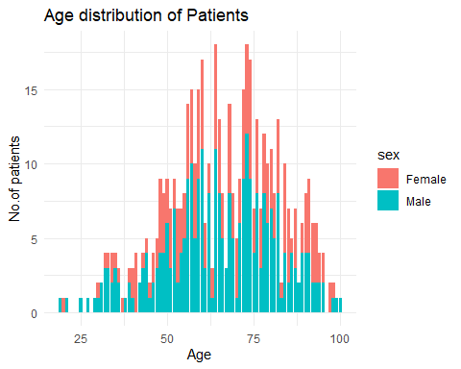
1. Age distribution graph.
Observation:-
Most no. of patients in the age of 60s and 70s.

Slide 5
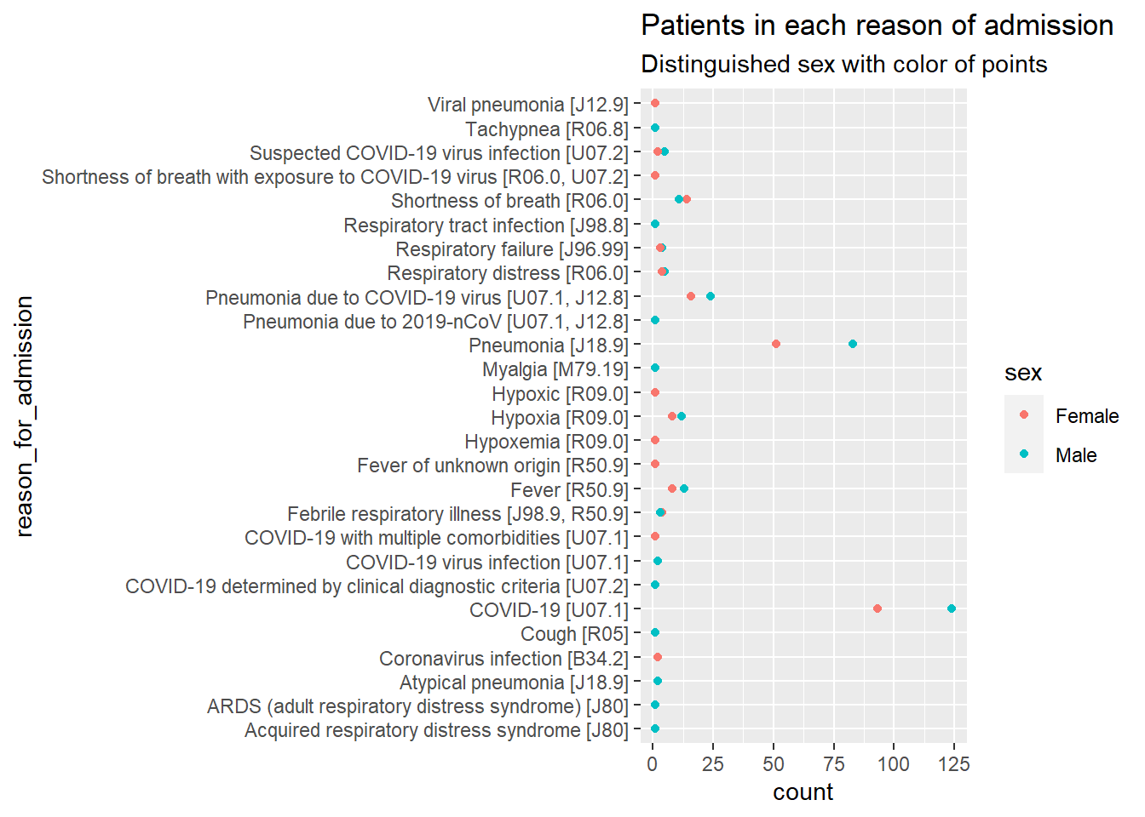
2. How many male and female patients are admitted for each reason for admission?
Observation:-
In most reasons of admissions no. of male patients are more than the female.
Covid-19 related admissions are majority in this dataset of 508 patients.

Slide 6
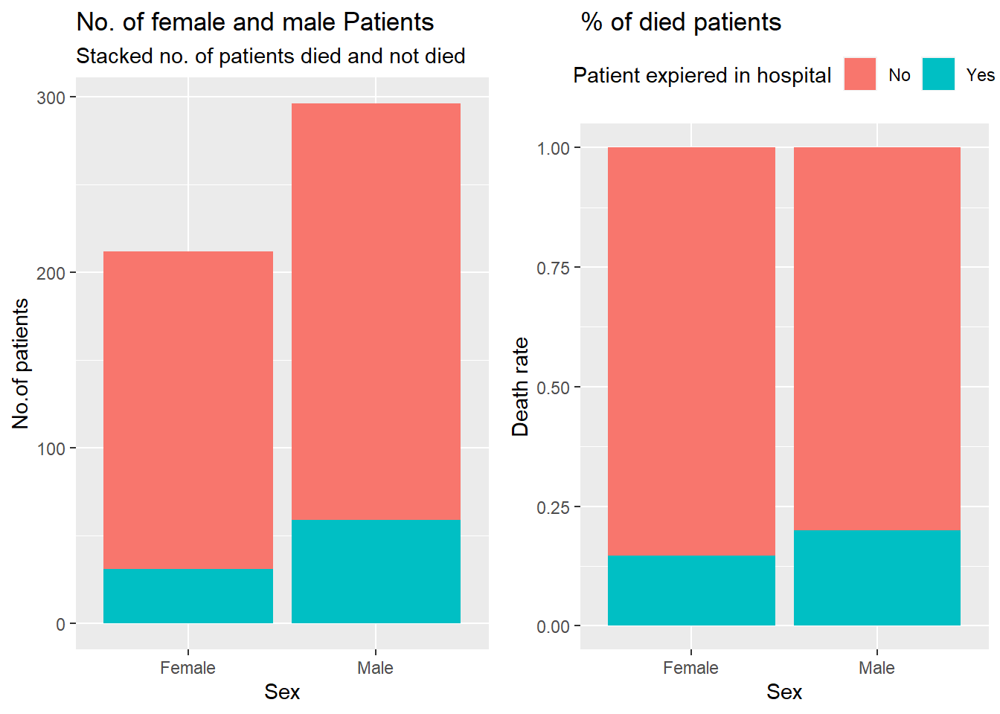
3. How many patients died in the hospital
Observation:-
1. There were more male patients than female in the dataset.
2. 90 patients expired in hospital out of 508 patients in the dataset.
3. Male death rate was higher than female.

Slide 7
ANALYSIS PART 1

Slide 8
1. Average, min, and max age, height and weight of the patients who are admitted
age height weight Min. : 19.00 Min. :125.0 Min. : 27.70 1st Qu.: 55.75 1st Qu.:159.0 1st Qu.: 65.80 Median : 66.00 Median :167.6 Median : 76.70 Mean : 66.03 Mean :166.9 Mean : 80.27 3rd Qu.: 78.00 3rd Qu.:175.0 3rd Qu.: 89.80 Max. :100.00 Max. :198.0 Max. :199.60 NA's :236 NA's :150

Slide 9
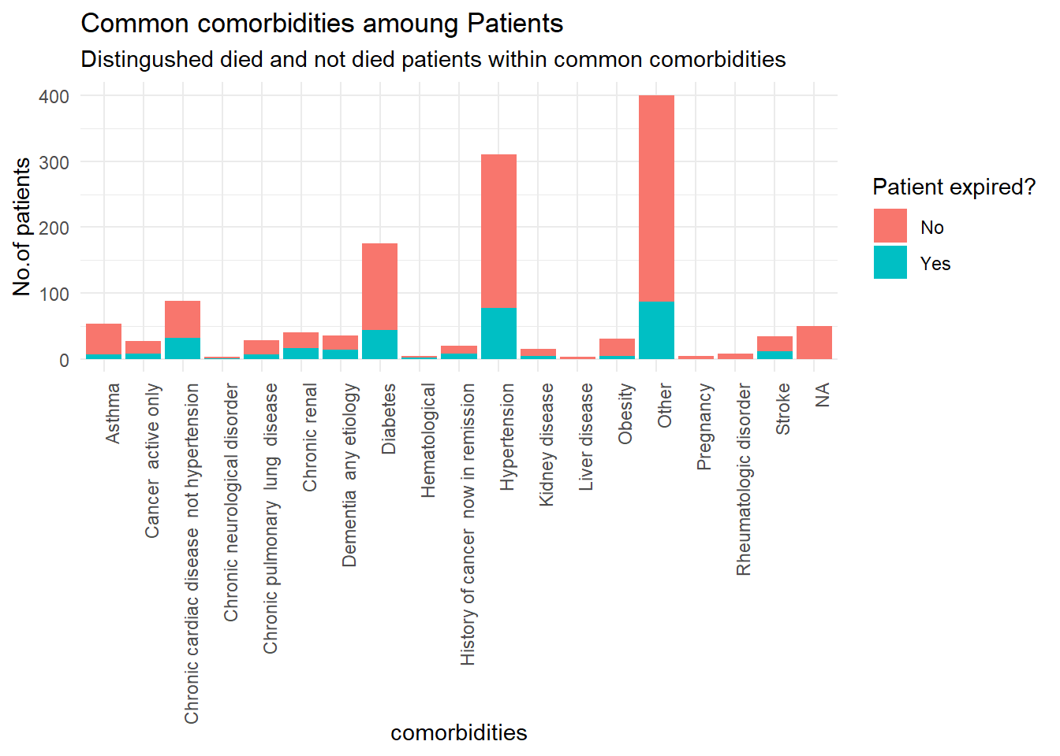
2. Most common comorbidities found in patients in the dataset.
Observation:-
Hypertension and Diabetes are the common comorbidities found in most of the patients and most patients had other medical conditions.

Slide 10
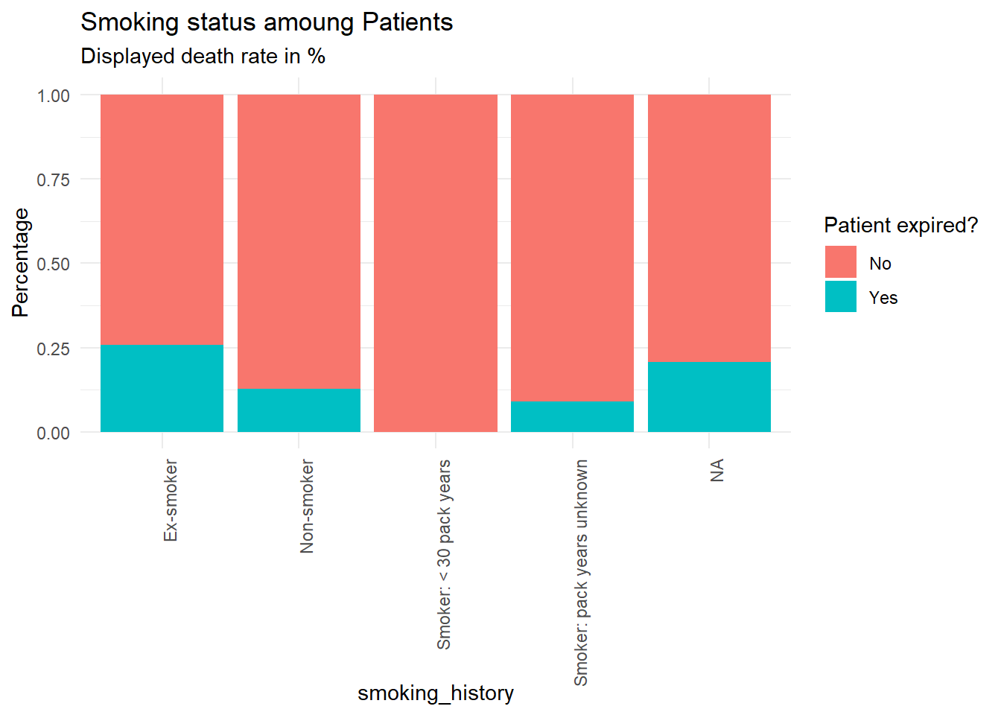
3. Smoking history among patients.
Observation:-
Ex-smokers does show a bit higher death rate than nonsmokers.

Slide 11
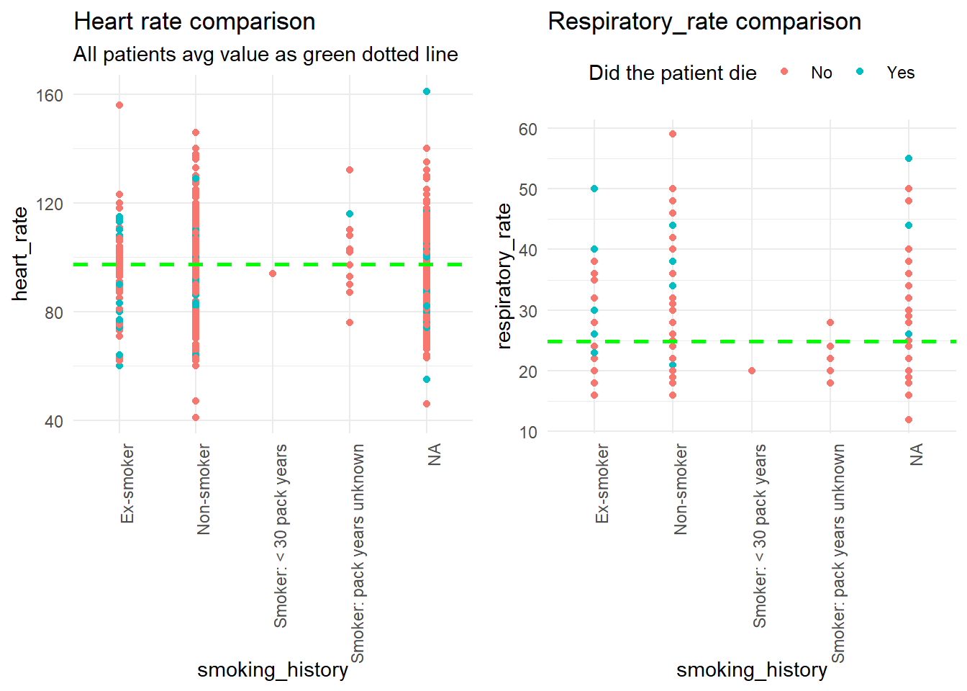
4. Average Vitals in patients in different smoking category

Slide 12
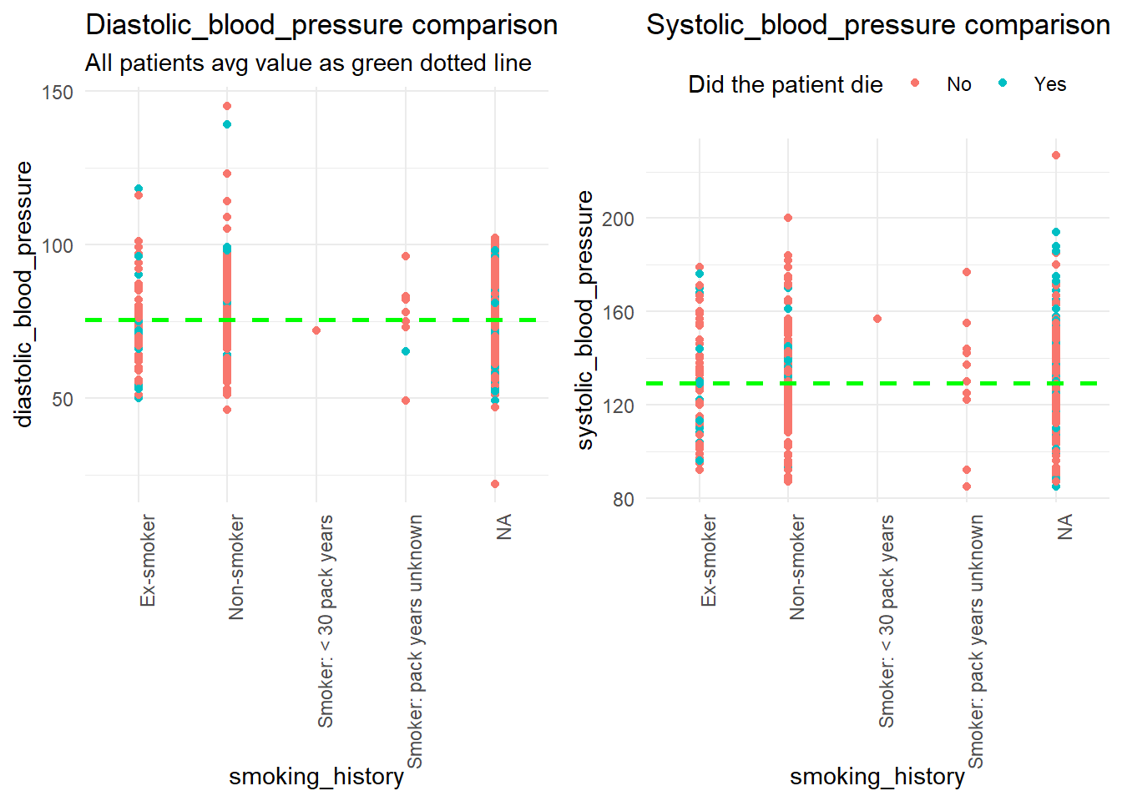
Observation:-
Systolic bp normal reading 90-120:- Avg Sbp of all patients in the dataset is above 120, smoker group avg Sbp is bit high(157). Rest of the reading do not show much difference from the dataset avg readings

Slide 13
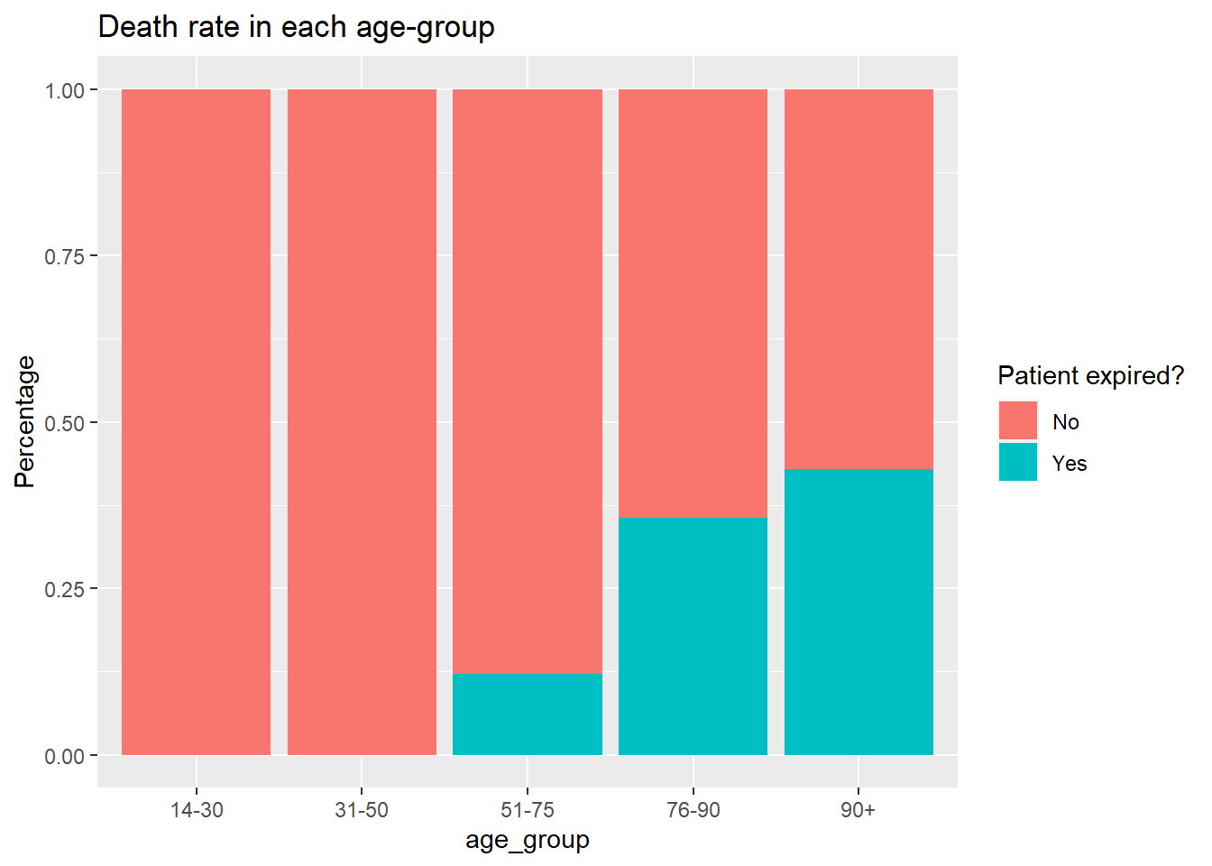
9.No.of patients expired in the hospital for each age group
Observation:- Most death rate is in the age group 90+.

Slide 14
ANALYSIS PART 2

Slide 15
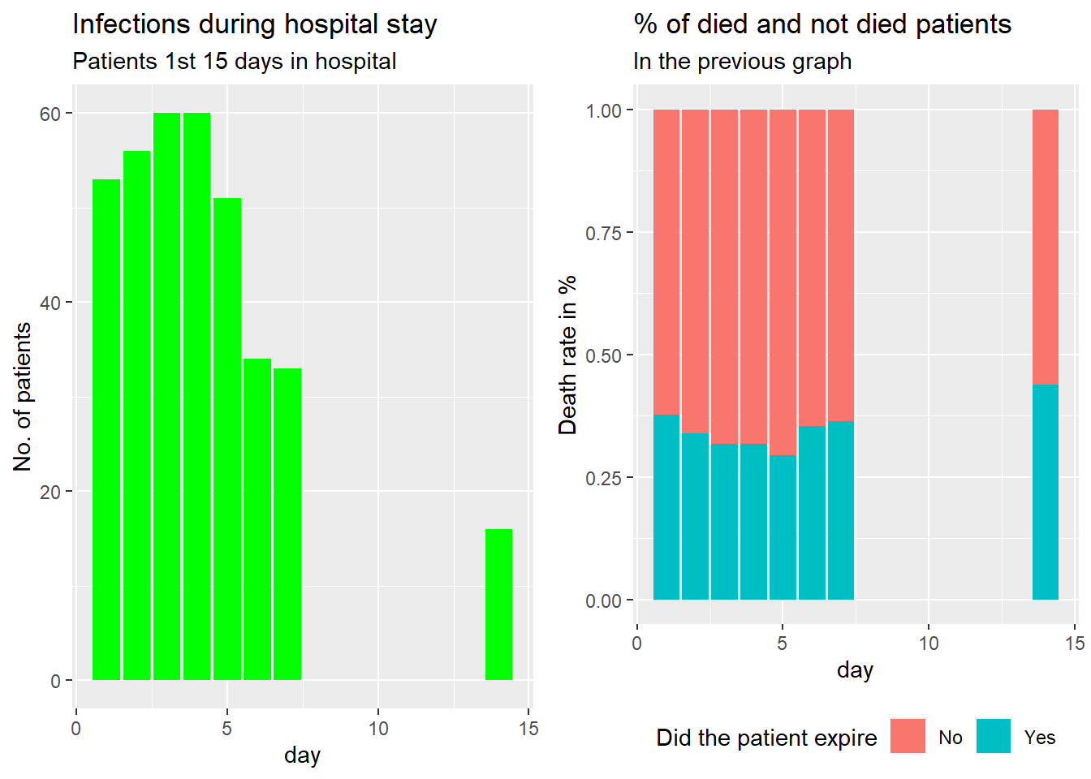
1. How many patients were clinically diagnosed with infections?

Slide 16
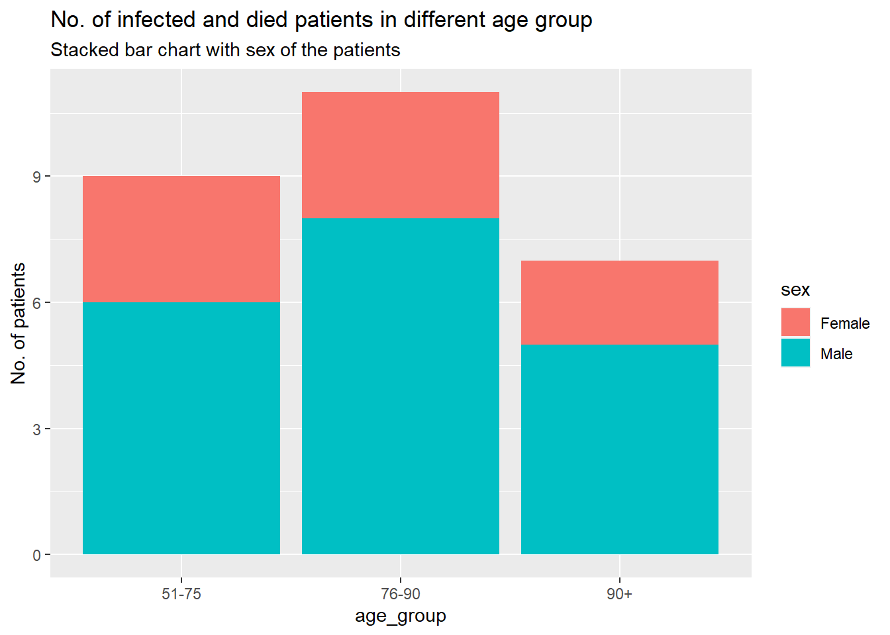
Observation:-
27 patients died among 87 those with clinically diagnosed infections.
More no. of people were diagnosed with other infections on their 3rd or 4th day of their hospital stay. Mostly after the 7th day no infection readings but on 14th day showing some more infections reading. 25-30 % of the people who diagnosed infections expired in hospital. Those who got infections on 14th day ,45% passed away.
76-90 age group has more no. of patients with clinically diagnosed infections and died in the hospital.
In all age group male death rate was way higher than female.

Slide 17
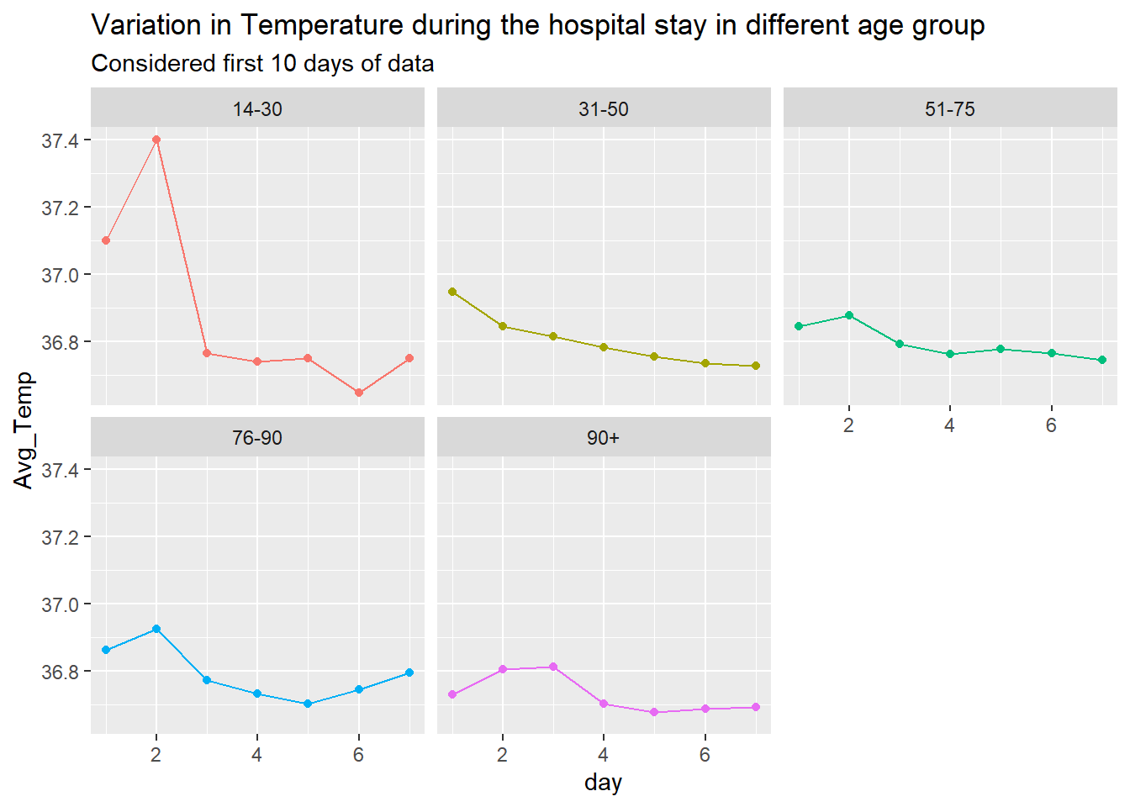
Temperature
2. Visually analyze the data to see if there were vital changes during their stay. Vitals include systolic bp, diastolic bp, temperature, and heart rate, wbc, rbc, hematocrit, platelet count.
Observation:- Normal temperature range:- 97 F (36.1 C) and 99 F (37.2 C); No significant Temp-variation .

Slide 18
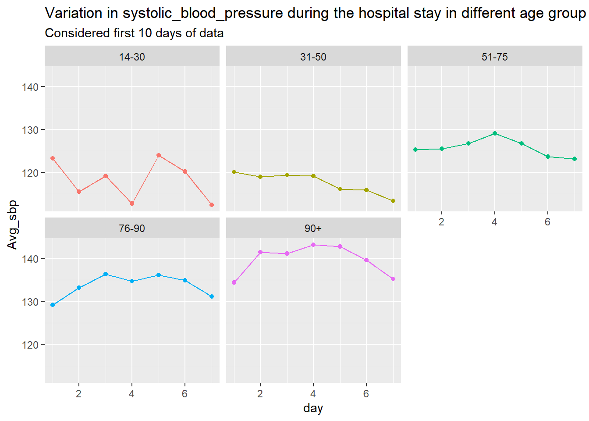
Systolic blood pressure
Observation:- Systolic bp normal reading 90-120:- Sbp was significantly high throughout these days in patients above age 50.

Slide 19
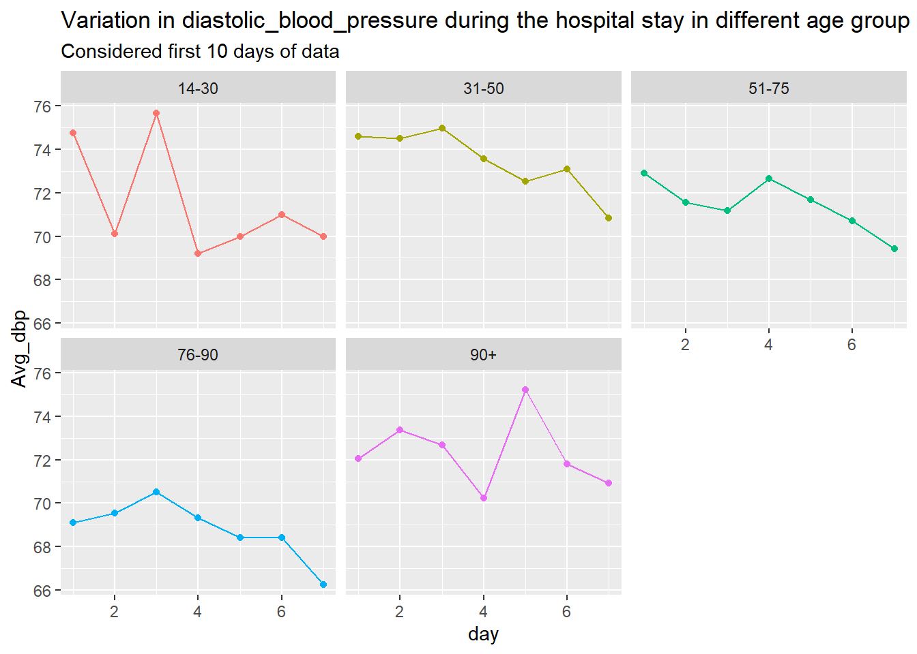
Diastolic blood pressure
Observation:- Diastolic bp normal reading 60-80:-Dbp seemed to be in the normal levels.

Slide 20
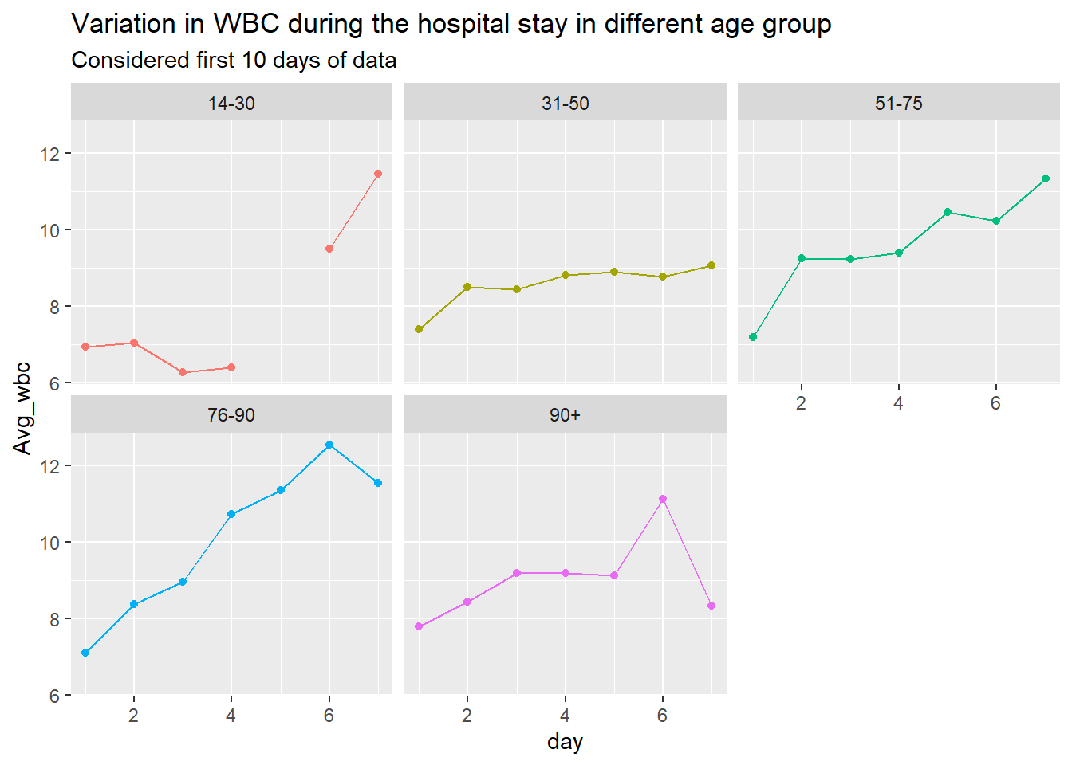
Wbc
Observation:- Normal WBC reading ranges 4.5 to 11.0 × 109/L:- First 4 days all age group show normal readings; age group 51-90 show steady increase during rest of the days. After 5th day it goes above 11,which is a concern.

Slide 21
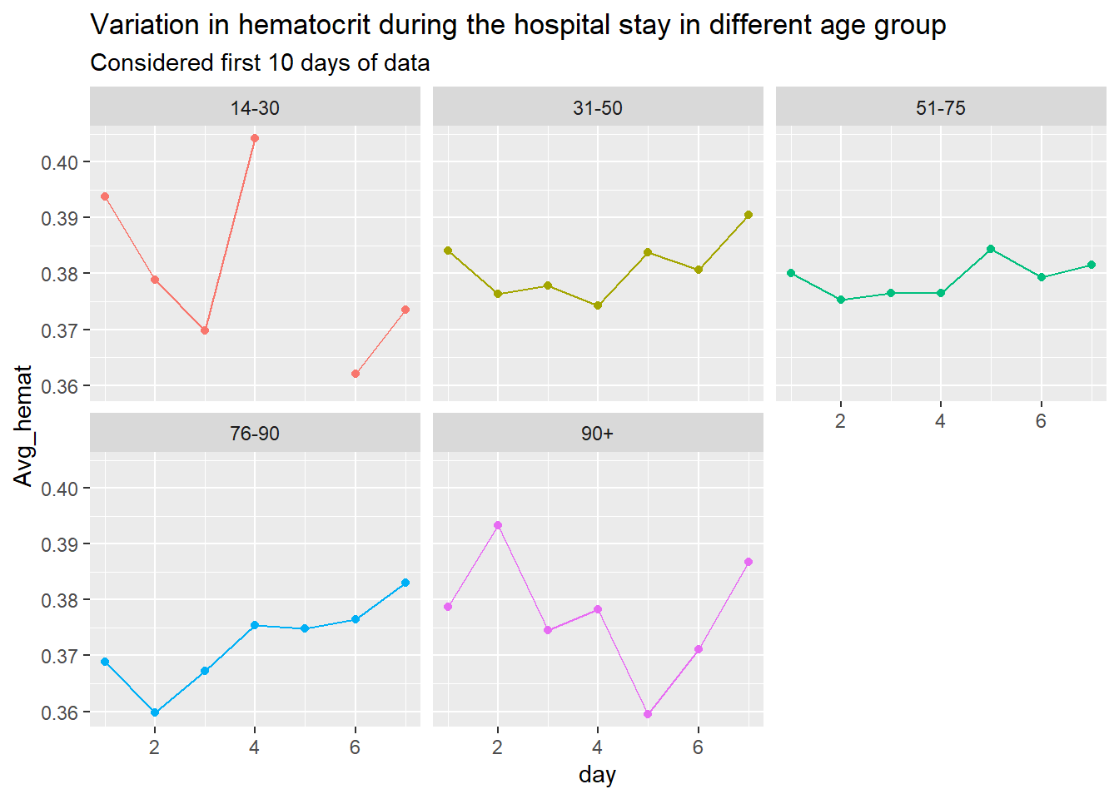
Hematocrit
Observation:- Normal levels of hematocrit for men range from 41% to 50%,for women is 36% to 48%:- Most patients in the normals reading range.

Slide 22
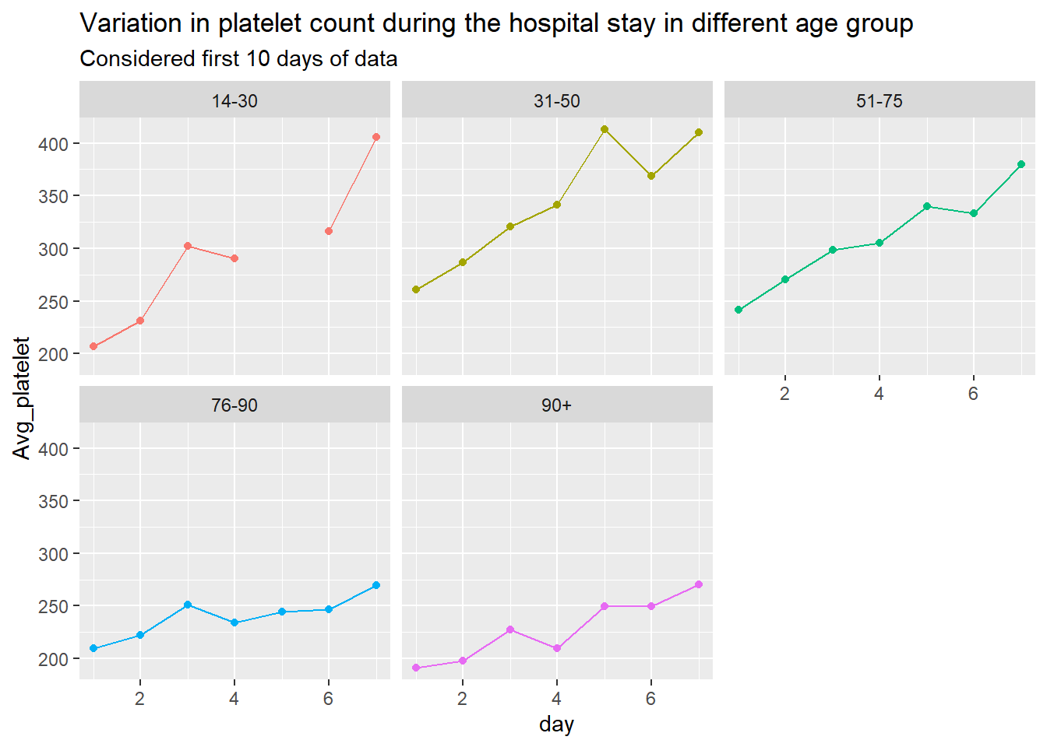
Platelet count
Observation:- Normal platelet count ranges from 150,000 to 450,000 platelets per microliter of blood:- All in the normal range,though age group 76 and above show lower levels.

Slide 23
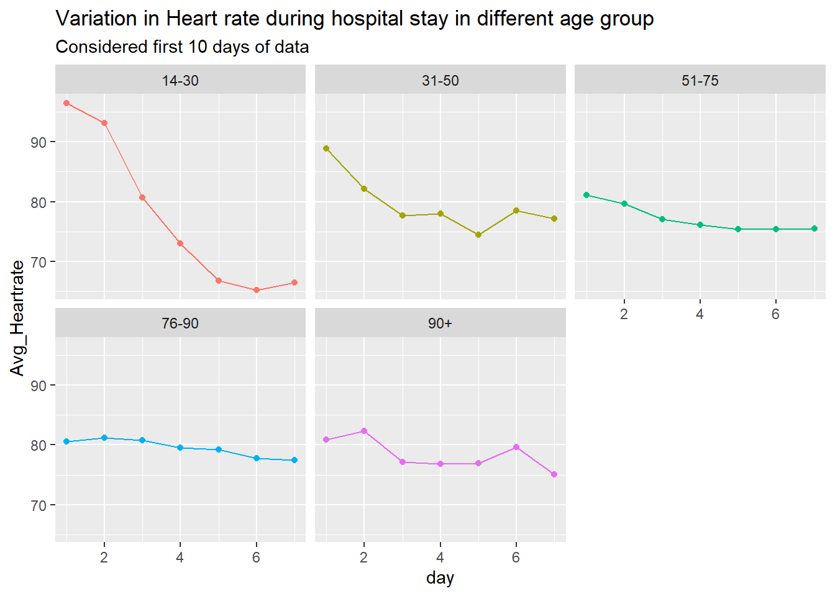
Heart rate
Observation:- Heart rate normal range 60-100:- All in normal range.

Slide 24
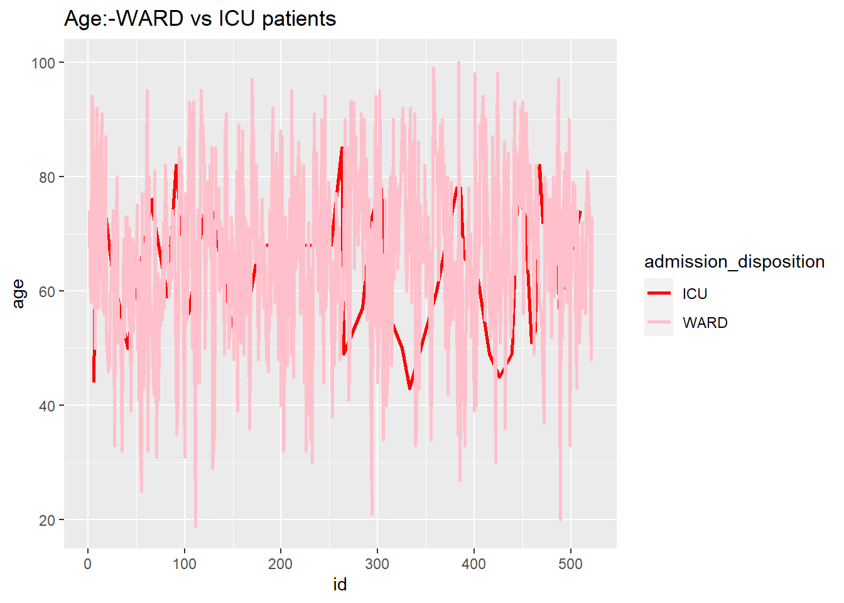
3. Compare patients in the WARD vs ICU
Age

Slide 25
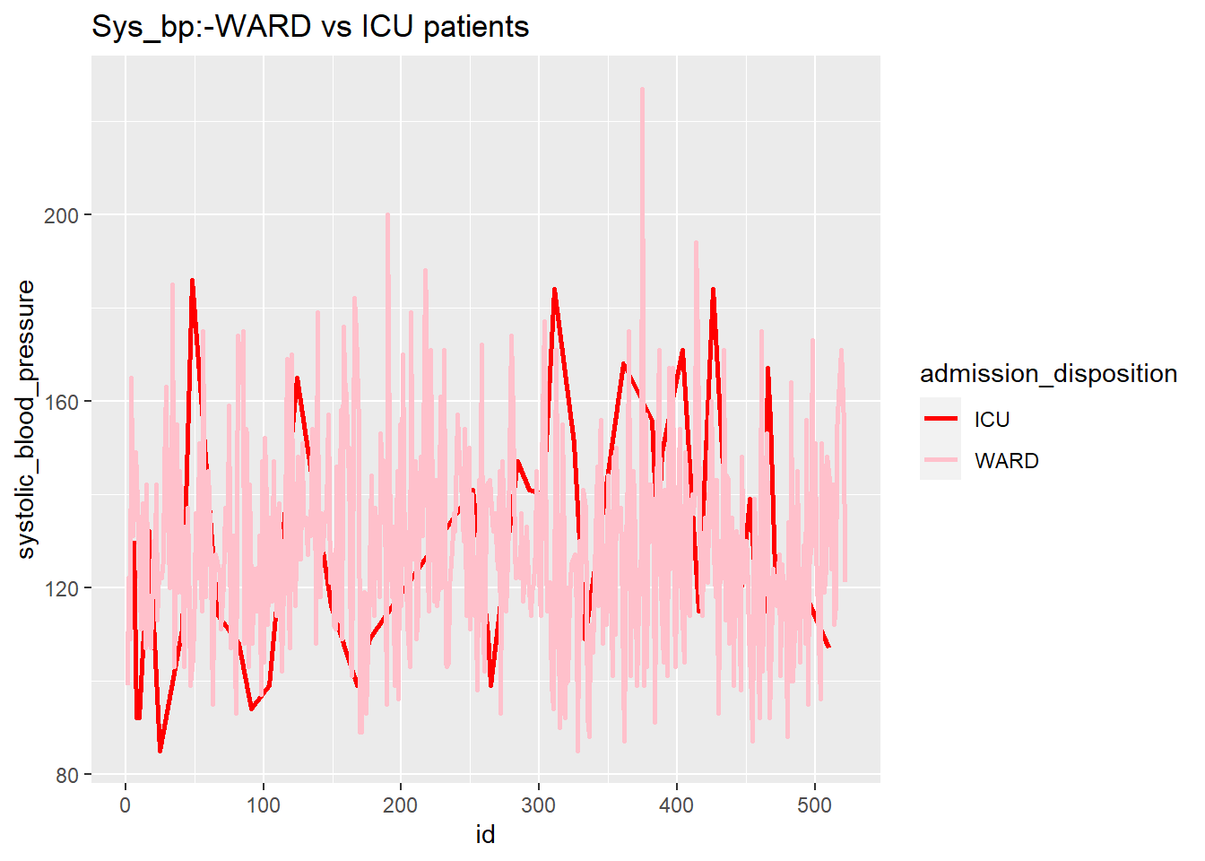
Systolic Blood Pressure

Slide 26
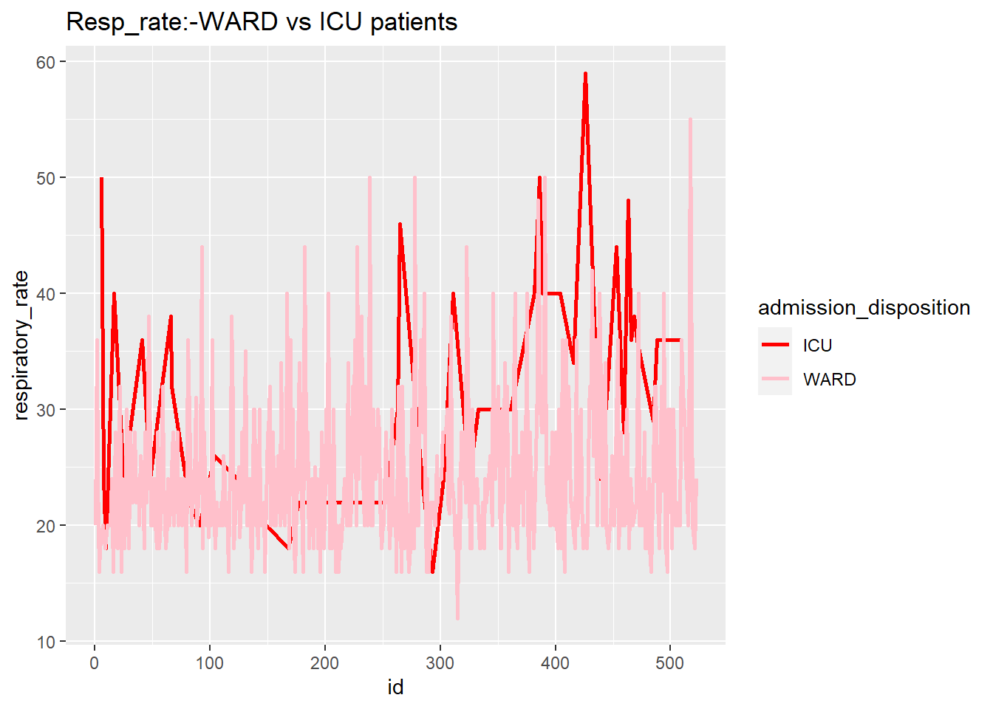
Respiratory rate

Slide 27
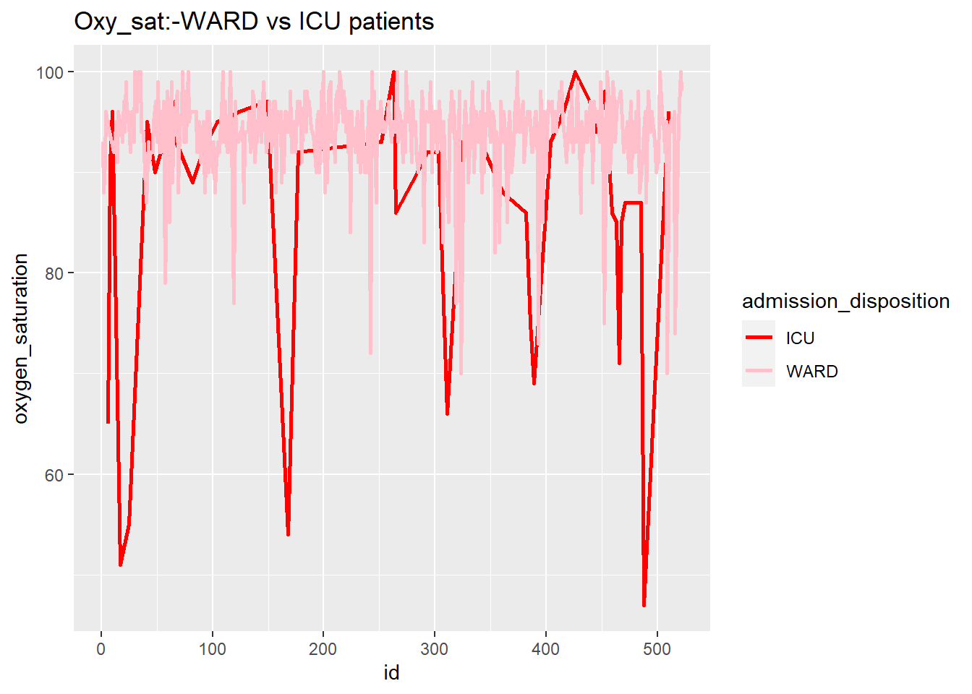
Oxygen saturation

Slide 28
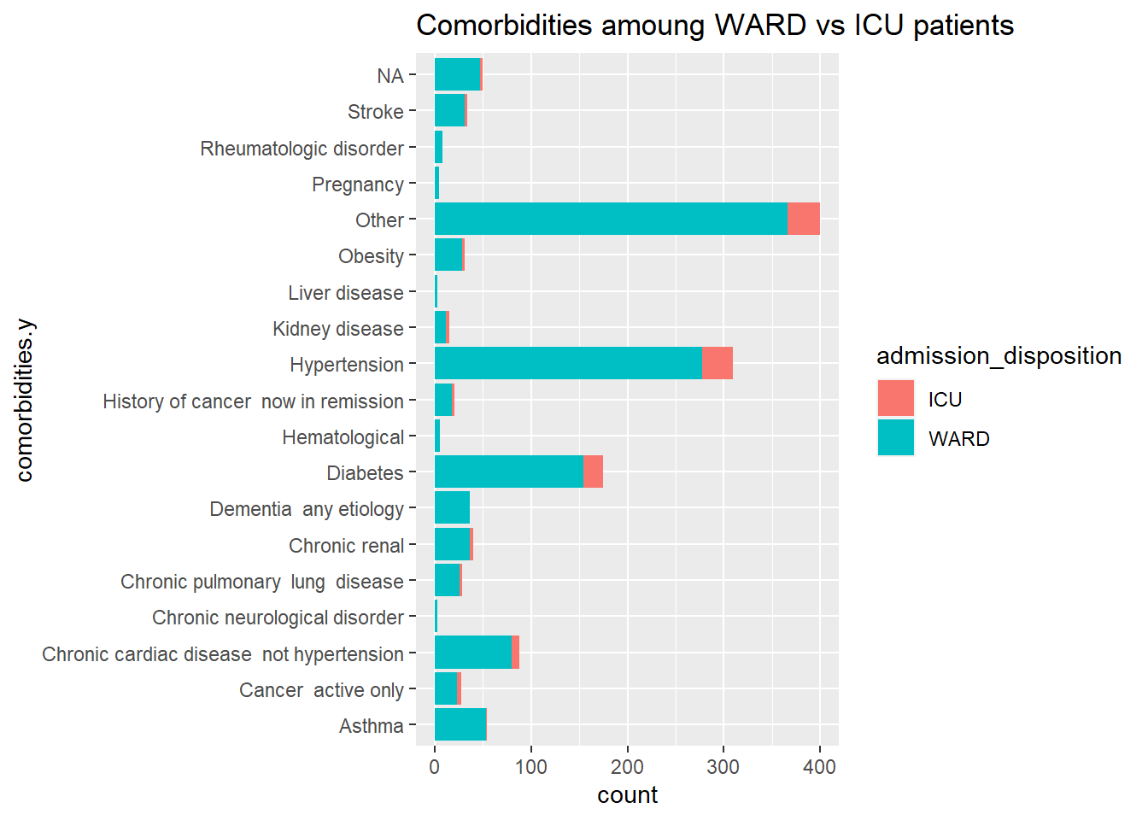
Comorbidities
Observation:- ICU patients:-
1. Below 90 Oxygen-sat, 2. High Systolic-bp and Respiratory rate, 3. Hypertension & Diabetes are common comorbidities.

Slide 29
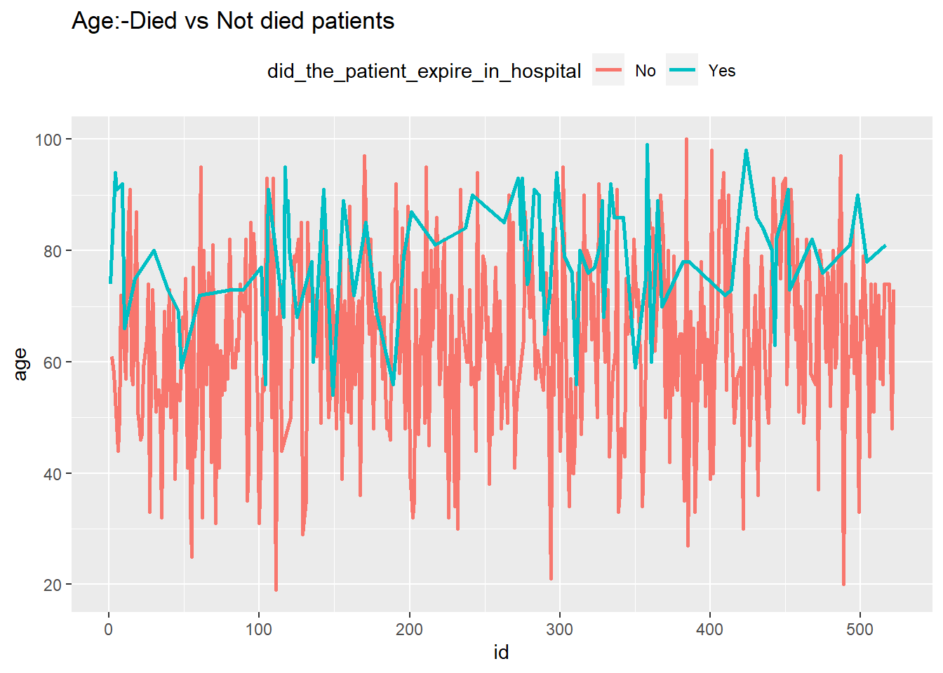
4. Compare patients who expired and not-expired in hospital.
Age

Slide 30
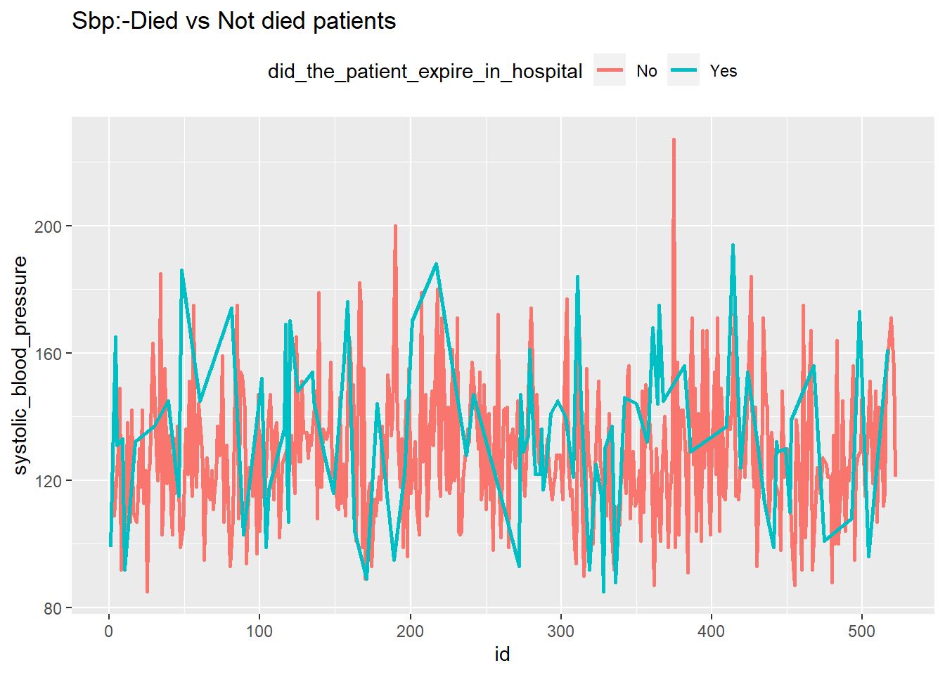
Systolic blood pressure

Slide 31
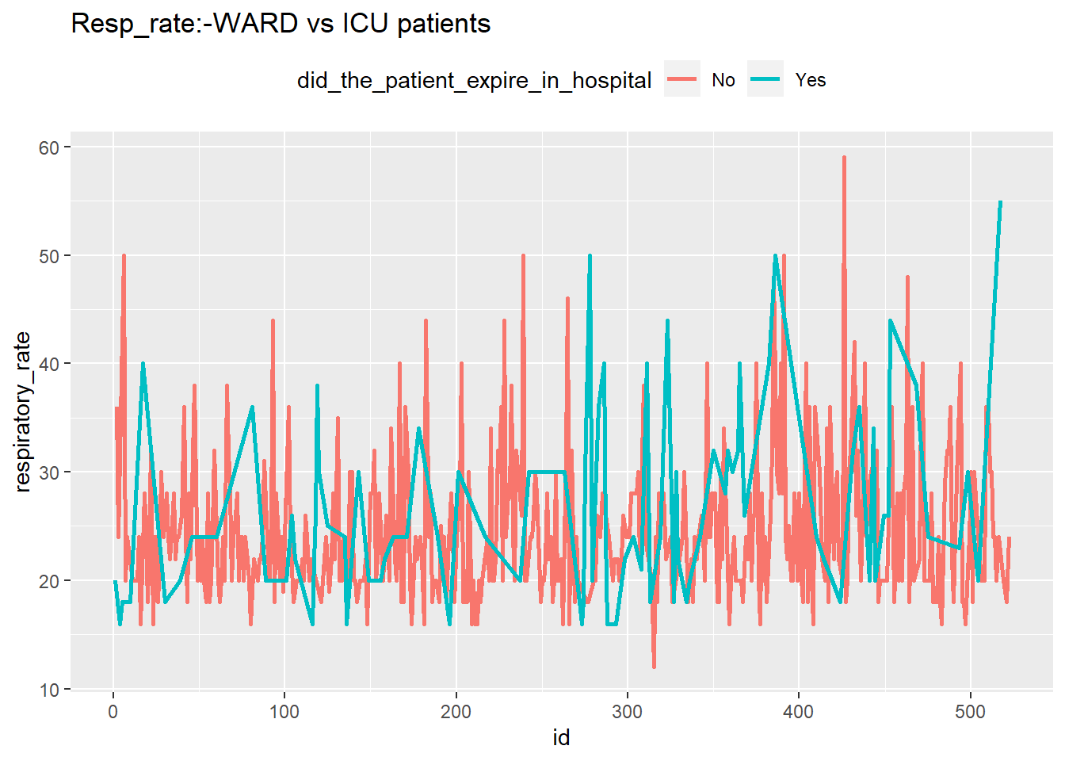
Respiratory rate

Slide 32
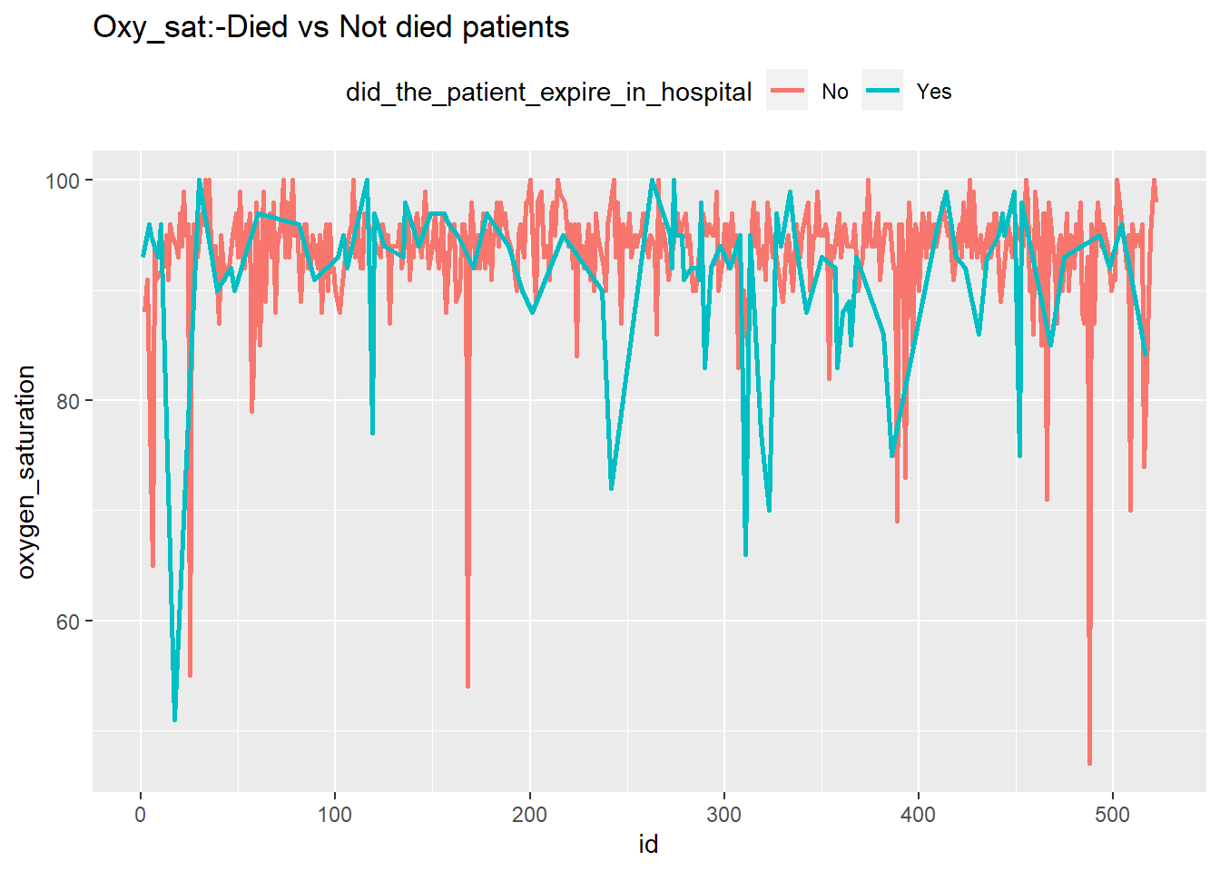
Oxygen saturation
Observation:- Higher levels of systolic bp and respiratory rate in died patients.

Slide 33
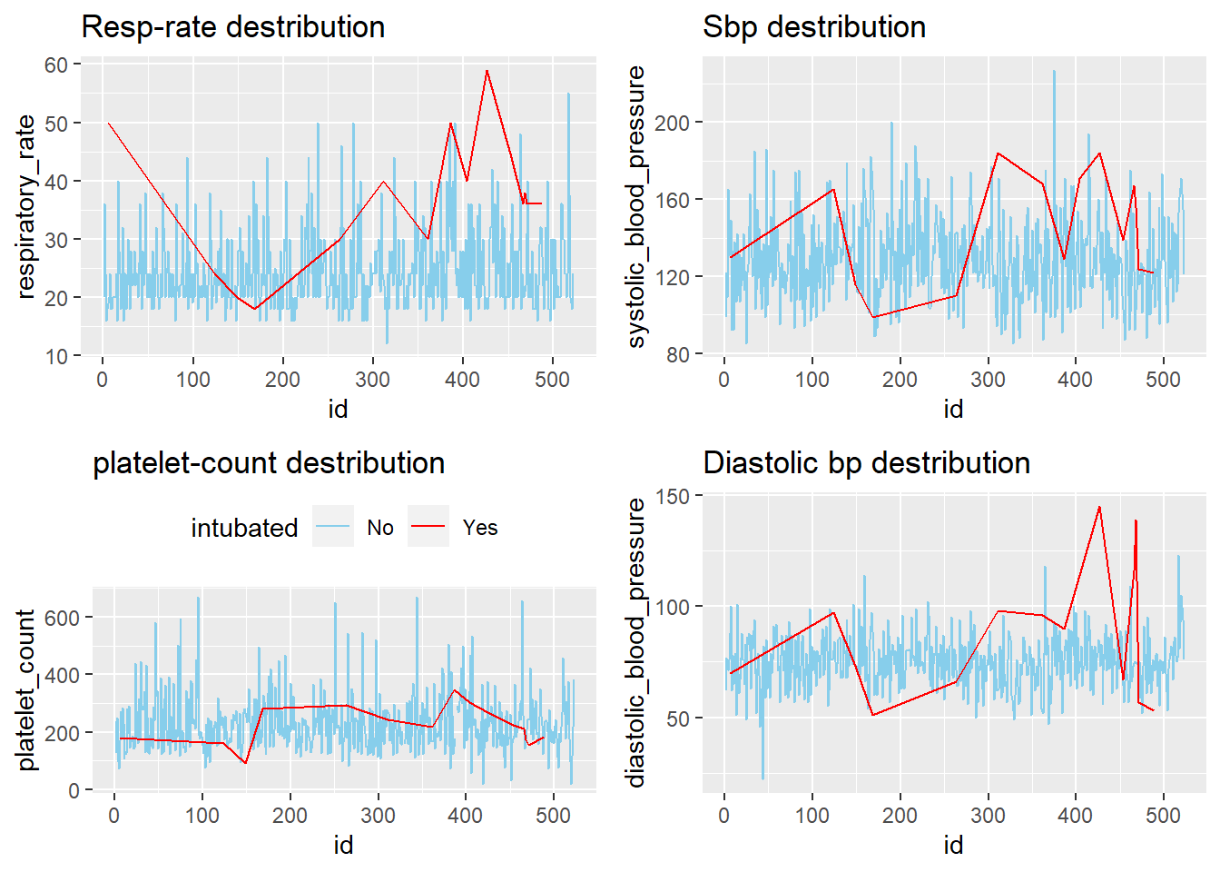
5. Compare intubated and not intubated patients
Observation:- Intubated patients definitely show some risky avg readings in Systolic bp,diastolic bp, respiratory rate and oxygen saturation.

Slide 34
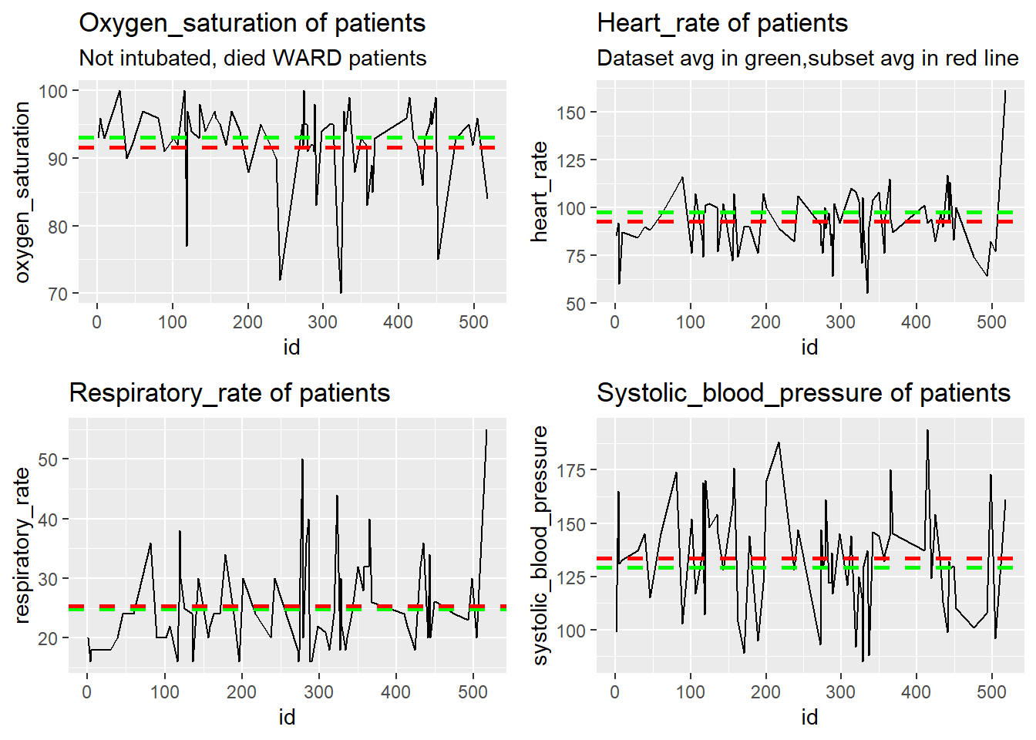
b2) Not intubated ,died patients in WARD
Observation:- The avg reading of this particular subset(Not intubated, died WARD patients) and of the entire data set do not vary much.

Slide 35
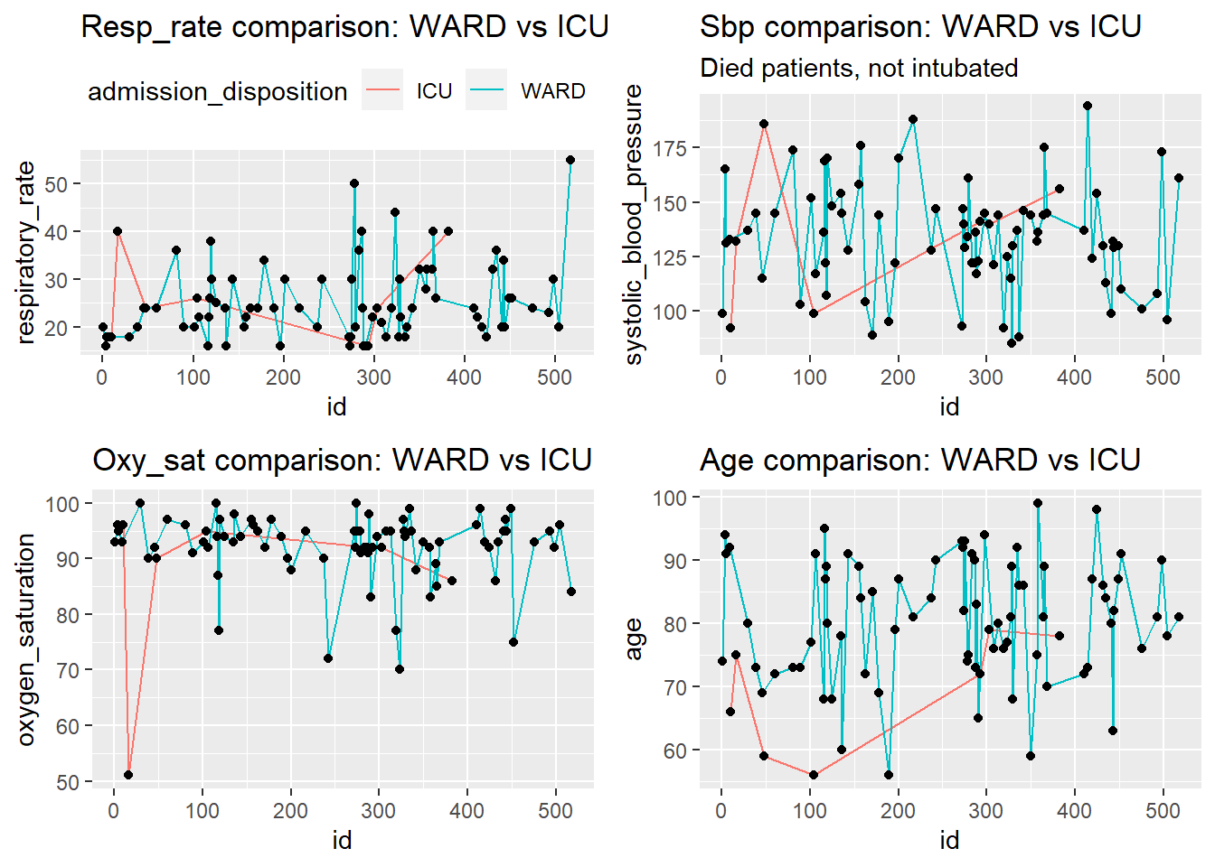
c)Not intubated, died patients in ICU and WARD comparison:
Observation:- Viz supports the above findings about vitals, ICU patients show younger crowd

Slide 36
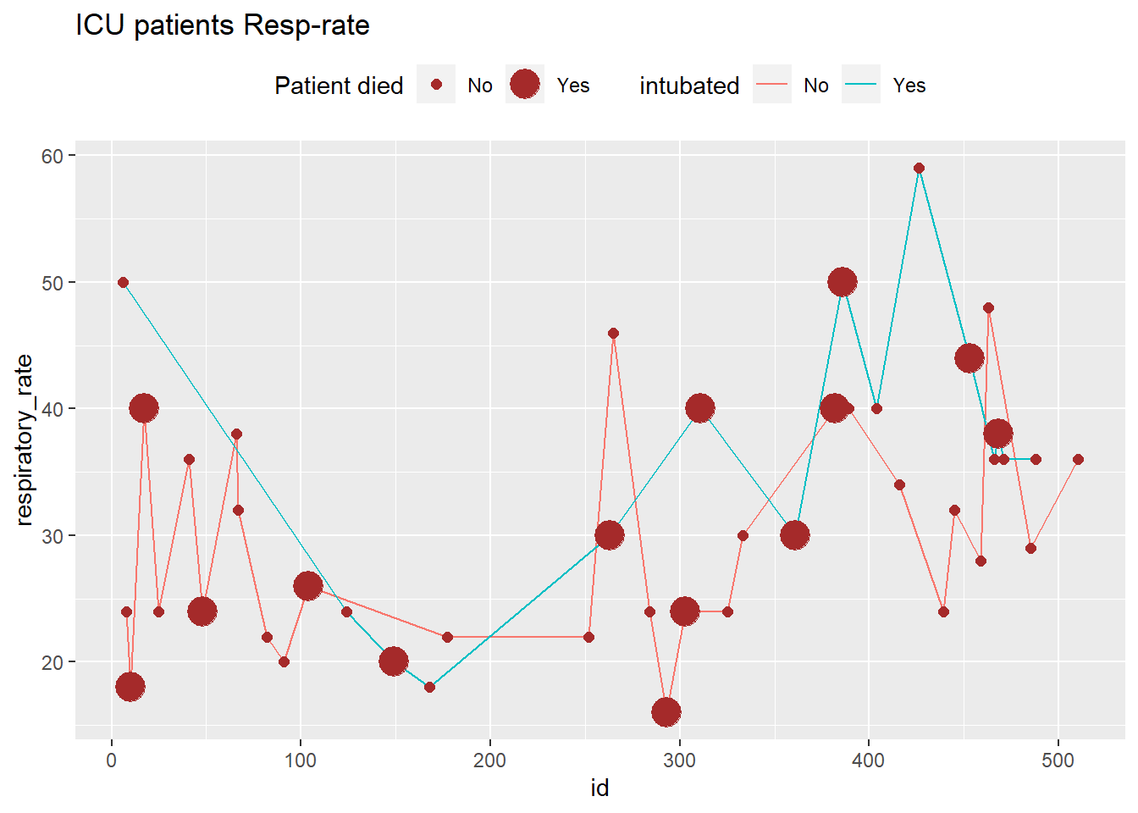
6. Compare ICU patients who got intubated and not intubated
ICU patients: Respiratory rate

Slide 37
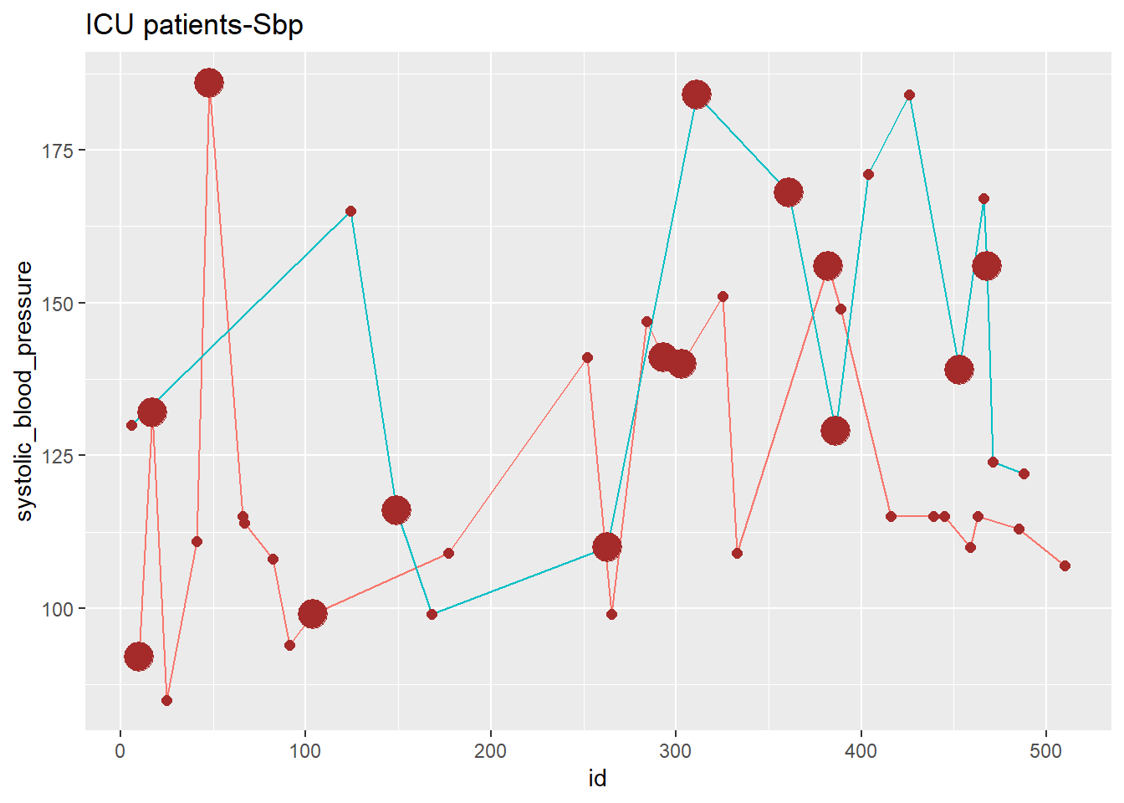
ICU patients:
Systolic blood pressure

Slide 38
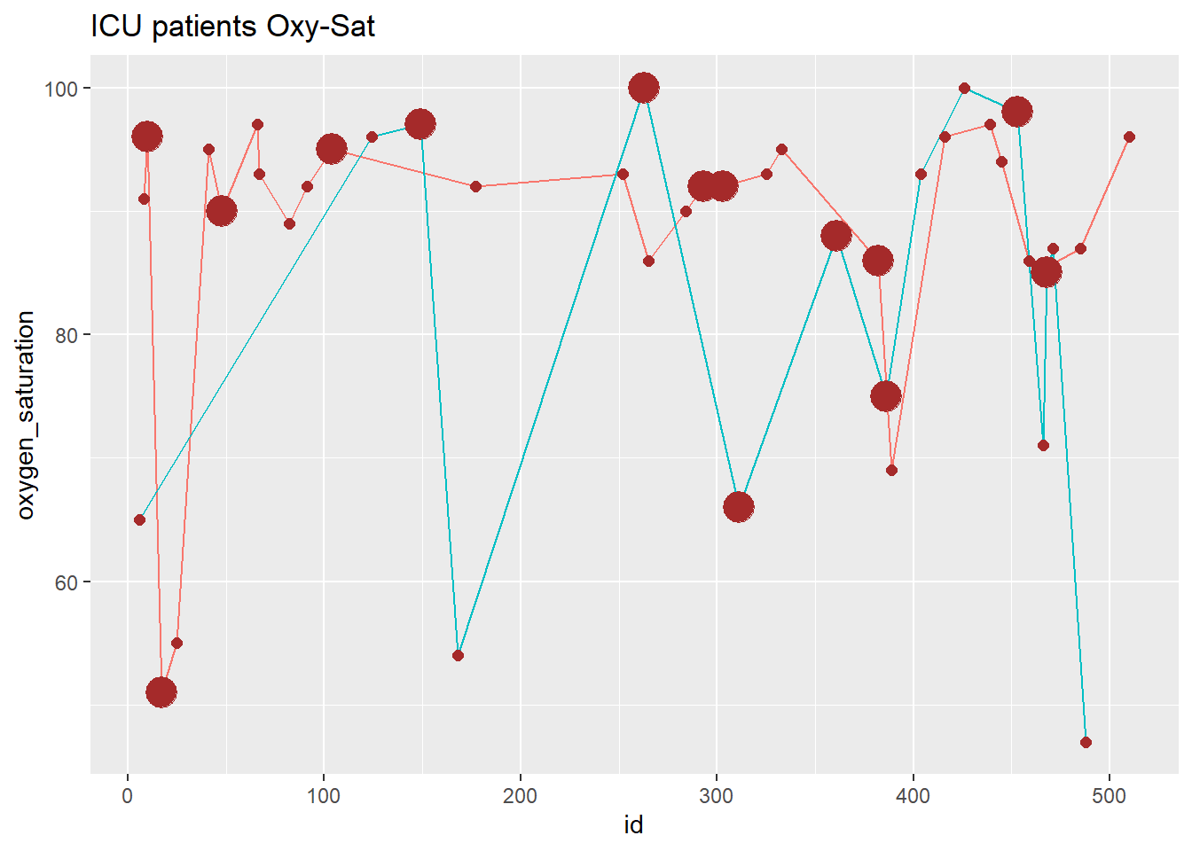
ICU patients:
Oxygen saturation

Slide 39
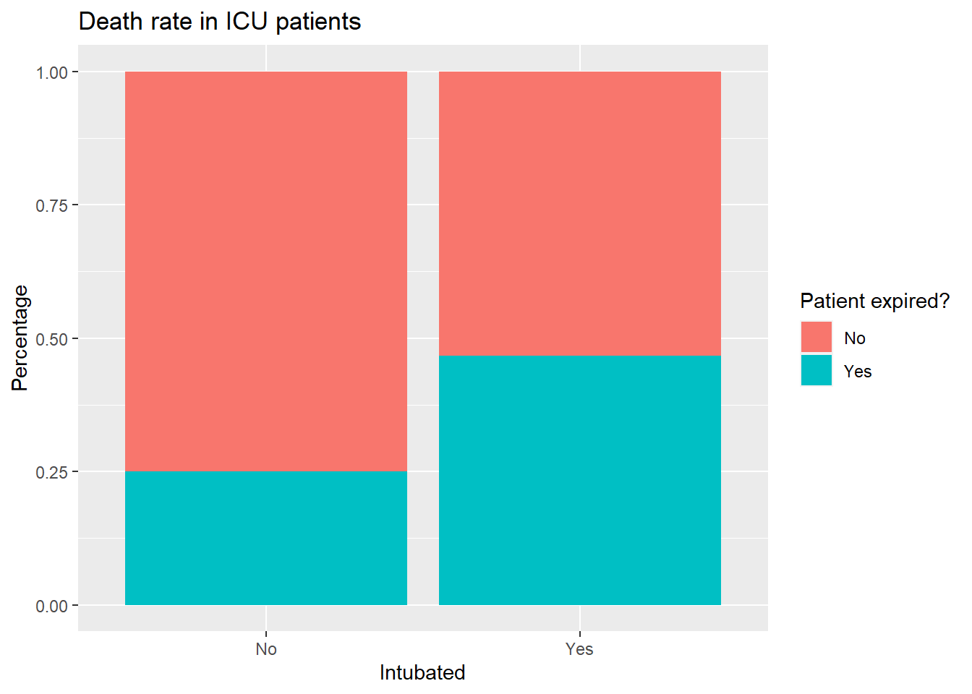
Death rate in ICU patients
Observation:-
1.There were 43 ICU patients, more in the age group 51-75.
2.There were 15 intubated and 28 not intubated patients.
3.Intibated patients shows higher levels of respiratory rate, systolic blood pressure and oxygen saturation.
4.Death rate is more among intubated patients in ICU

Slide 40
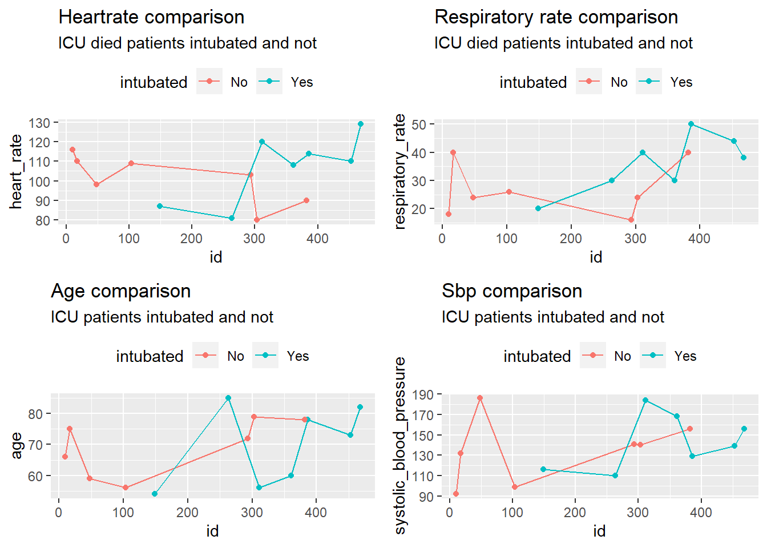
7. Comparison Visualization
(a)ICU-died:-intubated &
not intubated patients
Observation:-
ICU-died patients:- Intubated patients– Higher levels of Heart rate, respiratory, Sbp than not intubated ones

Slide 41
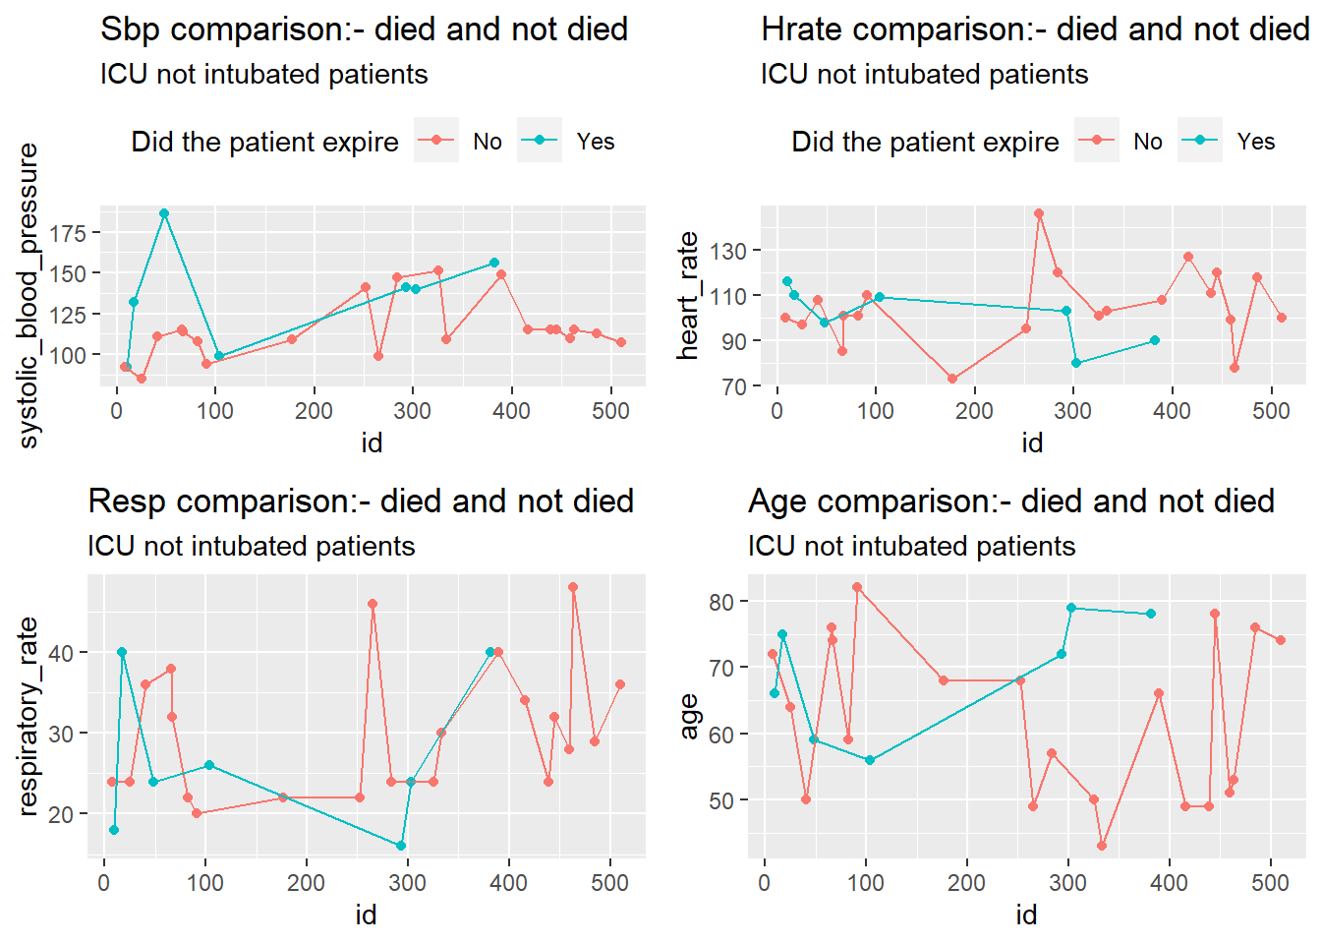
(b)ICU-Not Intubated:-died and not died
Observation:-
ICU-Not Intubated patients:-Higher levels of Sbp in died patients than not died ones

Slide 42
ANALYSIS PART 3

Slide 43
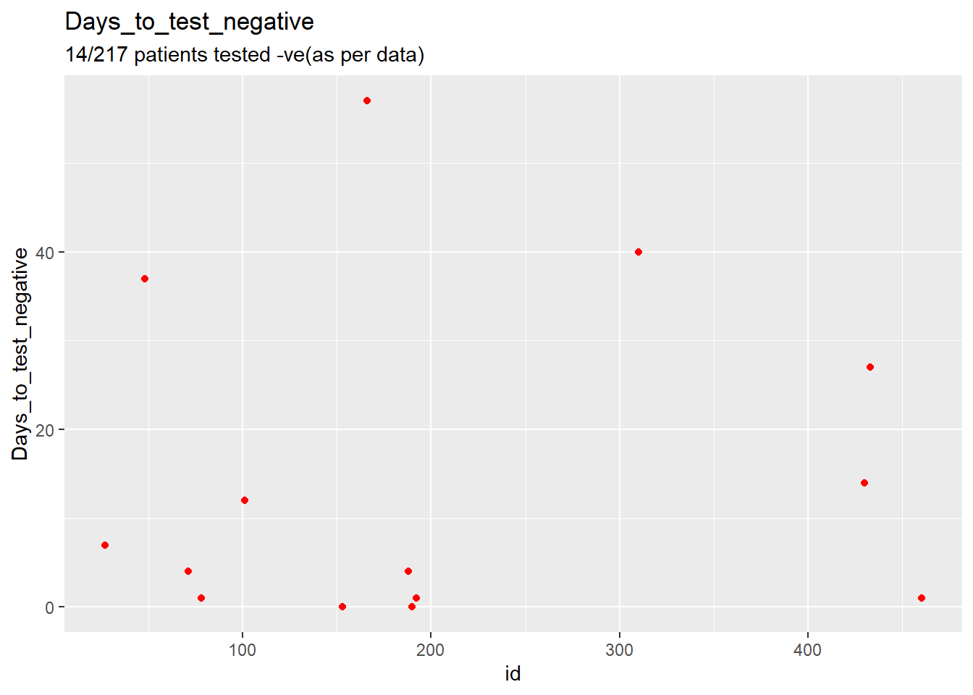
1. As patients admitted with varies of reasons, filtering the patients admitted with the specific reason of COVID-19.
Patients admitted with the reason of Covid-19:
217(27 expired in hospital)

Slide 44
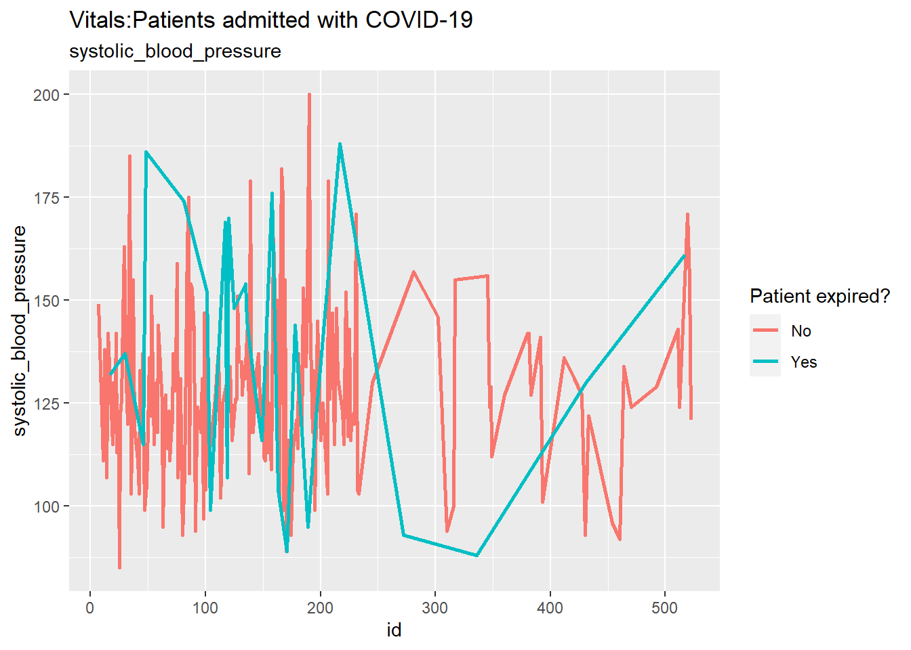
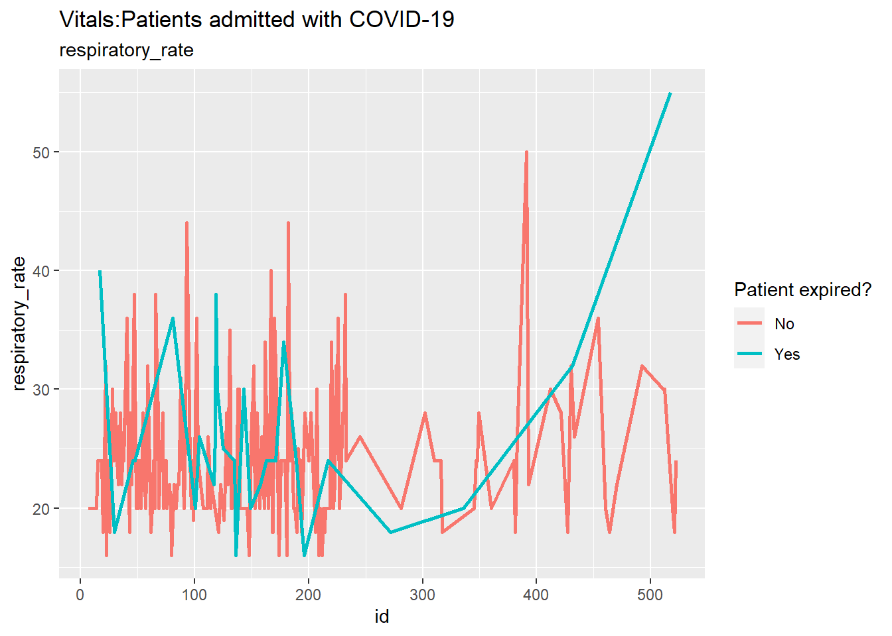
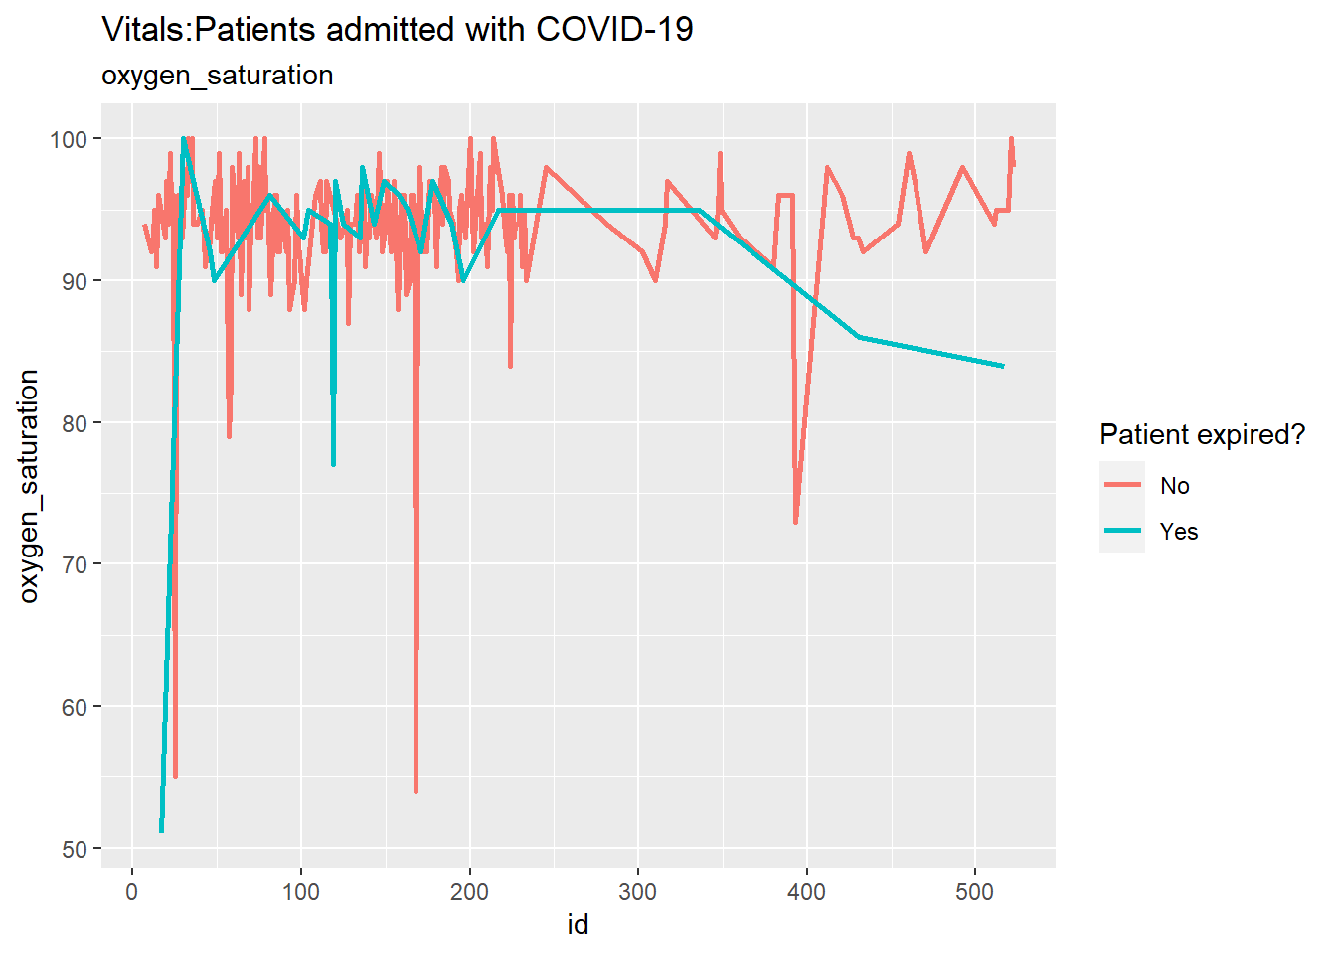
2. Checking the vitals of patients admitted with the specific reason of COVID-19

Slide 45
ANALYSIS RESULTS
Total Patients in the dataset: 508 (296M,212F)
Most no. of patients in the age of 60s and 70s.
Total patients died: 90(59M,31F),(83 Intubated, 7 Not),(14 ICU[7 Intu,7 Not],76 WARD), more people died in the age-group 76-90
Total ICU patients: 43(15 Intu, 28 Not)
Oxygen saturation was significantly low and respiratory rate was high in ICU patients(43 ICU/465 WARD patients),Oxygen saturation below 90% is very concerning and indicates an emergency.
Most common Comorbidities in the patients:-Hypertension (310/508), Diabetes (175/308), Chronic cardiac disease (88/508). And 400/508 patients have other medical conditions
Systolic blood pressure, Respiratory-rate and oxygen-saturation were risky vital levels.

