Slide 1

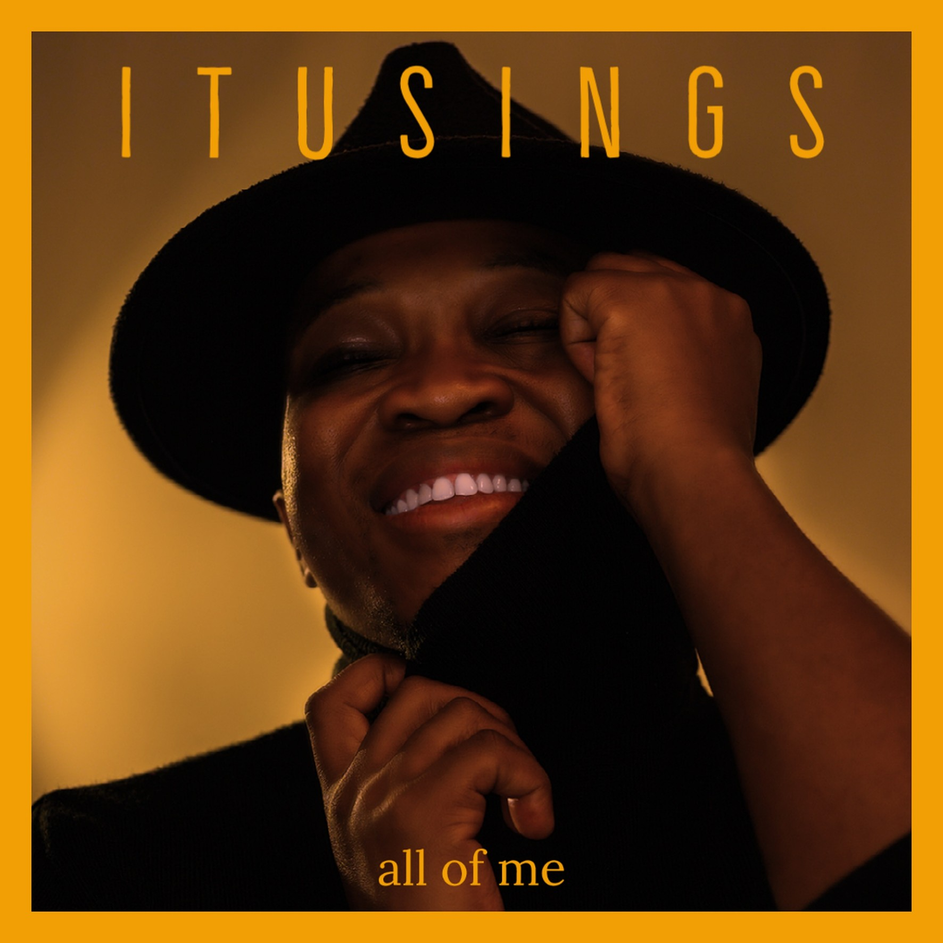
ItuSings
Itumeleng Tshabane
South African Vocalist & Live Performer
ItuSings is a South African singer and performer from Pheli, Pretoria, celebrated for his powerful vocals, emotional depth, and commanding stage presence. His journey began in 2014 when he won CMS Unplugged with Metro FM by popular vote — a defining breakthrough that introduced him to national audiences. He later appeared on The Voice SA and Pursuit of Jazz, cementing his place in the music industry.
His acclaimed cover of "No Woman No Cry" earned him widespread respect, while "Missing You" with Encore and "All of Me" continue to showcase his artistry and versatility.
CAREER HIGHLIGHTS
◆ CMS Unplugged Winner — Metro FM · 2014 (popular vote)
◆ Featured on The Voice SA & Pursuit of Jazz
◆ Collaboration with Grammy Award-winner Vusi Mahlasela
◆ Corporate stages: Vodacom · RMB Starlight Classics · Athletics SA · CSIR
◆ International shows — Silversea & Silver Ray · Royal Caribbean Productions
ig
▶
@ItuSings
ItuSings

