Slide 1
Identification of pathogenic disease-associated short tandem repeats (STRs) in clinical samples
James Osei-Mensa, KCCR
20-05-2024
DSI-Africa: First Human Genome Repeat Expansions Analysis Virtual Workshop
May 8-21, 2024

Slide 2
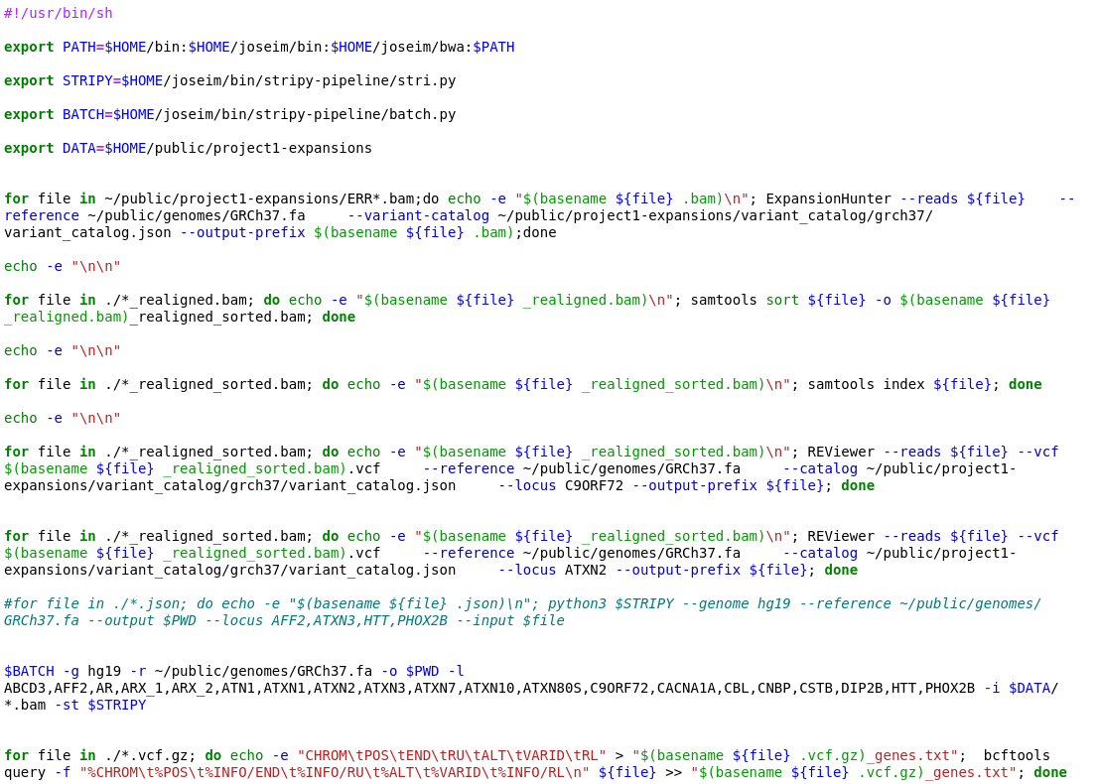

Slide 3
ERR1955473 (Pathogenic C9ORF72, Amyotrophic lateral sclerosis and/or frontotemporal dementia)
<STR5>,<STR41>
47.2703 5-5/35-54
ERR1955504 (Intermediate ATXN2 , Spinocerebellar ataxia 2)
<STR22>,<STR34>
33.3243 22-22/34-34

Slide 4
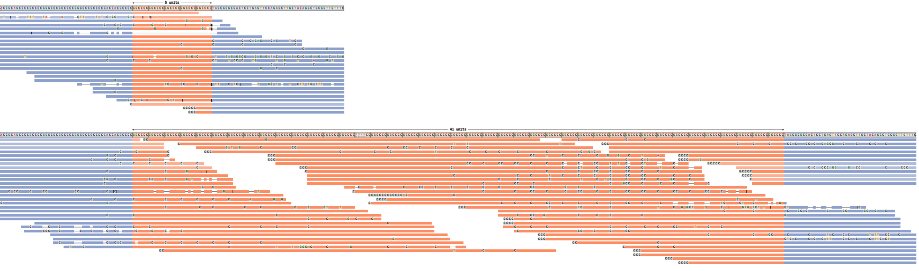
ERR1955473 (Pathogenic C9ORF72, Amyotrophic lateral sclerosis and/or frontotemporal dementia)

Slide 5
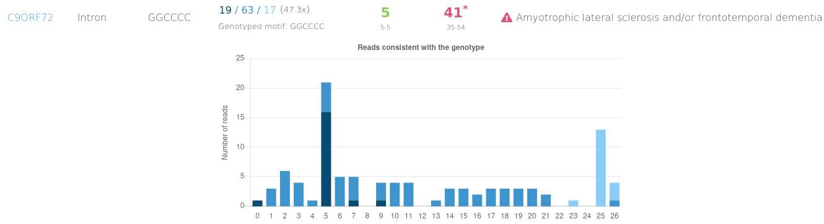
ERR1955473 (Pathogenic C9ORF72, Amyotrophic lateral sclerosis and/or frontotemporal dementia)

Slide 6
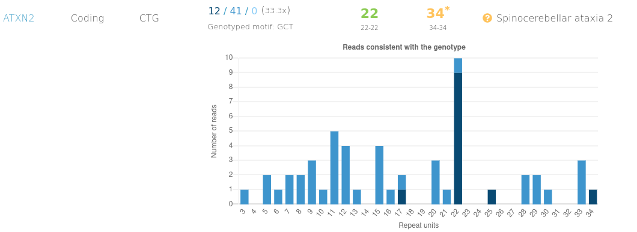
ERR1955504 (Intermediate ATXN2 , Spinocerebellar ataxia 2)

Slide 7
Conclusion
ERR1955473 is in the pathogenic range for C9ORF72 which is associated with Amyotrophic lateral sclerosis and/or frontotemporal dementia)
ERR1955504 is in the intermediate range for ATXN2 which is associated with Spinocerebellar ataxia 2)
RFC1 is associated with cerebellar ataxia, neuropathy, vestibular areflexia syndrome (CANVAS) due to a bialleic expansion https://www.ncbi.nlm.nih.gov/books/NBK564656/
ERR1955462 had a biallelic expansion <STR8>,<STR60>
Data Repository: https://github.com/Aduboahen/DSI-STR-PROJECT1

