Slide 1
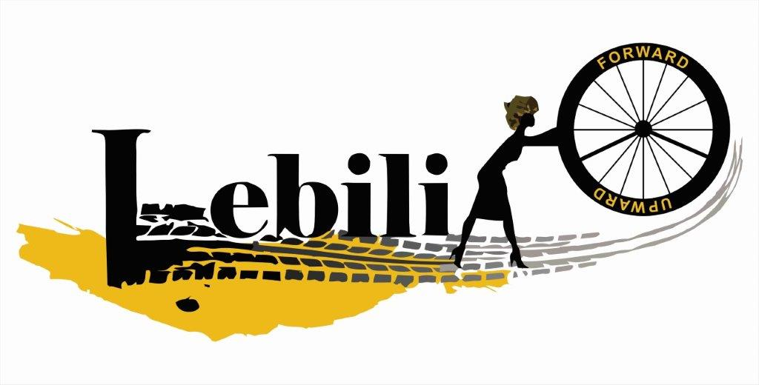
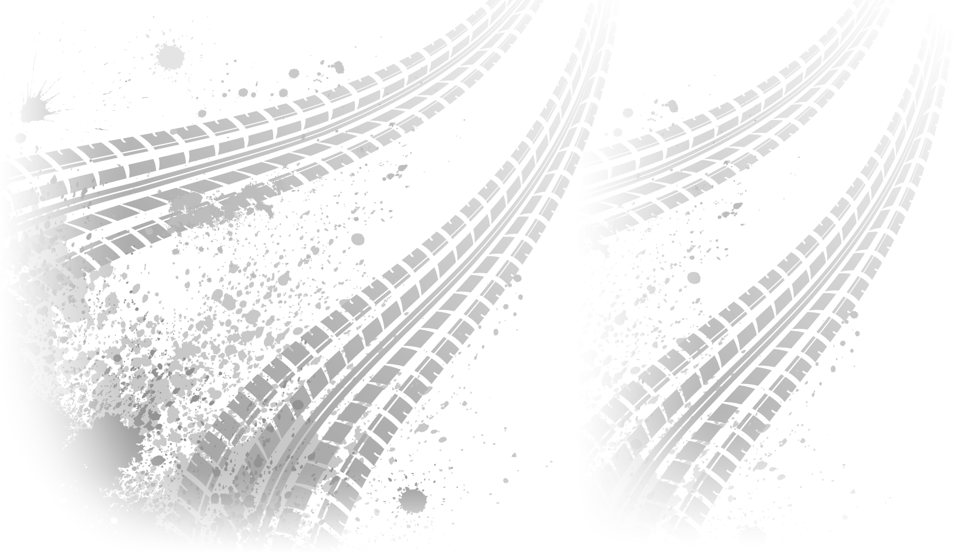
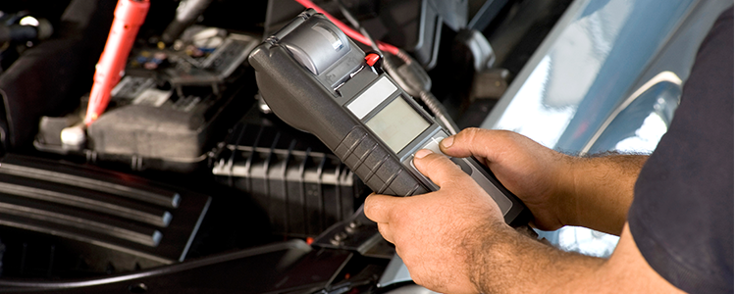

Contact us at:
lebogang@lebili.co.za
+27 79 948 3076
www.lebili.com
Tire Check
Mining operations demand reliability, safety, and efficiency. Your tires play a critical role in achieving these goals. Ensure the longevity and performance of your mining equipment with comprehensive tire check solutions tailored to the unique challenges of mining environments.
Our package includes:
Wheel alignment
Tire inspection and repair
Consultation services
Thread Depth Analysis
Pressure monitoring
Stand 1189 unit A kadoma street Steelpoort industrial park

