Slide 1
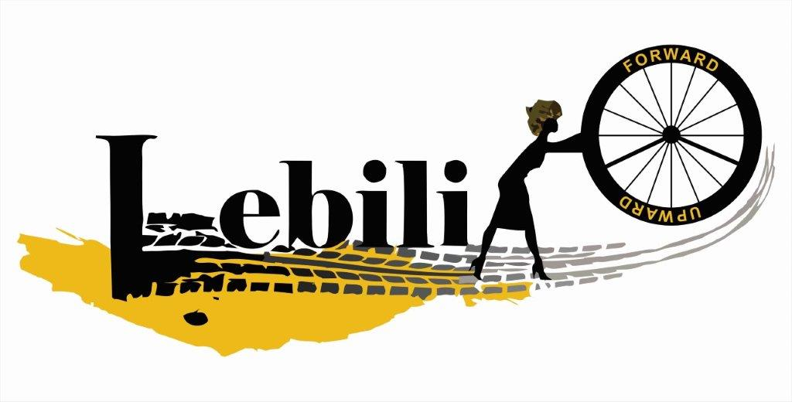
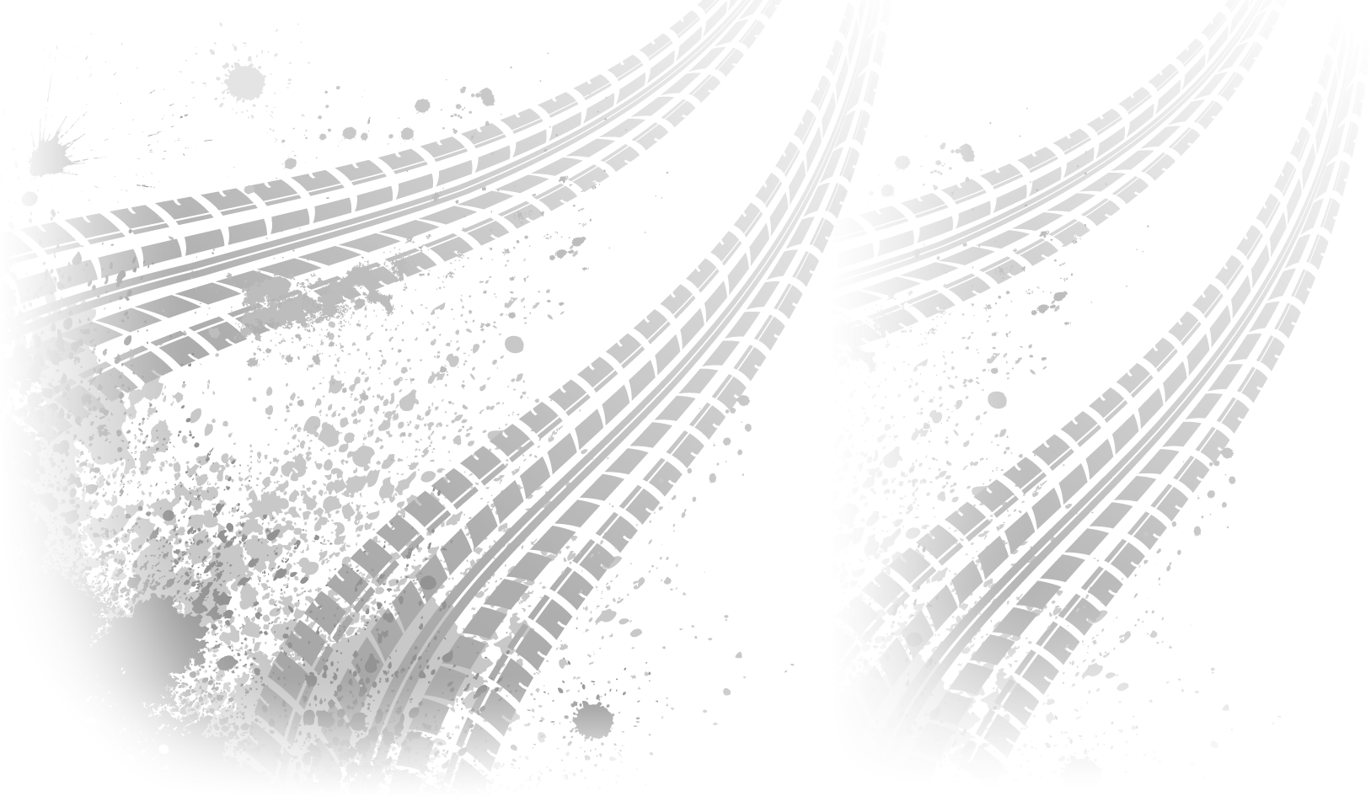
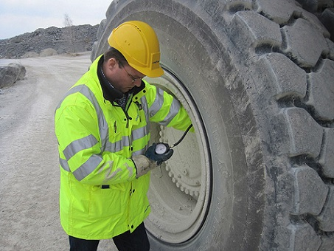

Contact us at:
lebogang@lebili.co.za
+27 79 948 3076
www.lebili.com
Tire fill
We understand the frustrations and expenses associated with traditional tire maintenance. Our innovative tire fill technology
offers a wide range of benefits, making it the superior choice for your vehicles.
Here's why you should consider our tire fill
solutions:
Long-lasting Durability
Enhanced Traction
Puncture-Proof
Eco-Friendly
Cost-Efficient
Tire fill solution:
Liquid Tre fill
Foam tire fill
Tire installation services
Tire fil maintenance
Stand 1189 unit A kadoma street Steelpoort industrial park

