Slide 1
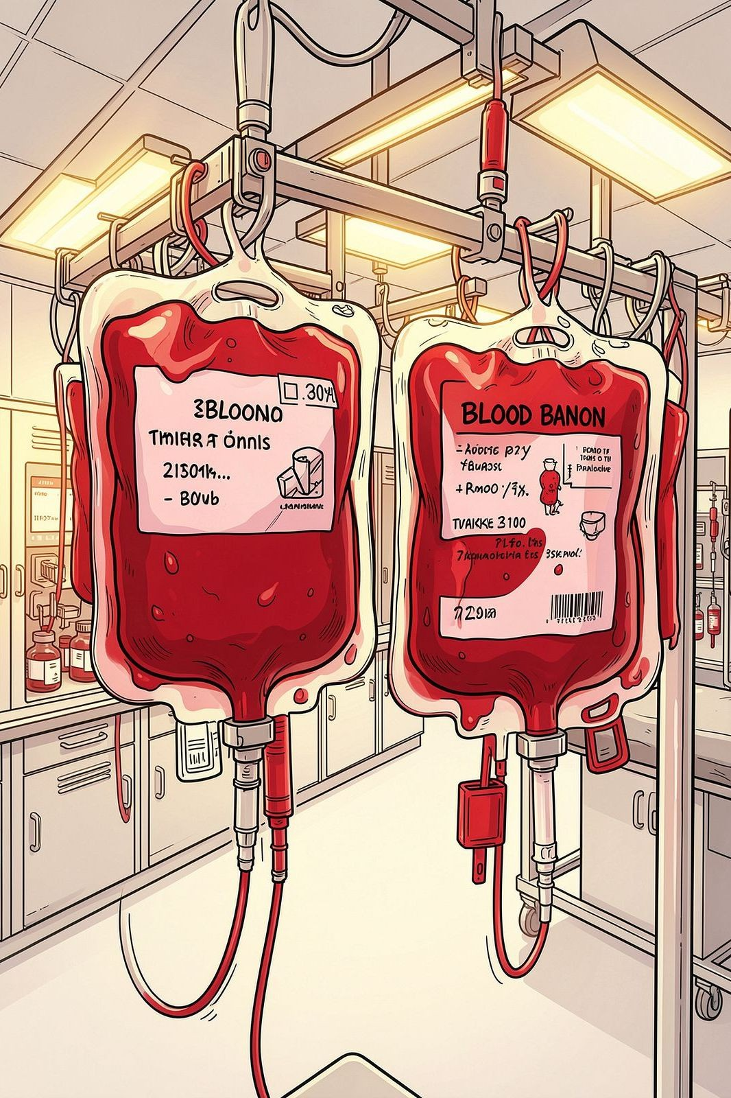
Smart Blood Management System
An Innovative Approach in Java — redefining how blood banks operate, track inventory, and save lives through intelligent software.
JAVA · SPRING BOOT · HEALTHCARE TECH

Slide 2

Challenges in Tíaditional Blood Management
Manual systems are slow, error-prone, and costly. Hospitals struggle with outdated records, delayed responses, and no real-time visibility into blood availability.
⏳ Dclm?cd Píoccssing
Manual entry slows donor registration and blood allocation during emergencies.
📉 Invcntoí? 4mps
No real-time tracking leads to shortages or wastage of critical blood units.
🔒 Dmtm Risks
Paper records are vulnerable to loss, damage, and unauthorised access.

Slide 3
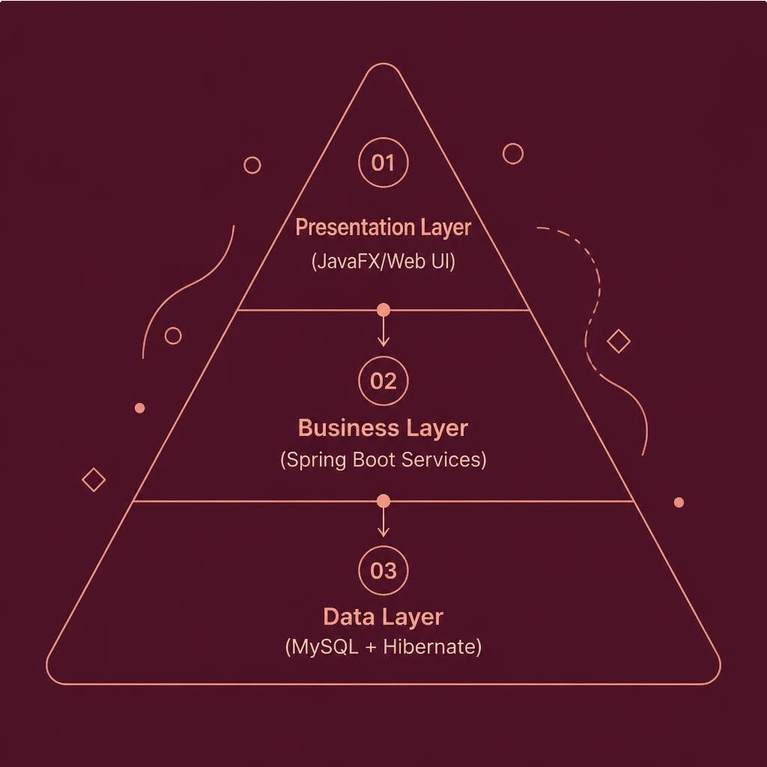
S?stcm 6íchitcctuíc: Jmvm-Bmscd Solution
The system follows a clean three-tier architecture — separating presentation, business logic, and data persistence for scalability and maintainability.
Pícscntmtion Lm?cí
JavaFX / Web UI for staff interaction
Busincss Lm?cí
Spring Boot services handling core logic
Dmtm Lm?cí
MySQL database with JPA/Hibernate ORM

Slide 4
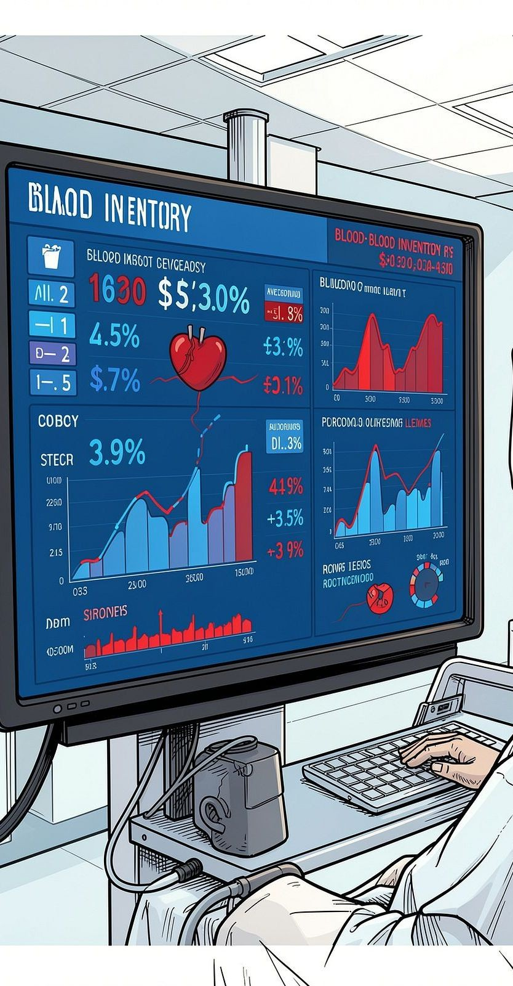



¼c? Fcmtuícs mt m 4lmncc
Rcml-Timc Invcntoí?
Live tracking of blood units by type, expiry, and location across all storage facilities.
Donoí Mmnmgcmcnt
Complete donor profiles with donation history, eligibility status, and automated reminders.
Low-Stock 6lcíts
Automated notifications when blood group levels fall below defined thresholds.
Scmích & Rcpoíting
Advanced filters and audit-ready reports for administrators and medical staff.

Slide 5

Donoí Modulc: Rcgistímtion & Eligibilit?
The Donor Module simplifies the entire journey — from first-time registration to repeat donations — with built-in safety checks.
01
02
03
Online Registíation
Donors register via web or kiosk with demographic and medical details.
Eligibility Scíeening
Automated checks for age, weight, haemoglobin, and last donation date.
Appointment Scheduling
Donors book slots; system sends SMS/email confirmations and reminders.

Slide 6

Blood Request Module: Píocessing & Allocation
When a hospital submits a blood request, the system instantly matches available units, validates compatibility, and confirms allocation — all within seconds.
Request Submitted
Compatibili ty Check
Unit Allocation
Dispatch Confiímatio n
This streamlined workflow eliminates manual cross-referencing, reduces human error, and ensures the right blood reaches the right patient at the right time.

Slide 7



Technology Stack
Jmvm 1T
Core language with modern features, strong typing, and enterprise-grade performance.
Spíing Boot
Rapid application development with REST APIs, dependency injection, and auto-configuration.
M?S0L = Hibcínmtc
Reliable data persistence with JPA ORM for seamless Java-to-database mapping.
Spíing Sccuíit?
Role-based access control, JWT authentication, and encrypted data transmission.
The stack is fully open-source, reducing licensing costs while maintaining enterprise reliability.

Slide 8
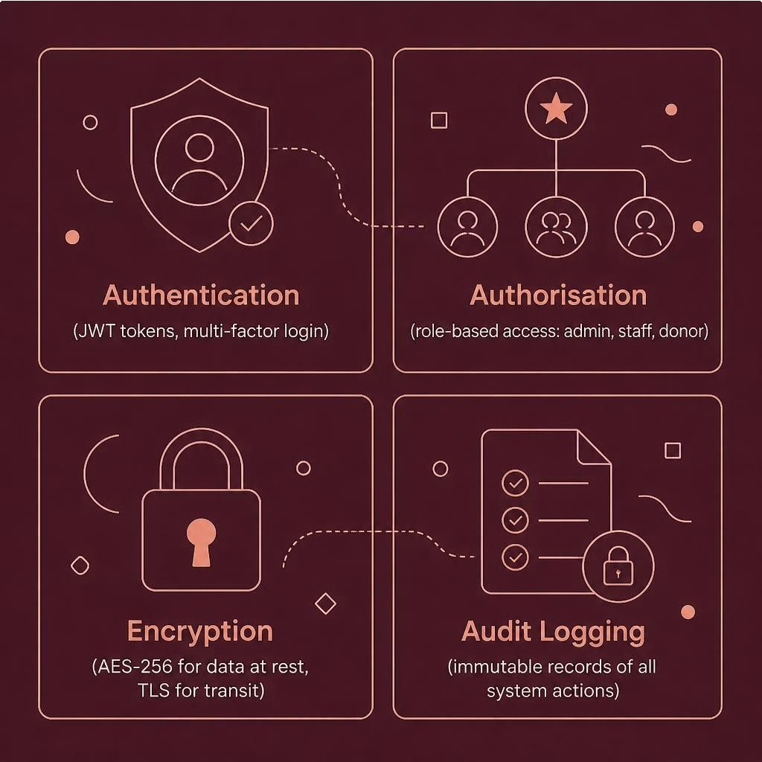
Sccuíit? & Dmtm Píivmc?
Píotccting Scnsitivc Hcmlth Dmtm
Blood donor and patient data is highly sensitive. The system enforces strict access controls and complies with healthcare data regulations.
Role-Based Access: Admins, medical staff, and donors see only what they should.
End-to-End Encryption: All data in transit and at rest is encrypted.
Audit Trails: Every action is logged for accountability and compliance.

Slide 9

Benefits & Impact
T0%
Fmstcí 6llocmtion
Reduction in time to match and dispatch blood units during emergencies.
40%
Lcss Wmstmgc
Decrease in expired blood units through intelligent expiry tracking and alerts.
tt%
Dmtm 6ccuímc?
Near-perfect record integrity compared to manual paper-based systems.
?4/T
S?stcm Uptimc
Always-on availability ensures blood banks operate without interruption.

Slide 10

Futuíe Enhancements & Conclusion
What's Next
6I-Powcícd Dcmmnd Foíccmsting
Predict shortages before they occur using historical data.
Mobilc 6pp foí Donoís
Self-service registration, appointment booking, and donation history.
Intcí-Hospitml Nctwoík
Share inventory across facilities for regional blood management.
Key Takeaway
The Smart Blood Management System demonstrates how modern Java engineering can solve real-world healthcare challenges — improving efficiency, ensuring data security, and ultimately saving lives.
INNOVATE. AUTOMATE. SAVE LIVES.

